Slide 1
Презентация к уроку по теме: «Дом Шекспира»
Ходакова А.К. идентификатор: 408-787-356
Учитель английского языка
ГБОУ Школа №1387

Slide 2
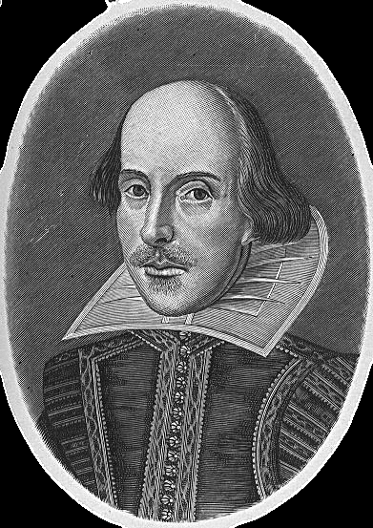
William Shakespeare
1564-1616

Slide 3
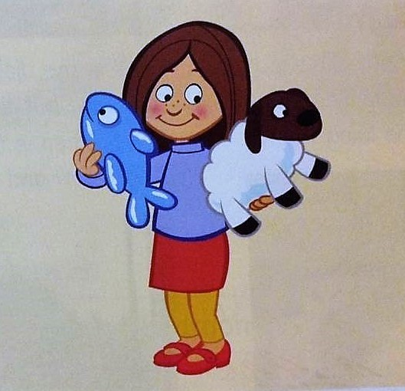
Let’s chant
Shirley’s shoes are red,
Her T-shirt is blue.
She’s got a toy sheep,
And a toy fish too.
The sheep is white,
The fish is blue.
Shirley wants to play,
With me and with you.

Slide 4
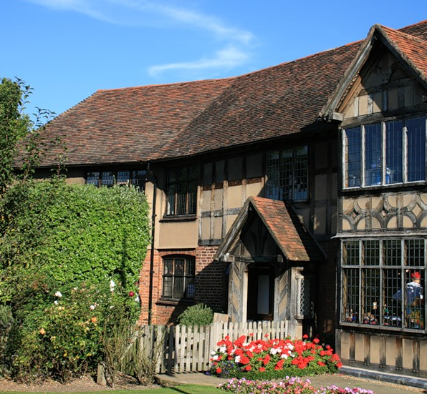
Shakespeare’s house

Slide 5
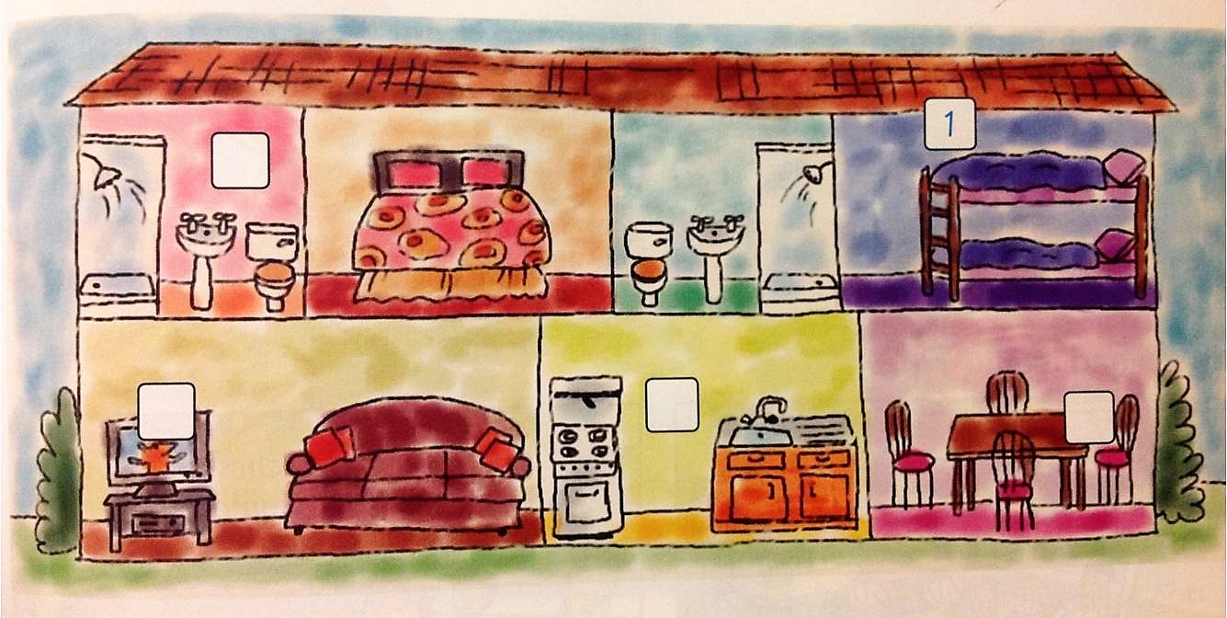
Let’s listen and number

Slide 6
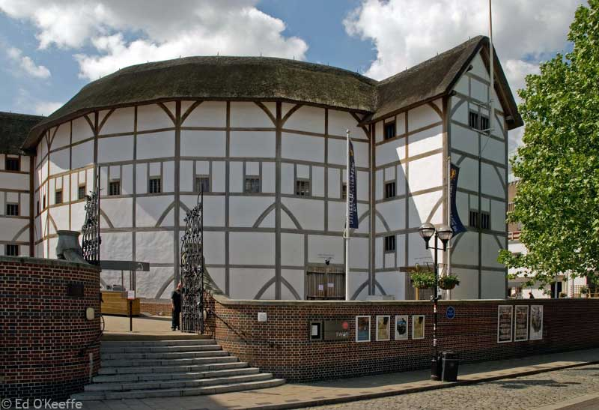
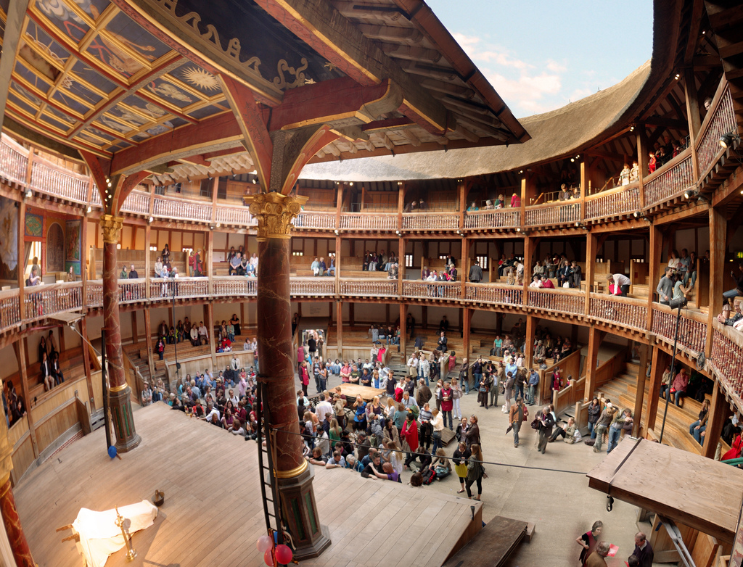
The Globe Theatre

Slide 7
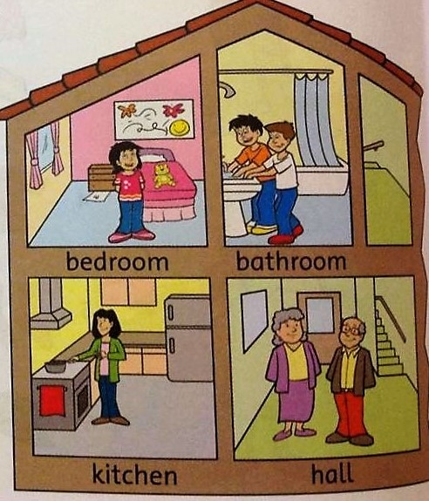
Let’s write Where’s or Where’re and rooms
Where’s Alison?
She’s in her bedroom.
________ Jamie and Dave?
They’re in the ________.
________ Mum?
She’s in the _______.
_______ Grandma and Grandpa?
They’re in the _________.

