Slide 1
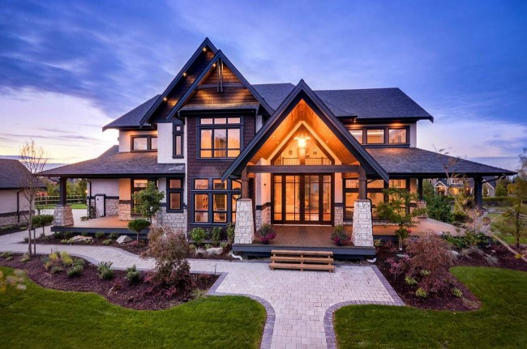
My house
– There’s no place like home; – East or west – home is best.
-В гостях хорошо, а дома лучше. -Свой уголок хоть боком пролезть - всё - лучше. -Хоть по уши плыть, а дома быть. -Свой дом – самое лучшее место.
Презентацию выполнила:учитель английского языка ГБОУ «ШКОЛА
№1929» Мамедова С.А.

Slide 2
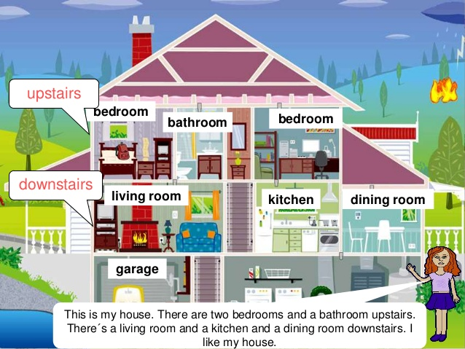

Slide 3
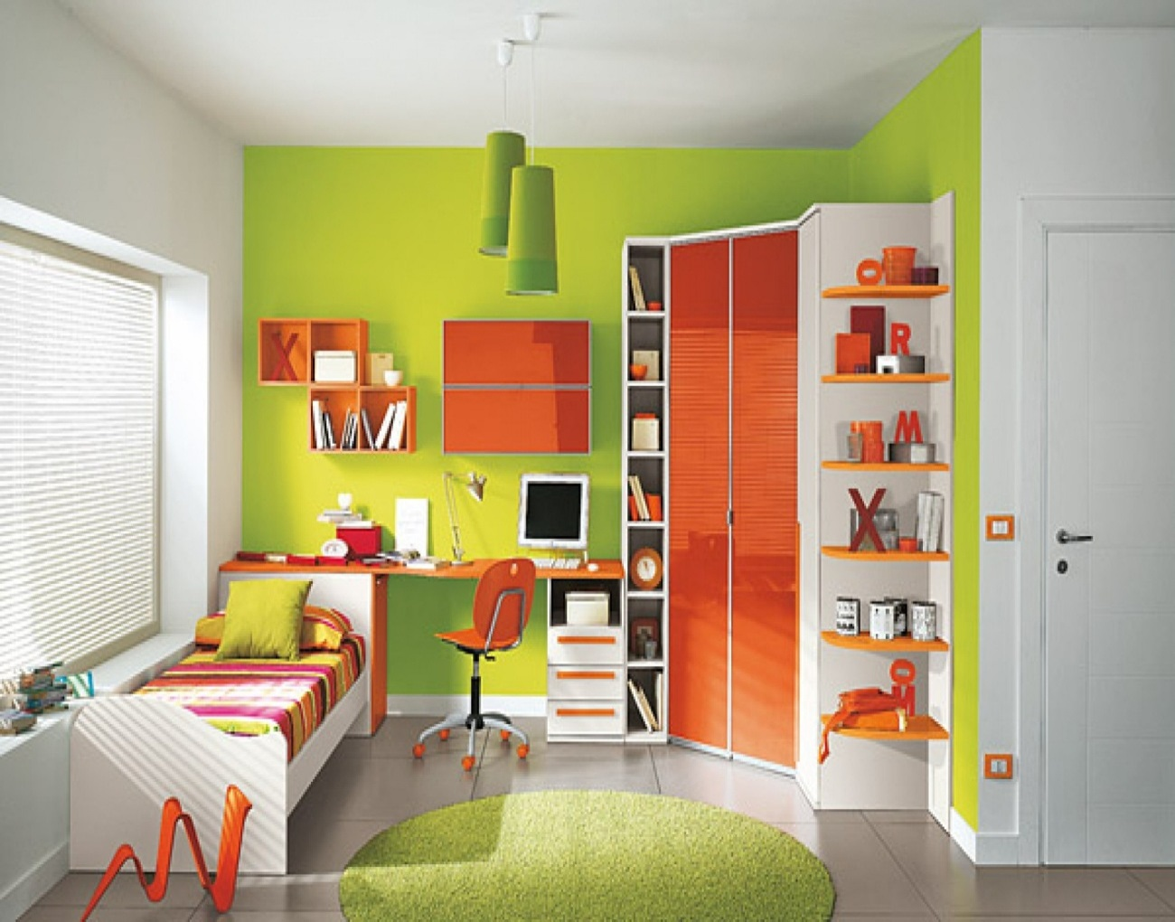
PREPOSITIONS OF PLACE Answer the questions: Use: in ,on, under, next to, behind, in front of, at

Slide 4
1.Where is the bed?
2. Where is the lamp?
3.Where is the carpet?
4.Where is the computer chair?
5.Where is the computer?
6.Where are the windows?
7.Where is the bookcase?
8. Where is the desk?

Slide 5
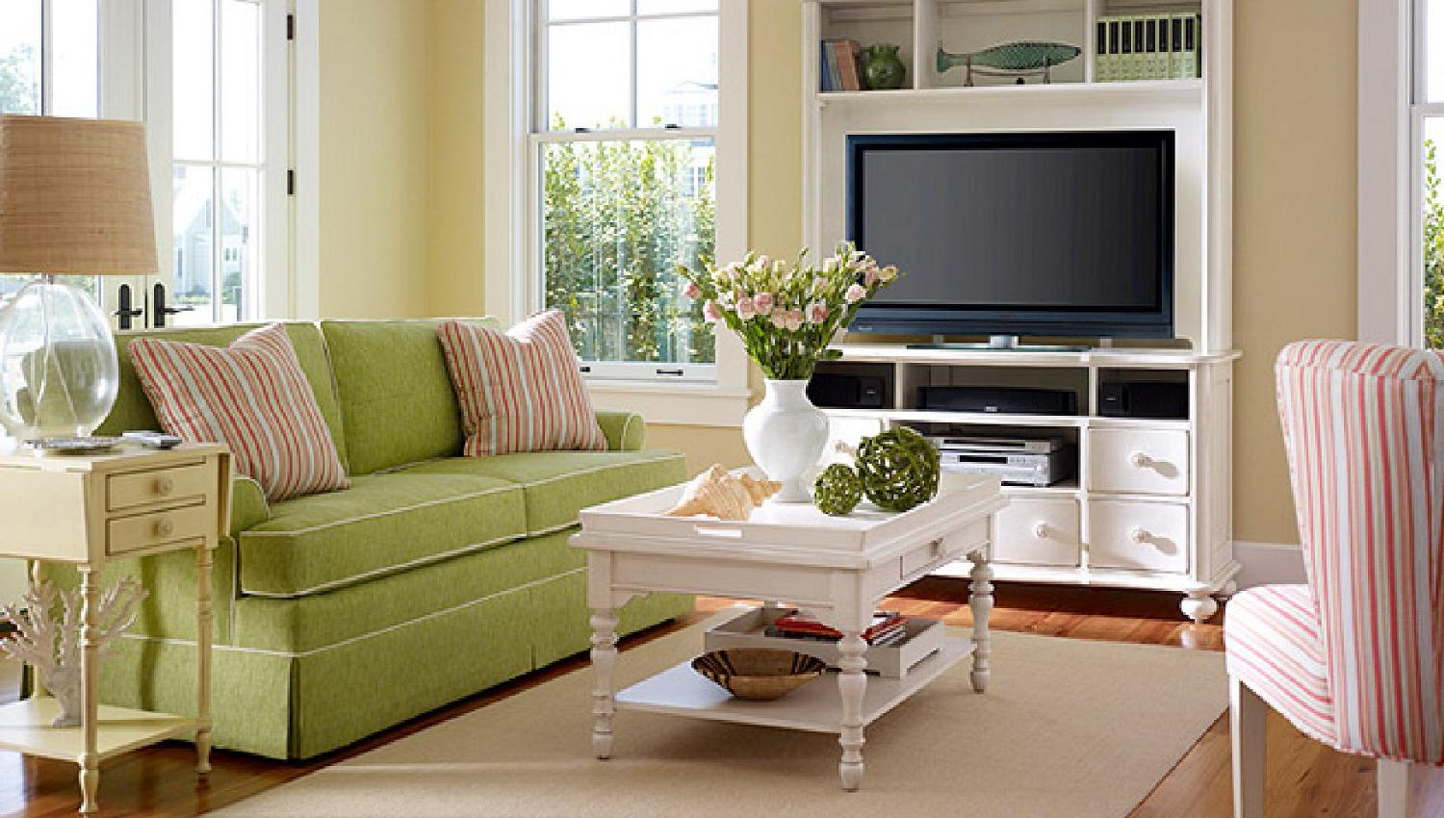
Look at the picture.
Complete the sentences with:
Is there, Are there,
There isn’t, There aren’t.
Answer the questions.

Slide 6
1.----- a carpet in the room?
2.----- a window in the room?
3.----- three chairs in the room?
4.----- a sofa in the room?
5.----- paintings in the room?
6.----- two tables in the room?
7.----- two armchairs in the room?
8.----- a bookcase in the room?

Slide 7
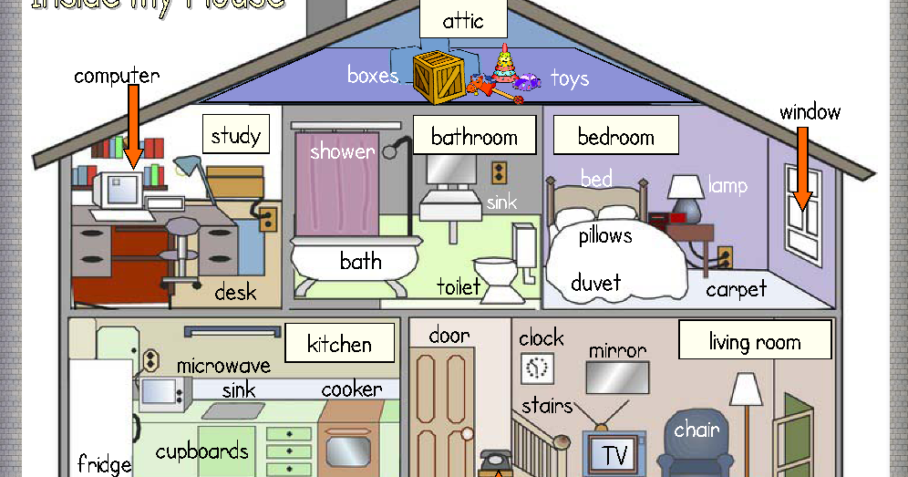

Slide 8

Thank you for your attention!

