Slide 1


Slide 2
What Makes People different?

Slide 3
What Makes People Different?
- appearance
- personality
-education
- behaviour and manners
- beliefs and opinions
- tastes
-language and culture

Slide 4
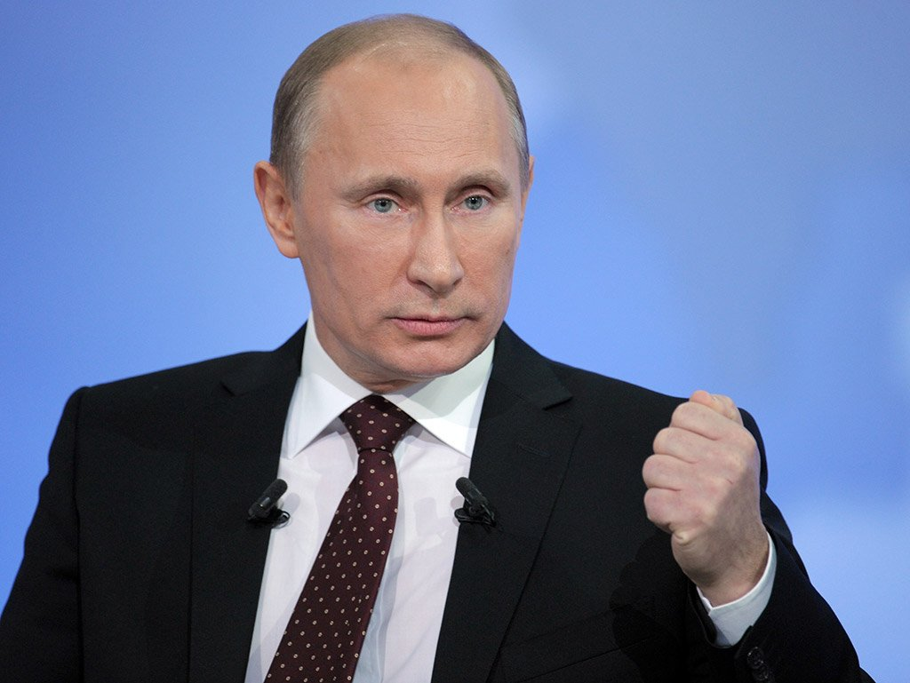
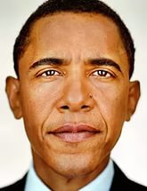
Look at the pictures and describe the following people. What do you think about them (appearance,personality,etc.)?

Slide 5
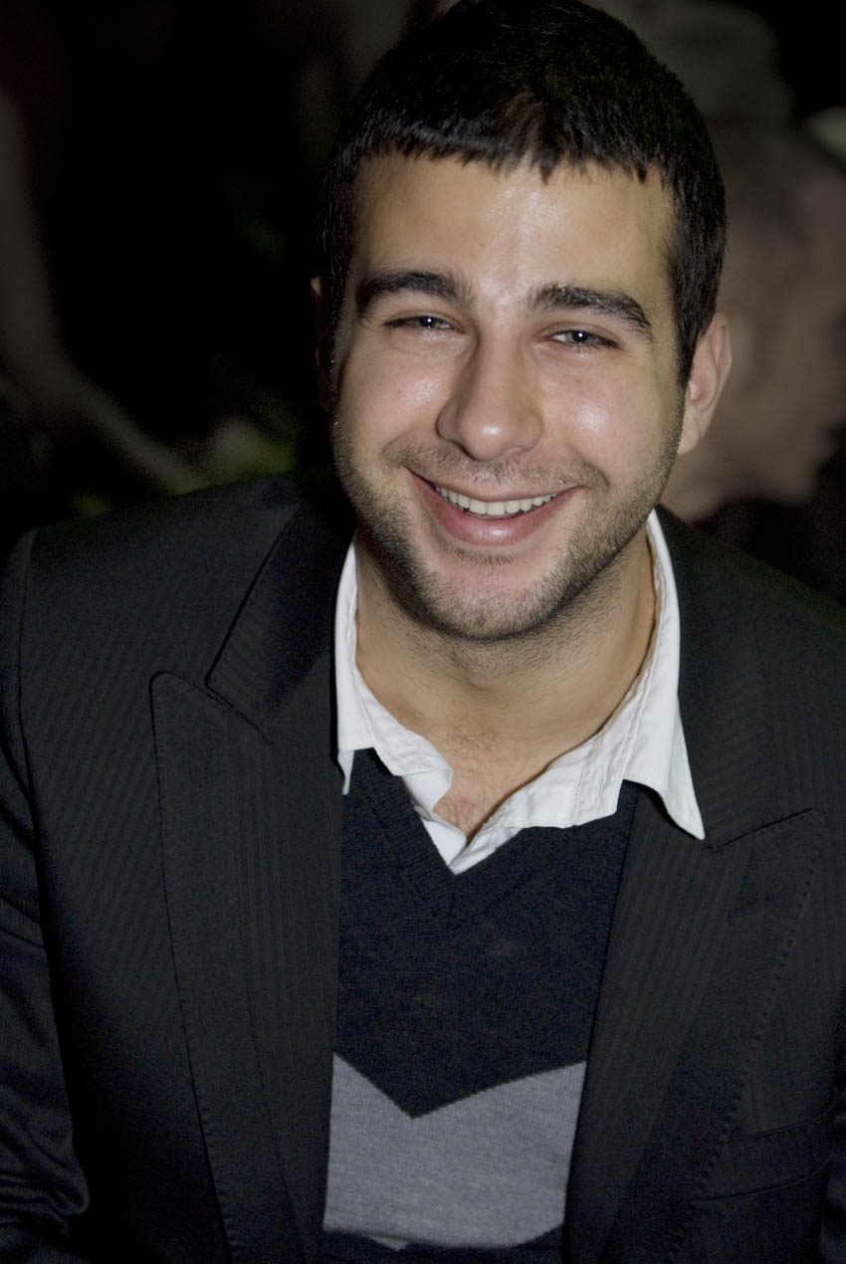
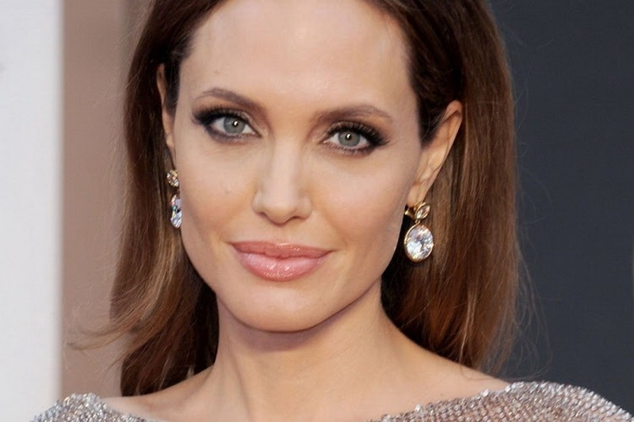
What do you think about the following ones?

Slide 6

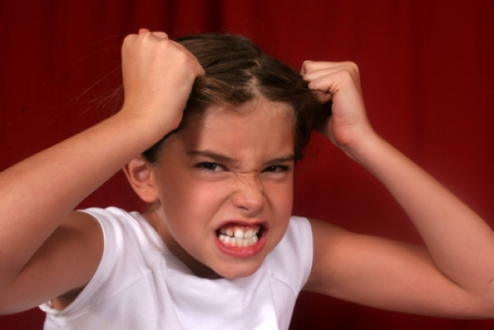
What can you say about the behaviour, traits of character and emotions of these people?

Slide 7
Match Russian and English equivalents
1. Introvert a. строгий
2. Outgoing b. зависимый
3. Unreliable с. депрессивный
4. Messy d. ненадежный
5. hard-working е. общительный
6. Strict f. интроверт
7.Depressive g. трудолюбивый
8. Dependable h. неряшливый

Slide 8


What do you think about our lesson today?
It was cool and interesting!!!
It was boring, I looked forward to the end of the lesson

Slide 9

Thank you for your job, my favourite pupils!!!

