Slide 1

Nurses are the heart of health care.
Автор - составитель:
Рахмясова Индира Ильдусовна,
преподаватель английского языка
КГБПОУ НМТ
г. Норильск, 2017

Slide 2

«Nurses are the heart of health care».
(Donna Wilk Cardillo)
Do you agree with this statement?

Slide 3

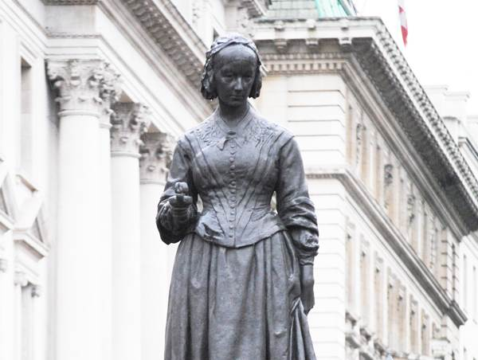
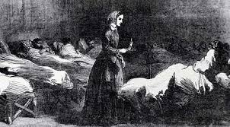
Can you guess who is that?
?

Slide 4
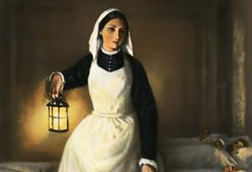
The lady with the lamp.
?

Slide 5
[ɜː]
Germany ['ʤɜːmənɪ] Германия
Turkey ['tɜːkɪ] Турция
To hurt [hɜːt] причинять боль
Nursing ['nɜːsɪŋ]
[ɪə]
Crimean War [kraɪ'mɪən] Крымская Война
Crimea [kraɪ'miːə] Крым
Volunteers [ˌvɔlən'tɪəz] добровольцы

Slide 6
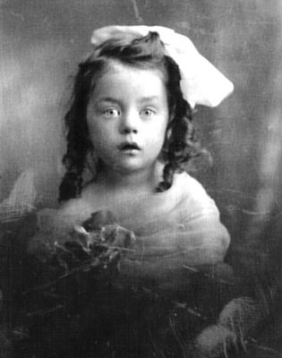
When and where was Florence born?
on the 12th of March in 1820
on the 12th of May in 1820
on the 22nd of May in 1820

Slide 7
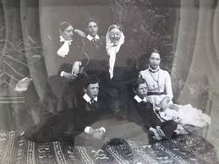
From what family did she come from?
from a wealthy family
from the Royal family
from the working class

Slide 8
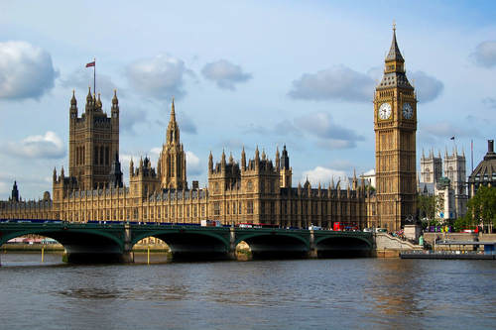
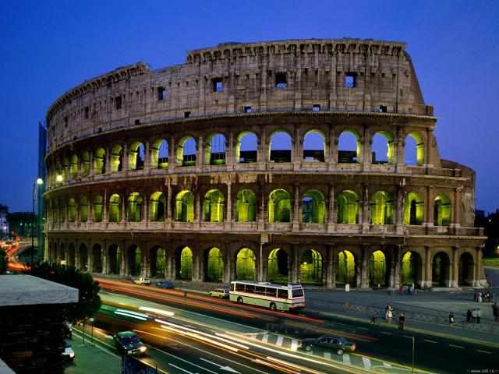
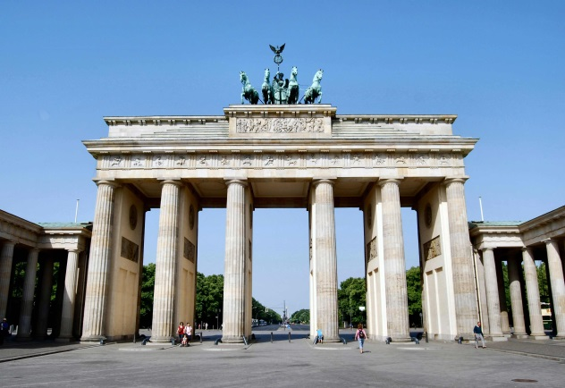
Where did she study?
England
Italy
Germany

Slide 9
Why did people call her "The Lady with the Lamp"?
She saved a lot of lives with a lamp
She made her rounds at night caring a lamp
She always carried a lamp

Slide 10
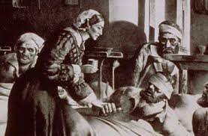
What did she do during the war in Crimea?
worked in Turkey
organized hospitals
studied at the university

Slide 11
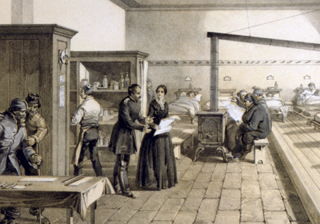
What did she do for the improving of hospitals?
bought expensive medicines
opened chemists
improved sanitary conditions

Slide 12
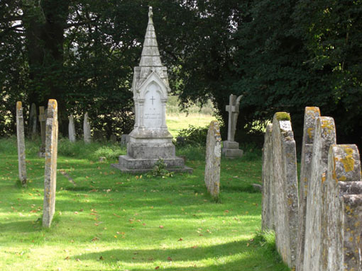
When and where did she die?
in 1910, in London, England
in 1820, in Florence, Italy
in 1854, in Crimea

Slide 13
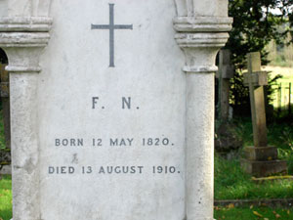
What does her inscription state?
«To Florence Nightingale, with love from family».
b) «F.N. Born 12 May 1820. Died 13 August 1910».
c) «F.N. Born 1820. Died 1910».

Slide 14

Yes!
Right you are!

Slide 15

Unfortunately,
it is not right!

Slide 16

Interview with Florence Nightingale.
- Interviewer: Good afternoon, Miss Nightingale! My name is__. Nice to meet you!
- Florence Nightingale:
- Interviewer: Miss Nightingale, may I ask __, please?
- Florence Nightingale: __
- Interviewer: Miss Nightingale, you have taken part in the Crimean War. ____?
- Florence Nightingale: ___
- Interviewer: Miss Nightingale, you have made a lot of sanitary improvements. ___ ?
- Florence Nightingale: ___
- Interviewer: Miss Nightingale, I am going to be a nurse. What ___?
- Florence Nightingale: ____
- Interviewer: Thank you,____
- Florence Nightingale: ____

Slide 17

Let’s have a rest!
No smoking, no drinking, No running, stop thinking. Work all day, play all night, Always love, never fight. Come early, don’t be late, Try to be good, don’t hate. Eat apples, drink juice, Never think about bad news.
Hands up! Clap, clap. Hands on the hips! Step, step! Bend your left, bend your right, Turn yourself around. Hands up! Hands down! Hands at sides and sit down!

Slide 18
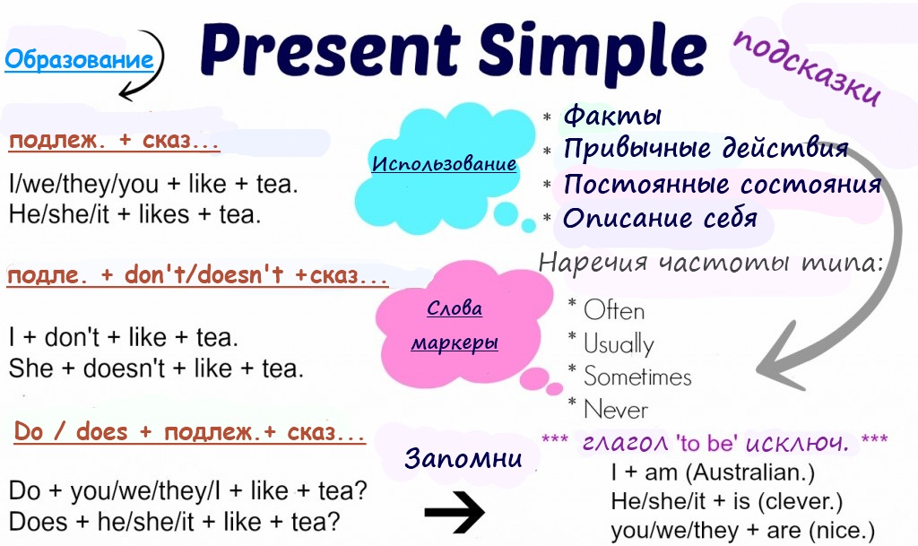

Slide 19
Open the brackets using Present Simple. Translate the sentences into Russian.
I usually (to catch) a bad cold in winter.
What you (to do) every weekend?
The nurses always (to take) the patients’ temperature.
She (to check) her blood pressure every day.
Your mother (to work) at the hospital? Yes, she…
My son often (to have) a headache and fever.
He (not to study) well.
Why he always (to check) her BP?
They usually (to provide) first aid.
You (to be) a nurse? No, I … …
The doctor’s assistant usually (to prescribe) medicines.
Why you (to sterilize) instruments every day?
Nurses always (to take) care of the sick.
I (not to do) harm to my patients.

Slide 20
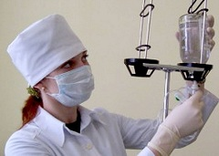


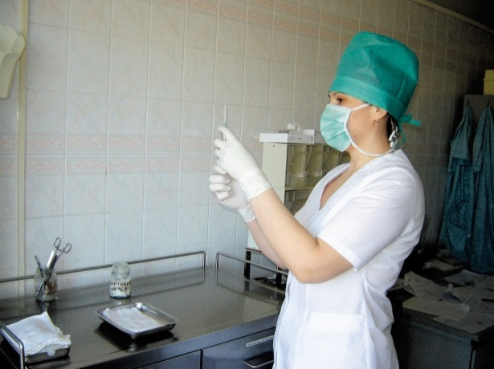
The duties of a nurse.
She usually ____.
She ___ every day.
She always_____.

Slide 21
The features of a character of a nurse.
I think that a nurse should be____ because___.
Responsible Qualified Hardworking
Patient Polite Merciful
Attentive Highly educated Careful

Slide 22
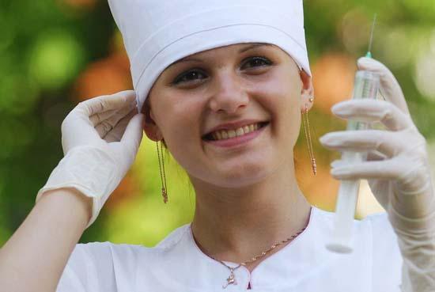
Who is a nurse?

Slide 23
My future profession is a nurse.
Hello! My name is ____. I study ____.
I am a student of___ department. My future profession is____.
The nurse is _____. She\he usually___, ___, ___.
Actually, I want\don’t want to be a nurse because___,___.
I__,___,__to be a highly educated specialist.
I am sure that my future profession is very ___ because________.
Besides I think that it is very difficult\easy\noble to be a nurse because____.
To my mind, the nurse should be___,__,___ person because____.
As for me, the most important in my future profession is____
I like to study at Nursing Affair because____.

Slide 24


Thank you, everybody!

Slide 25
Links:
https://www.google.ru/search

