Slide 1
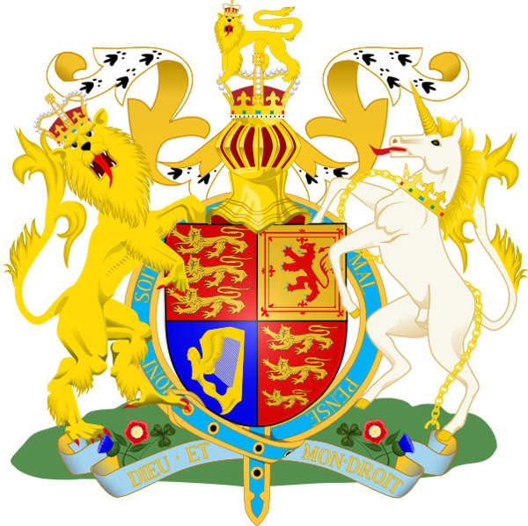
Travelling to the United Kingdom of Great Britain and Northern Island.
Автор - составитель:
Рахмясова Индира Ильдусовна,
преподаватель английского языка
КГБПОУ НМТ
г. Норильск, 2017

Slide 2
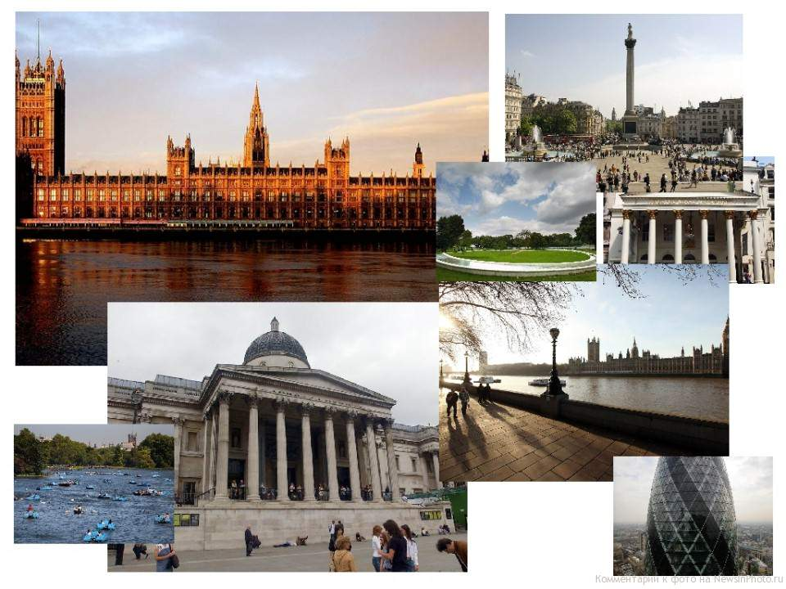
The city of pictures.

Slide 3
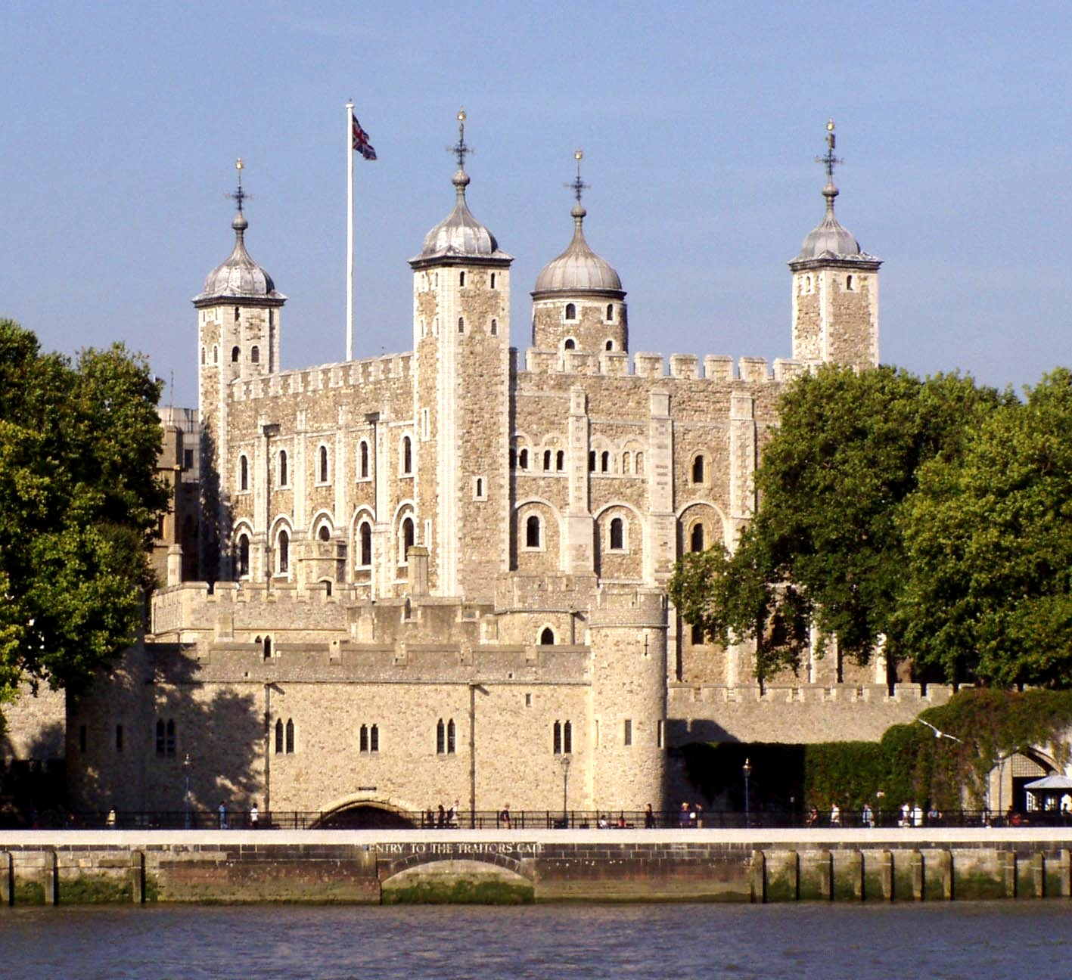
?

Slide 4
The Tower of London.

Slide 5
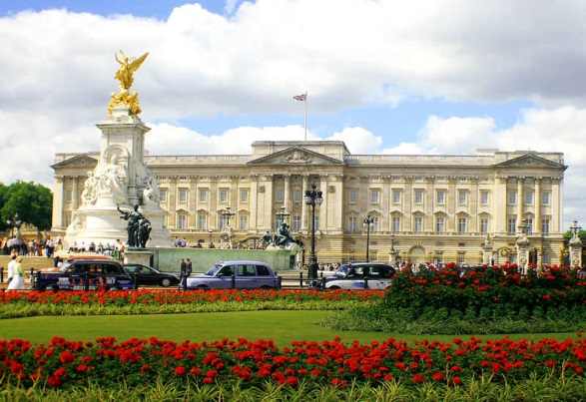
?

Slide 6
Buckingham Palace.

Slide 7
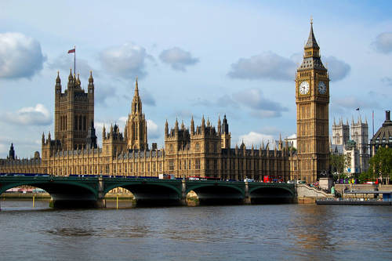
?

Slide 8
The Houses of Parliament.

Slide 9
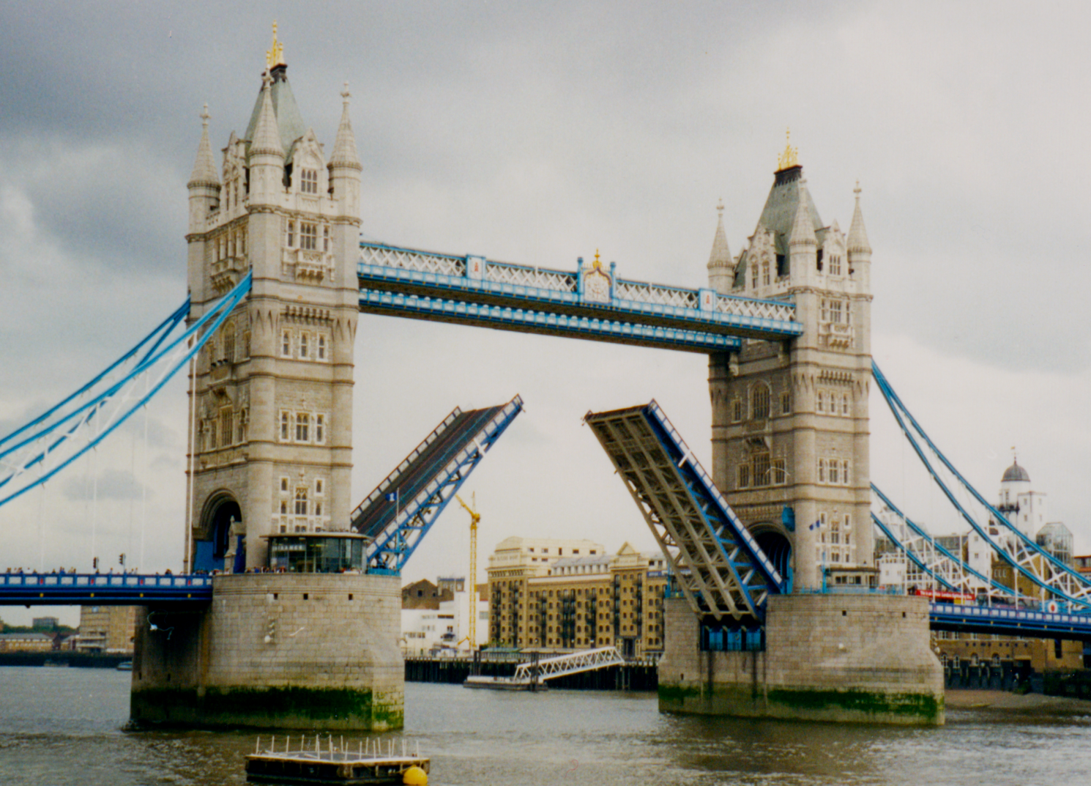
?

Slide 10
Tower Bridge.

Slide 11
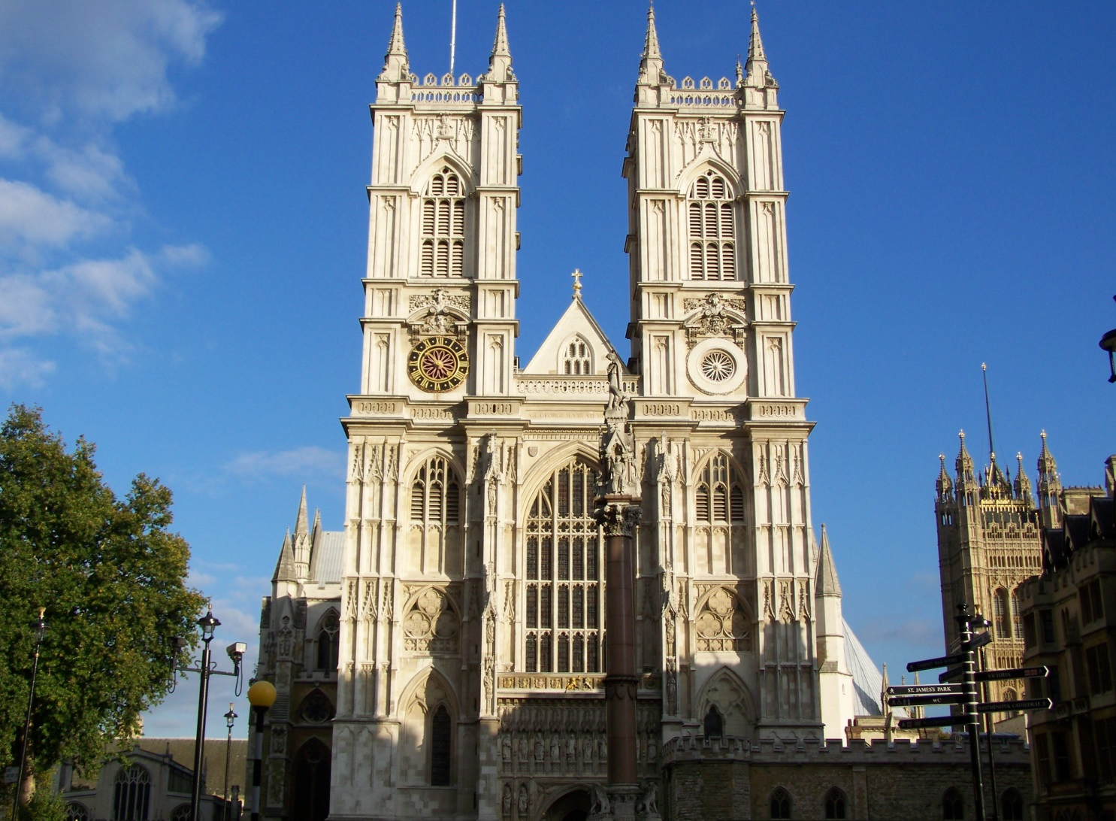
?

Slide 12
Westminster Abbey.

Slide 13
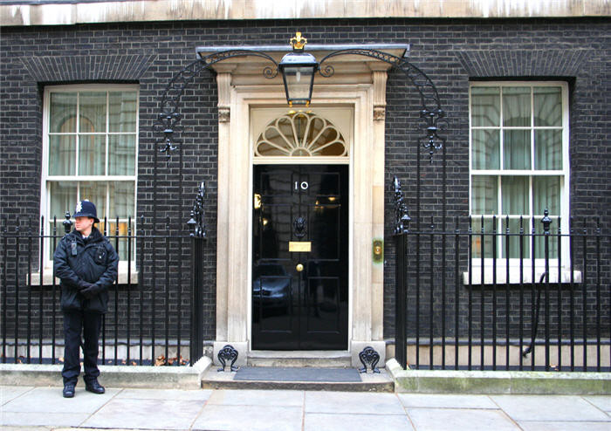
?

Slide 14
10 Downing Street.

Slide 15
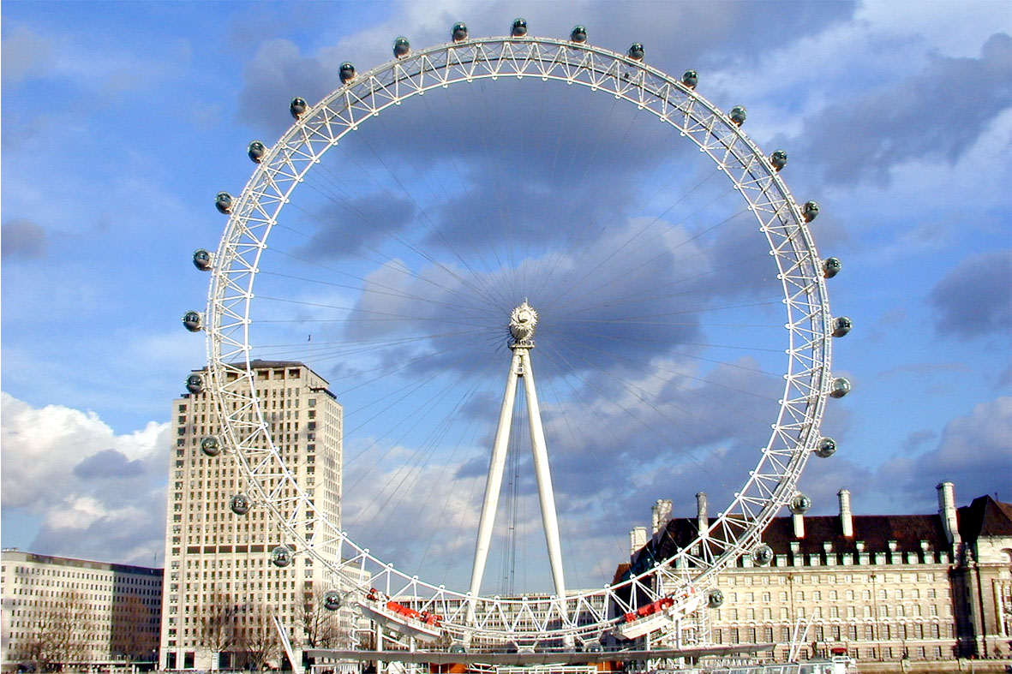
?

Slide 16
London Eye.

Slide 17
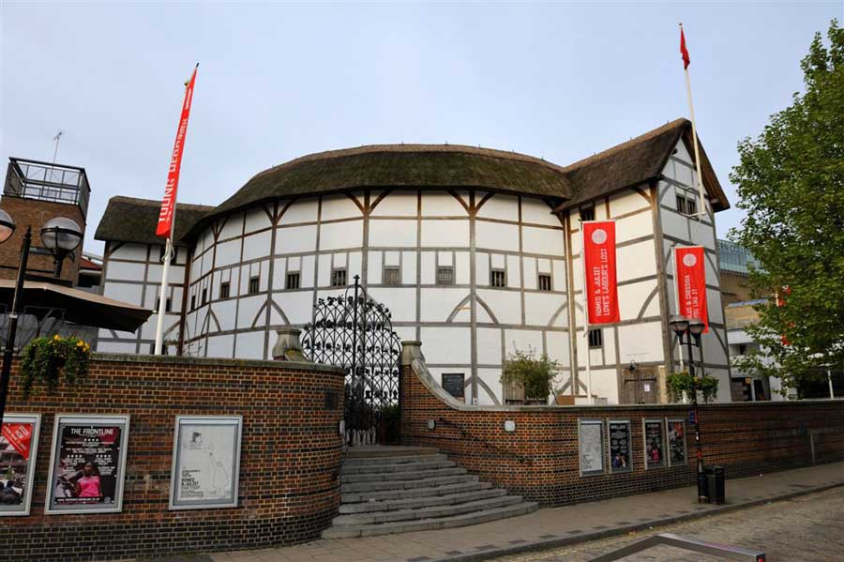
?

Slide 18
Globe Theatre.

Slide 19
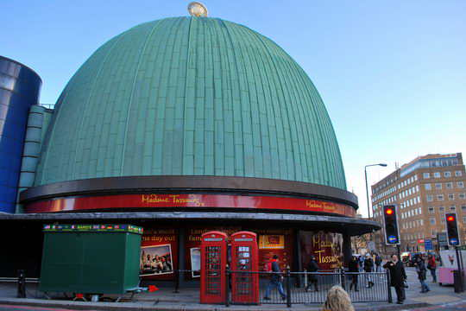
?

Slide 20
Madame Tussaud’s.

Slide 21
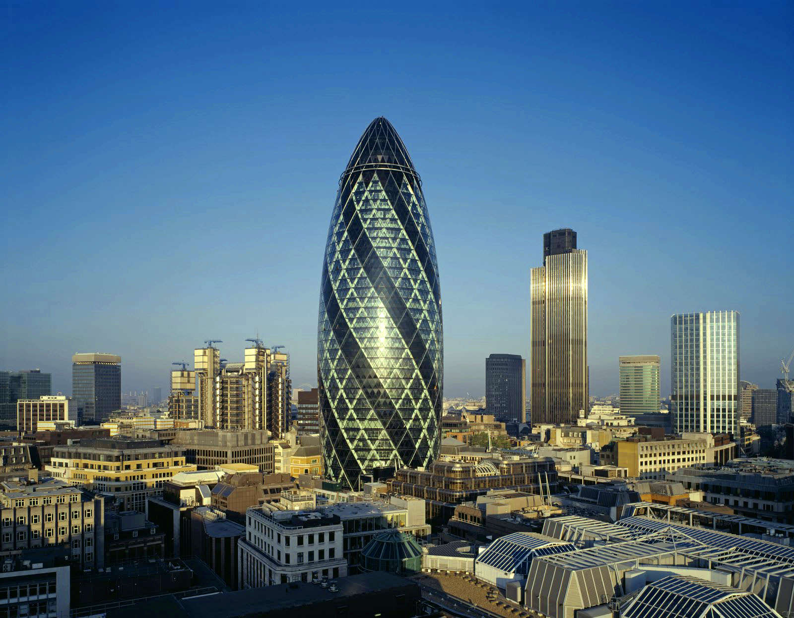
?

Slide 22
30 Saint Mary Axe.

Slide 23
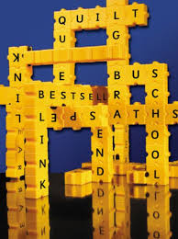
The city of fillword.

Slide 24
Find 9 famous British people.
f | l | o | r | e | n | c | e | a | r | b | h
i | b | e | c | k | h | a | m | y | o | m | o
n | e | l | s | o | n | o | e | h | w | e | l
c | b | e | a | t | l | e | s | c | l | k | m
q | o | t | o | l | k | i | e | n | i | t | e
d | w | i | d | g | u | d | i | a | n | a | s
k | i | p | l | i | n | g | z | p | g | o | f

Slide 25

The city of the article «the».

Slide 26
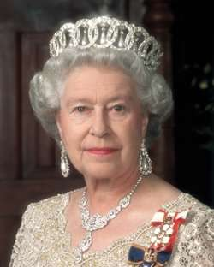
___Queen Elizabeth II.
The
-

Slide 27
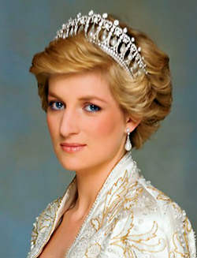
___Princess Diana.
The
-

Slide 28
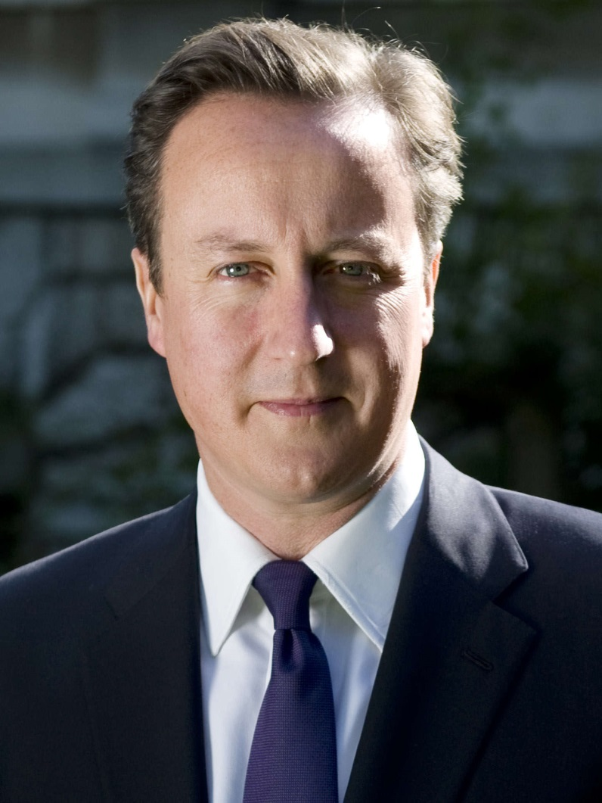
___David Cameron.
The
-

Slide 29
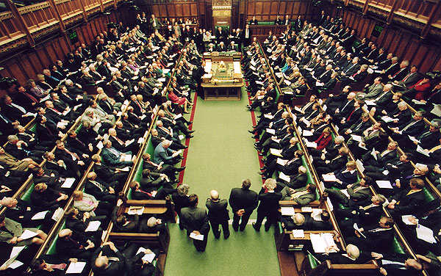
___Parliament.
The
-

Slide 30
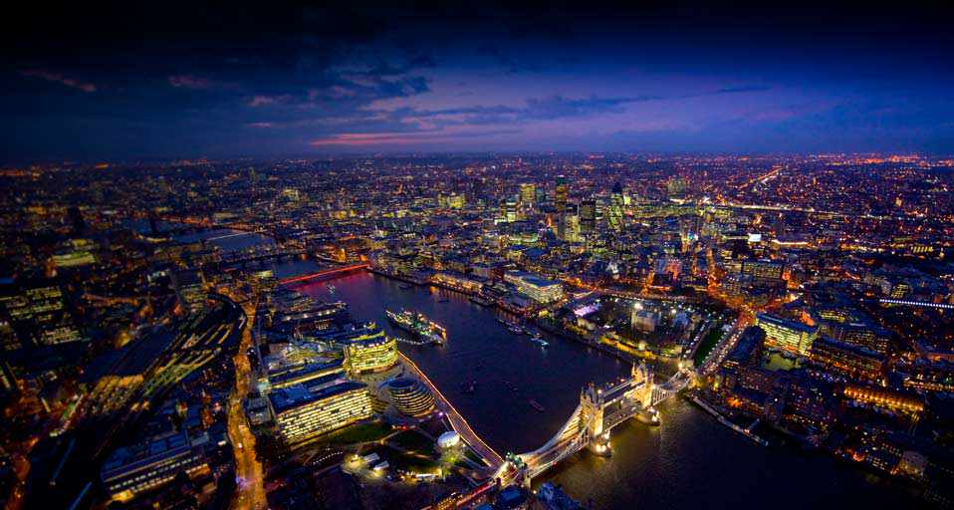
___London.
The
-

Slide 31
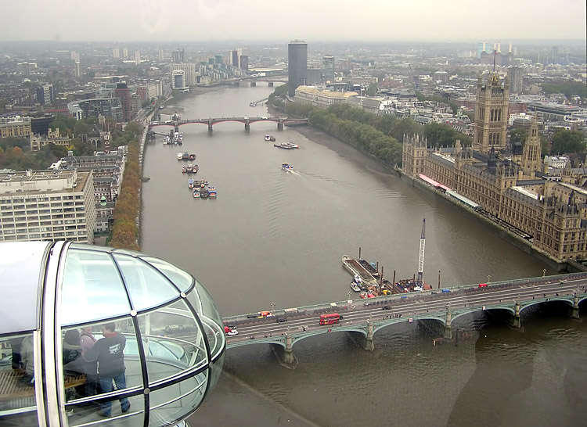
___Thames.
The
-

Slide 32
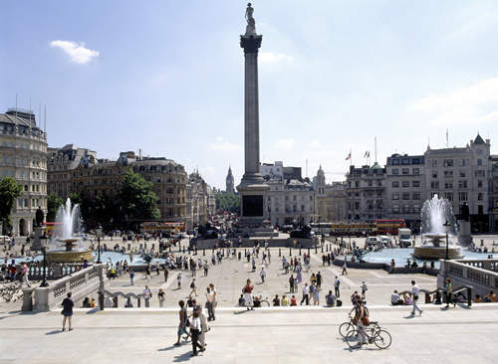
___Trafalgar Square.
The
-

Slide 33
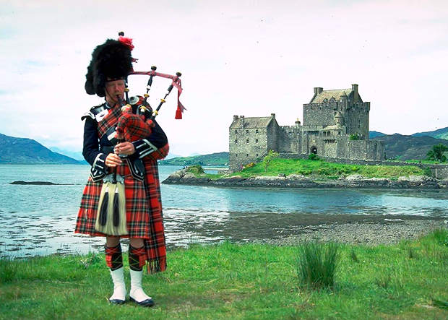
___Scotland.
The
-

Slide 34
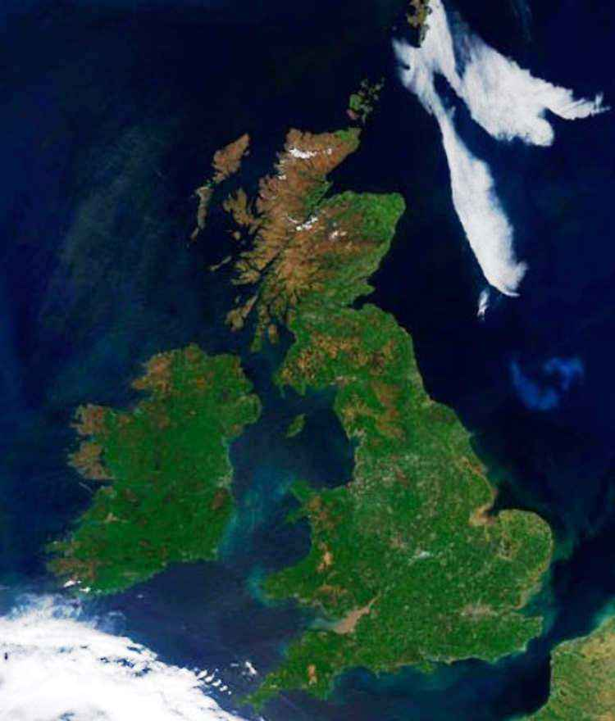
___British Isles.
The
-

Slide 35
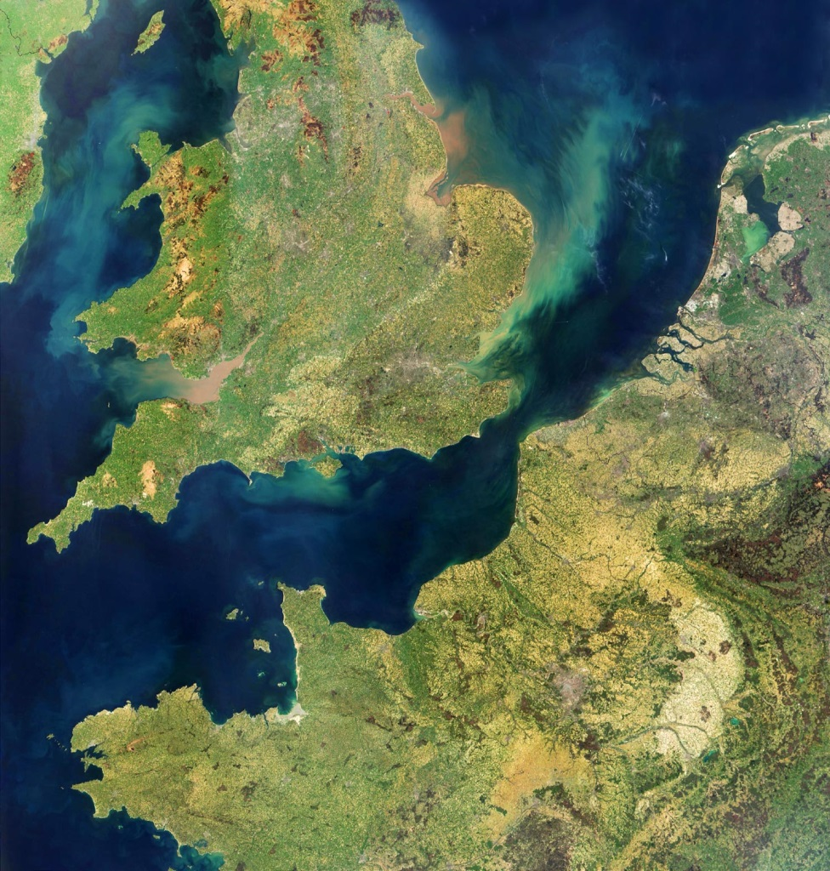
___English Channel.
The
-

Slide 36

Right you are!

Slide 37
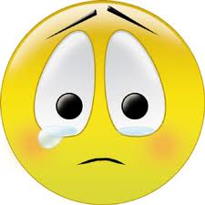
Unfortunately,
It is not right.

Slide 38
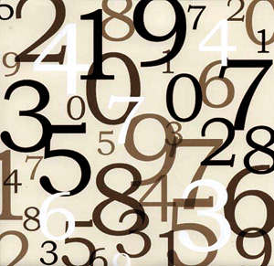
The city of «Numbers».

Slide 39
1666
1926
1952
2012
25
14
221

Slide 40
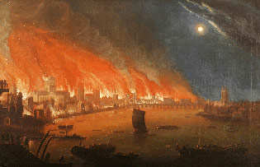
The Great Fire of London.

Slide 41
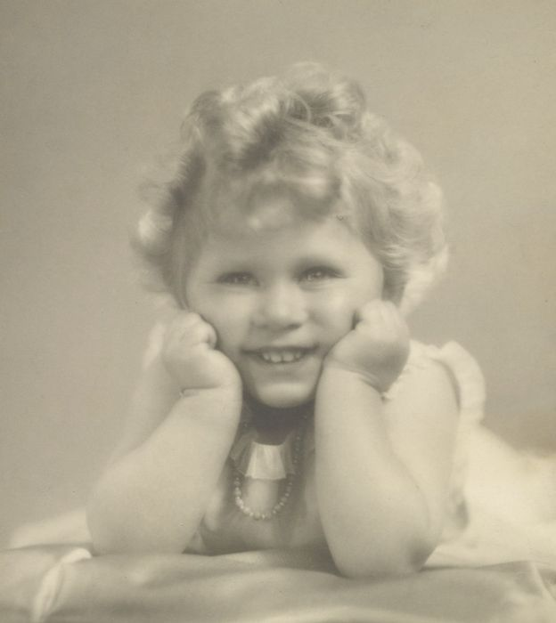
Queen Elizabeth II was born in 1926.

Slide 42
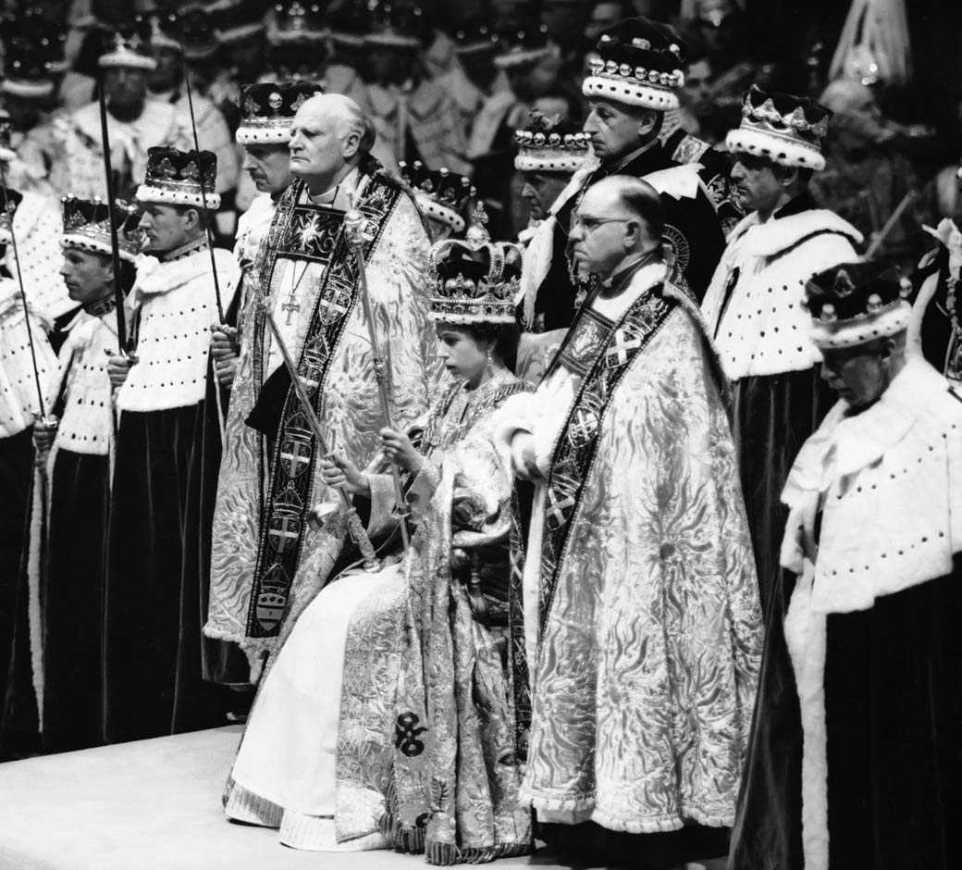
Queen Elizabeth II began to reign in 1952.

Slide 43
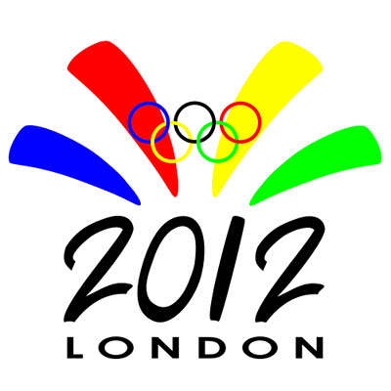
The Summer Olympic Games took place in London.

Slide 44
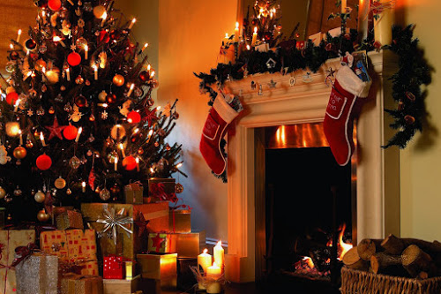
Christmas is celebrated on the 25th of December in England.

Slide 45
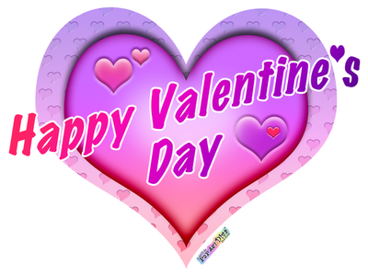
Saint Valentine's Day is celebrated on the 14th of February in England.

Slide 46
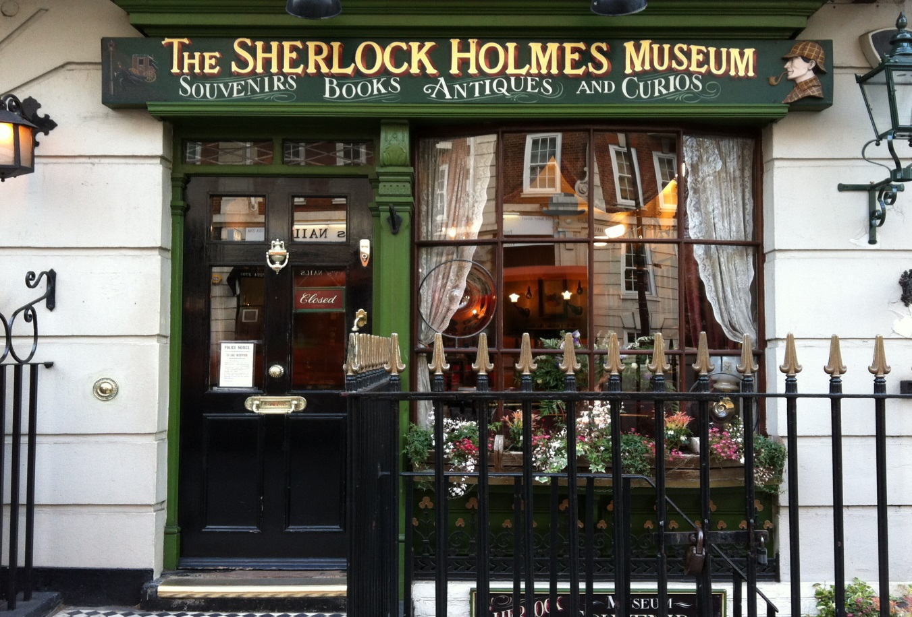
221B Baker Street is the address of Sherlock Holmes.

Slide 47
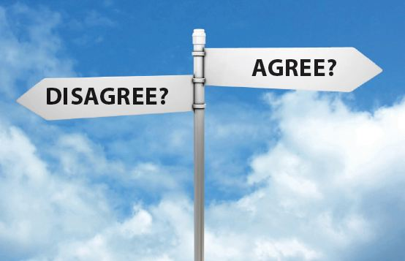
The city of «Agree or disagree».

Slide 48


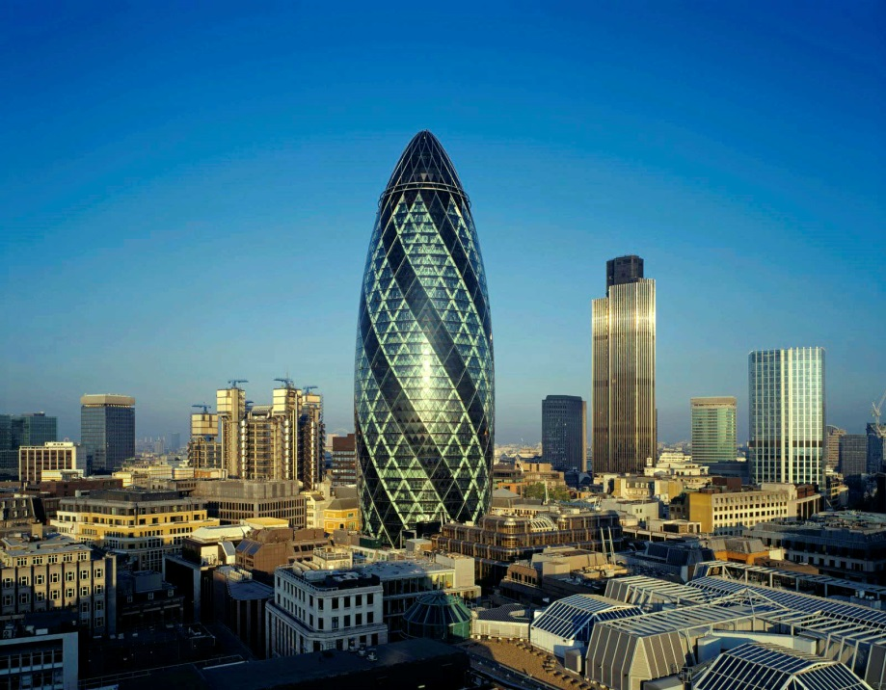
The nickname of the 30 Saint Mary Axe is «skyscraper».

Slide 49
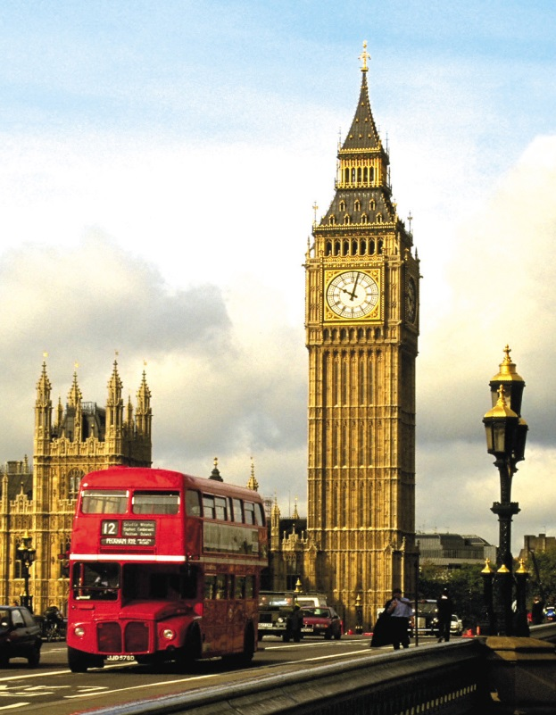
The nickname of the great clock tower is «Big Ben».

Slide 50
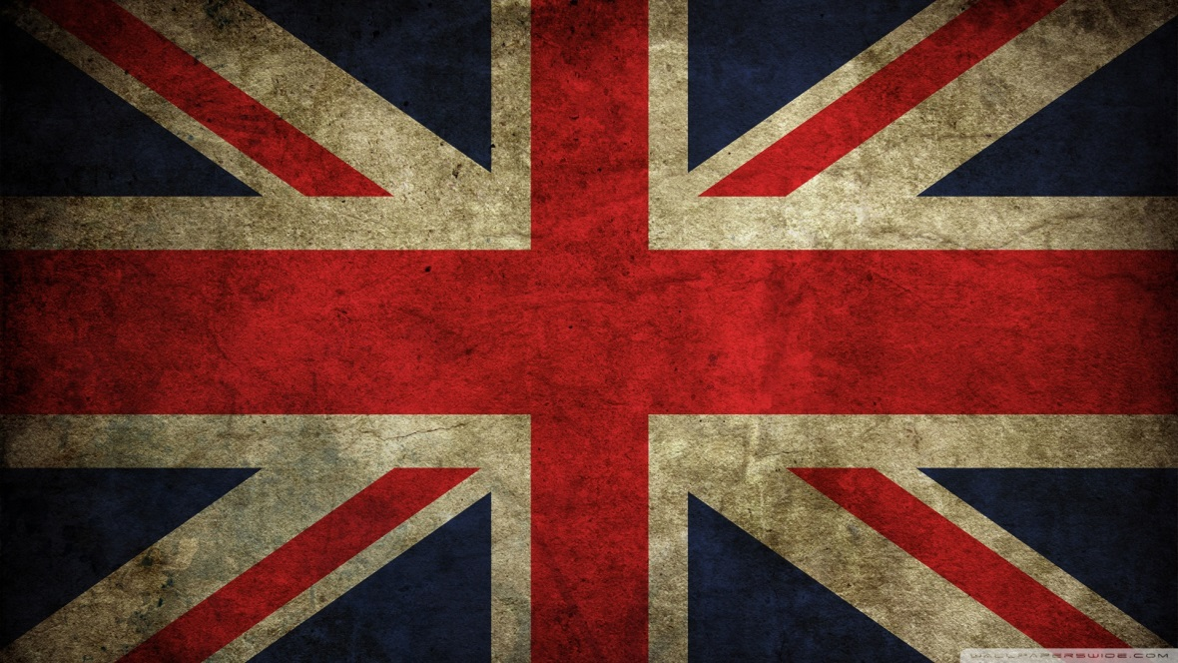
The nickname of the flag of the United Kingdom is «Jack».

Slide 51
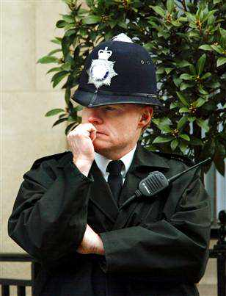
«Bobby» is a British policeman.

Slide 52
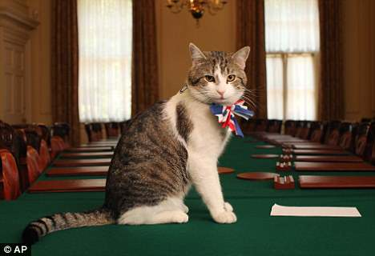
The current Chief Mouser to the Cabinet Office is a cat Tom.

Slide 53
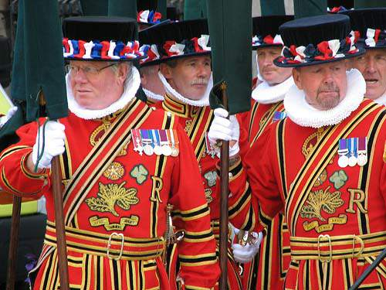
«Beefeater» is a nickname of the raven at the Tower of London.

Slide 54
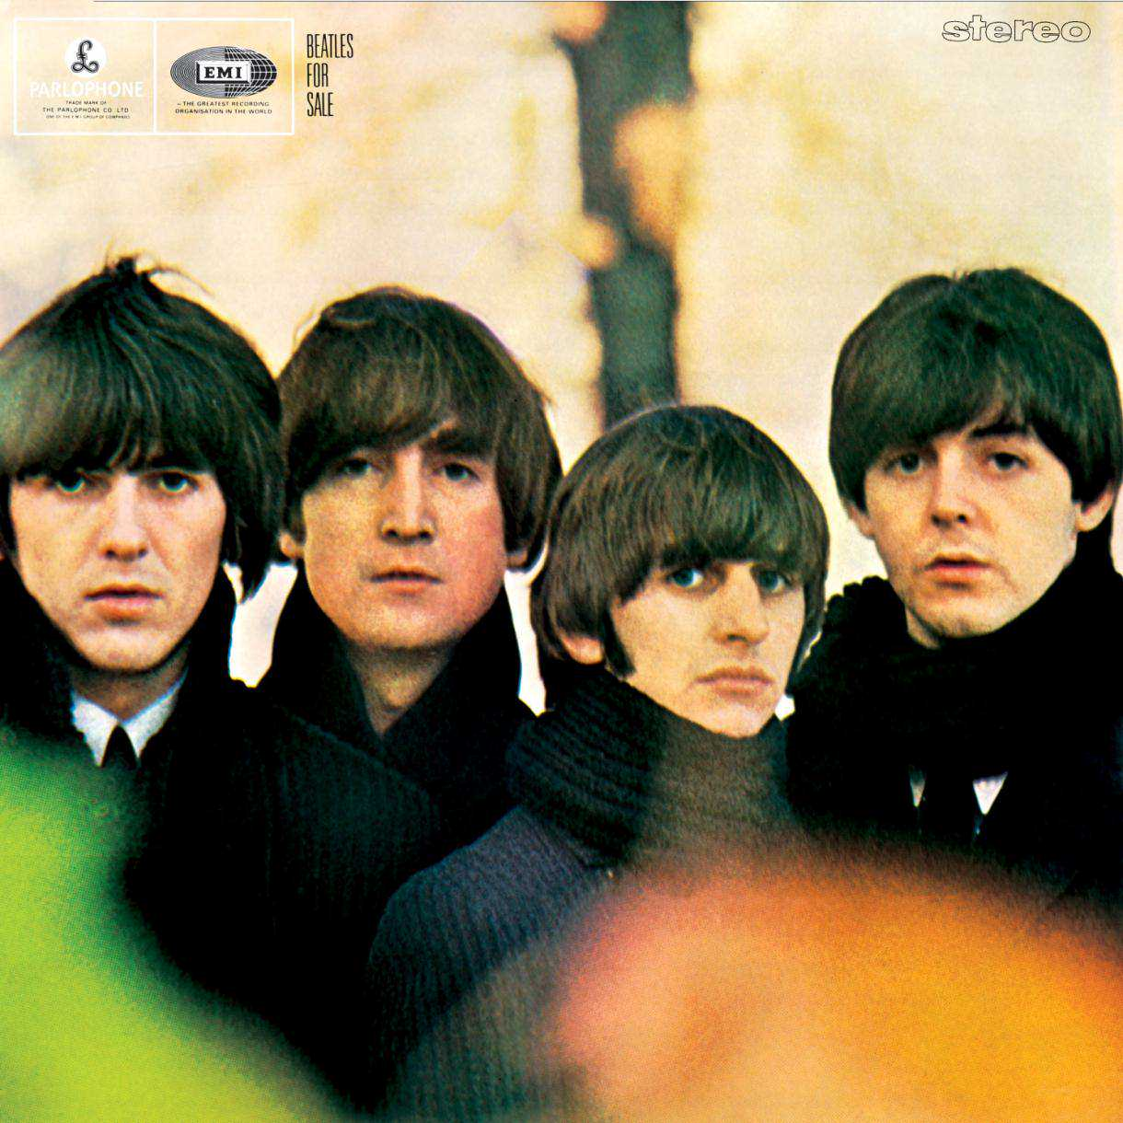
«The Beatles» is a nickname of the taxi drivers in London.

Slide 55

I agree because…

Slide 56

I disagree because…

Slide 57
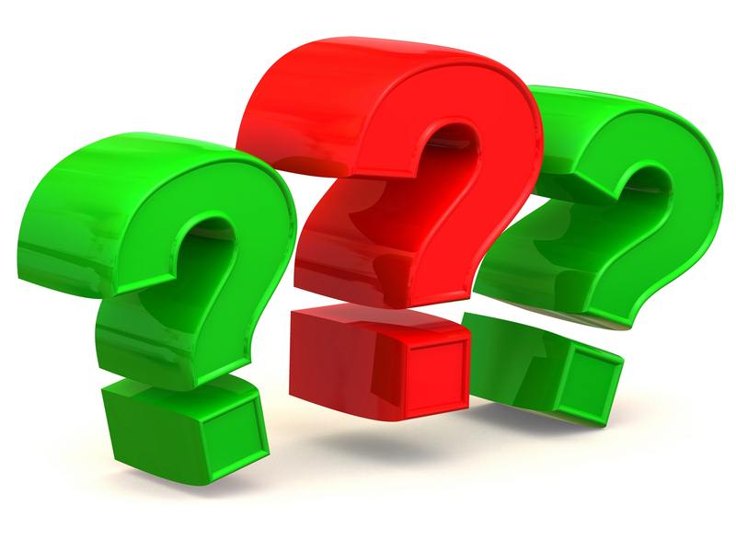
The city of «Questions».

Slide 58
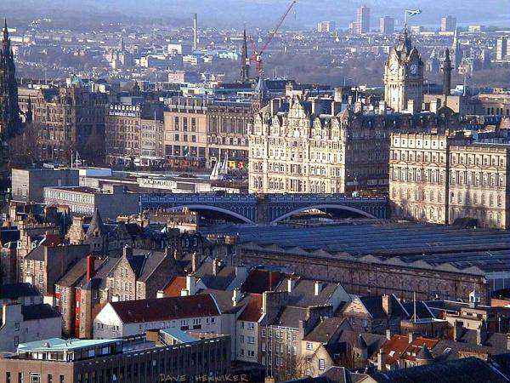
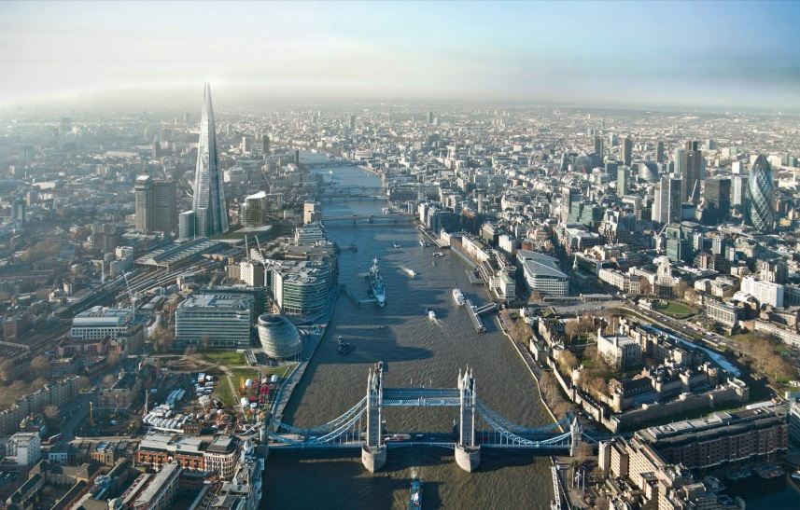
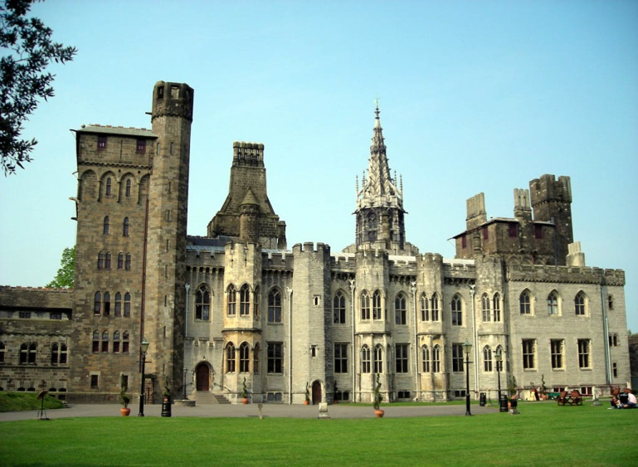
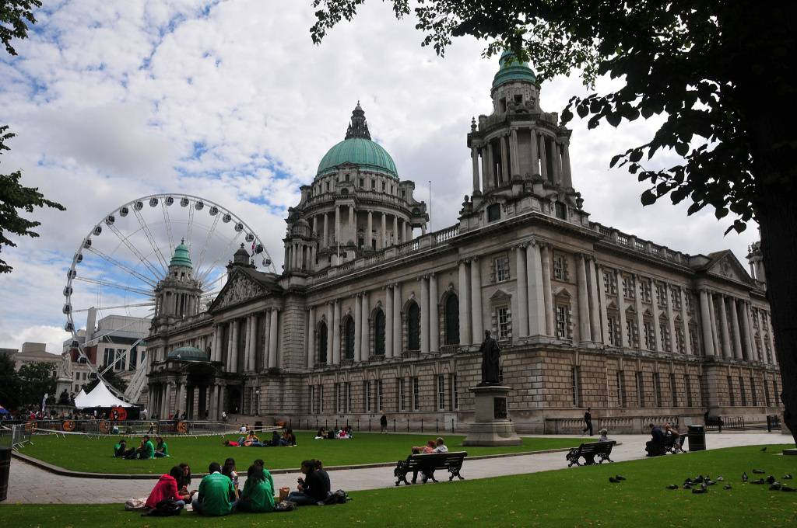
What is the capital of England?

Slide 59

That is correct! London.

Slide 60
Unfortunately,
it is not correct.

Slide 61
What is the capital of Scotland?

Slide 62
That’s correct! Edinburgh.

Slide 63
What is the capital of Wales?

Slide 64

That is correct! Cardiff.

Slide 65
What is the capital of Northern Ireland?

Slide 66
That is correct! Belfast.

Slide 67
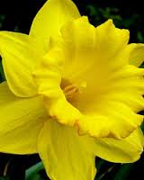
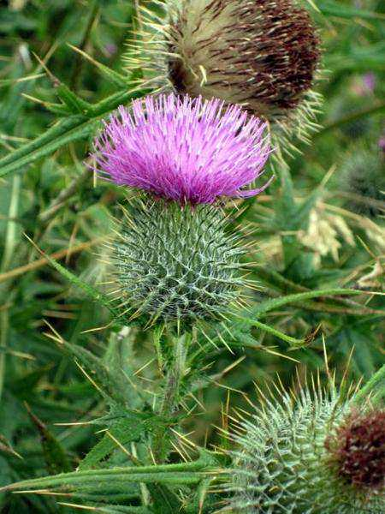
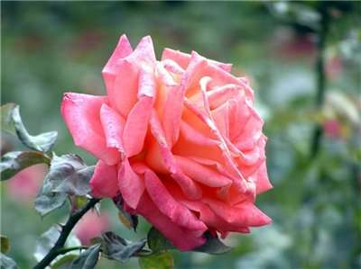
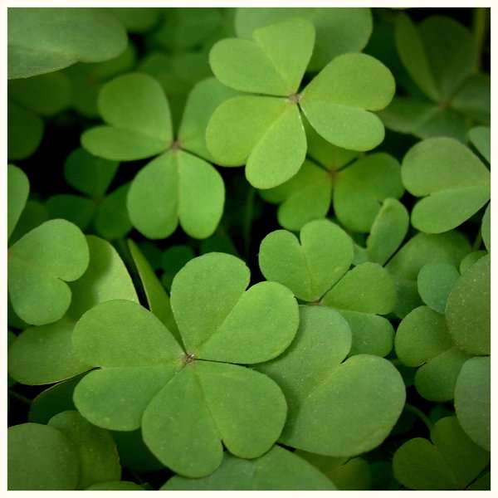
What is the national symbol of England?

Slide 68
Yes! Red Rose.

Slide 69
What is the national symbol of Scotland?

Slide 70
Yes! Thistle.

Slide 71
What is the national symbol of Wales?

Slide 72
Yes! Daffodil.

Slide 73
What is the national symbol of Northern Ireland?

Slide 74
Yes! Shamrock.

Slide 75
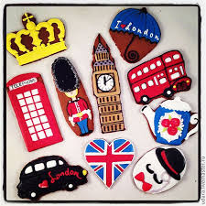
The city of «Creative works».

Slide 76
I want to tell you about …because…
I can say that the most interesting for me…because…
I think that ….
I learnt that…

Slide 77

The city of «Results».

Slide 78

The team «…» has…points.
The team «…» has…points.
And the winner is….!

Slide 79
My congratulations!

Slide 80


Thank you, everybody!

Slide 81
Links:
https://www.google.ru/search?q=фотографии+великобритании&newwindow
https://www.google.ru/search?q=смайлики&newwindow
https://www.google.ru/search?q=30+st+mary+axe&newwindow
https://www.google.ru/search?newwindow

