Slide 1
Phonetic practice
[æ]
If you, Sandy, have two candies
Give your candy to Andy, Sandy.
If you, Andy, have two candies
Give your candy to Sandy, Andy.

Slide 2
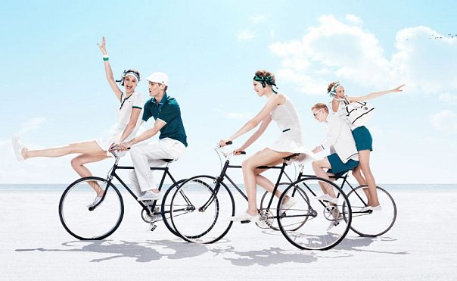

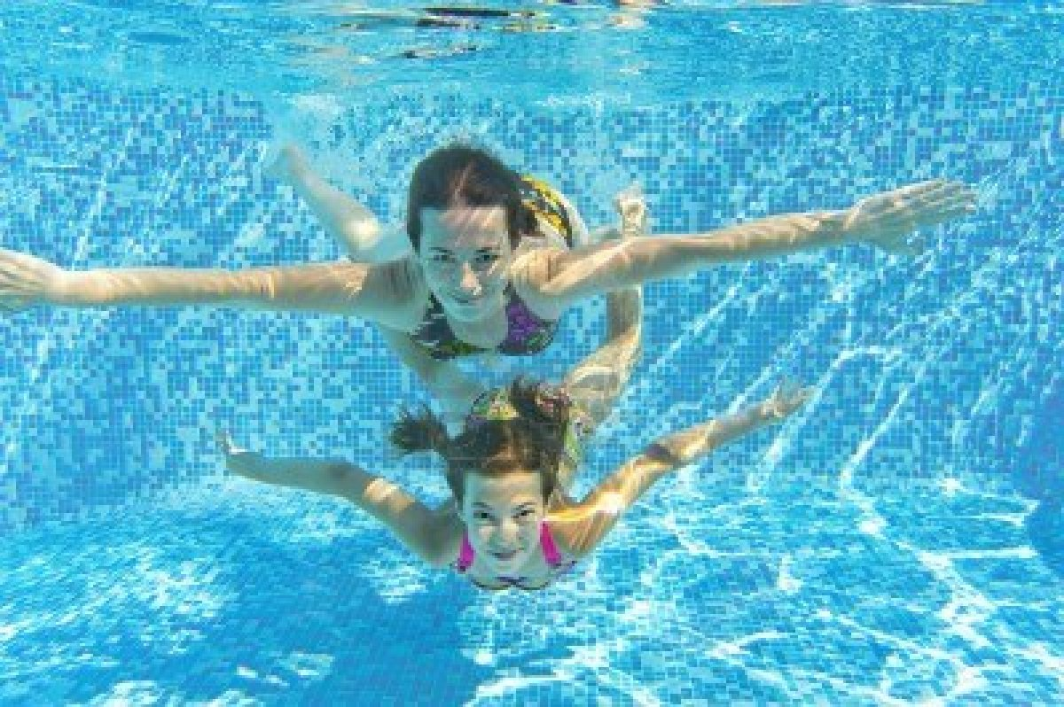
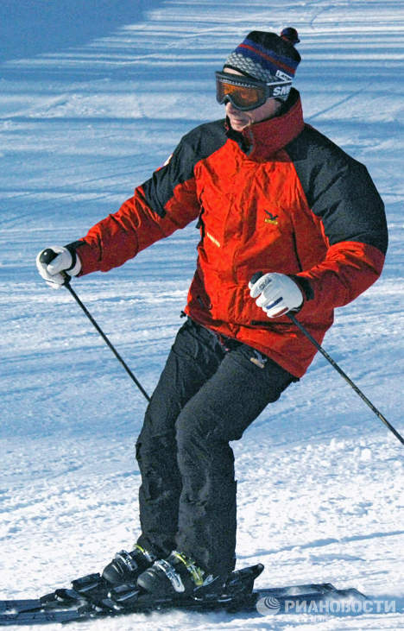
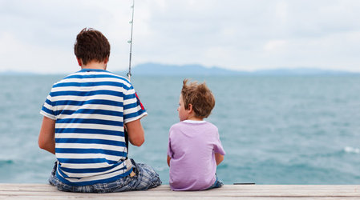
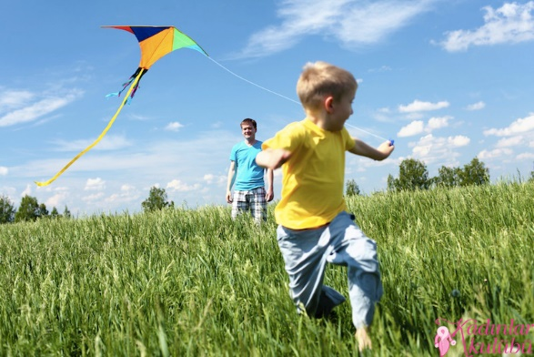
?

Slide 3
Hobbies and free time

Slide 4

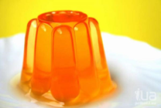

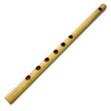
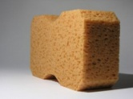


1. Match the words with the pictures.
a) | e)
b) | f)
c) | g)
d)
Jellyfish
Sponge
SpongeBob
Dance
Jelly
Glasses
Flute

Slide 5
1. Match the words with the pictures.
a) 1.Jellyfish | e) 5. Jelly
b) 3. SpongeBob | f) 7. Flute
c) 2. Sponge | g) 4. Dance
d) 6. Glasses

Slide 6
Present Simple Tense V/Vs
I like fruits – My friend likes fruits.
My friend lives in London – I live in London.

Slide 7
2. Read and fill in the gaps with verbs in Present Simple Tense.
Sponge Bob _____ (to live) on the bottom of the Pacific Ocean. He lives there in a pineapple house with his pet, Gary. Sponge Bob _____ (to like) to work as a cooker at the Crusty Crab restaurant with his neighbor Squidward. He ______ (to have) two friends. One of his friends _____ (to be) a silly starfish called Patrick. They always _____ (play) together. The second friend, Squirrel Sandy ____ (to be) from earth. Sometimes friends ______ (to gather) together and _____ (to have) fun.

Slide 8
2. Read and fill in the gaps with verbs in Present Simple Tense.
Sponge Bob lives on the bottom of the Pacific Ocean. He lives there in a pineapple house with his pet, Gary. Sponge Bob likes to work as a cooker at the Crusty Crab restaurant with his neighbor Squidward. He has two friends. One of his friends is a silly starfish called Patrick. They always play together. The second friend, Squirrel Sandy is from earth. Sometimes friends gather together and have fun.

Slide 9
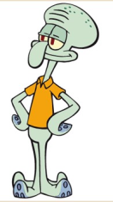
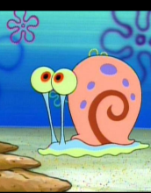
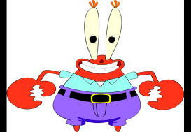
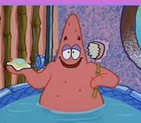
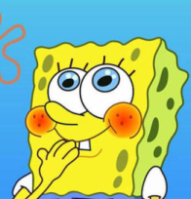
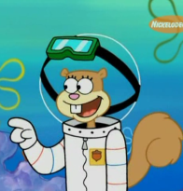
3. Match a character and a picture
Sponge Bob | Gary | Patrick | Squidward | Mr. Crabs | Squirrel Sandy

Slide 10
3. Match a character and a picture
Patrick | Sponge Bob | Gary | Squirrel Sandy | Squidward | Mr. Crabs

Slide 11
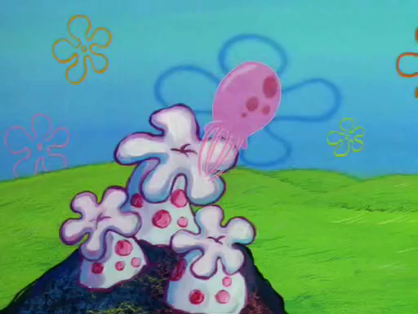
Watch a cartoon

Slide 12
4. Match the word with the definition.
1. Wild animals 2. Have fun 3. Guy 4. Party is over 5. Enough 6. Shake 7. Fields | a) A friend, a boy. b) Animals who live in the forest. For example "a bear". c) A large area of ground covered in grass where team sports are played. d) When there is a large amount of something. e) This is the end of the party. f) Amuse oneself. g) Move or dance.

Slide 13
4. Match the word with the definition.
1. Wild animals 2. Have fun 3. Guy 4. Party is over 5. Enough 6. Shake 7. Fields | a) A friend, a boy. b) Animals who live in the forest. For example "a bear". c) A large area of ground covered in grass where team sports are played. d) When there is a large amount of something. e) This is the end of the party. f) Amuse oneself. g) Move or dance.

Slide 14
Past Simple Tense Ved/V2
Live – lived
Fly - flew

Slide 15
Write the necessary form for the following verbs
Present Simple | Past Simple | Translation
Catch |  | ловить
Like | liked
Have |  | иметь
Dance | danced
Be |  | быть
Go | went
Invite |  | приглашать
Start |  | начинать
Shake | shook
Want |  | хотеть
Make |  | делать
Help | helped

Slide 16
Write the necessary form for the following verbs
Present Simple | Past Simple | Translation
Catch | caught | ловить
Like | liked | нравиться
Have | had | иметь
Dance | danced | танцевать
Be | was/were | быть
Go | went | идти
Invite | invited | приглашать
Start | started | начинать
Shake | shook | трясти
Want | wanted | хотеть
Make | made | делать
Help | helped | помогать

Slide 17
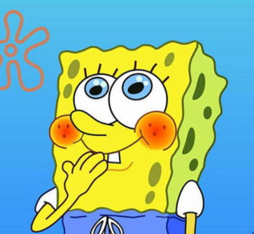
5. Tick whether it is true or false (T/F)
1. SpongeBob caught a jellyfish to get jelly for his sandwiches.
2. SpongeBob didn’t like jelly because it wasn’t tasty.
3. SpongeBob had fun with jellyfish.
4. Squidward danced with SpongeBob and jellyfish.
5. When the party was over friends went to bed.
6. At night jellyfish invited friends and they started to dance again.
7. Jellyfish liked the music Squidward played.
8. Jellyfish liked the music Gary played.
9. Gary shook his hands.
10. SpongeBob helped jellyfish to return to jellyfish fields.

Slide 18
5. Tick whether it is true or false (T/F)
1. SpongeBob caught a jellyfish to get jelly for his sandwiches. F
2. SpongeBob didn’t like jelly because it wasn’t tasty. F
3. SpongeBob had fun with jellyfish. T
4. Squidward danced with SpongeBob and jellyfish. F
5. When the party was over friends went to bed. T
6. At night jellyfish invited friends and they started to dance again. T
7. Jellyfish liked the music Squidward played. F
8. Jellyfish liked the music Gary played. T
9. Gary shook his hands. F
10. SpongeBob helped jellyfish to return to jellyfish fields. T

Slide 19
6. Complete the sentences to follow the story. Choose the right variant.
1. Sponge Bob caught a) a jellyfish b) a fish c) a butterfly
2. He made a) coffee b) jelly c) soup
2. Jellyfish wanted to play with a) Sandy b) Gary c) SpongeBob
3. Sponge Bob and Jellyfish a) had fun b) watched TV c) read at the Sponge Bob's house.
4. Jellyfish a) helped b) invited c) played friends and they a) danced b) watched TV c) slept all the night.
5. Jellyfish made much a) coffee b) noise c) music
6. Sponge Bob wanted to a) play computer games b) play hockey c) stop the party
7. Jellyfish liked the music a) Gary b) Squidward c) Sandy played.
8. a)SpongeBob b) Patrick c) Sandy helped jellyfish to return to jellyfish fields.

Slide 20
6. Complete the sentences to follow the story. Choose the right variant.
1. Sponge Bob caught a) a jellyfish b) a fish c) a butterfly
2. He made a) coffee b) jelly c) soup
2. Jellyfish wanted to play with a) Sandy b) Gary c) SpongeBob
3. Sponge Bob and Jellyfish a) had fun b) watched TV c) read at the Sponge Bob's house.
4. Jellyfish a) helped b) invited c) played friends and they a) danced b) watched TV c) slept all the night.
5. Jellyfish made much a) coffee b) noise c) music
6. Sponge Bob wanted to a) play computer games b) play hockey c) stop the party
7. Jellyfish liked the music a) Gary b) Squidward c) Sandy played.
8. a)SpongeBob b) Patrick c) Sandy helped jellyfish to return to jellyfish fields.

Slide 21
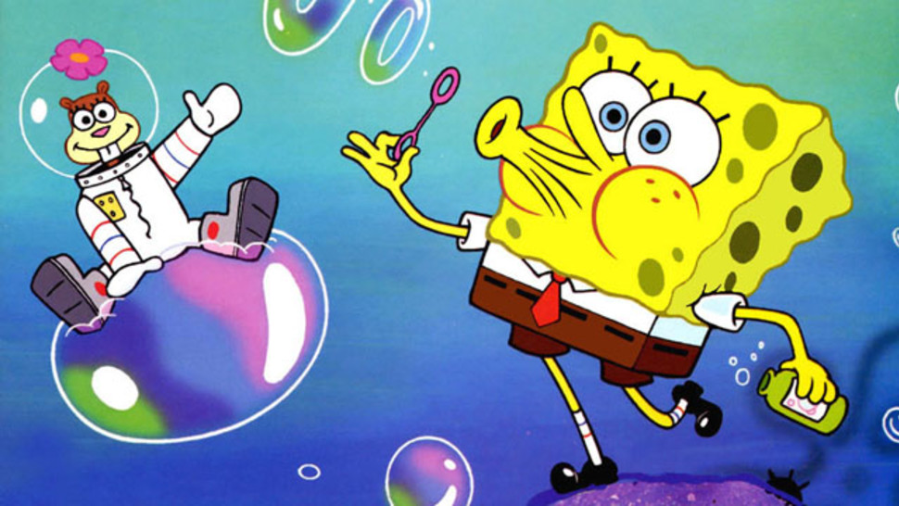
7. Answer the questions.
Do you like jelly?
Would you like to catch jellyfish in the sea?
Can you have fun with a jellyfish?
Would you like to dance all the night?
Who do you have fun with?
When do you have fun?
What is your hobby?

Slide 22

8. How do you have fun? Write your story using the scheme.
I like/don’t like having fun.
I always have fun with…
We usually…
My hobby is…
I think it’s…

Slide 23

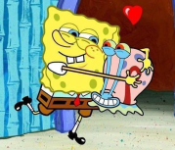
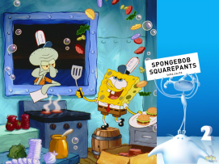
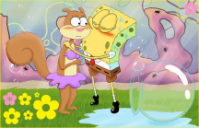
Home task. 9. Describe a picture. Use Past Simple Tense.
1).................................... (hug)
3).............................................. (catch)
4)................................................ (cook)
2).........................................(kiss)

Slide 24
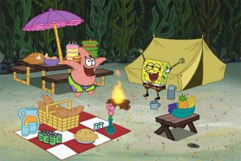
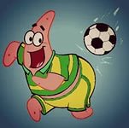
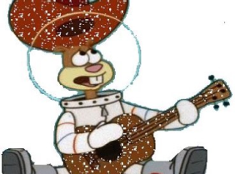
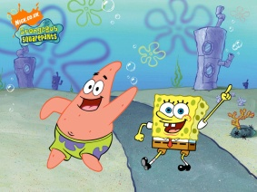
5).............................................................(have picnic)
7)............................................. (play football)
6).............................................. (play a guitar)
8).................................. (dance)

Slide 25
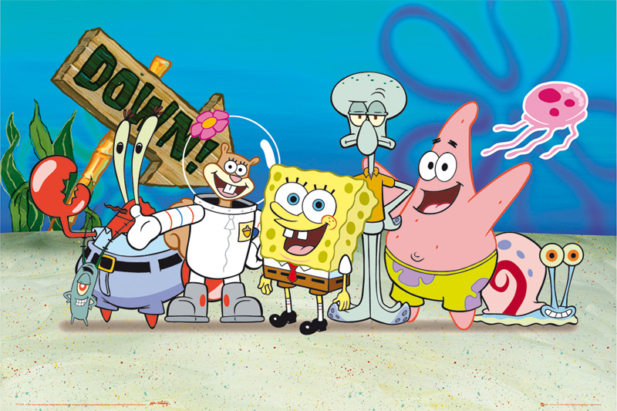
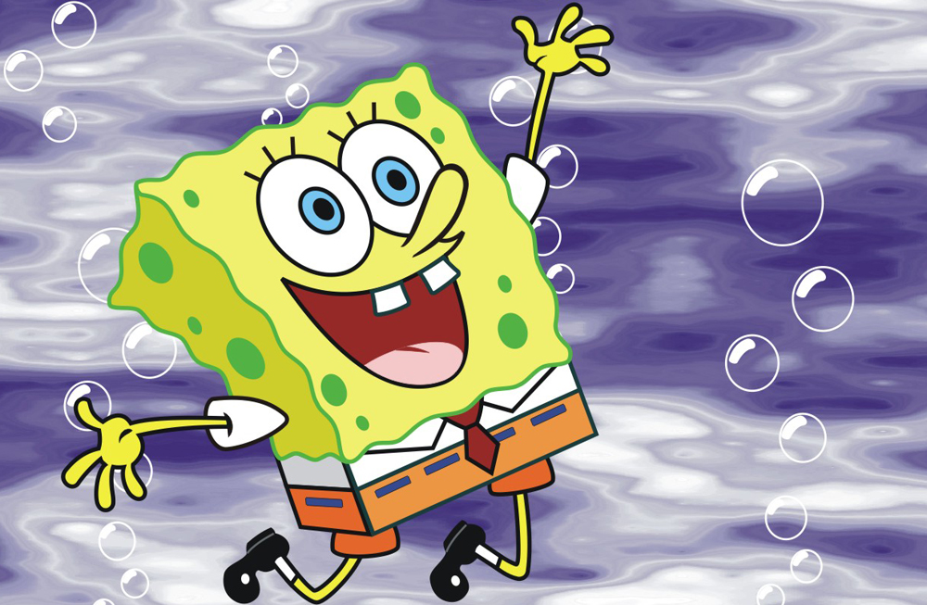
Thank you for your work!

Slide 26

Put a SMILE!
«Мне все понятно»
2. «Ничего не понятно»
3. «Понятно, но нужна помощь учителя»
4. «Понятно, но нужна помощь учебника»

