Slide 1

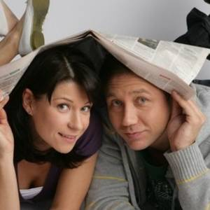
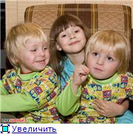
A poster about my favourite TV family
Voronins’ family

Slide 2
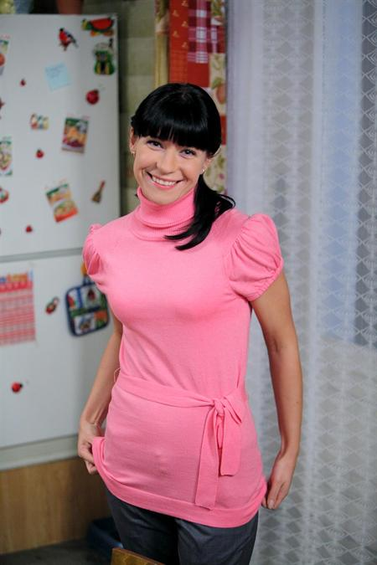
VERA
She is ….., she has got …… hair. She is very clever. She …… dance. But she …….cook.
can, tall, long, can’t

Slide 3
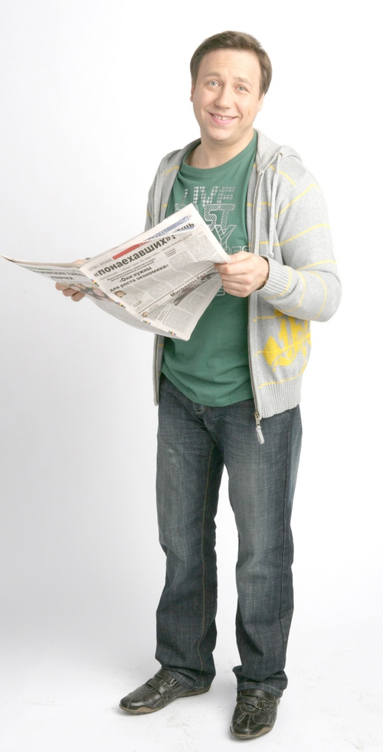
KOSTYA
He is …….., he’s got ……. hair. He is very funny. He ……. football. He …….. write sport news. He …….play chess.
Can’t, can, short, brown, likes

Slide 4
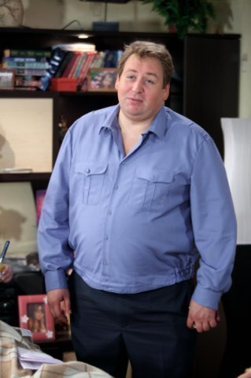
LENYA
He is …… and …….. He is kind. He likes his family very much. He is a ……policeman. He …….. run very fast.
Plump, good, can’t, tall

Slide 5
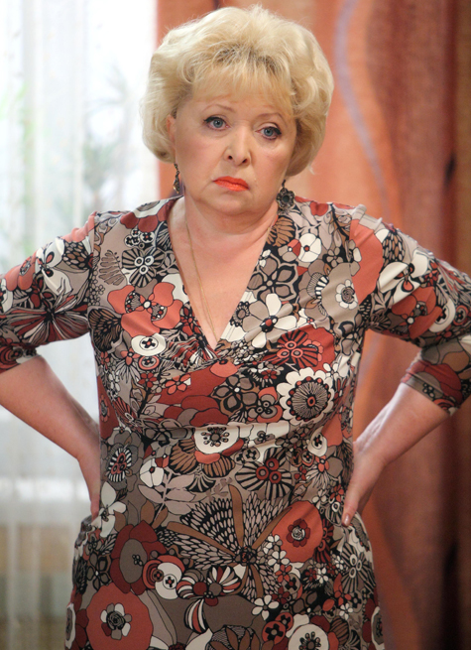
GALINA
She is ……. and old. She is plump. She……cook very well. She ……. her son Kostya.
Likes, plump, can

Slide 6
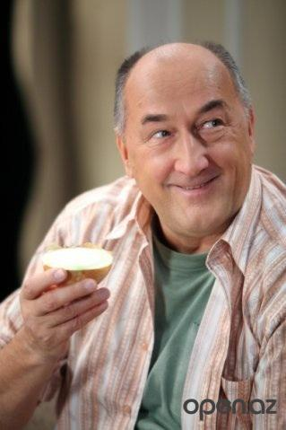
NIKOLAY
He is old and …... He is very …... He …… football very much. He likes his car.
Likes, tall, lazy

