Slide 1
FOOD

Slide 2
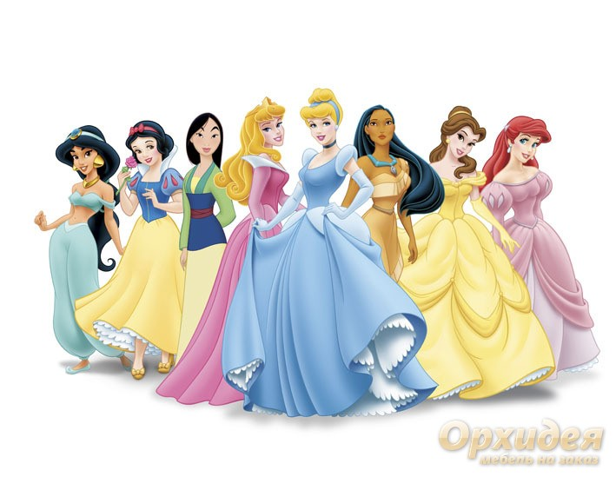
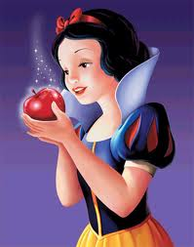

Slide 3
doctor, tea, sweets, keep, read, tell, clean, sing, drink, eat

Slide 4
ee
[i:]
ea

Slide 5
“An apple a day keeps the doctor away”

Slide 6
[e] – dress, bread, get, red
[u:]- school, juice, too, took
[i:] – eat, sweets, tea, clean
[ei] – play, take, tasty

Slide 7
cheese | [tςi:z] | Сыр
cabbage | [kæbidз] | Капуста
carrot | [kærət] | Морковь
bread | [bred] | Хлеб
juice | [dзυ:s ] | Сок
cake | [keik] | Торт
tea | [ti:] | Чай
milk | [milk] | Молоко
orange | [orindз] | Апельсин
coffee | [kofi] | Кофе
sweet | [swi:t] | Сладость
meat | [mi:t] | Мясо
honey | [hΛni] | Мед

Slide 8
cheese
cabbage
carrot
bread
juice
cake
tea
milk
orange
coffee
sweet
meat
honey

Slide 9
Сыр
Капуста
Морковь
Хлеб
Сок
Торт
Чай
Молоко
Апельсин
Кофе
Сладость
Мясо
Мед

Slide 10
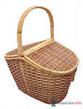
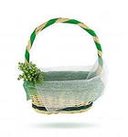
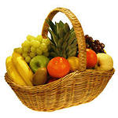
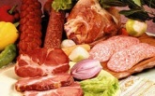
We have got a lot of … .

Slide 11
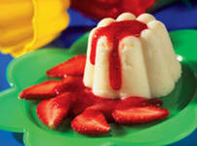
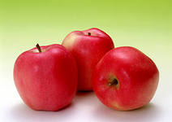
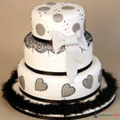
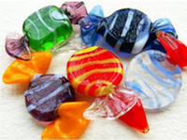
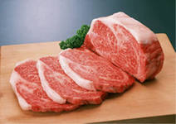

Snow White likes …and…
Red apples
Pudding
Tasty sweets
cake
Meat
Honey

Slide 12
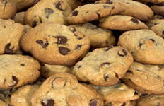
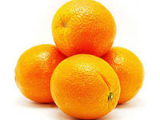
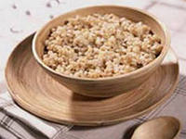
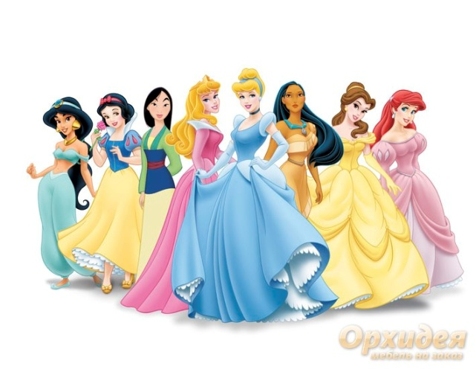
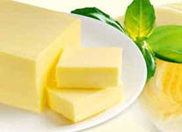
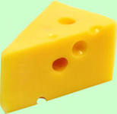
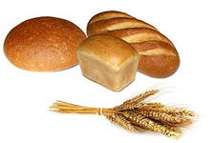
They like …. and.....
Cookies
Oranges
Porridge
Butter
Cheese
bread

Slide 13
Find the words
lemonorangecupspaghettimeatchickencheesefruitvegetableeggice-cream

Slide 14
Check yourself
lemonorangecupspaghettimeatchickencheesefruitvegetableeggice-cream

Slide 15
Find as many words as possible
D | S | B | T | S | O | U | P | J
R | W | R | A | M | C | U | P | U
I | E | E | S | I | E | A | T | I
N | E | A | T | L | T | E | A | C
K | T | D | Y | K | E | G | G | E

Slide 16
Check yourself.
D | S | B | T | S | O | U | P | J
R | W | R | A | M | C | U | P | U
I | E | E | S | I | E | A | T | I
N | E | A | T | L | T | E | A | C
K | T | D | Y | k | E | G | G | E

Slide 18
The English have four meals a day: breakfast, lunch, tea, and dinner or supper.
English people like tea. They drink a lot of tea. They like to drink tea with milk, not with lemon.
We know that you don’t like porridge, but English people like to eat porridge with milk very much.
They usually eat it for breakfast. English people don’t eat much bread. They never eat bread with meat
or vegetables. But they sometimes eat bread
with soup.

Slide 19
Answer the questions:
How many meals a day do the English have?
Do the English eat porridge for breakfast or for dinner?
Do English people like porridge?
Do English people drink a lot of tea?
Do English people eat much bread?
What do the English like to drink tea with?
What do the English like to eat porridge with?

Slide 20
have, drink, tea, lemon, porridge, bread, soup
The English …. four meals a day: breakfast, lunch, tea, and dinner or supper.
English people like tea. They drink a lot of … . They like to … tea with milk, not with … .
We know that you don’t like porridge, but English people like to eat ….. with milk very much.
They usually eat it for breakfast.
English people don’t eat much …. .
They never eat bread with meat or vegetables.
But they sometimes eat bread with …… .
Choose the right word.

Slide 21
Home work
Написать рецепт своего любимого блюда.
Ex.10 p.83

Slide 22

Now children, the
lesson is over.
Good luck!

