Slide 1
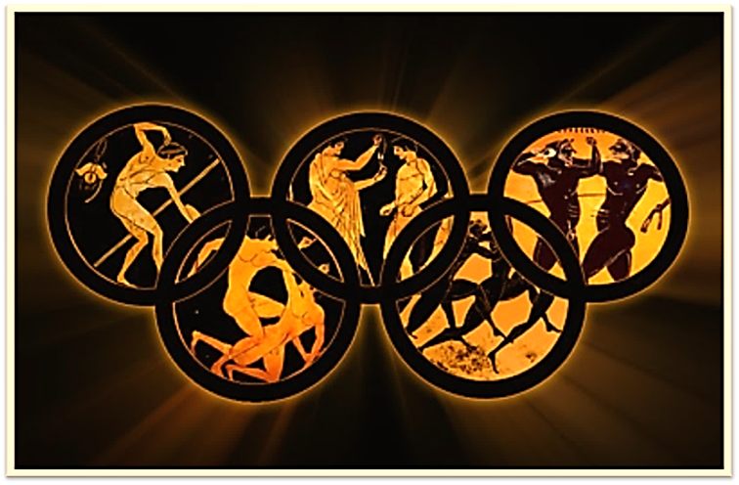
THE OLYMPIC GAMES

Slide 2
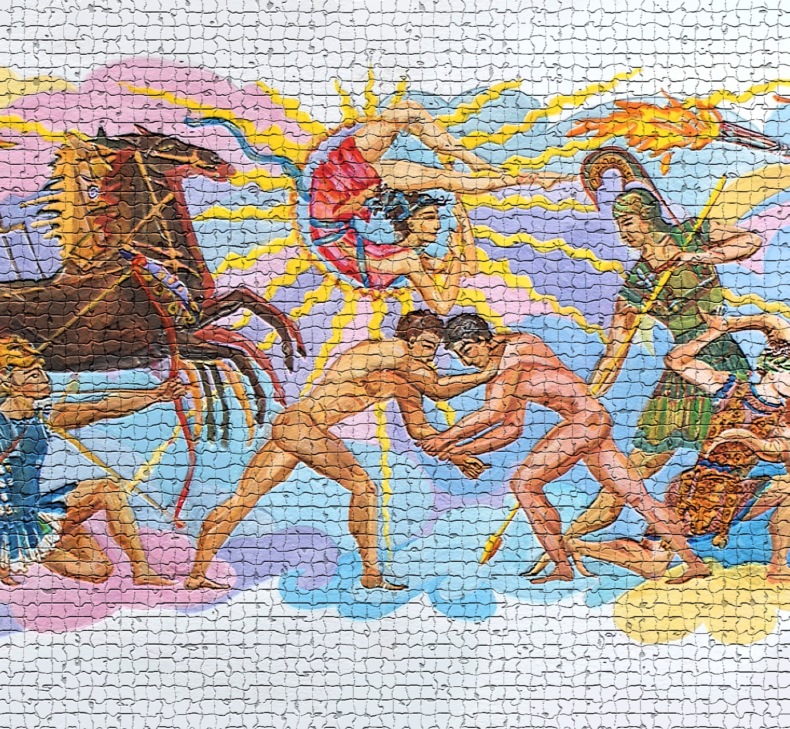
The Olympic Games have a very long history.

Slide 3
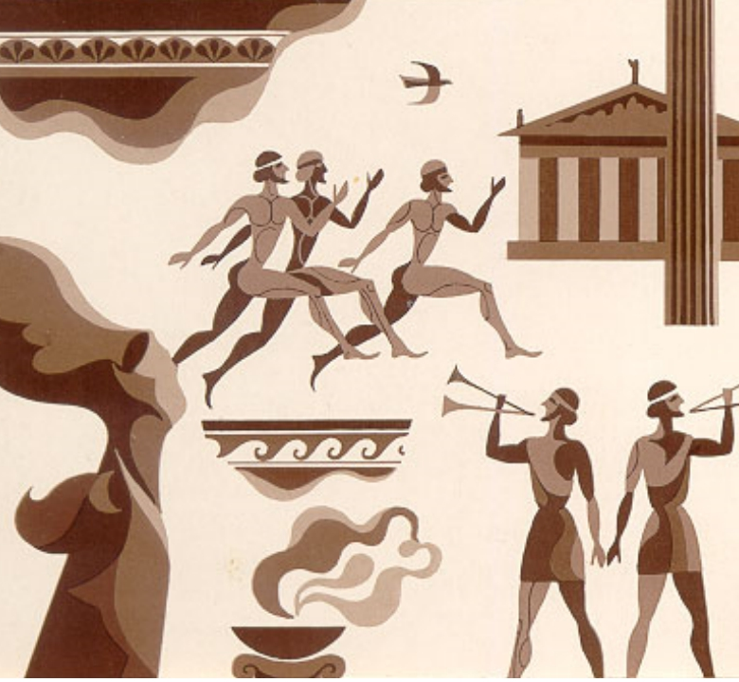
But only one competition was at the 1st Olympic Games. It was the run competition on a 200 meters distance.

Slide 4
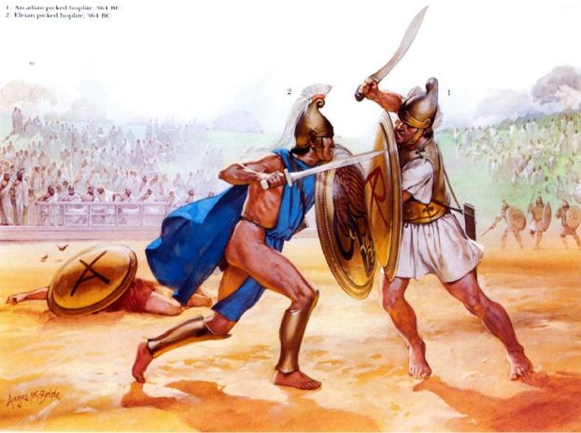
Olympia to
compete in
running, long
jumps,
throwing of
discus and
javelin and
wrestling.

Slide 5
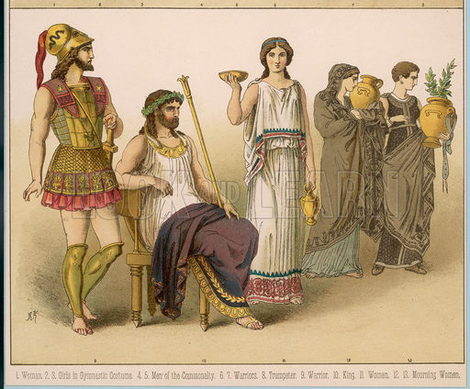
The
olympionics of ancient
Greece
became very popular.

Slide 6
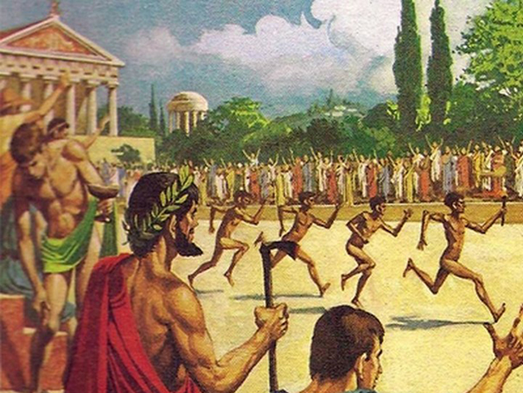
Only men
could take
part in the
Olympic
Games.

Slide 7
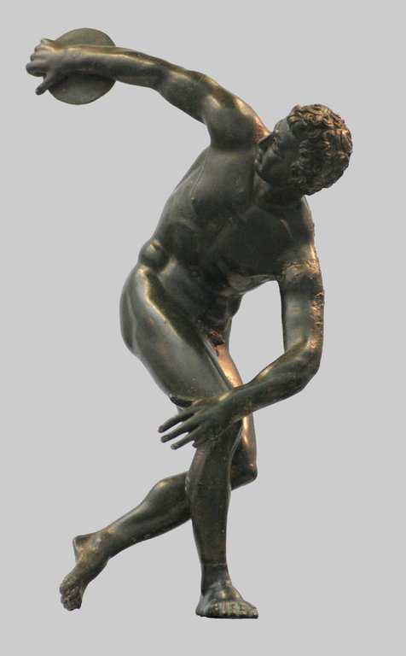
Magnificent
strong bodies inspired
artists and
sculptors.

Slide 8
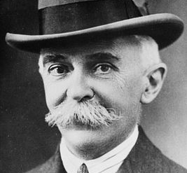
In 1894, a Frenchman, Baron Pierre de Coubertin, addressed all the sports governing bodies and pointed out the significance of sports and its educational value

Slide 9
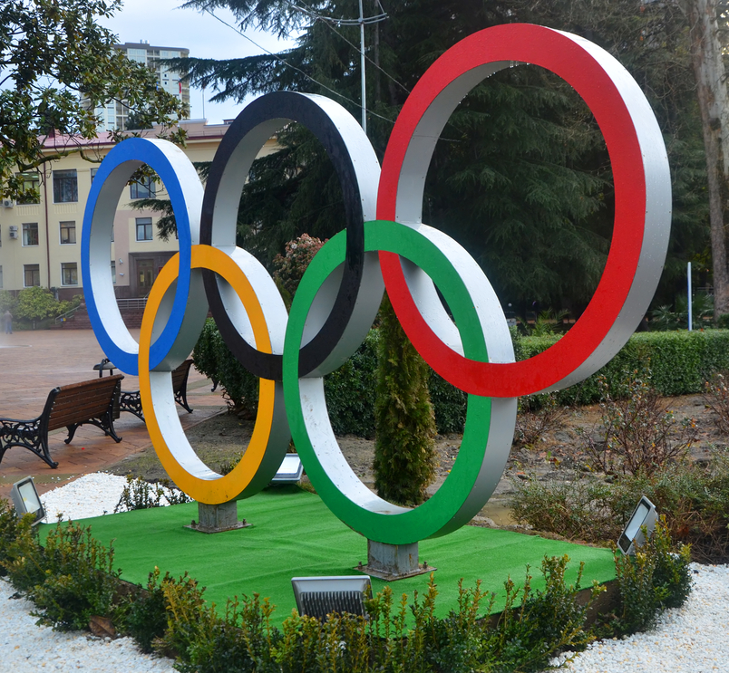
The colours of the rings are blue, red, yellow, green and black, because every country in the world has at least one of these colors on their national flag.

Slide 10
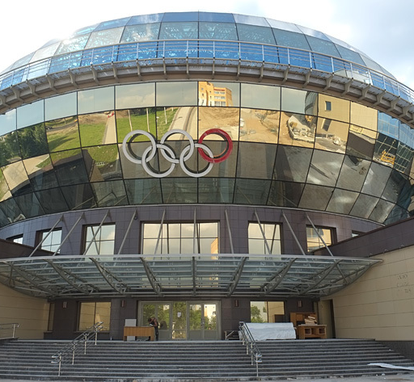
In 1896 the International Olympic Committee was set up. The International Olympic Committee decides upon the programme of the games, the number of the participants and the city-host for the Games.

Slide 11
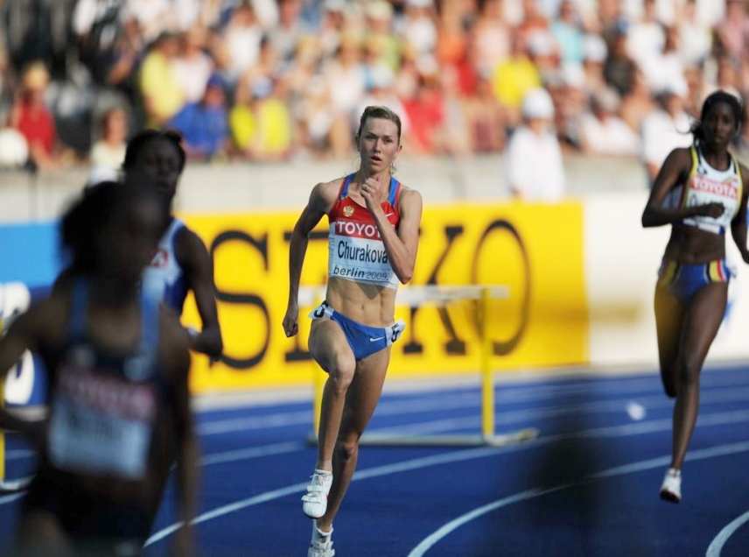
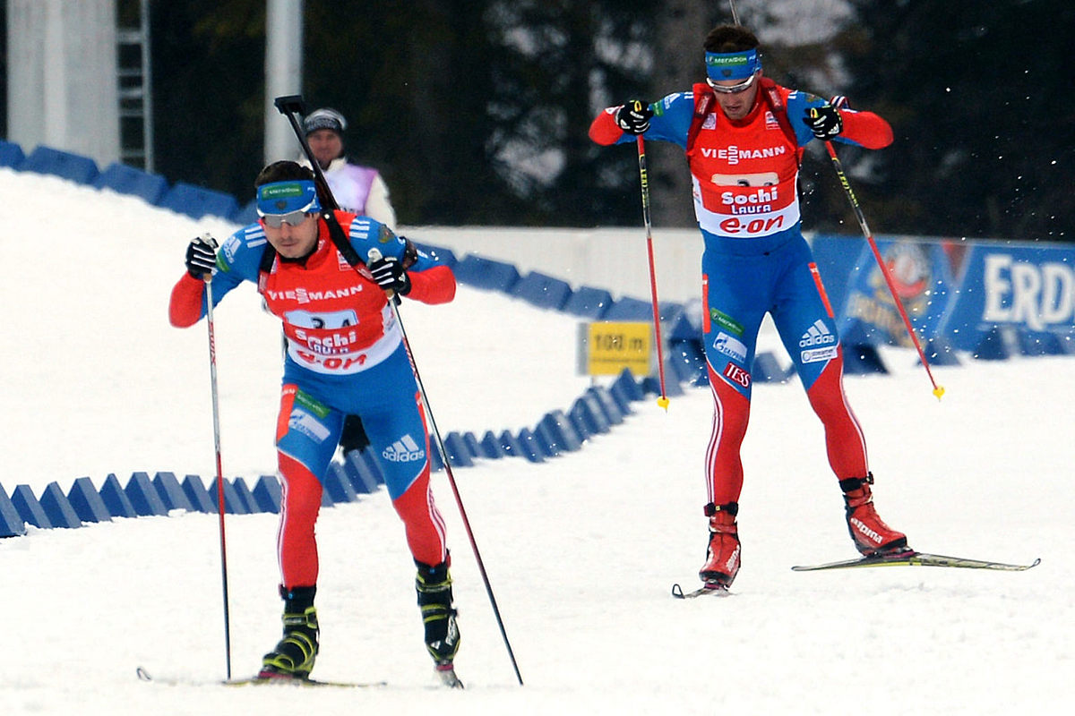
Summer and Winter Games are held separately. There are always several cities wishing to host the Games. The most suitable is selected by the International Committee.

Slide 12
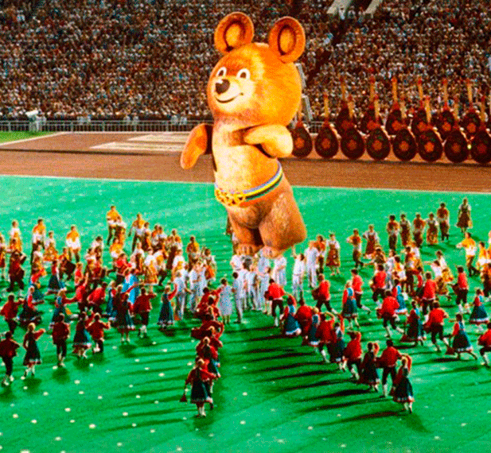
Russia joined the Olympic movement in 1952.

Slide 13
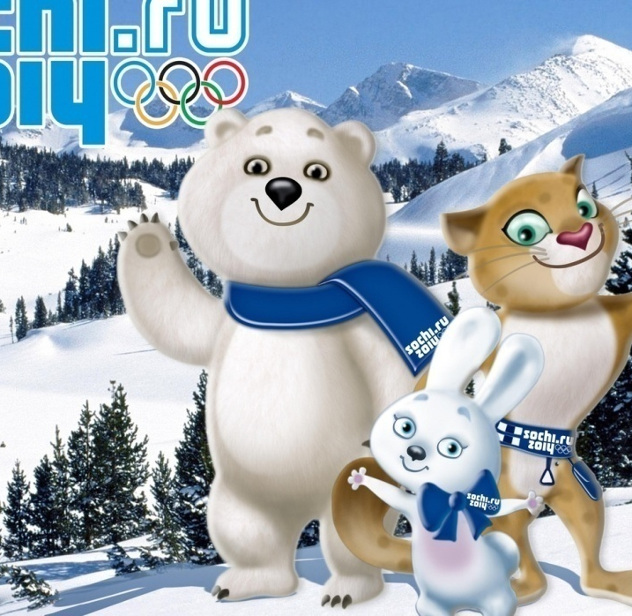
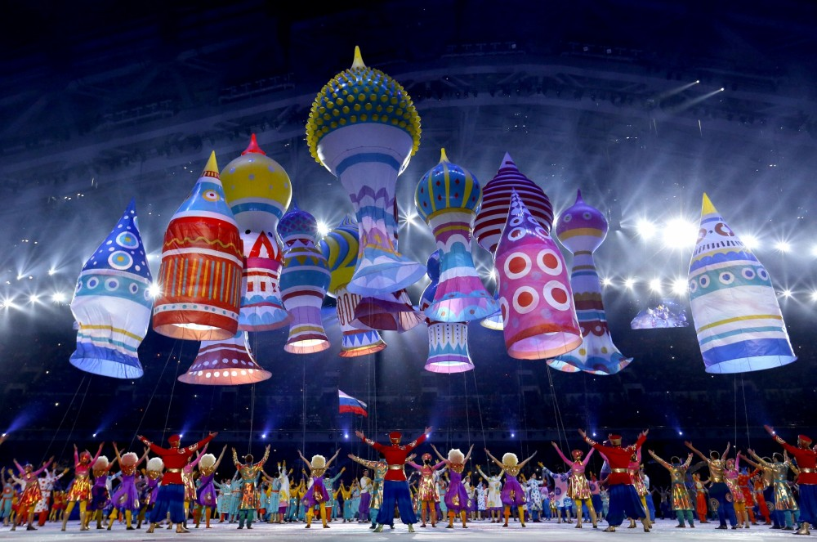
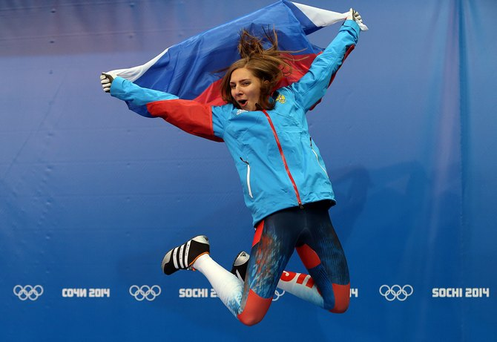
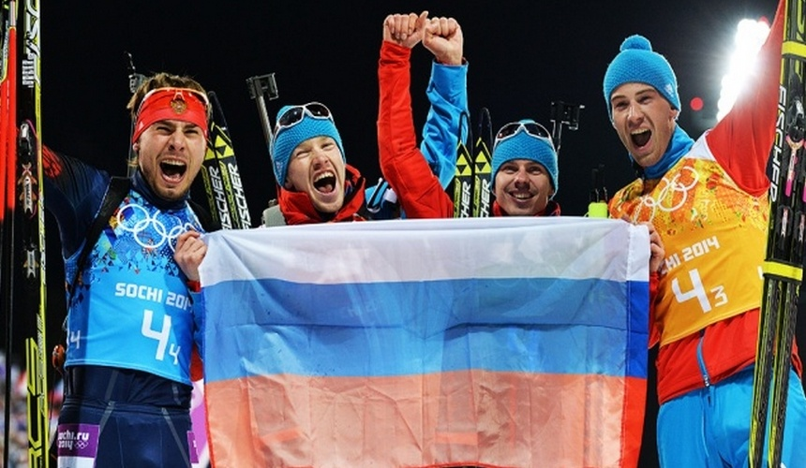
In 2014 the 22nd Olympic Games took place in Sochi, where Russia was the leader in quantity of the won medals

Slide 14
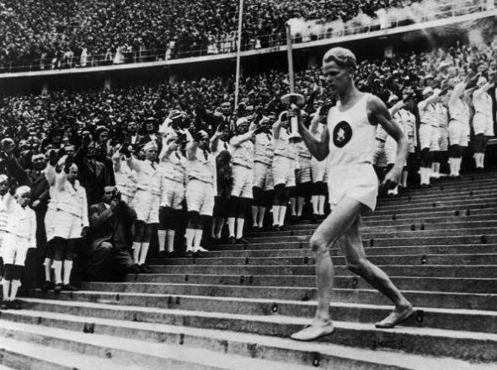
Politics and the Olympic Games

Slide 15
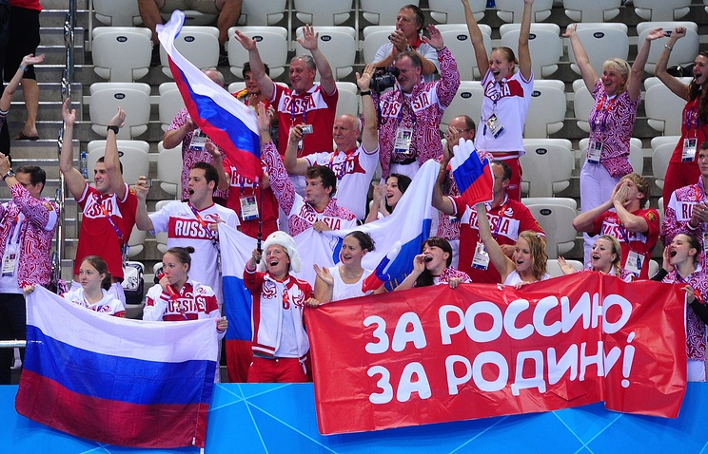
Today, unfortunately, the Olympic Games became the place of clarification of the political relations.

Slide 16
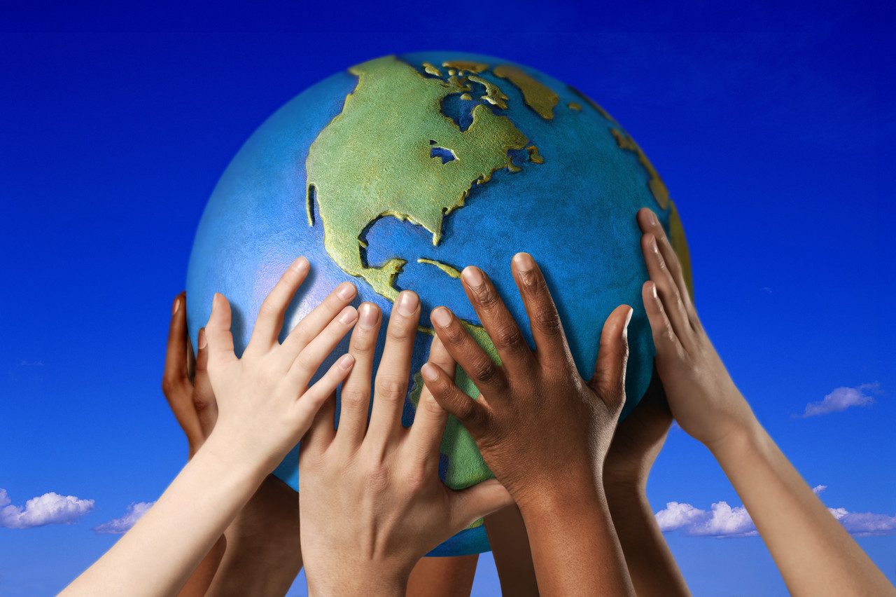
The Olympic Games - the world symbol of the peace and friendship.

Slide 17
Answer the questions:
1. What interesting information have you learnt about the Olympic Games?
2. Why is the Olympic Games a symbol of peace?
3. Whom do we have to thank for the revival of the Olympic Games ?
Why?
4. What is the emblem of the Olympic Games ?
5. What do they mean?
6. What does the International Olympic Committee do?
7. Into what 2 groups are the Olympic Games divided?
8. When did Russia join to the Olympic movement?
9. How many times was Russia a host of the Olympic Games

Slide 18
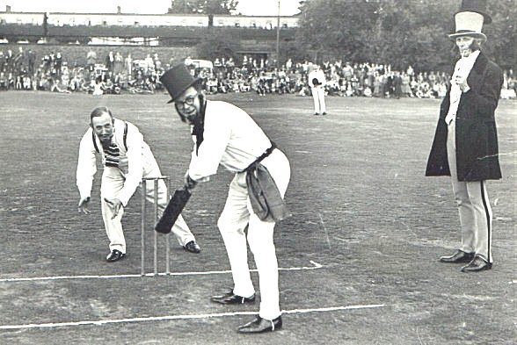
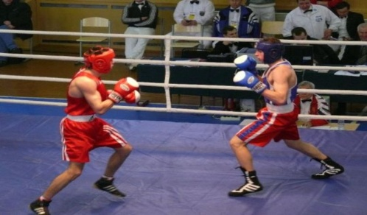
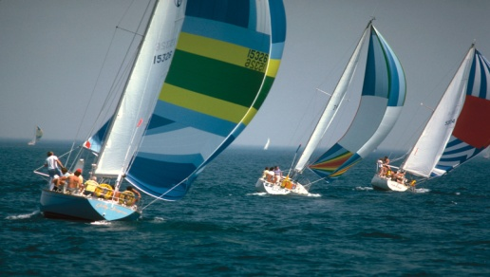
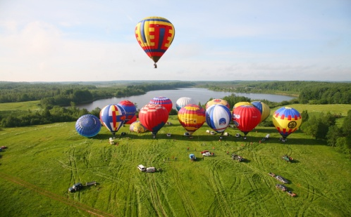
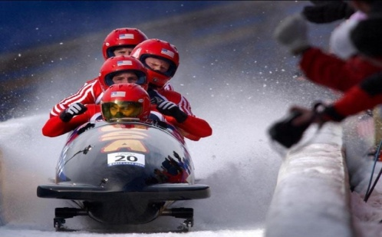
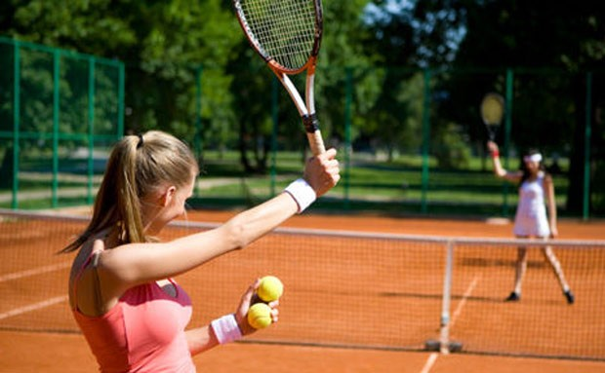
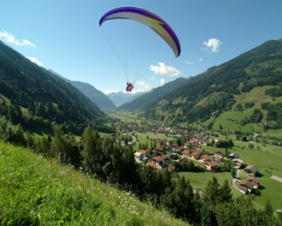
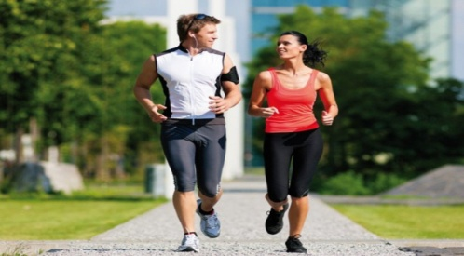
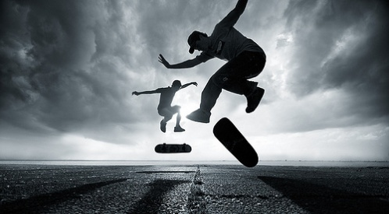
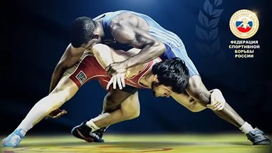
Cricket boxing yachting
Ballooning bobsleighing tennis parachuting
jogging skateboarding wrestling

Slide 19
Indoor activities outdoor activities
Sailing
Skating
Surfing
Baseball
Diving
Bowling
Tennis
Handball
Horse-racing
Wrestling
Ice hockey
Archery
volleyball

Slide 20
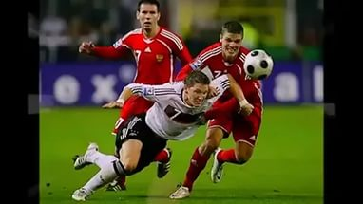
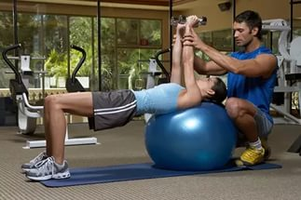
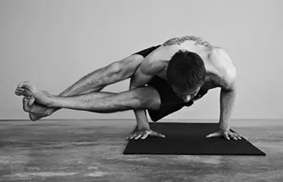
To play a sport to do a sport
To be into a sport

Slide 21
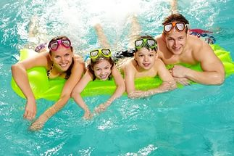
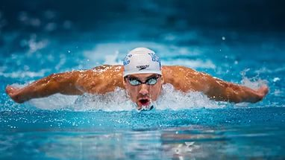
To go V-ing to V

Slide 22
Choose the most suitable expressions from the ones in brackets:
I (swim / go swimming / do swimming) once a week.
b) In Russia a lot of children (play / do / go) hockey.
c) He is a professional. He (goes skiing / skies / does skiing) four hours a day.
d) I want to be fit. That is why I (go / do / play) aerobics in our fitness club.
e) Jack is really (into / playing / doing) football. He plays himself and has a good collection of football stars photos.
f) In her teens my mother (swam / went swimming / did swim­ming) and her best result was bronze in a national championship.

