Slide 1
In the World of Fairy Tales

Slide 2
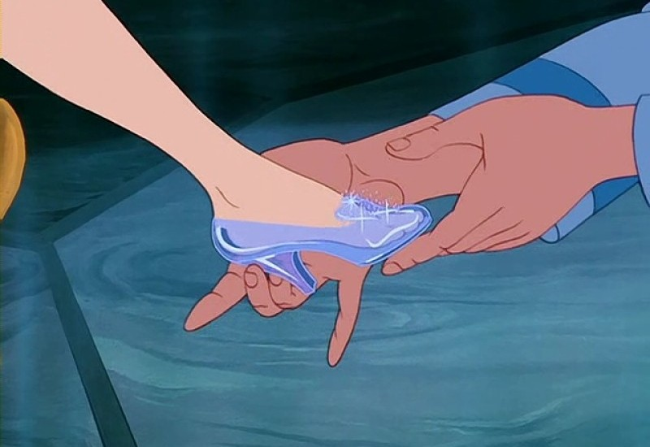
What’s the name of a character who lost a shoe?
- Alice
- Ellie
- Cinderella
- Goldilocks

Slide 3
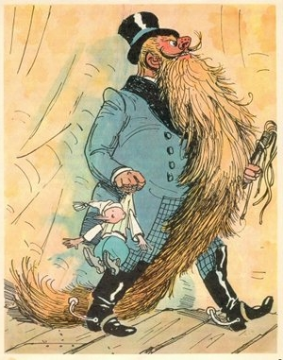
Choose the real name of Karabas-Barabas:
- The Green Fisherman
- Carlo Collodi
- Mangiafuoco [mandʒaˈfwɔːko]
- Mister Geppetto [dʒepˈpetto]

Slide 4
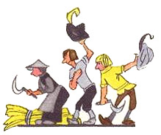
The old miller died. He had three sons. The first son got a mill, the second son got a donkey, the third son got a …… What was it?
- a cock
- a dog
- a horse
- a cat

Slide 5
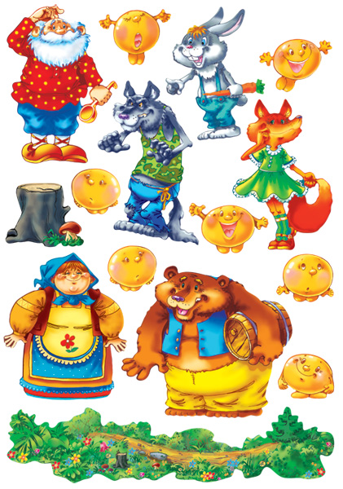
What is the most cunning animal in all fairy tales?
- a goat
- a hare
- a bear
- a fox

Slide 6
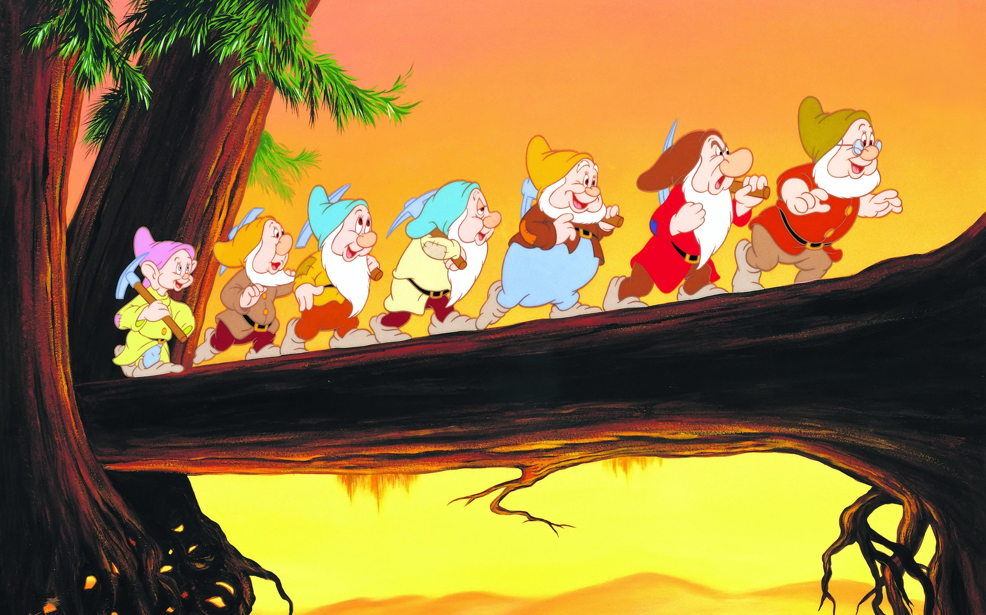
Who was the best friend of the Seven Dwarfs?
- The Prince
- The Witch
- Snow White
- The Wicked Queen

Slide 7
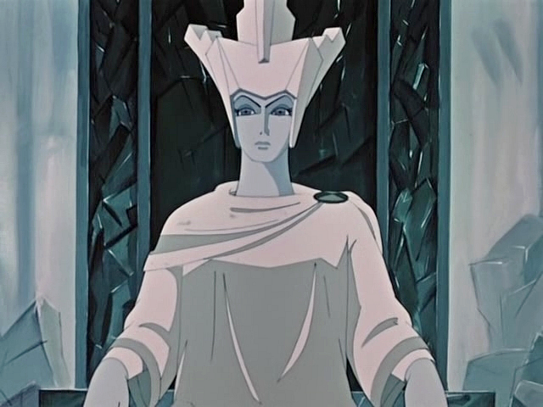
What were the names of the characters of a well-known tale “The Snow Queen”?
- Kay and Alice
- Kay and Gerda
- Toto and Ellie
- Quasimodo and Esmeralda

Slide 8
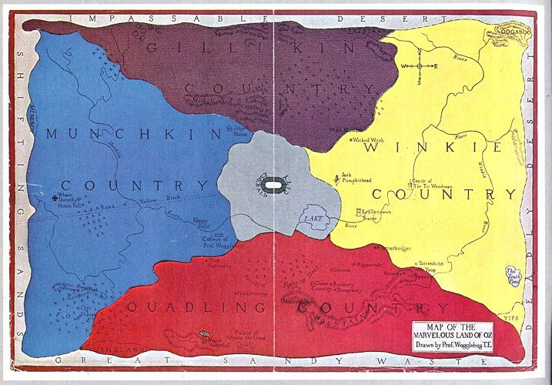
Name the continent that matches to the name of a book “The Wonderful Wizard of Oz”:
Antarctica
South America
Australia
- Africa

Slide 9

Who wrote “Snow White and the Seven Dwarfs?
- Lewis Carroll
- Walt Disney
- Charles Perrault
- The Brothers Grimm

Slide 10
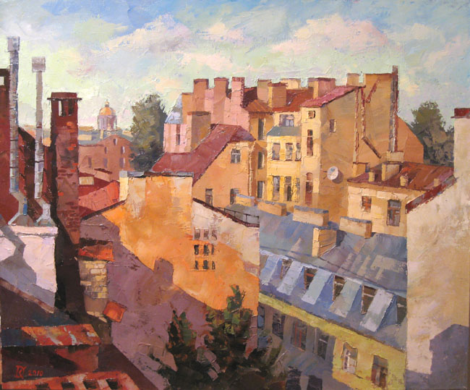
Who lives on the roof?
- Peter Pan
- Harry Potter
- Nils
- Carlson

Slide 11
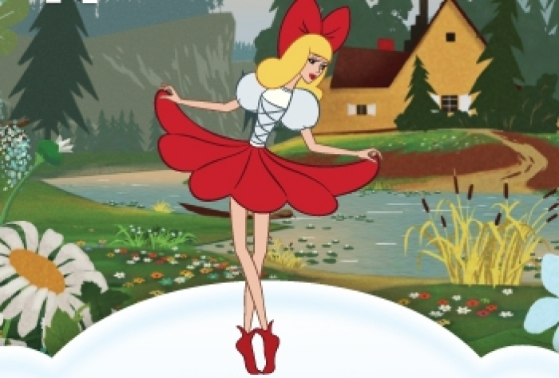
Who wanted to marry Thumbelina?
- a toad
- a mole
- a mouse
- the flower-fairy prince

Slide 12
Who wrote the fairy tale “Thumbelina”?
The Brothers Grimm
Charles Perrault
Rudyard Kipling
- Hans Christian Andersen

Slide 13
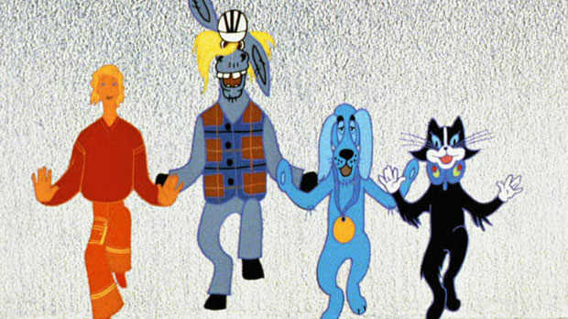
Continue the phrase: the Bremen Town ………..
- actors
- artists
- poets
- musicians

Slide 14
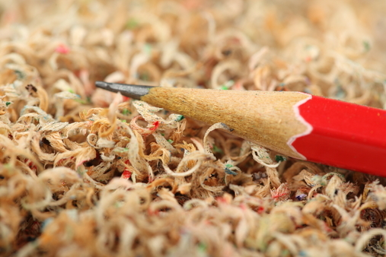
He said he had sawdust in his head. Who is he?
- Scarecrow
- Winnie-the- Pooh
- the Wizard of Oz
- Carlson

Slide 15
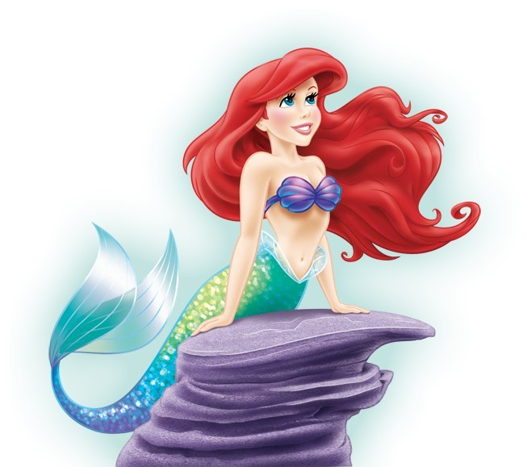
Who had a fish tail?
- Goldilocks
- Snow White
- the Little Mermaid
- Thumbelina

Slide 16
Who is the author of the stories about Mowgli?
- Hans Christian Andersen
- Lewis Carrol
- Mark Twain
- Rudyard Kipling

Slide 17

Who said that: “We are one blood, thou and I”?
Mowgli
Aladdin
Sinbad the Sailor
- the Dwarf’s Nose

Slide 18
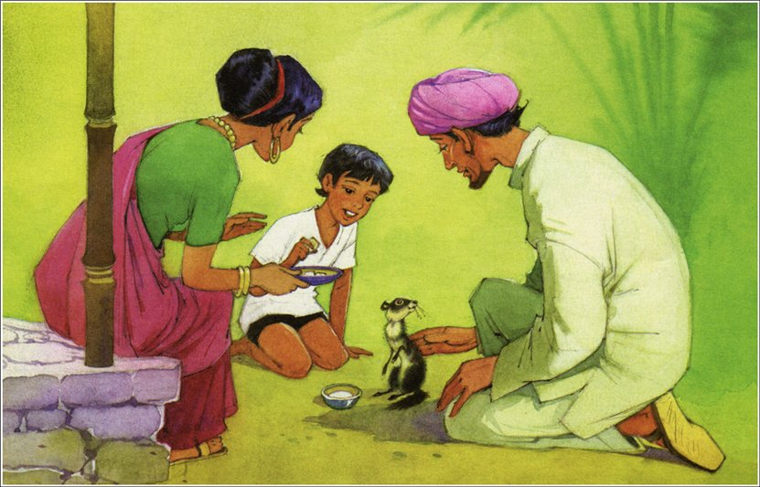
What kind of animal was Rikki-Tikki-Tawi?
- a hamster
- a rat
- a raccoon
- a mongoose

Slide 19
Which of the boys didn’t want to grow up?
- Christopher Robin
- Tom Sawyer
- Harry Potter
- Peter Pan

Slide 20
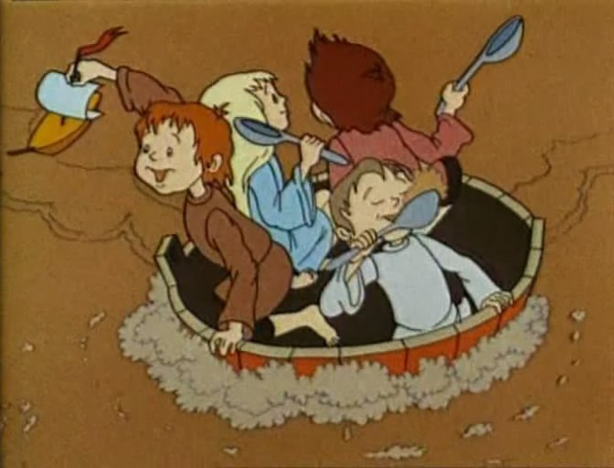
What food cooked the Magic Pot?
Soup
Porridge
Jam
- chocolate

Slide 21
Her name was Mary. She got a toy for Christmas. What is the name of this fairy tale?
Silver Skates
the Nutcracker and the Mouse King
- the Months-Brothers
- Paddington and the Christmas Shopping

