Slide 1


Slide 2


Slide 3
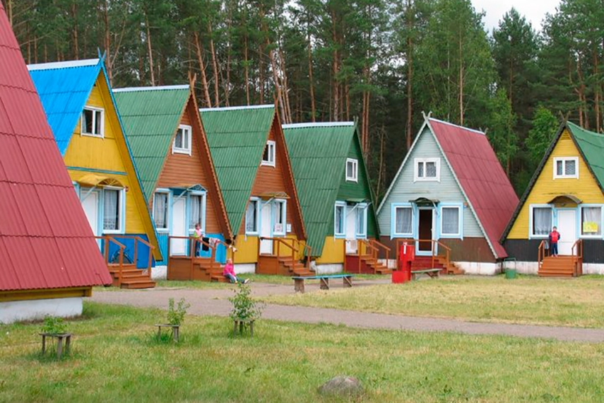

Slide 4

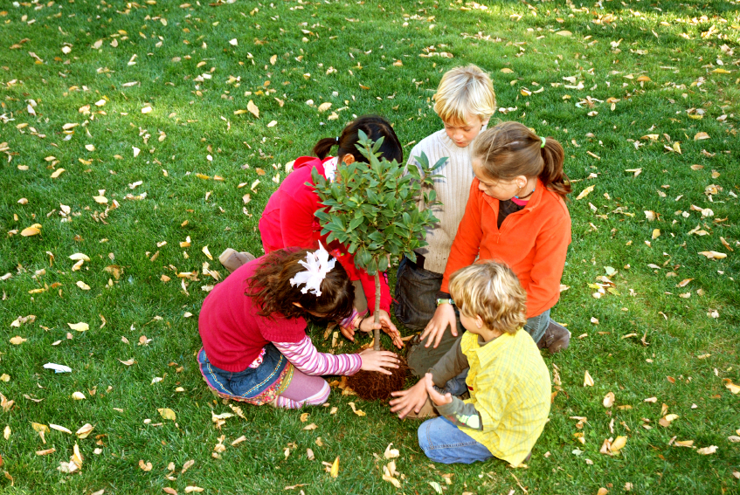

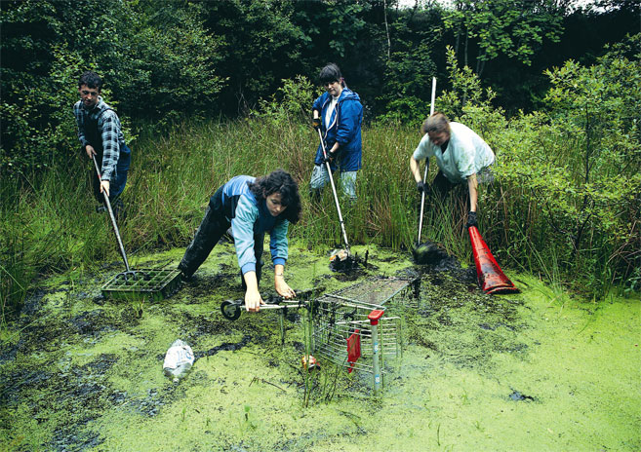
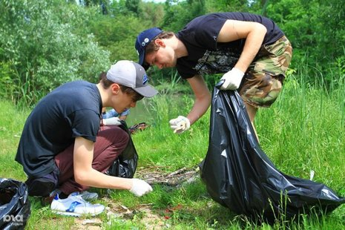

Slide 5
climatic
global
water /air/soil
melting of
destruction
cutting down
of animal habits
the trees
the polar ice
pollution
changes
warming

Slide 6

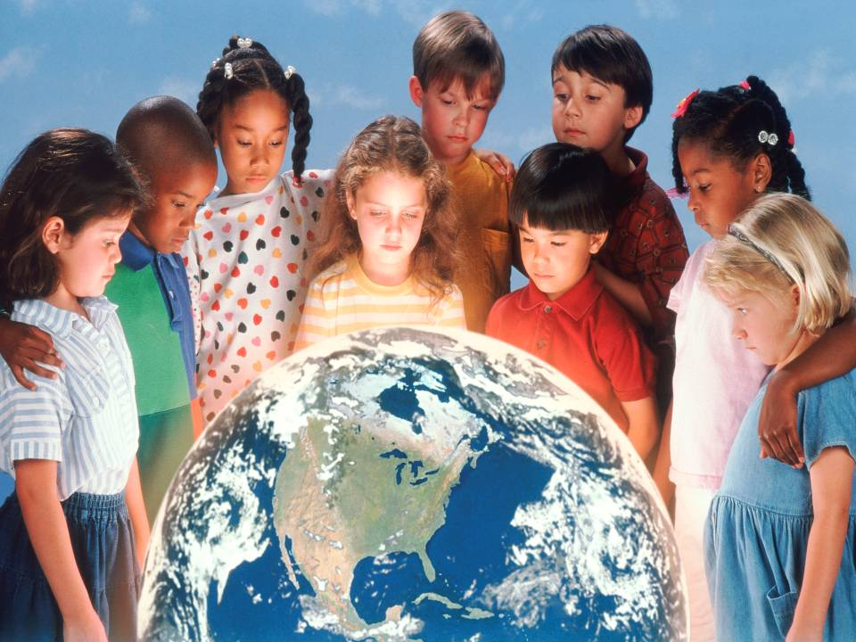

Slide 7

Paul Coleman
By walking the Planet,
I deliver a message…
Video

Slide 8
True or False
1. Paul Coleman is in Japan._
2. He is interviewing the Treeman._
3. The Treeman’s come from the forest just for fun_
4. People are more connected with nature after meeting with The Treeman._
5. Paul thinks that it’s nice to be friend with The Earth._
False
True
False
True
True

Slide 9


Slide 10
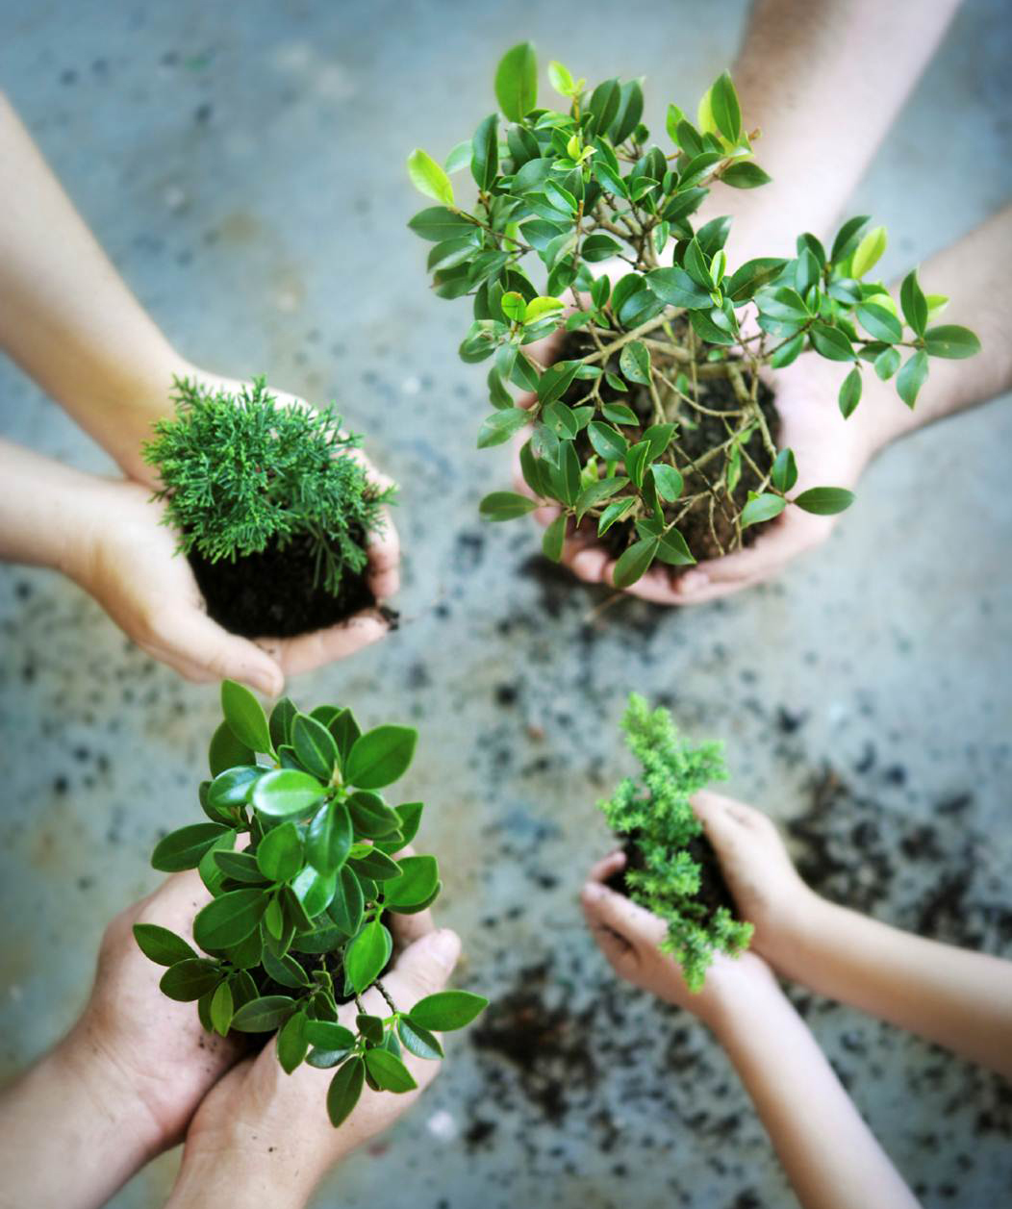

Slide 11
complete
do..
b…
h…
  Present Perfect Continuous

Slide 12

They are tired because….

Slide 13
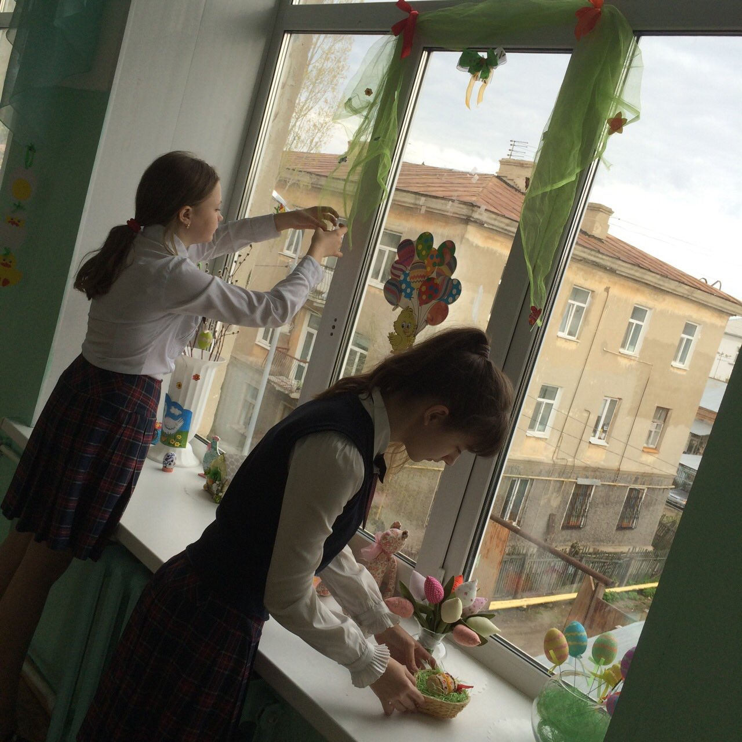
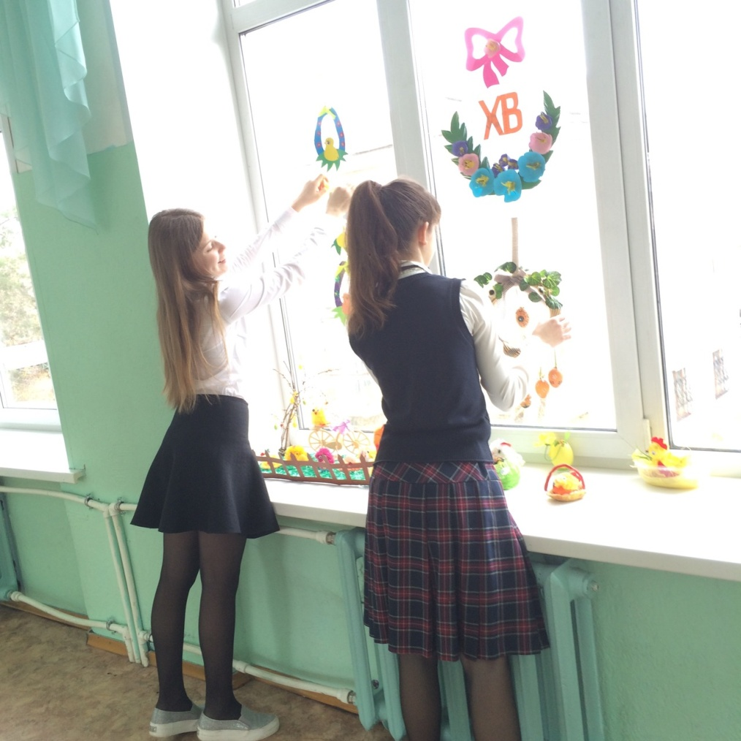
They are tired because….

Slide 14
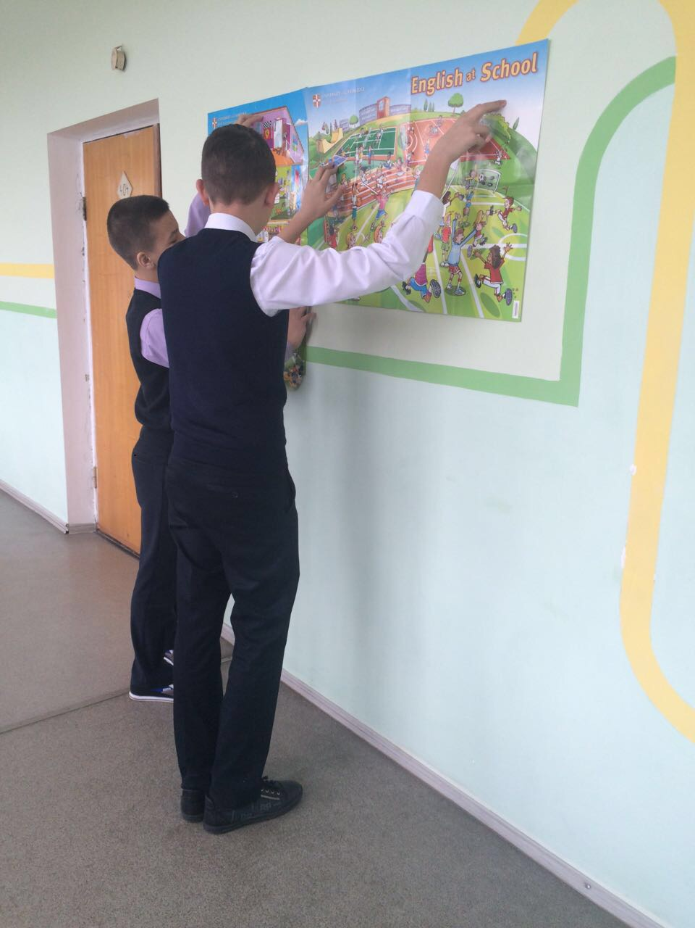
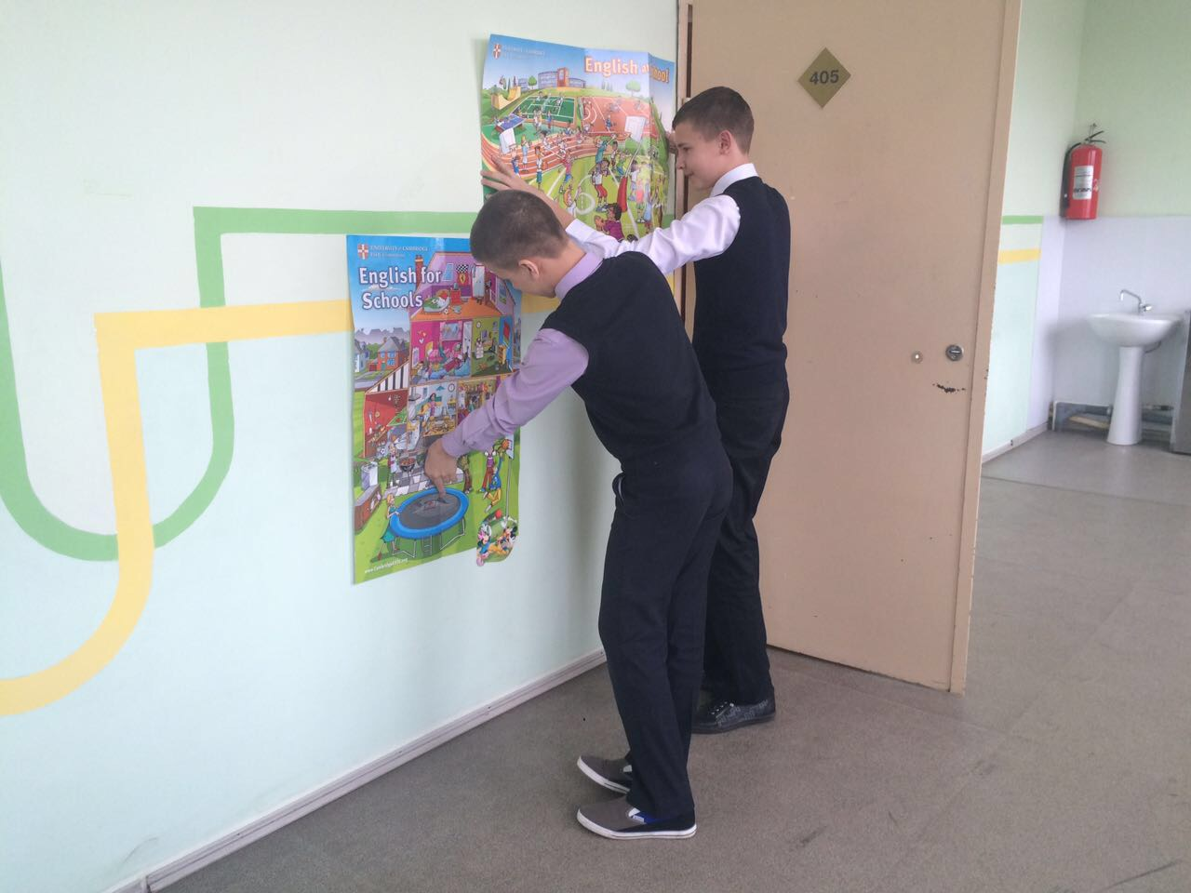
They are tired because….

Slide 15
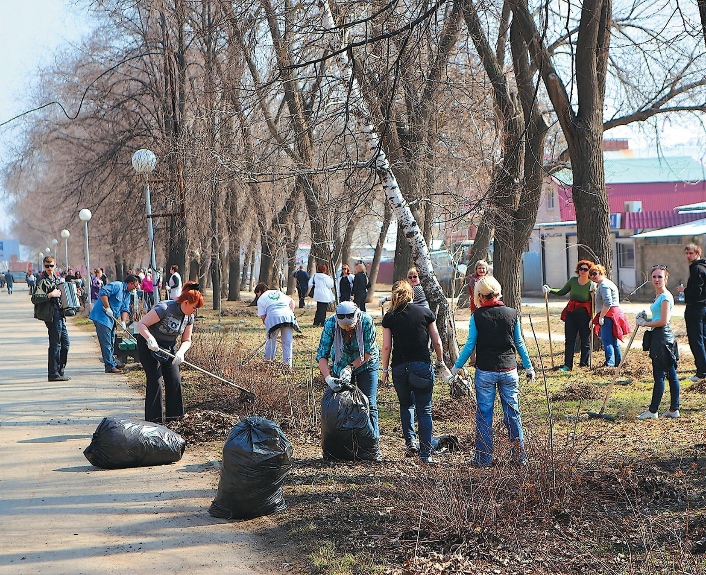
They are tired because….

Slide 16
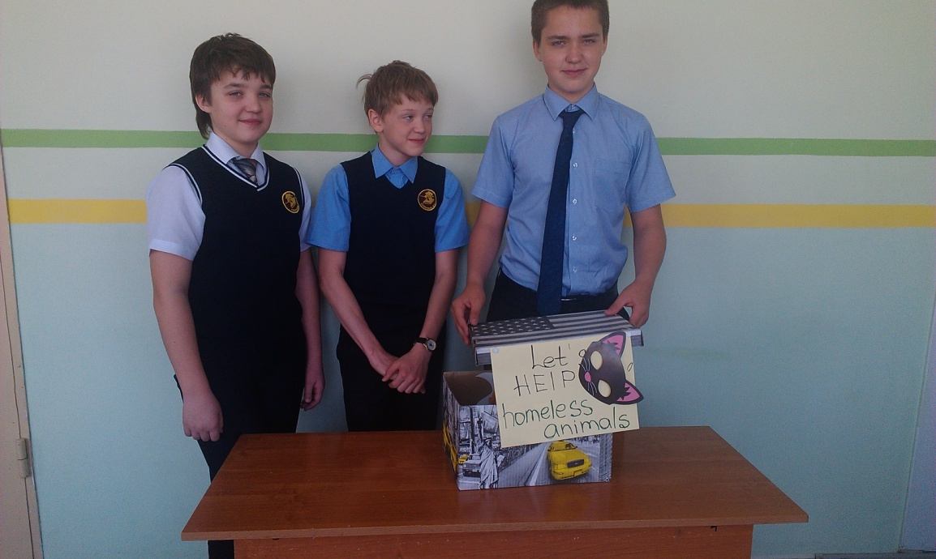
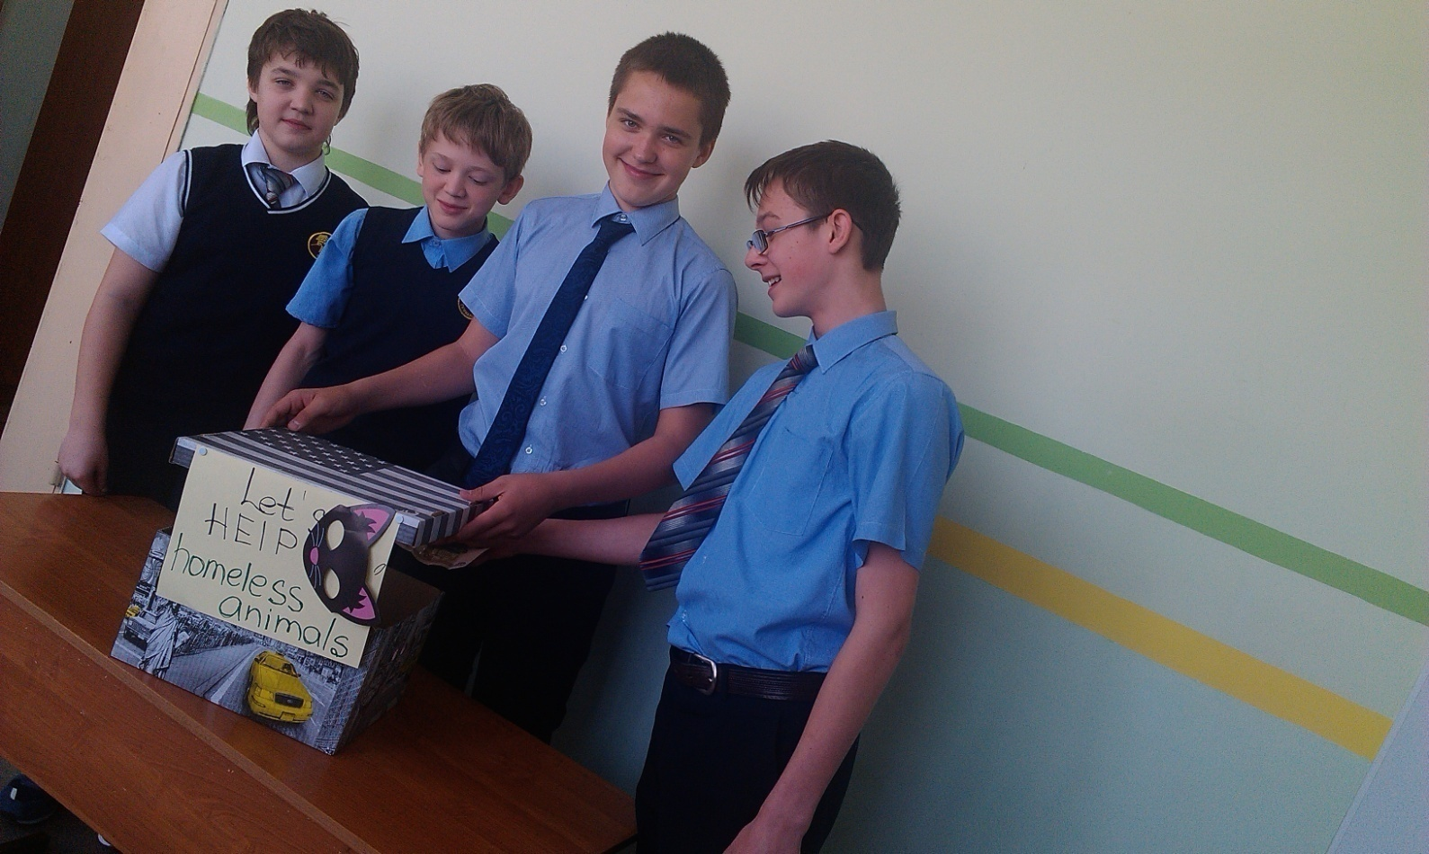
They are tired because….

Slide 17


Slide 18
Match
Plant
Go on a nature
Sit around a
Cook on a
Sleep in wooden
Collect rubbish for
['haɪkɪŋ]
['bɑ:bɪkju:]
['kæmpfaɪə]
[ri:'saɪklɪŋ]
[hʌts]
[tri:z]

Slide 19
Complete
Plant trees
Go on a nature hike
Sit around a campfire
Cook on a barbecue
Sleep in wooden huts
Collect rubbish for recycling

Slide 20

exciting, great, splendid, difficult, boring, dynamic, marvelous, useless, unusual,
intelligent
My students
1
were
2 adjectives
2
read, wrote, spoke, listened, talked, sang, danced, learnt, found out, recalled, trained
because they
3 verbs
3
For me they are …
The definition to the 1-st word
Friends
Helpers
4

Slide 21
exciting, great, splendid, difficult, boring, dynamic, marvelous, useless, unusual
The lesson
1
was
2 adjectives
2
read, wrote, spoke, listened, talked, sang, danced, learnt, found out, recalled, trained
because we
3 verbs
3
For me this lesson is …
The definition to the 1-st word
joy, sadness, boredom, knowledge, opportunity
4

Slide 22
At home
Describe your days in the eco-camp.
What other friendly environment solutions can you suggest?

Slide 23
Thank you!

Slide 24
список электронных ресурсов
http://bicyclegasoline.deviantart.com/art/Letterpress-Earth-without-art-is-just-Eh-313332452
https://myspace.com/earthwalker_paul_coleman/mixes
http://mitalexfoto.ru/
http://cs630922.vk.me/v630922217/1e364/R7LhnX3ed9U.jpg
https://www.youtube.com/watch?v=BPwL_H6okqI

