Slide 1

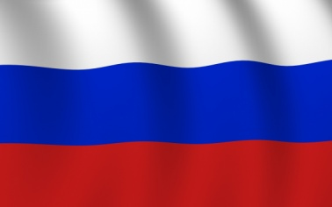
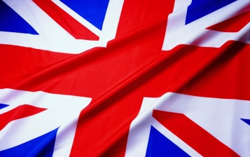
Интегрированный урок по английскому языку и обществознанию «Политическое устройство России, США и Великобритании»
Урок-соревнование
Подготовили Нуждина Марина викторовна, учитель английского языка и соловьева Наиля зуфаровна, учитель истории и обществознания
Школа-интернат № 19 оао «РЖд»

Slide 2
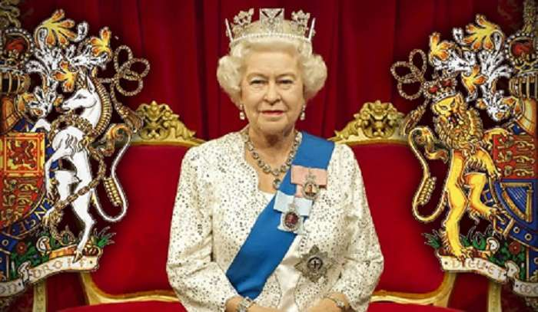
Political system of the UK

Slide 3
The Monarch ( Queen Elizabeth, II)
Name the parts of political system of the UK
The Government
The Prime Minister
Non-Cabinet Minister
The Cabinet
Parliament
The House of Commons
The House of Lords
The Official Opposition
The People

Slide 4
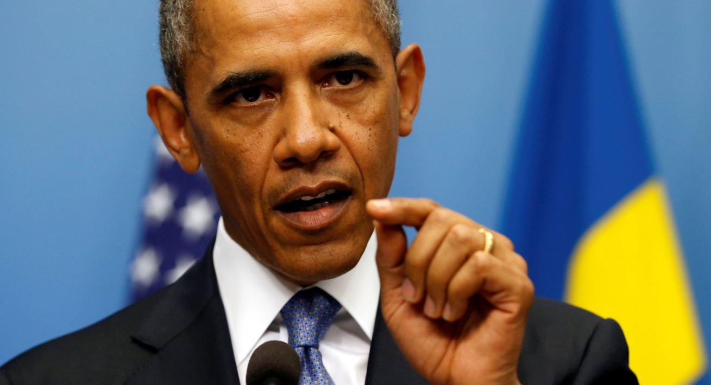
Political system of the USA

Slide 5
Fill the table.
The USA
The President
The Administration
The Cabinet
He is head of state and elected by people, rule the country, appoint secretaries, sign bills.
Secretaries as head of the most important departments in the Administration, control government departments.
The House of Representatives
The Senate
Congress
435 members, elected by people, vote against the project, revise, examine bills.
100 members, make laws, revise bills, approve secretaries, elected by people
The People
All man and woman over 18 elect The Congress, The Administration and The President

Slide 6
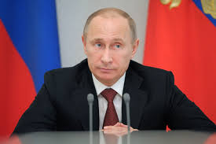
Political system of the Russian Federation

Slide 7
Fill the table
the Duma
the Federal Assembly
The Federal Council
The Russian Federation
The President
The Federal Government
The Chairman of the Government
The Ministers
The People

Slide 8
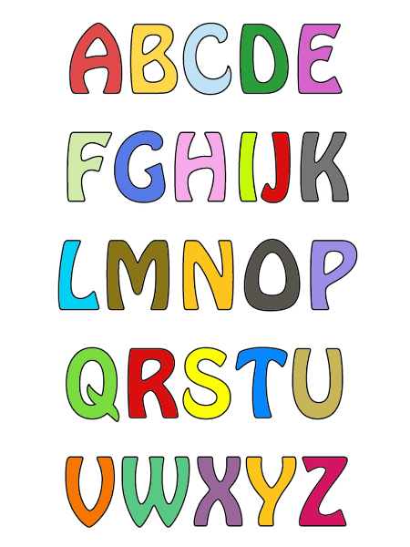
Game
«ALPHABET CODE»

Slide 9

16,1,18,20,25.
PARTY

Slide 10

4,9,19,3,21,19,19.
DISCUSS

Slide 11
15,16,16,15,19,9,20,9,15,14.
OPPOSITION

Slide 12
3,1,2,9,14,5,20.
CABINET

Slide 13
7,15,22,5,18,14,13,5,14,20.
GOVERNMENT

Slide 14
16,1,18,12,9,1,13,5,14,20.
PARLIAMENT

Slide 15
4,5,16,1,18,20,13,5,14,20
DEPARTMENT

Slide 16
16,15,12,9,3,25
POLICY

Slide 17
4,5,12,1,25.
DELAY

Slide 18
5,12,5,3,20
ELECT

Slide 19
3,15,14,7,18,5,19,19
CONGRESS

Slide 20
16,18,5,19,9,4,5,14,20
PRESIDENT

Slide 21
GAME «FIND A COUPLE»

Slide 22
1. Законодательный а) the policy
2. Большинство b) to oppose
3. Представитель c) legislative
4. Пересматривать d) to pass
5. Правительство e) majority
6. Политики f) policies
7. Выступать против g) the government
8. Принимать h) to rule
9. Политика i) a representative
10. Управлять j) to revise

Slide 23
Game
«Correct or not correct?»

Slide 24

make - signs
The Queen makes the bills.

Slide 25

-
The Queen has mostly representative functions.

Slide 26
Legislative - executive
The government represents the legislative branch of power.

Slide 27
Prime Minister - Cabinet
The Prime Minister is responsible for government policies.

Slide 28
-
Parliament represents the legislative branch of power.

Slide 29
Lords - Commons
The House of Lords controls the government.

Slide 30
Sign - delay
The House of Lords has the power to sign bills for one year.

Slide 31
Shadow Cabinet - Cabinet
The Shadow Cabinet coordinates the work of the government departments.

Slide 32

«Guess who»

Slide 33

The House of Commons
makes laws, discusses political problems.

Slide 34

The House of Lords
can delay bills for one year

Slide 35
The Cabinet
determines government policies and coordinates government departments.

Slide 36
The Monarch
is the official head of state and an integral part of Parliament in her constitutional role.

Slide 37


Slide 38
The Russian Government has… branches.
a) three b) four c) five

Slide 39
The Congress meets in …in Washington D. C.
a) the White House b) the Pentagon c) the US Capitol

Slide 40
The official head of the state in Russia is …
a) the President b)the Prime Minister c) Parliament

Slide 41
The Queen … the bills.
a) signs b)votes on c) passes

Slide 42
The Government of Russia represents the… branch of power.
a) legislative b) representative c) executive

Slide 43
…. guarantees the basic rights of the people in Russia.
a) the President b) the Duma c) the Federal Assembly

Slide 44
… elect the members of the Federal Assembly.
a)the Government
b) the people c)the President

Slide 45
The Chairman in Russia is …
a )elected b) invited
c) appointed

Slide 46
The Russian Presidents term is …
a) 2 years b) 4 years c) 6 years

Slide 47
… makes laws in the UK.
a) The House of Commons b) the House of Lords c) the Cabinet

Slide 48
The Duma consists of … deputies.
a) 540 b) 450 c)400

Slide 49
The members of the Federal Council are …
a)elected b) non- elected c) appointed

Slide 50
The British Prime Minister is the leader of the party with the majority seats in …
a) The House of Lords
b) the House of Commons.

Slide 51
Wordsearch

Slide 52
Find these words in the table
F | E | P | D | O | D | O | B | J | G | K | G | H | S | S | D | B | B
I | C | G | R | E | H | O | E | N | I | M | R | E | T | E | D | B | H
P | I | R | O | E | L | B | H | C | J | C | O | N | G | R | E | S | S
L | V | L | E | R | S | A | B | I | V | J | C | S | W | Q | O | G | L
O | E | T | O | W | G | I | Y | J | L | S | S | A | P | F | F | A | E
D | R | E | H | O | O | E | D | H | H | M | N | H | T | Y | U | G | S
E | Y | M | U | D | H | P | N | E | N | E | E | V | A | I | T | M | I
L | T | R | G | U | G | P | A | D | N | P | H | L | L | G | G | I | V
U | R | E | L | L | O | G | I | N | I | T | E | L | P | J | H | I | E
R | E | V | G | K | O | J | G | U | D | D | F | E | E | U | D | O | R
E | W | O | G | R | E | S | P | O | N | S | I | B | L | E | J | P | U
Q | Q | G | S | C | R | U | D | E | F | H | N | O | P | M | S | W | W
Президент
Власть
Государство
Управлять
Определять
Конгресс
Принимать
Откладывать
Ответственный
Пересматривать

Slide 53
Translator

Slide 54
Translate into English:
1. Королева дает королевскую санкцию законопроектам, принятым парламентом.
2. Премьер – министр назначается королевой и назначает кабинет.
3. Члены палаты общин избираются народом.
4. Законодательная власть принадлежит парламенту, состоящему из двух палат.
5. В США законодательная власть осуществляется конгрессом, состоящим из сената и палаты представителей.
6. Высший исполнительный орган состоит из президента, вице-президентаи кабинета.

Slide 55
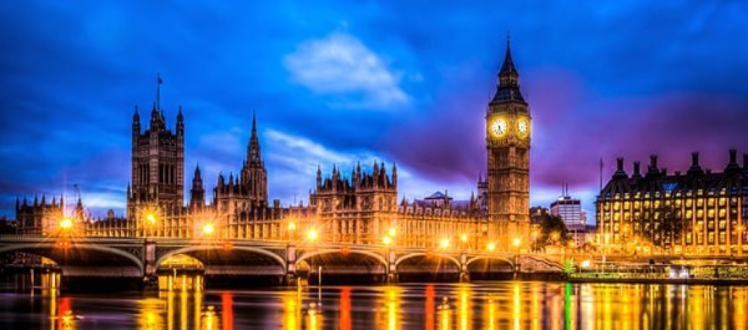
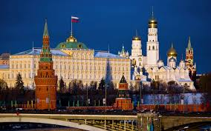
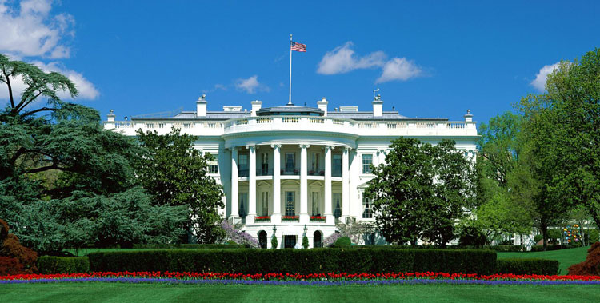
The end.

