Slide 1
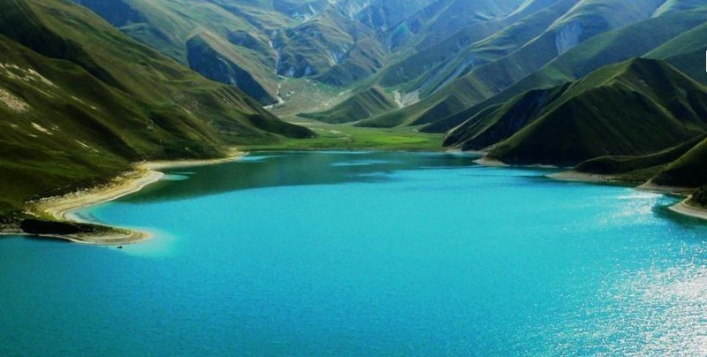
Save our planet!
Presentation is made by
Tatiana Berezhnaya,
teacher of English, Rybachie school,
Alushta, Crimea

Slide 2

New vocabulary
1. To donate (to) – жетвовать, дарить
2. To heal (of) – исцелять от...
3. To get rid of – избавляться от...
4. To save - экономить, спасать
5. To ban - запрещать
6. To fine for- штрафовать
7. Violence - жестокость

Slide 3
8. Mercy – милосердие
9. Compassion - жалость, сострадание, сочувствие
10. Greed - жадность
11. Soul – душа
12. Generosity – щедрость
13. To destruct, to destroy – разрушать
14. Charity - благотворительность

Slide 4
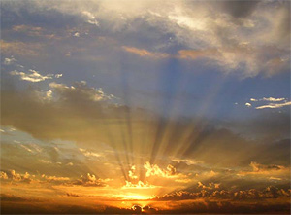

“Be the change you wish to see in the world”
Mahatma Gandhi

Slide 5
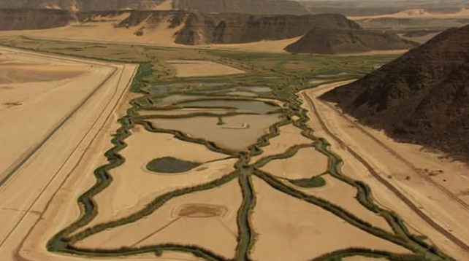
Global issues
Natural disasters
Еcological problems
Social problems

Slide 6
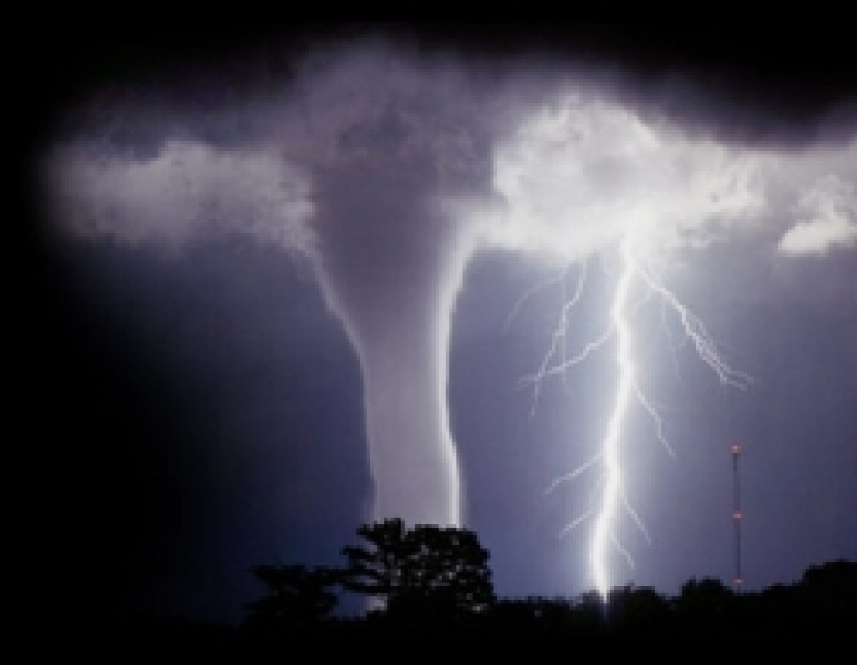
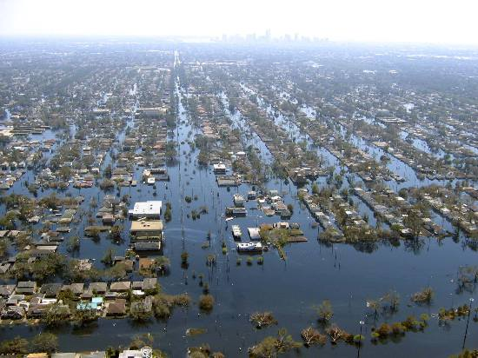
Natural disasters

Slide 7
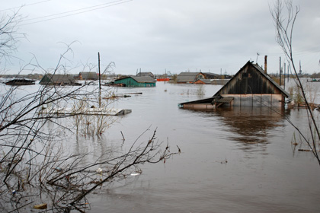
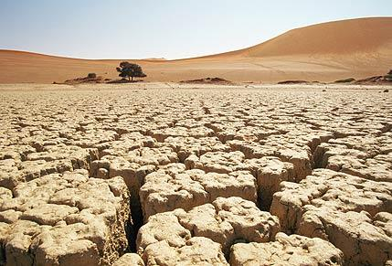
Flood Drought

Slide 8
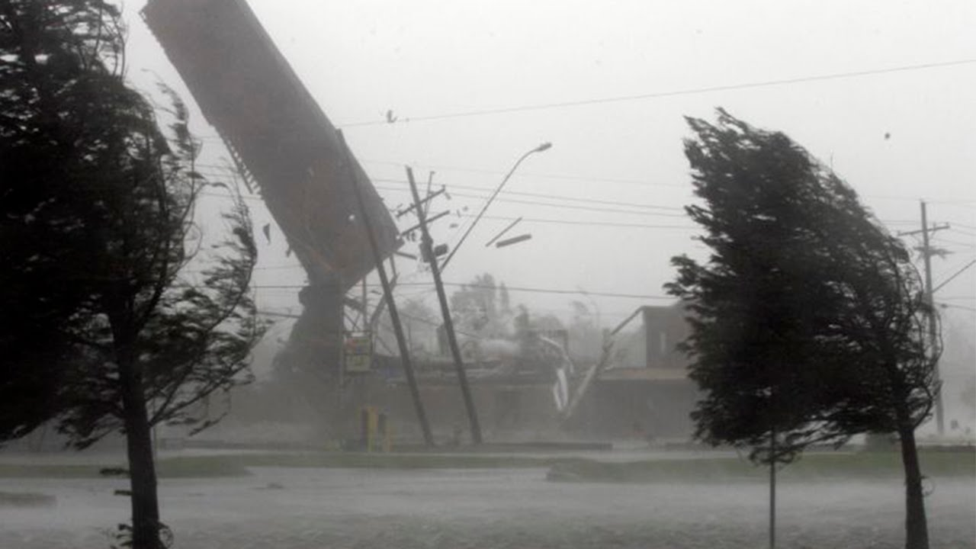
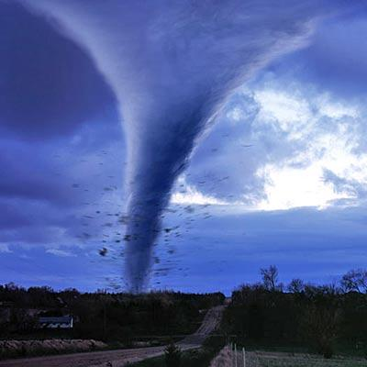
Hurricane Tornado

Slide 9
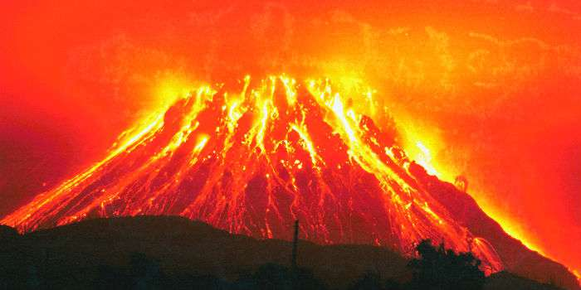
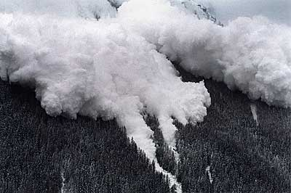
Volcano Avalanche

Slide 10
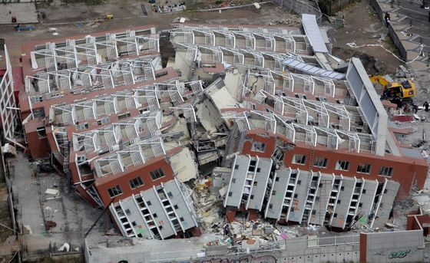
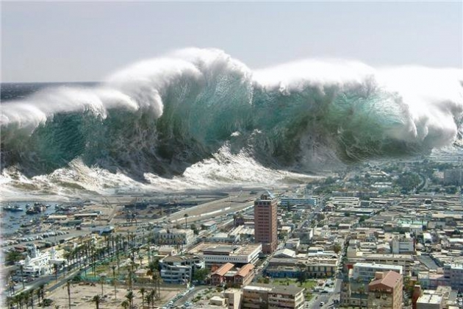
Earthquake Tsunami

Slide 11
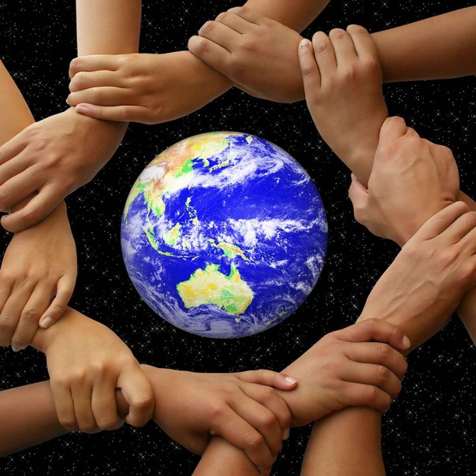
Ecological problems

Slide 12
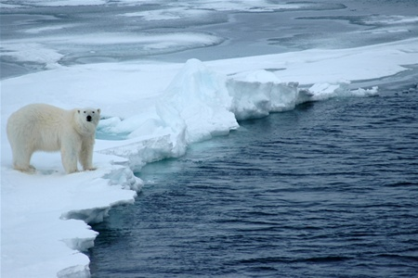
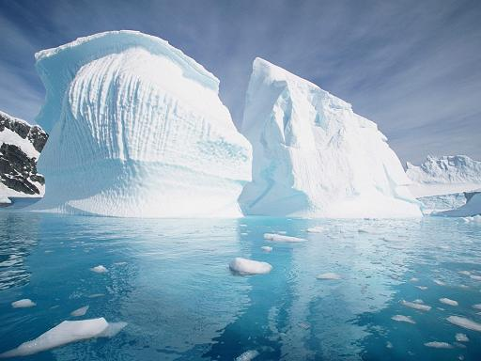
Global warming

Slide 13
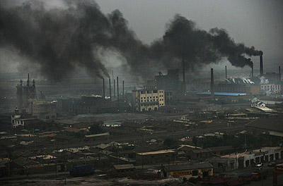
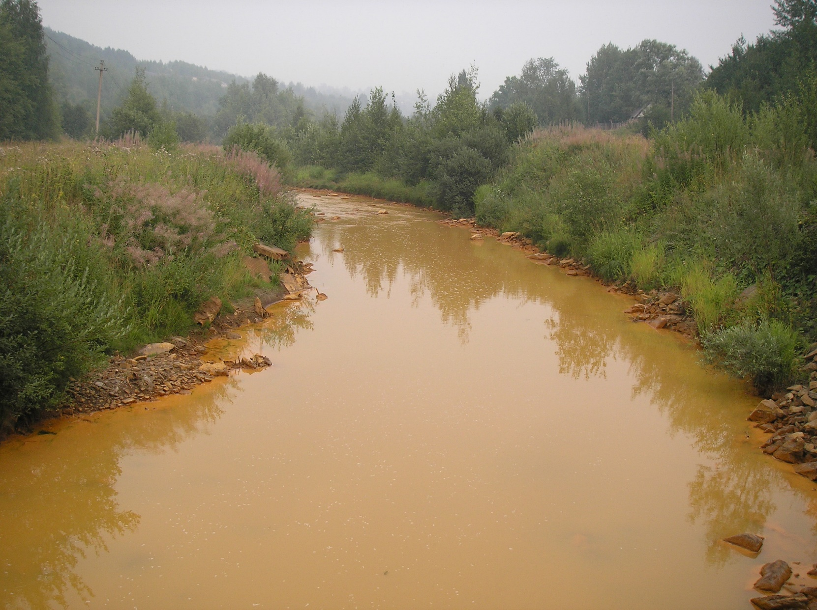
Pollution

Slide 14
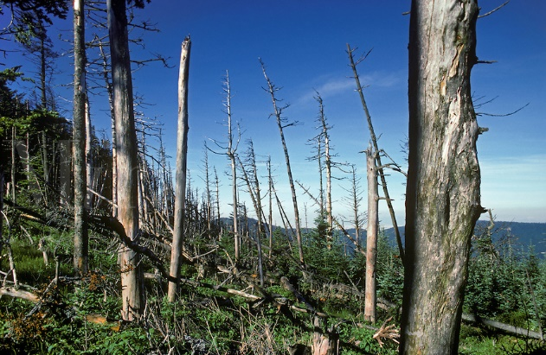
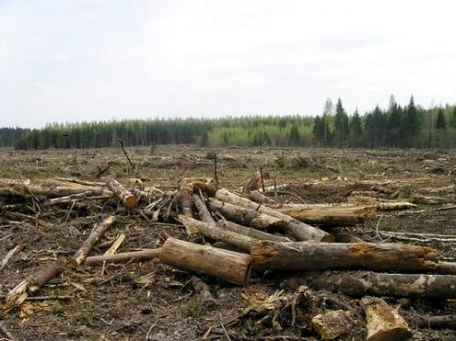
Acid rains Deforestation

Slide 15
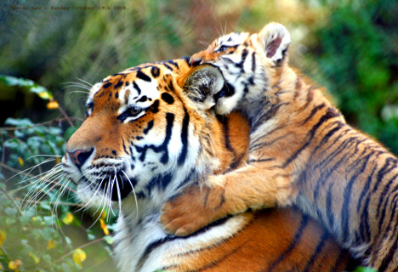
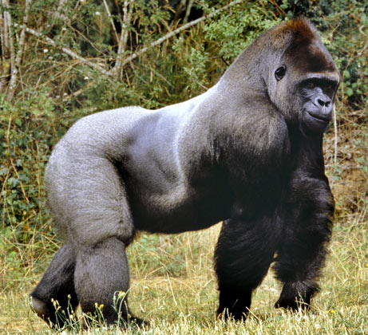
Endangered species

Slide 16
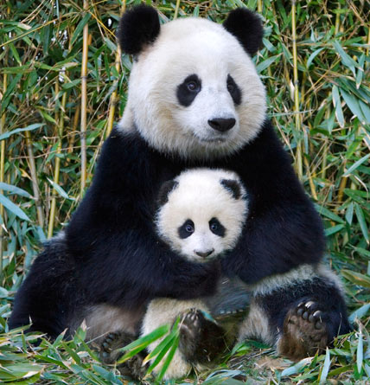
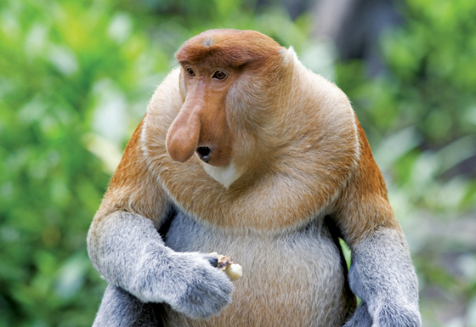

Slide 17
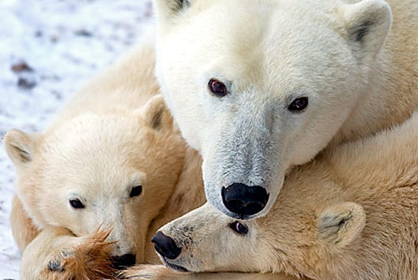
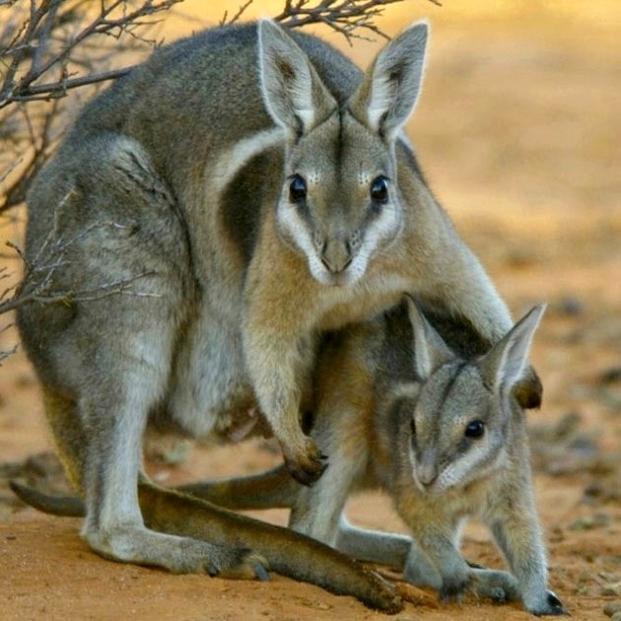
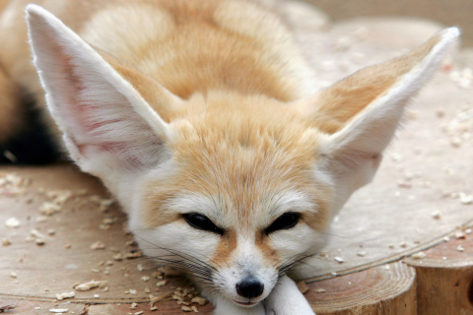
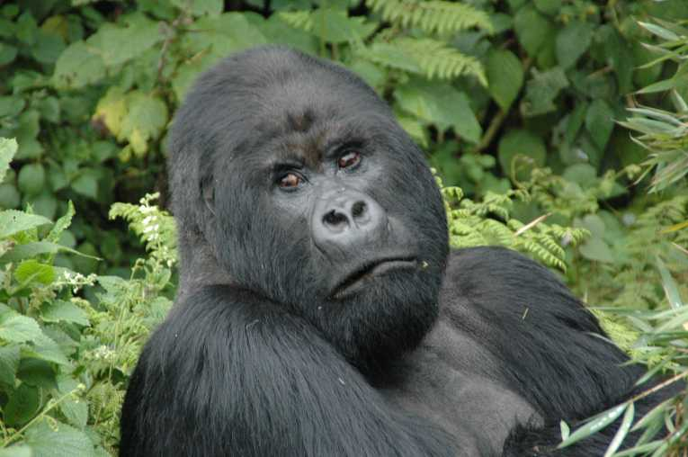
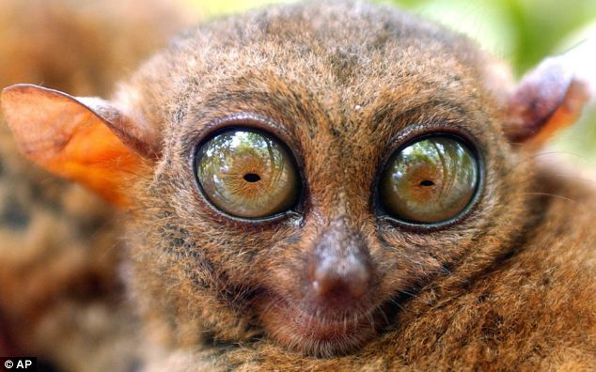
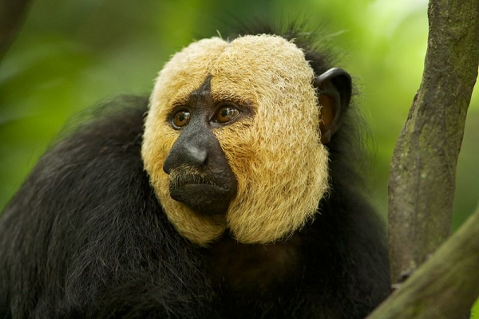
Is it too late for us?...

Slide 18
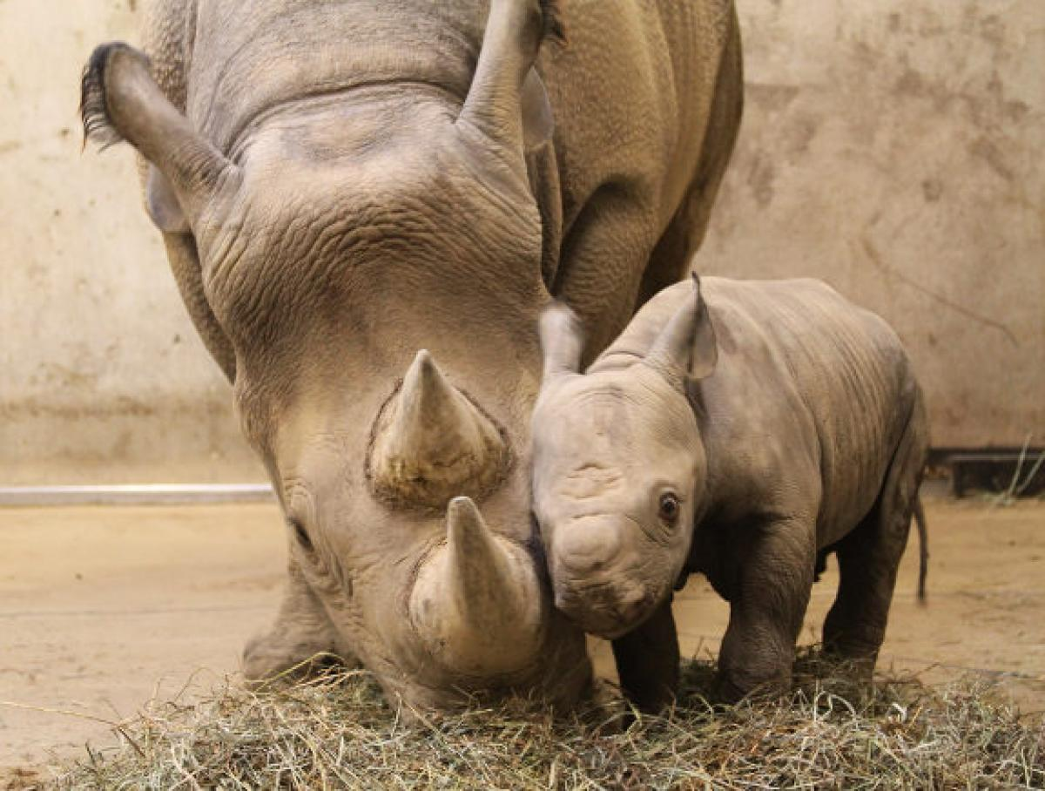
They need our help to survive! our protection… our mercy… our compassion… Stop killing animals until it is too late!!!

Slide 19
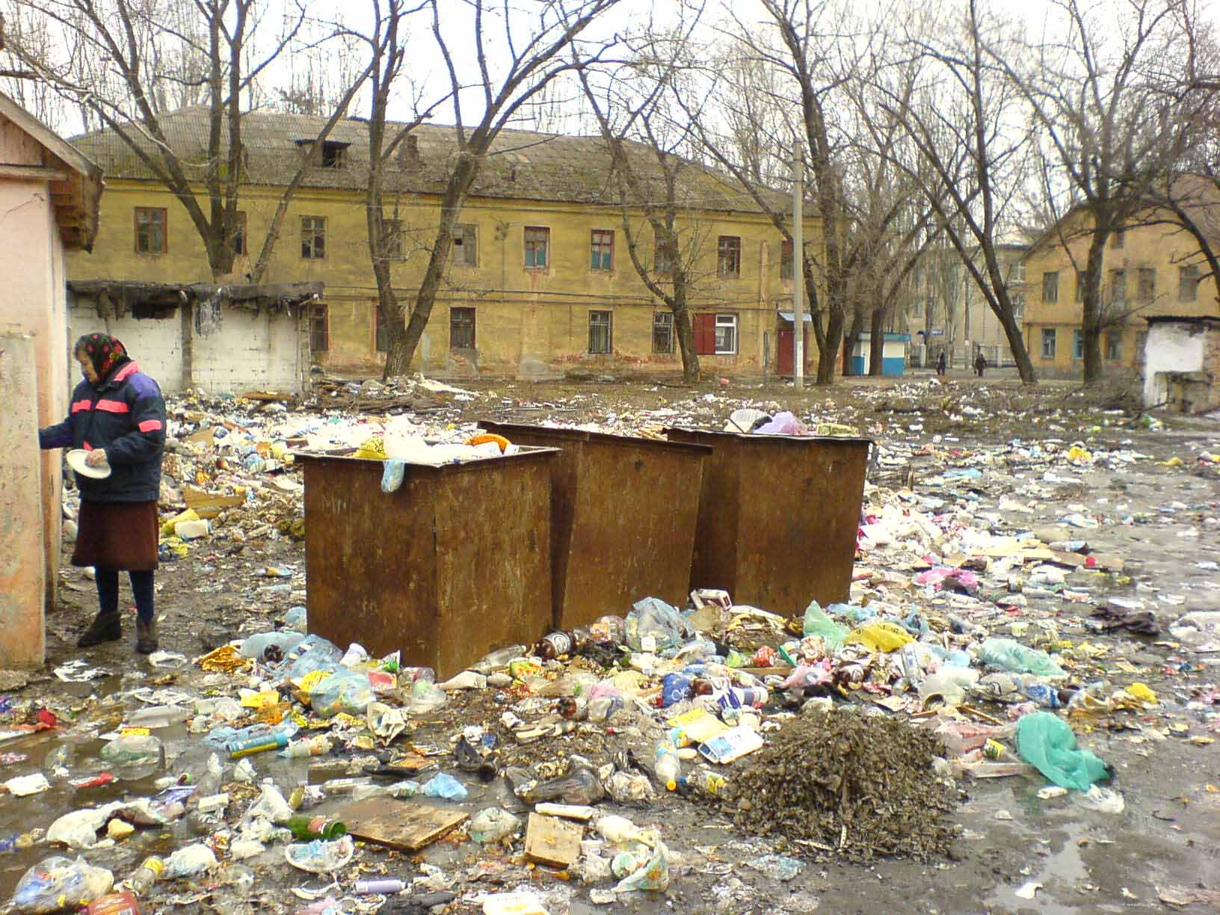
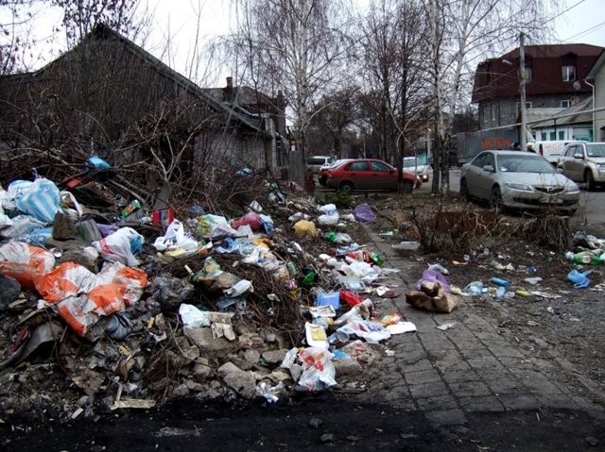
Littering

Slide 20
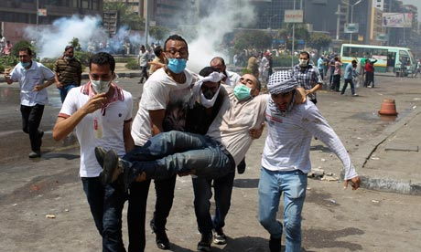
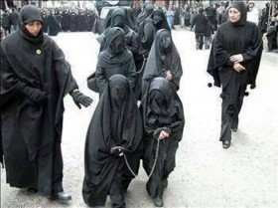
Social problems

Slide 21
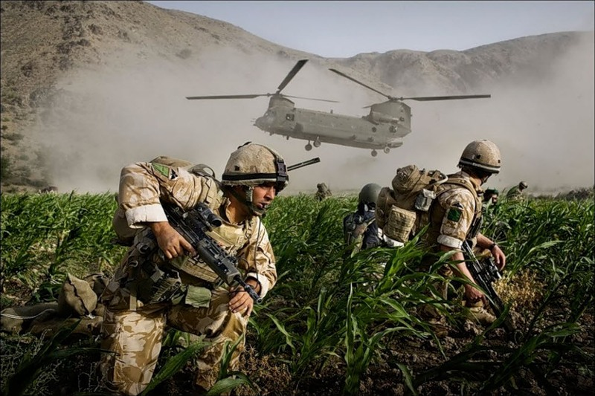
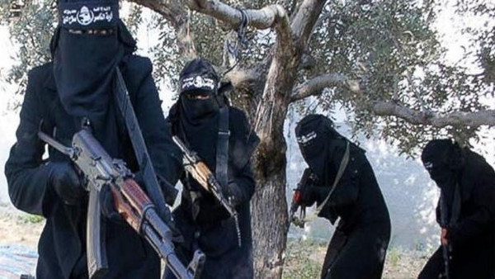
Wars Terrorism

Slide 22
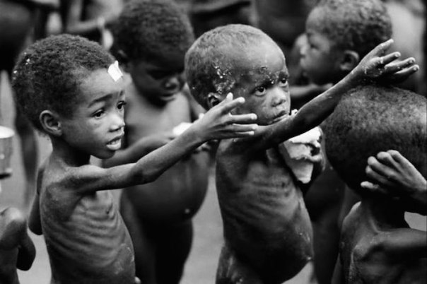
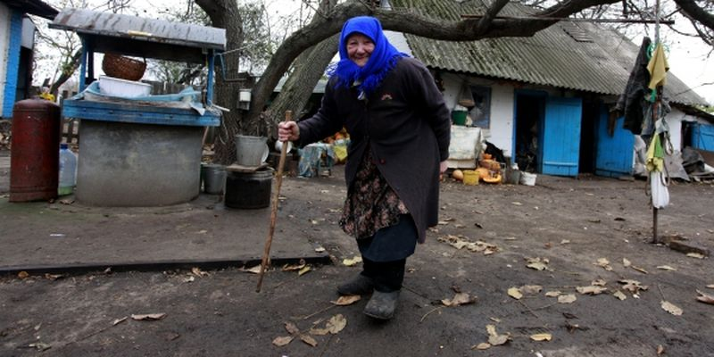
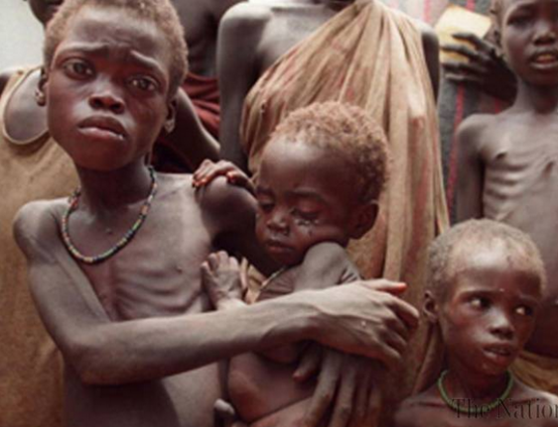
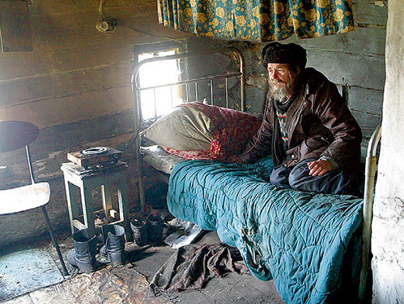
Poverty Famine

Slide 23
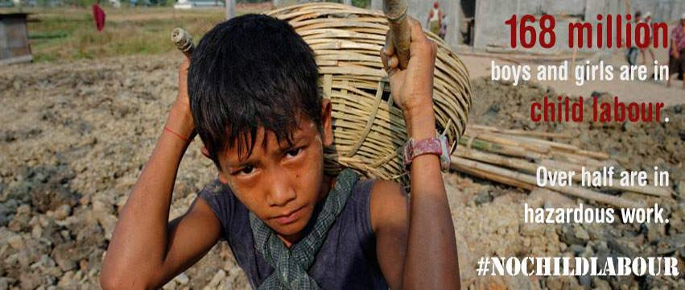
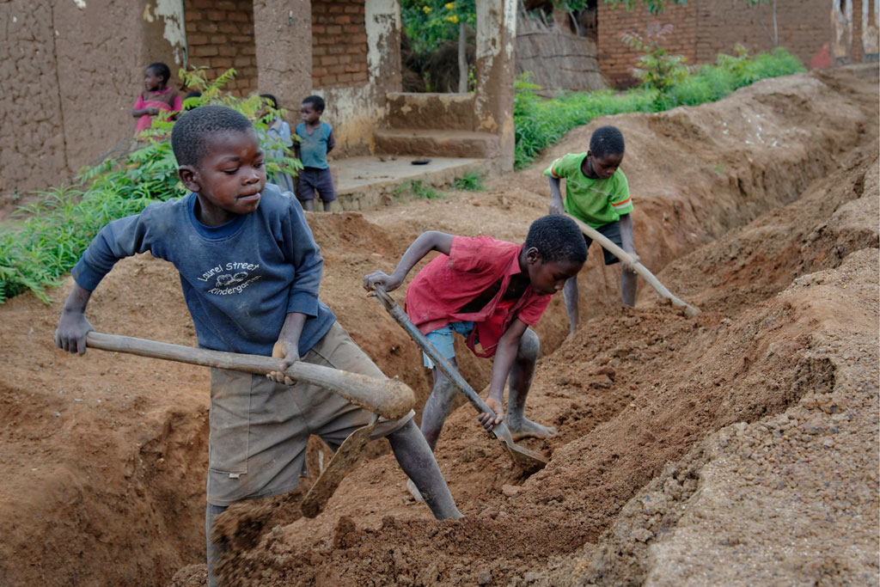
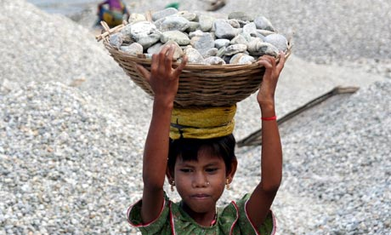
Child labour

Slide 24
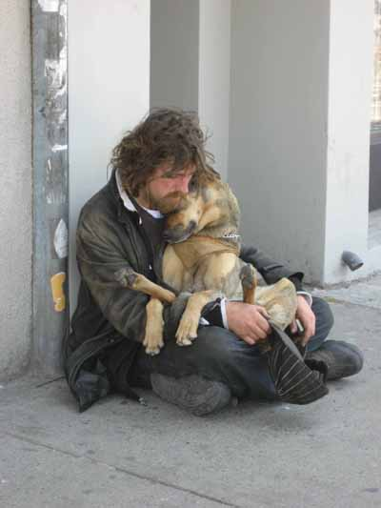
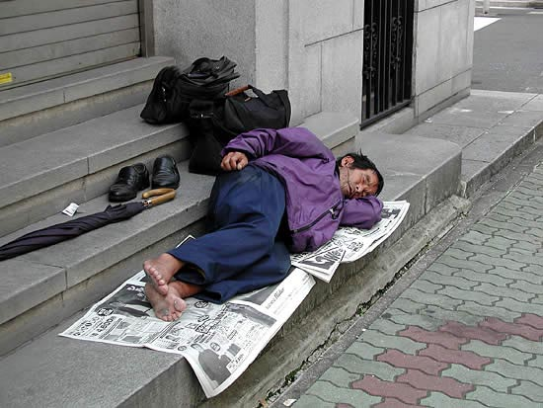
Homelessness

Slide 25
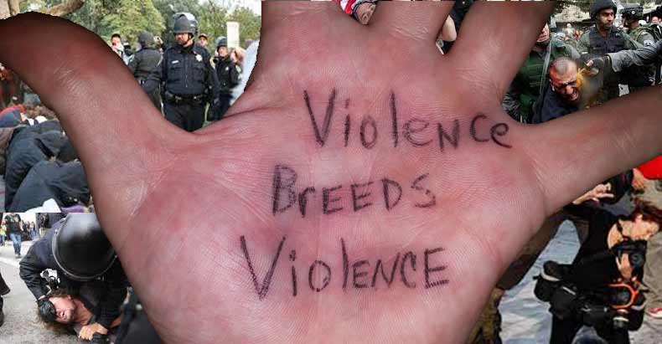
Stop violence! Stop greed!

Slide 26


We are on a mission to save this planet! Let’s go for green!!!

Slide 27
What does it mean to be green?
1)to recycle paper, metal, glass, plastic, wastes 2)to reduce pollution, traffic, packaging, lettering 3)to reuse bottles, cans, lids, clothes, plastic bags 4)to save water, energy, gas, oil, electricity 5)to ban and fine for hunting, cutting down trees, littering, pollution 6)to donate to animals in danger, people in poverty

Slide 28
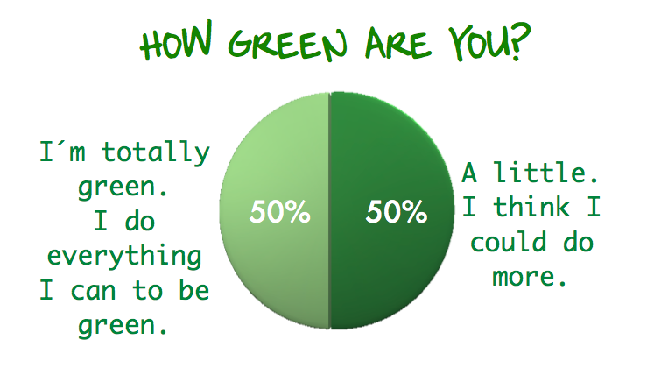

Slide 29
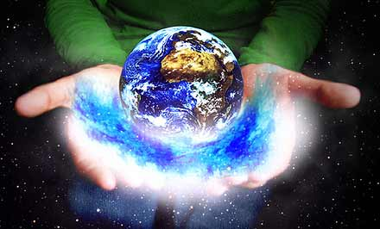
The future of our planet is in our hands!

Slide 30
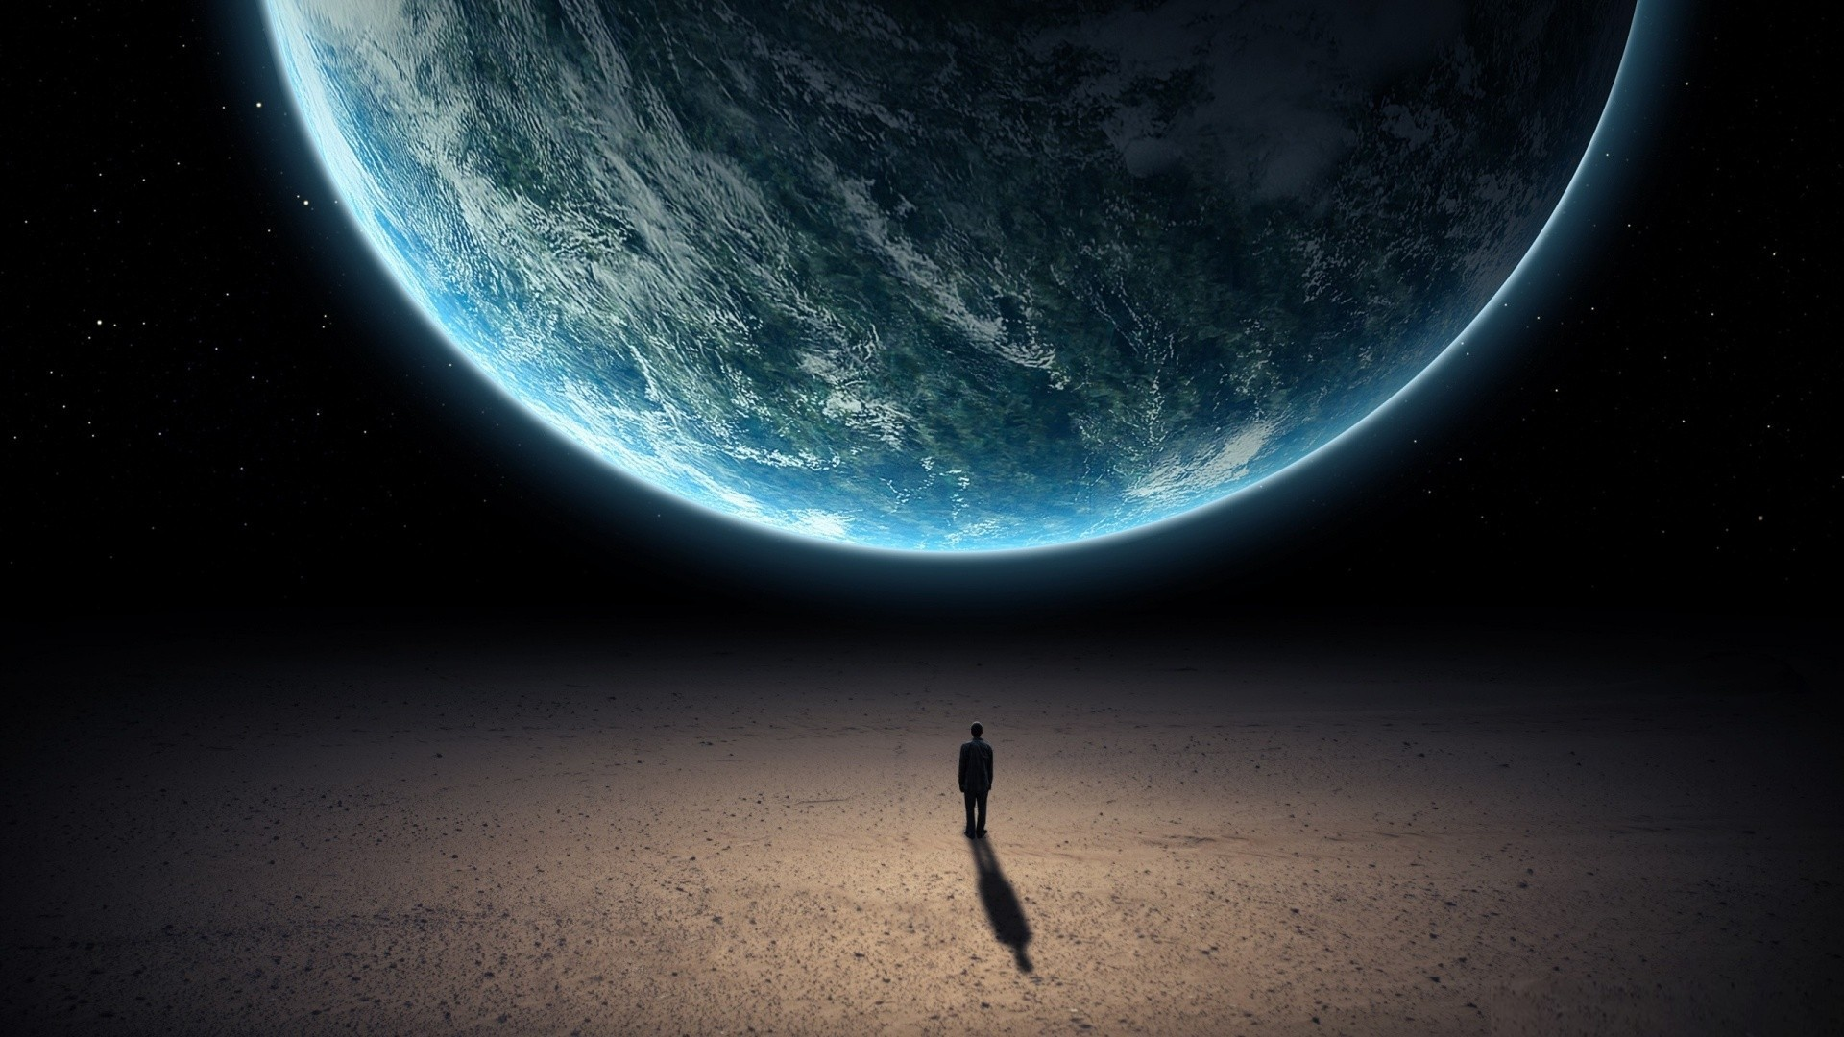
the end

