Slide 1
Урок английского языка в 6-м классе с применением технологии РКЧМП
учитель: Бокова Ольга Сергеевна
МБОУ «СОШ № 4 г. Шатуры»
2015 год

Slide 3
[t] – worked, helped, cooked, asked, knocked
[d] – learned, opened, answered, turned, cleaned
[id] – wanted, visited, shouted, decided, interested

Slide 4
be - was, were
have – had
meet – met
teach – taught
buy – bought
read – read [red]
get – got
hear – heard
see – saw

Slide 5
give – gave
say – said
make – made
keep – kept
leave – left
find – found
come – came
go – went
drink – drank

Slide 7



Slide 9
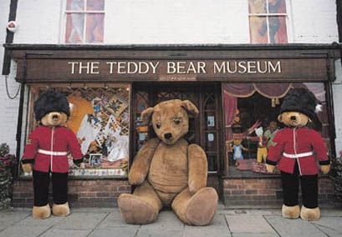

Slide 10
+ | - | ?
I knew that … | I didn’t know that … | I would like to know about …

Slide 12
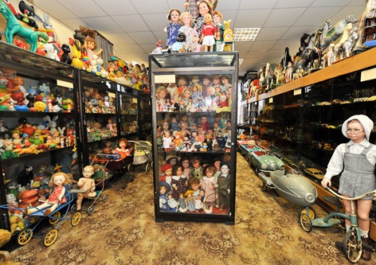

Slide 13
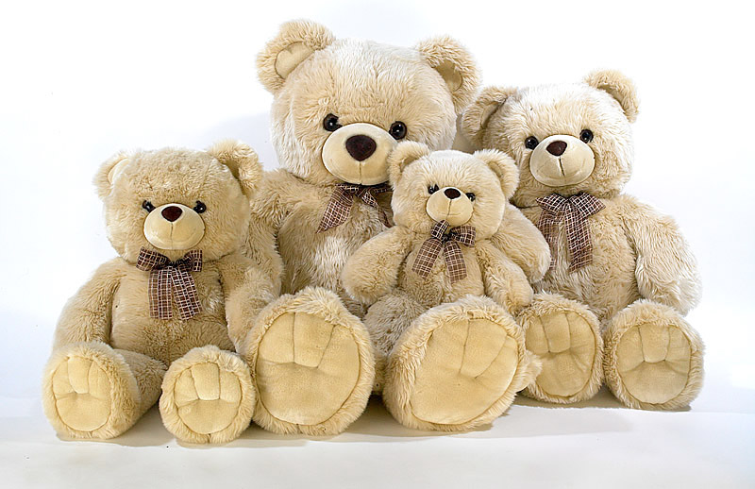

Slide 15


Slide 16
Cinquain poetry
1word (a subject or a noun)
2 words (adjectives) that describe word 1
3 words (action verbs) that relate to word 1
4 words (feelings or a complete sentence) that relates to word 1
1 word (a synonym of line 1 or a word that sums it up)

Slide 17
Toys
Fantastic, magic,
Make happy, teach, relax
With them our dreams come true
Games

Slide 18
Thank you!
Good – bye!

