Slide 1

True friends
Шайгарданова Л.З., учитель английского языка МАОУ «СОШ№56» г. Набережные Челны

Slide 2

Team Cheer
One for all and all for one!

Slide 3
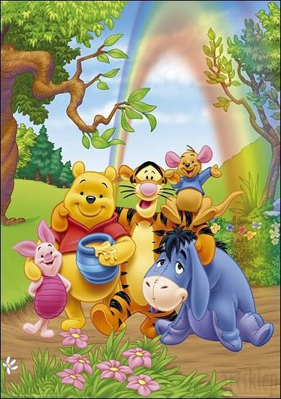
“True friends”
True friends are persons, who share,
True friends are persons, who care.
They try to understand
And give a helping hand.

Slide 4


Pleasant journey!

Slide 5

“Questions”

Slide 6

Rally Robin

Slide 7

1) What is friendship?
2) What proverbs about friends and friendship do you know?
3) What examples of literature and cartoon characters that may be called true friends can you name?

Slide 8
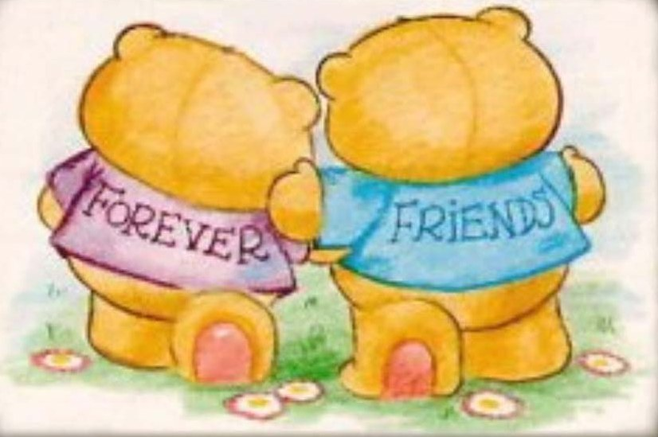
Friendship is a thing that lasts forever.

Slide 9
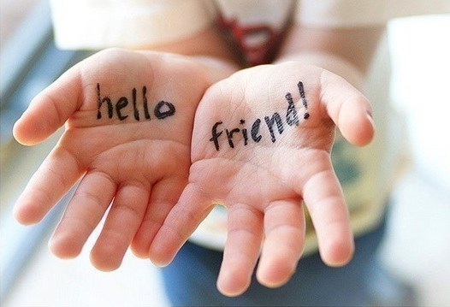
A faithful friend is the medicine of life.

Slide 10




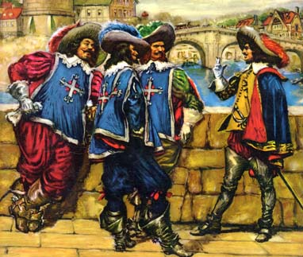

True friends

Slide 11

“Different opinions”

Slide 12

Think Write Round Robin

Slide 13
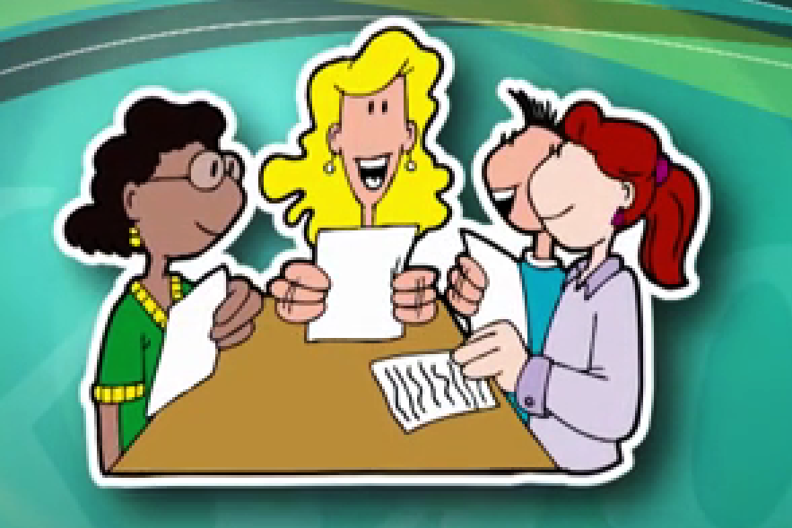
Single Round Robin

Slide 14
trust secrets with somebody – доверять секреты кому-либо;
get on nerves – действовать на нервы;
rely on - положиться;
cheer up - подбодрить;
make up with- подружиться;
when you are down – когда тебе грустно;
hang out with – проводить свободное время

Slide 15

Watch out! Pirates!

Slide 16

Jot Thoughts

Slide 17

Tic-Tac-Toe

Slide 18

Let’s have a rest!

Slide 19

“A friend in need”

Slide 20
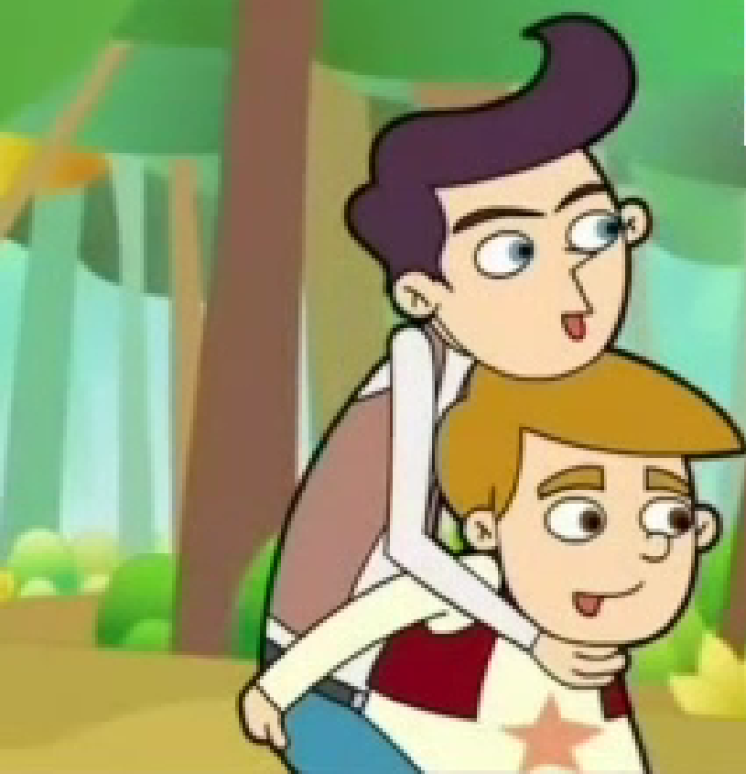
Answer the questions:
Is Jim a true friend? Why?
2) What would you do in this situation, if you were Jim?

Slide 21

Mix Pair Share

Slide 22
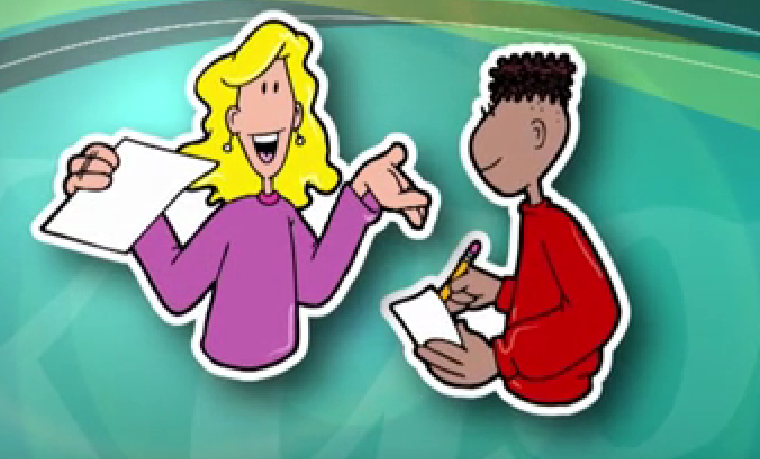
Timed Pair Share

Slide 23
Answer the questions:
Is Jim a true friend? Why?
2) What would you do in this situation, if you were Jim?

Slide 24
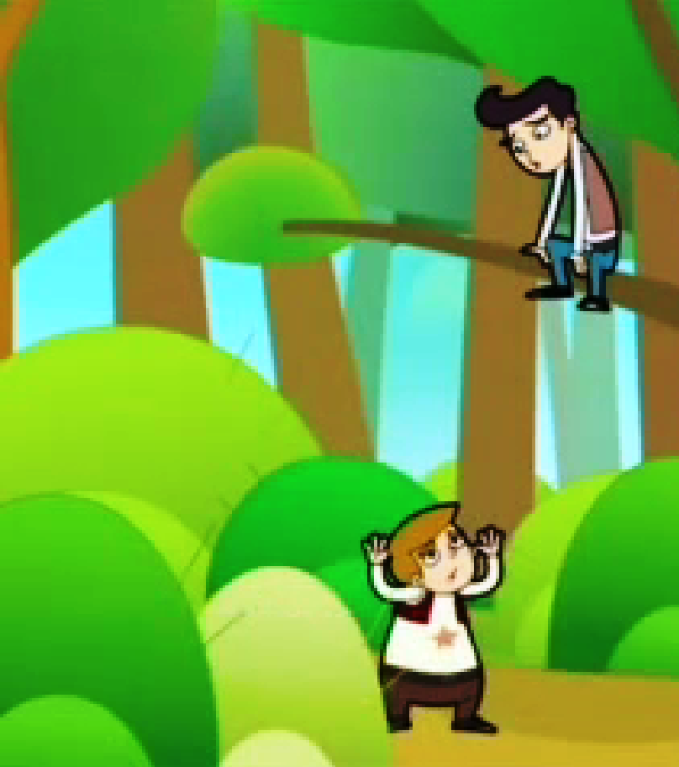
Is Tim a true friend? Why?
2) What would you do in this situation, if you were Tim?
3) What is the moral of the story?

Slide 25

“Friendship Soup”

Slide 26
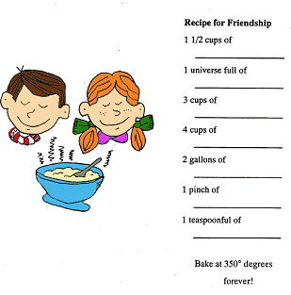
“Friendship Soup”

Slide 27

A true friend is invaluable treasure

Slide 28

Reflection

Slide 29

Reflection

Slide 30

Reflection

Slide 31
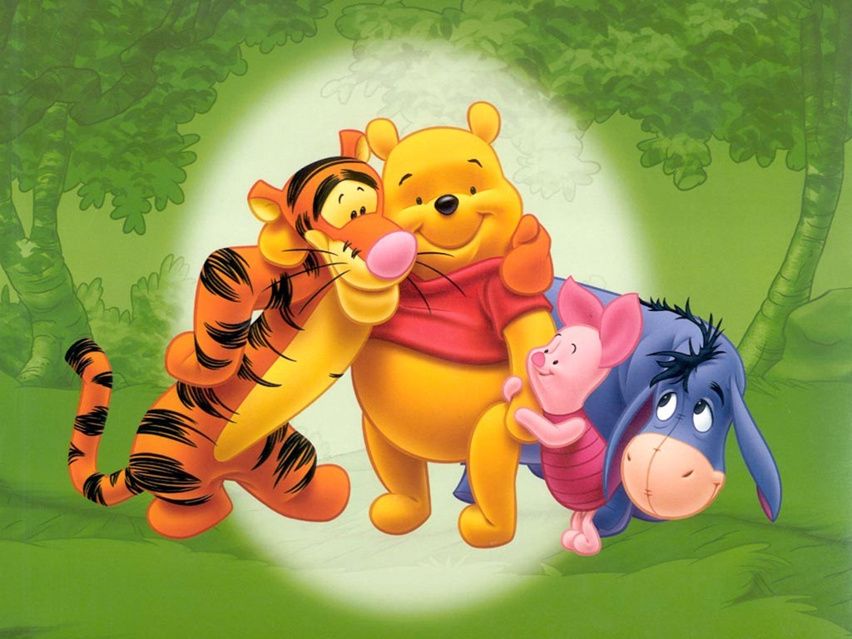
Homework
Write a story about your true friend, using the supporting text

Slide 32
Internet resources:
www.LearningStationMusic.com
www.images.yandex.ru
http://www.youtube.com/watch?v=373wQ-X35Ro
www.Muzofon.com

Slide 33

Thank you! Good luck!

