Slide 1
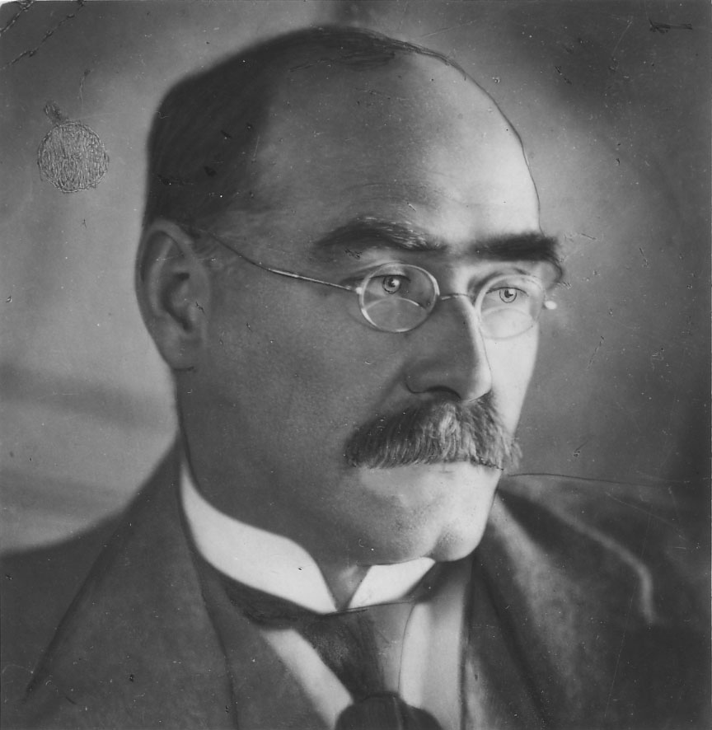
Created by:
Alexander gerasimov
Teacher:
Erokhina ekaterina y.
Joseph Rudyard Kipling

Slide 2
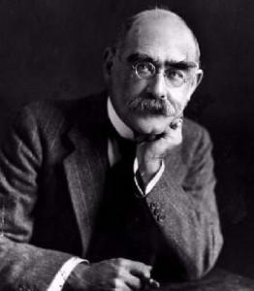
British author and poet, born in Bombay, India in the family of a Professor of the local school of arts John Lockwood Kipling and Alice Kipling.

Slide 3
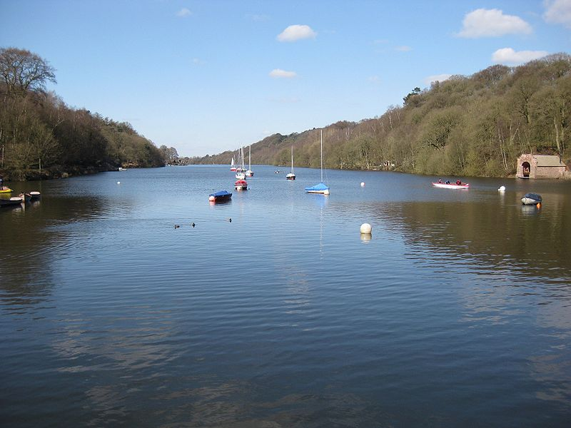
It is believed to recieve The name Rudyard in honor of the English lake Rudyard.

Slide 4
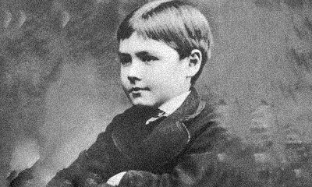
He had a very happy childhood until, at the age of six, he and his sister were sent to England to be educated.

Slide 5
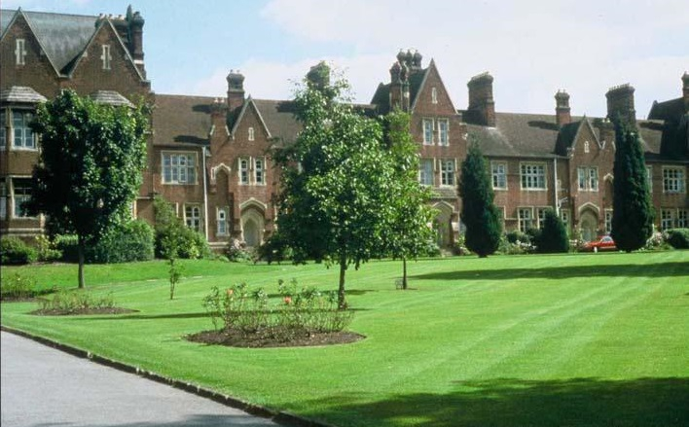
His next six years were miserable. He was neglected and treated cruelly by the couple who were looking after him. At 12, he went to live with his aunt and only then spoke of what he had gone through.

Slide 6
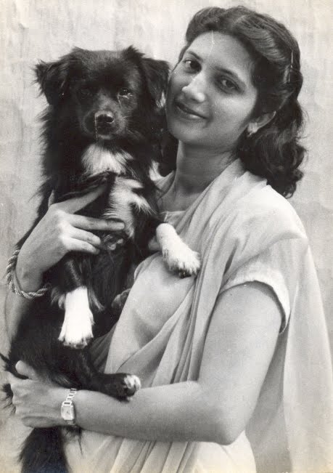
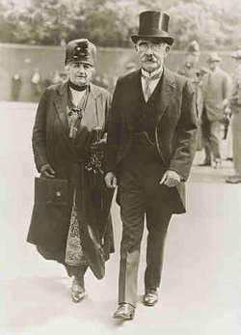
He travelled extensively and married in 1892.

Slide 7



Over the next few years Kipling wrote The Jungle Books (1894-1895), Captains Courageous (1897), The Day's Work (1898) and many more.

Slide 8
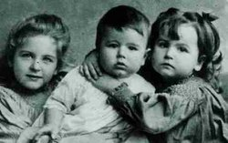
He had two daughters and a son, and life was wonderful until his eldest daughter died of pneumonia at the age of 7.

Slide 9
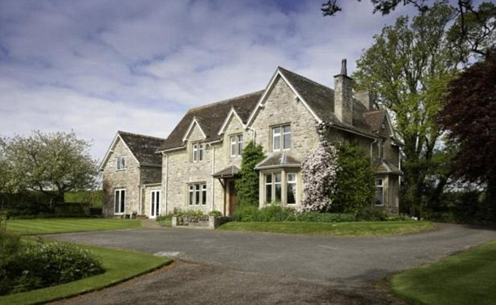
From then on life was never the same again and the family moved to the English countryside for a secluded life.

Slide 10
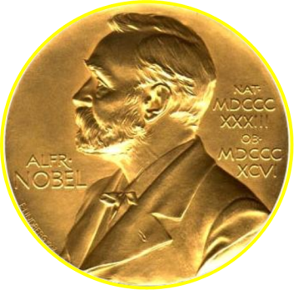
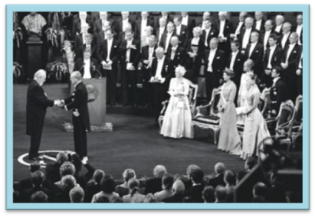
Kipling was awarded the Nobel Prize for literature .

Slide 11
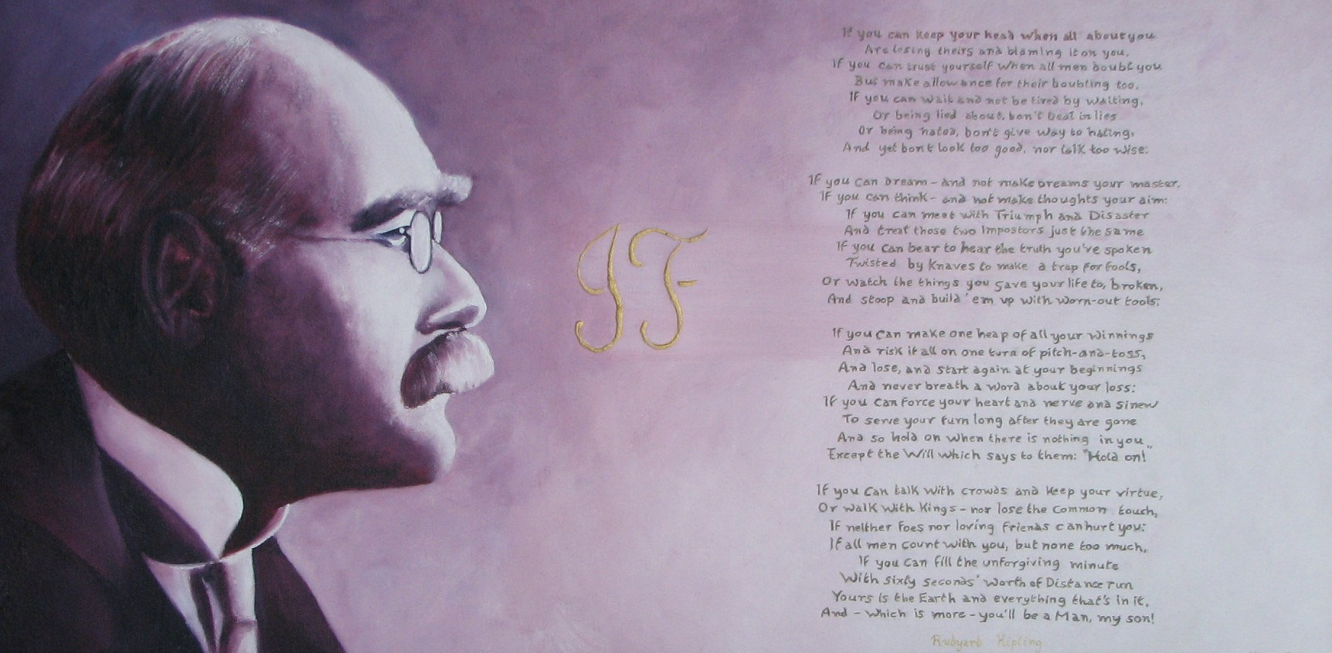
Kipling's most famous poem If (1895) is an inspiring, motivational poem about how to overcome difficulties. IT emphasises the value of inner strength and the ability to not show your emotions.

Slide 12
Quiz on the works of Rudyard Kipling

Slide 13
Biography | Guess written work | Name heroes
10 | 10 | 10
20 | 20 | 20
30 | 30 | 30
40 | 40 | 40

Slide 14
Name the years of Rudyard Kipling”s life
30 December 1865, Bombay — 18 January 1936, London

Slide 15
which country had Kipling lived for only 13 years and inspired for all life?
Kipling has inspired by own country - India

Slide 16
Why did Kipling fail the selection in military school?
Because he was short-sighted

Slide 17
For What newspaper did Kipling work as a journalist in India ?
Kipling worked a journalist in the editorial "Civil and military newspaper"

Slide 18
Name a work of summary: Work about how early humans domesticated animals - dogs, cows and horses, but the cat remained free. it walked and played cames when it wanted?
"The Cat Who Walked in Itself"

Slide 19
Name a work of summary: the story of a "mama's boy" who suddenly enters the harsh living conditions of fishermen, is reborn in this new situation for him, and then returned to his parents
The brave seafarers

Slide 20
Name a work of summary: Story about sea animal who went with his big family in the Pacific ocean, where he will meet new friends and unforgettable adventures
White cat

Slide 21
Name a work of summary: story about a huge dog-ghost without teeth and fur, which always comes before an important event
Quiquern

Slide 22
Name three characters from the works of "Maugly"
Mowgli, Bagheera, Baloo, Kaa, Sherkhan, Tobacco

Slide 23
Name three characters from the works of "Rikki-Tikki-Tavi"
Rikki-Tikki-Tavi, Nag and Nagini, Chuchundra, Darcy - bird praising Rikki-Tikki-Tavi in their songs

Slide 24
name one to three characters from the works of "Kim"
Kimball O'Hara, Mahbub Ali, Colonel Creighton

Slide 25
name one to three characters of the autobiographical "Stalky & Co." or "Crazy Company"
Stalky, Makturk and Bug

