Slide 1
Good Food
Разработчик слайдов Учитель английского языка Шоюфская Сабина Намиковна

Slide 2
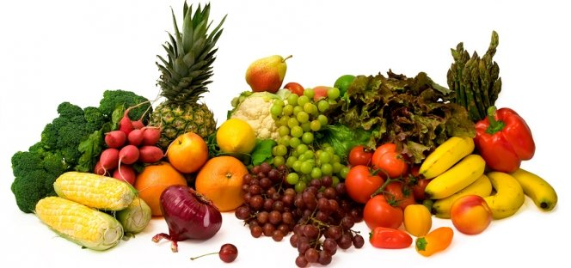
Phonetic Exercises
[tᶴ] chocolate, sandwich, chicken, chips, cheese [d3] jug, jar, juice, jelly, jam, vegetables [ᶴ] shape, fish, dish, sugar, sure, bush

Slide 3
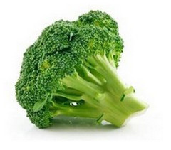

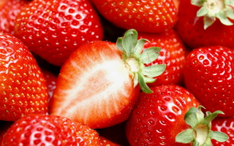

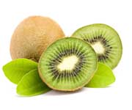

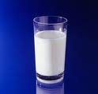

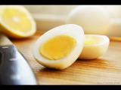
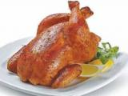
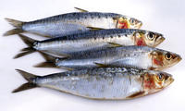
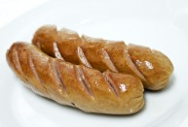
Look at the photos. What food can you see in the photos?
tomatoes
brocolli
cake
strawberries
Ice cream
kiwi
cheese
milk
egg
sardines
chiken
sausages

Slide 4
Let’ s listen to Toby(1) and Chris(2) are talking about food. Which of them eats healthiest food?

Slide 5
Listen again and complete the information in the network
My food
I usually eat a lot of meat and ________.
I don`t eat a lot of_____.
I drink a lot of _____.
My favourite meal is breakfast/lunch/dinner.
I often eat snacks, like _____.
Fruits: apple, banana, kiwi, cherry, lemon, strawberry, tomato;
Vegetables:beans, broccoli, cabbage, carrot, cucumber, lettuce, mushroom, onion, potato;
Cereals:bread, (breakfast)cereal, rice, pasta;
Meat: beef, chicken, lamb, pork sausages;
Fish: salmon, sardines, tuna;
Dairy: cheese, yoghurt
Drinks: coffee, cola, fruit juice(orange/lemon), milk, tea, water
Snacks:biscuits, cakes, chocolate, crisps, fruit, ice cream, nuts, popcorn, sweets

Slide 6
Let’s read the words all together and then one by one.
Bee { bi:} honey{ `hʌni}
carbon dioxide { ` ka:bən dai `ɔksaid} insect { `insect}
chemical { ` kemikl } omelet(te){ `ɔmlət}
climate { `klaimət } organic {ɔ:gænik}
create { kri`eit} owner { `əunə}
factory { ` fæctrəri } roof{ ru:f}
flat {flæt } sweet { swi:t}
gas {gæs} synthetic {sin` θetik}
grow {grəu} urban { 3`:bən}
hen {hen} webcam {`webkæm}

Slide 7
Roof Gardens
http://www.youtube.com/watch?v=PzgmQp-7QuY

Slide 8
2) Use the strategies to match words in blue in the text with these meanings:
1) the top part of a building (roof) 2) with no synthetic chemicals etc. (organic)
3) female birds that produce eggs to eat (hens) 4) it is sweet and bees make it (honey) 5) to produce food from plants (grow) 6)this gas change our climate(CO2) 7) insects that make honey (bees) 8) a person who buys a house or shop(owner)

Slide 9
Dialogue (Работа в паре.) You have to choose six questions to ask your partner
1) How much fresh food do you eat? 2) Do you ever eat organic food? Why/Why not? 3) How often do you eat fast food? 4) How often do you eat snacks? 5) What is your biggest meal of the day? 6) What time do you have dinner? 7) What is your favourite dish from your country? 8) What is your favourite international dish? 9) Where does your family buy food? 10) How often do you help with the food shopping?

Slide 10
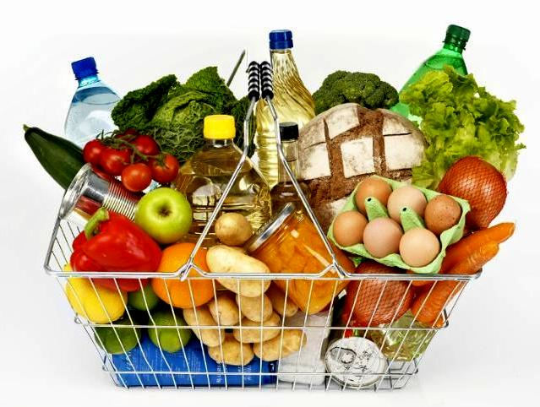
Tell the class some of your answers
(Example) Monica eats fast food once a week. Her family buys food at the local market…

Slide 11
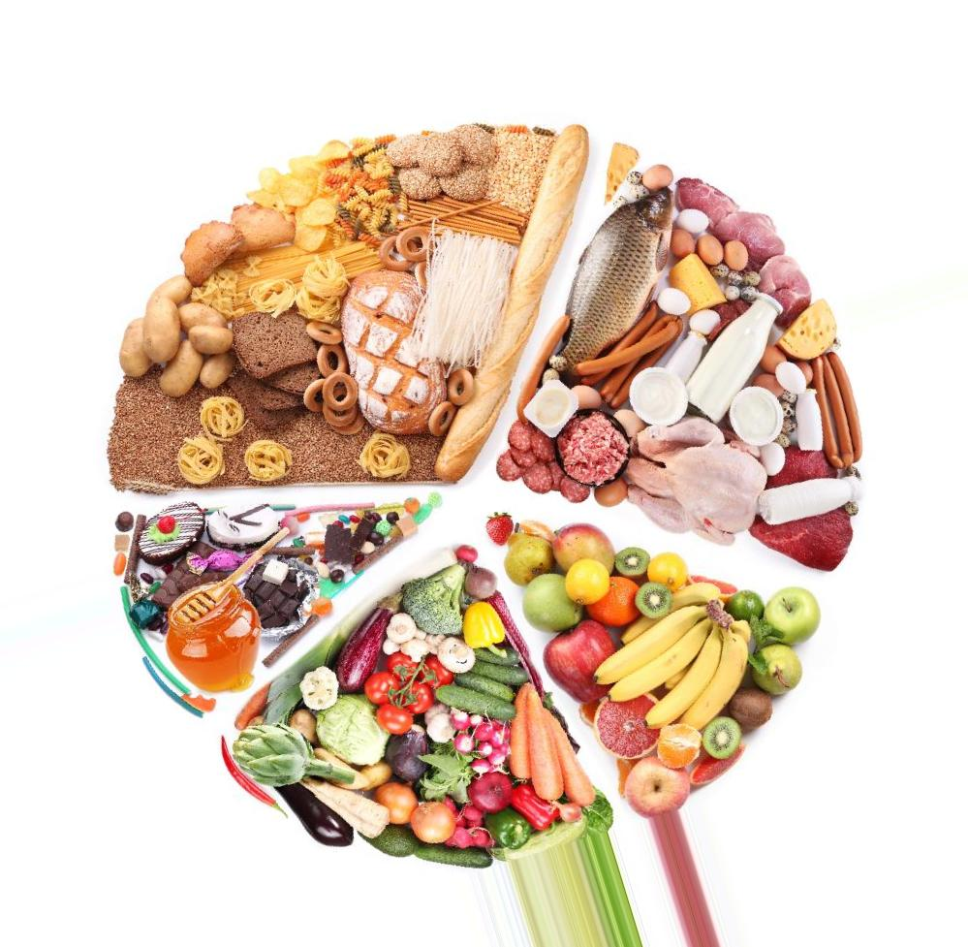
Thank you for your attention!

