Slide 1
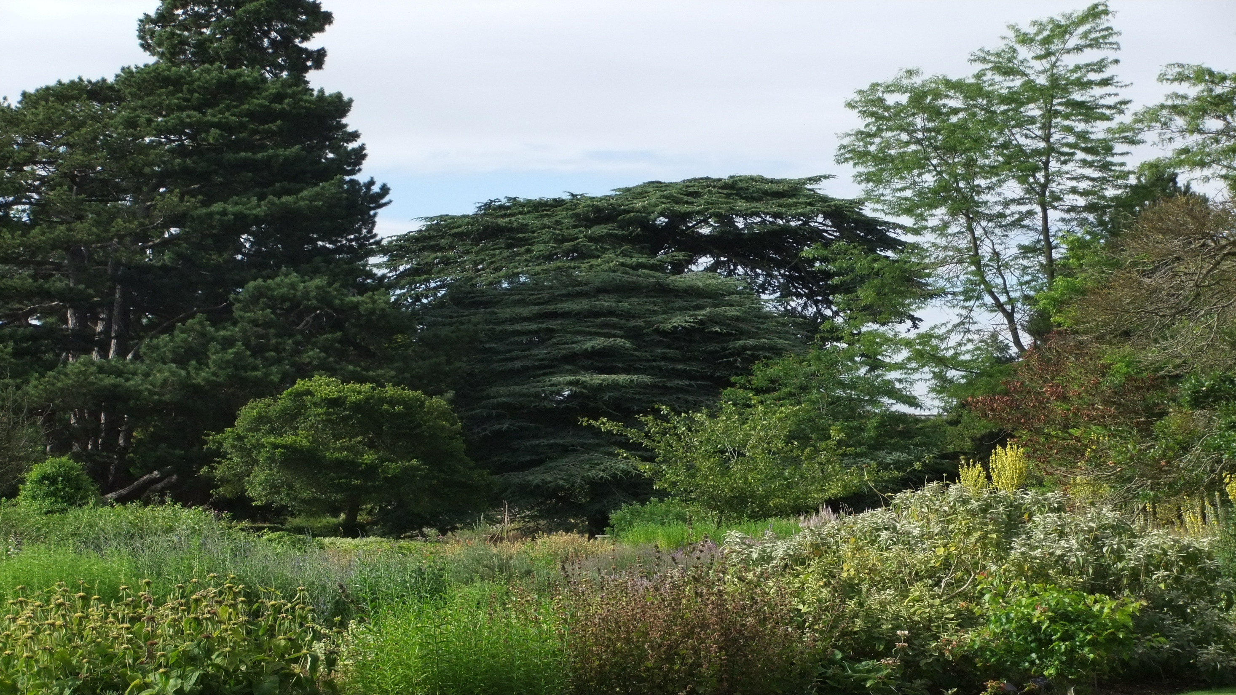
PROTECTION OF THE ENVIRONMENT

Slide 2
Цели:
Развивающие: развитие способности к обобщению и интерпретации;
Воспитательные: формирование способности осознавать экологические проблемы и необходимости помочь природе;
Учебные: развитие речевых навыков по теме.

Slide 3



3 R’s
Reuse
Reduce
Recycle

Slide 4


Slide 5
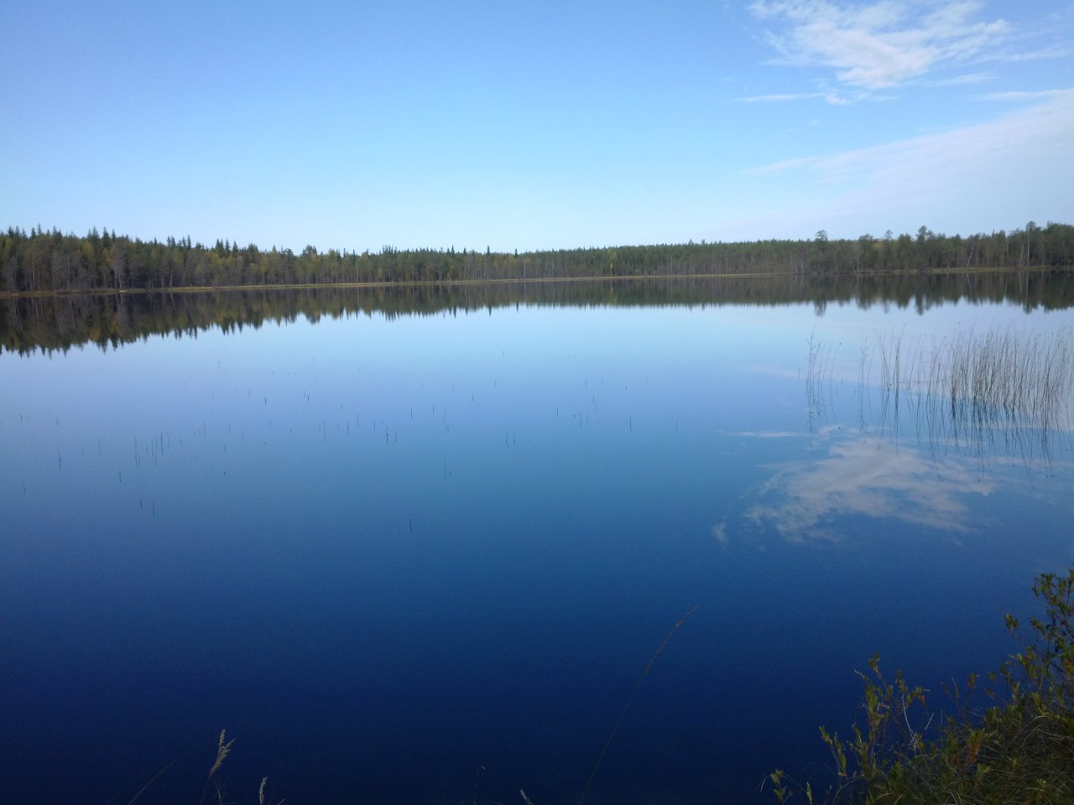
Ecological problems:
Killing animals
Cutting down the trees
Pollution

Slide 6

JOT THOUGHTS

Slide 7
TIC-TAC-TOE
Write 3 sentences

Slide 8
obligatory characteristics
not obligatory characteristics
environment
examples
opposite examples

Slide 9
Let’s think
At first I thought that the environment is…
Now I know that the environment is…

Slide 10
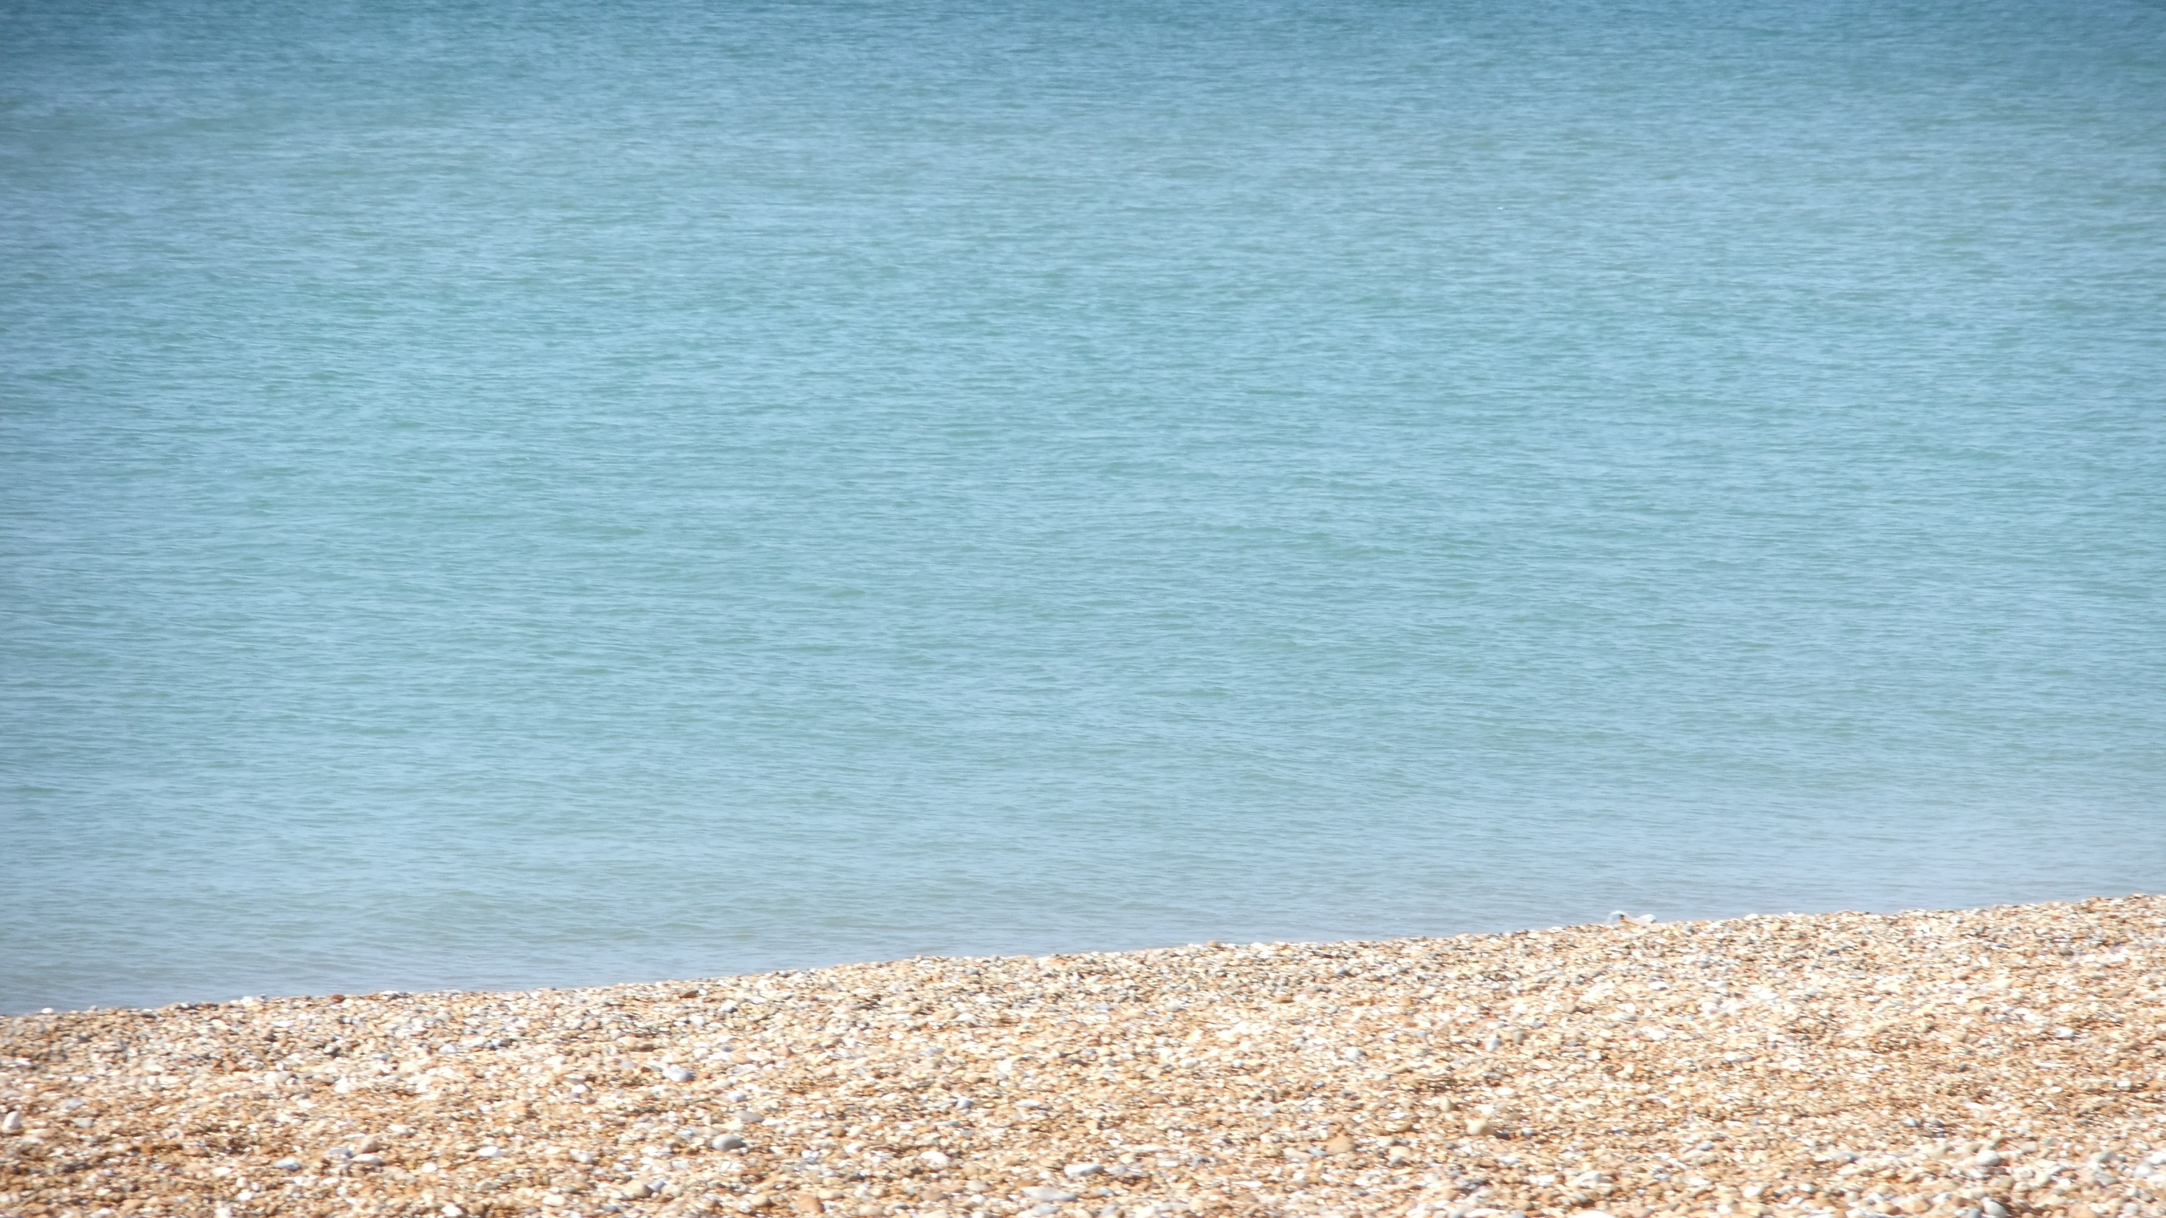
Ex. 8 p.65-read the poem and tell who is speaking in it.
Why are they speaking in such a way?

