Slide 1


Roses are …
Violets are…
Sugar is …
And so are …
you
blue
red
sweet

Slide 2


Slide 3







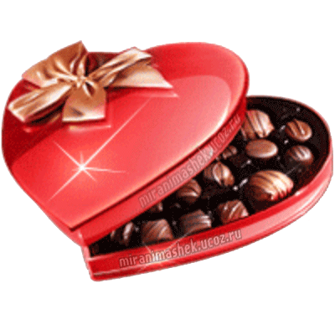

love любовь
a flower цветок
Sweets сладости
a rose роза
Sweetheart возлюбленный
Cupid Купидон
February февраль
a valentine валентинка
Wishes пожелания
Presents подарки
a kiss поцелуй
a gift- подарок
a heart сердце
a party вечеринка
a holiday праздник
a vase ваза

Slide 4

a valentine валентинка
wishes- пожелания
presents подарки
a kiss поцелуй
a gift подарок
a heart сердце
a party вечеринка
a holiday праздник
a vase ваза
a smile улыбка
a friend друг
a poem стихотворение
Friendship дружба
an arrow стрела
forever навсегда

Slide 5



Slide 6



Slide 7


Slide 8


Slide 9



Slide 10


Slide 11



Slide 12


Slide 13


Slide 14



Slide 15







1.
1
C
H
C
O
L
A
E
2.
2
T O Y S
4
3.
3
S
W
E
T
H
E
A
R
T
5
C
R
D
H
A
R
T
4.
V
A
L
E
N
T
I
N
E
5.
6
F L O W R S
6.

Slide 16

History of St. Valentine’s Day

Slide 17
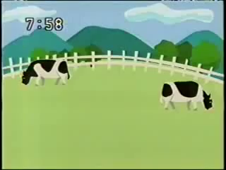
Break time

Slide 18
Find the words devoted to Love
Card
Red
Valentine
power
Love
Candy
Kiss
heart
Romance
sweet
Friend
Cake
cupid
Lorscard
omdhered
valentinehumksed
eshabgmnghpower
ydersalovescxpich
aodtrdbcandykidd
lkisstucroohneff
kfnetpheartpycyksl
kedromancebe
huigysweetuvpe
efriendf
adecake
rdacupidfs

Slide 19
THE POEM TO SWEETHEARTS
My heart is … a boiling kettle
Your heart is … a diamond
Your lips are …roses
Your eyes are … stars
My love is … The Universe
as hard as
as hot as
as bright as
as red as
as endless as

Slide 20
THE POEM TO SWEETHEARTS
My heart is ... Fire
Your heart is … ice
Your lips are … honey
Your eyes are .. an ocean
My love is … the sky
as cold as
as deep as
as hot as
as sweet as
as wide as

Slide 21


WELL-KNOWN PAIRS
Adam
Eve
Captain
Grey
Assol
Romeo
Juliet
Ophelia
Hamlet

Slide 22
WELL-KNOWN PAIRS
Master
Margaret
Desdemona
Othello
Cinderella
Prince
Lady
Hamilton
Admiral
Nelson

Slide 23




Sing a song

Slide 24

Do you like the lesson?
I want to learn more on this topic
I`ve learned new a lot
I need time to remember the lesson

