Slide 1

Health and how to keep it
Как быть здоровым

Slide 2
[æ]
apple
[еi]
day away
[i: ]
keep
[ɔ ]
doctor

Slide 3
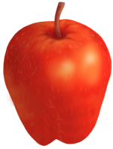
A proverb - пословица
An apple
a day keeps the doctor away

Slide 4
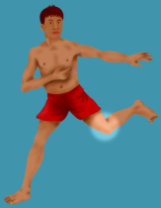
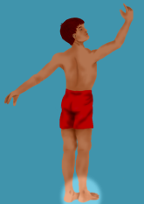
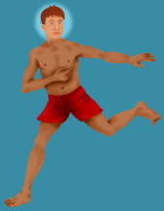
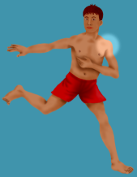
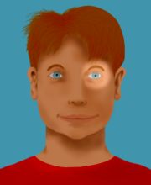
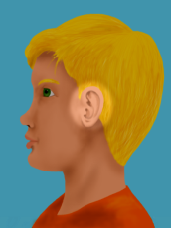
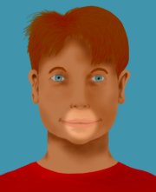
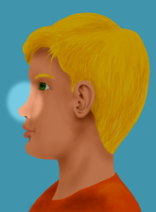
a head
a shoulder
a toe
a knee
an eye
an ear
a mouth
a nose

Slide 5
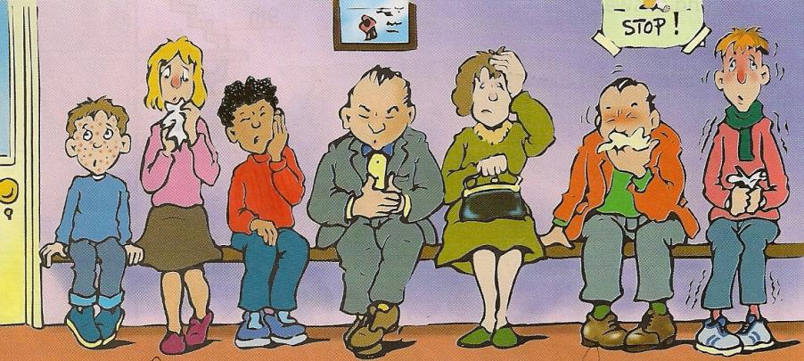
Illnesses
chicken pox
toothache
a headache
flu
ветрянка
зубная боль
головная боль
грипп
a cold
stomachache
a cough
простуда
боль в животе
кашель

Slide 6
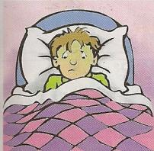
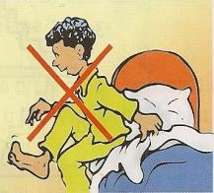
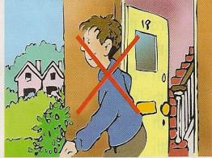
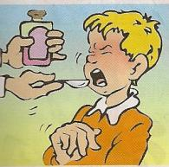
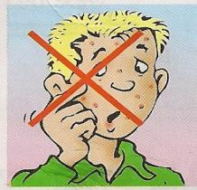
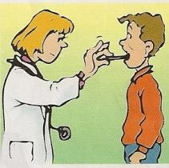
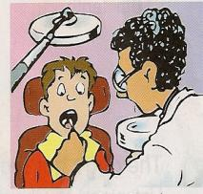
SHOULD / SHOULDN’T
take some
cough mixture
stay in bed
get up
go out
scratch your spots
go to the doctor
go to the dentist

Slide 7

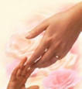
Hands!
Hands up!
Hands down!
Hands on hips!
Sit down!
Hands up!
To the sides!
Bend left!
Bend right!
One, two, three! Hop!
One, two, three! Stop!
Stand still!

Slide 8
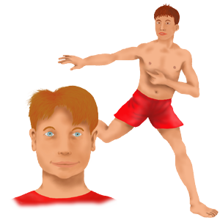
Parts of the body
Head and shoulders,
knees and toes, knees and toes, knees and toes!
Head and shoulders,
knees and toes,
eyes, ears, mouth and nose!

Slide 9

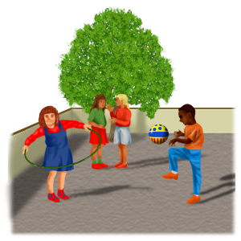
Skateboarding canoeing rollerblading wind-surfing swimming horse-riding running water skiing

Slide 10
An apple a day keeps the doctor away.

Slide 11



