Slide 1

SEASONS
Презентацию подготовила Бельтюкова И.С.,
учитель ГБОУ СОШ №72

Slide 2
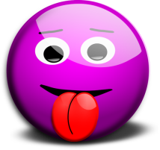
Read the exercises: [θ] – thick, thin, thing, think, three [ð] – then, weather, that, this, those [θ] [ð] [ð] [θθθik] [wiððis] [izzzðððis] [θθθin] [wiððæt] [izzzðððæt] [θθθɔ:t] [wiððem] [wɔzzzðððis] Elizabeth’s birthday is on the third Thursday of this month. Whether the weather be fine or whether the weather be not. Whether the weather be cold or whether the weather be hot. We’ll weather the weather whether we like it or not.
Th

Slide 3
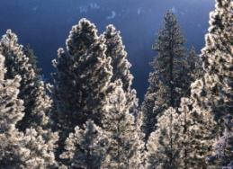
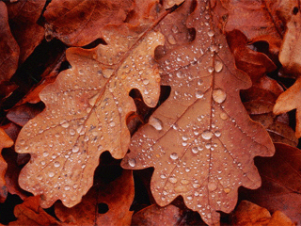
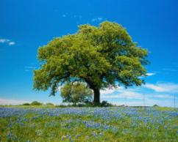
My Favorite Season
There are four seasons in the year. They are: SPRING, SUMMER, AUTUMN AND WINTER. All of them are wonderful! Spring is green! Summer is bright! Autumn is yellow! Winter is white!

Slide 4
Ordinal Numbers Write the numbers in the right place!
кккллпрр
10
2
31
5
1
4
12
st
rd
nd
th
6
23
21
22
30
3

Slide 5
Put the months in the right order
July |  | the first
March |  | the second
August |  | the third
May | is | the fifth | In the year
December |  | the seventh
February |  | the eight
November |  | the ninth
January |  | The twelve

Slide 6
SING A SONG!
January, February, March, April, May, June, July!
January, February, March, April, May, June, July!
August, September, October, November, December!
August, September, October, November, December!

Slide 7

What is the weather like?
Make up true sentences!
 |  | Hot
In winter |  | cold
In spring | It’s | rainy
In autumn | It isn’t | snowy
In summer |  | dry
 |  | windy

Slide 8
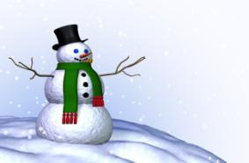
Cross one word out!
winter | frosty cold snowy white ski shorts skate boots hat snowball
summer | sunny cloudy rainy flowers sunglasses cap swimming overcoat
autumn | cloudy windy grey skating yellow wet jeans hat boots rainy blue
spring | green flowers warm sledge sunny cloudy dry blue bright grass

Slide 9
Let’s compare!
(hot) Summer is the _______season in the year.
(cold) Winter is the _______season in the year.
Fill in the proper form of comparisons.
(warm) Spring is ______ than autumn.
(rainy) Autumn is _____ than summer.
(short) In winter the days are ________ than in summer.
(long) In summer the days are the _________ of all

Slide 10


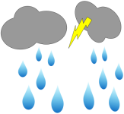

Listen and fill in proper word from the box. Snowing Blue Shining Blowing Hot Raining In Antarctica it’s __________, In Brazil the sun is __________, And in Mexico it’s __________. And in Spain the sky is__________. In Japan the wind is __________, In Tokyo now it’s __________, And in Italy it’s not. And in Greece it’s raining too.
World weather

Slide 11
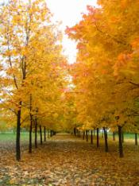
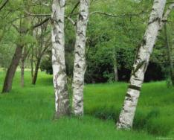
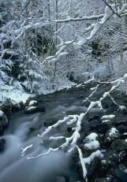
What is better?
Winter
Summer
In winter you can ski and skate, play snowballs and make a snowman!
In summer you can swim, ride a bike, play games and walk in the park!

Slide 12
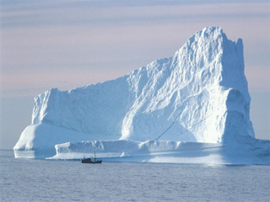
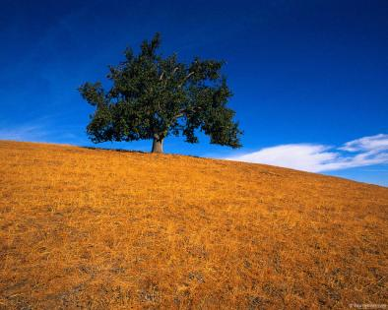
What is worse?
Winter
Summer
In winter the days are long and the nights are short. It’s very cold and snowy.
In Summer it can be terribly hot and dry.

Slide 13
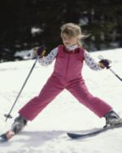


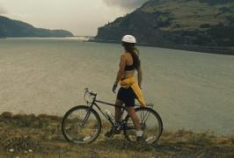
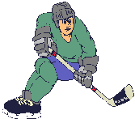

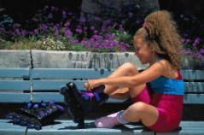
What can you do?
In winter
in summer

Slide 14

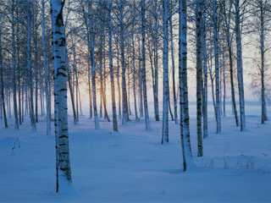
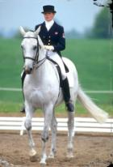
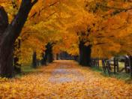

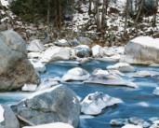
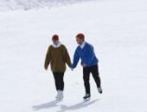
What is your favorite season and why?

Slide 15


