Slide 1

Лингвистические исследования учащихся в различных поисковых системах
через процесс освоения метода “QUIZ”
Методическая разработка
Автор: Журавлева И.Ю.
учитель английского языка
ГБОУ СОШ № 596
Приморский район
С. Петербург
2015

Slide 2
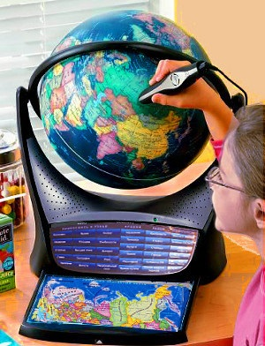

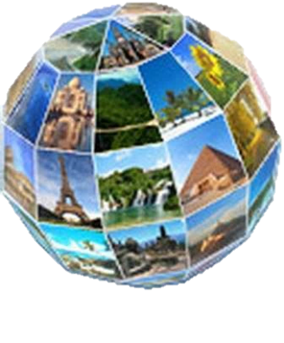
Give me the associations with the word “country”:
History…
Geographical position…
Population…
Capital…
Presidents…
Cities…
Outstanding People…
Holidays and Traditions…

Slide 3




What is Quiz ?
Task №1: Find the definition for the word “quiz”. Use Google search engine. Type “define: quiz” and write the definition on your work sheet.
http://en.wikipedia.org/wiki/Quiz

Slide 4

Quiz
is a form of game or mind sport in which the players (as individuals or in teams) attempt to answer questions correctly.
In some countries, a quiz is also a brief assessment used in education and similar fields to measure growth in knowledge, abilities, and/or skills.
Quizzes are usually scored in points and many quizzes are designed to determine a winner from a group of participants - usually the participant with the highest score.
http://en.wikipedia.org/wiki/Quiz

Slide 5
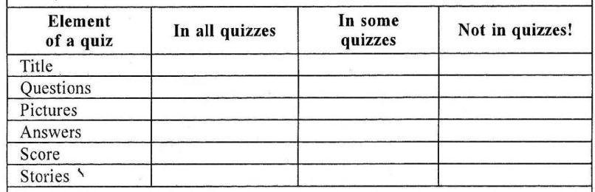
Task 2: Study the examples of the quizzes on the following sites, identify the main parts of any quiz and fill in the table on the card.
http://wiki.answers.com/Q
http://iteslj.org/v/ei/sports.html
http://iteslj.org/v/ei/animals.html
http://www.manythings.org/vq/mc-n1.html
http://www.allthetests.com/quiz29/quizbedingung.php
http://www.softschools.com/quizzes/grammar/pronoun/quiz227.html

Slide 6

So Quiz
can have such elements as …
Title
Questions
Score
Pictures
Answers

Slide 7
Quiz can be:
Multiple Choice Quiz (only one of several answers is correct)
Selection Quiz (each possible answer can be coupled to a score value. It means that there are no wrong answers, only answers with different score values)
Example of Multiple Choice Quiz and Test about yourself:
Question 1: How long is the river Volga?
right answer
wrong answer
wrong answer
wrong answer
wrong answer
True / False Test
Example of True / False Test (You can define yourself, if "right" or "wrong" answer should be counted as a correct one) :
Question 1:Volga is the longest river in Europa
True
False
Test about yourself (where your friends can test their knowledge about you)
Tube Test (where you categorize the answers)
Purity Tests (to measure how pure you are)
Yes
No
http://www.allthetests.com/quiz29/quizbedingung.php

Slide 8

Task 3: Reconstruct the questions of the quiz and write them in the table.
Try to answer the questions.
1. of America, the United States, Is, the ___ largest, in the world, country,(after Russia, Canada and China)?
2. is, the USA, situated?, Where
3. two, What, the US, countries, border?
4. by, is, What, the USA, washed, oceans?
5. discovered?, America, Who (and when)
6. In 1620, the nameof the ship, was, What, (that brought the Pilgrims to New England)?
7. is, flag?, the name, What, of the American
8. gave, of America?, the Statue of Liberty, Who, to the people
9. the largest city, is, of the USA?, What

Slide 9
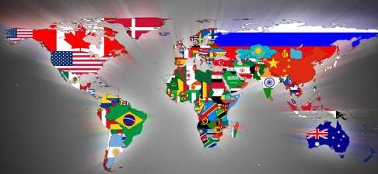
1.Is the United States of America the ___ largest country in the world (after Russia, Canada and China)?
A. 1st B. 2nd C. 3d D. 4th

Slide 10
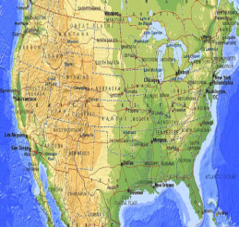
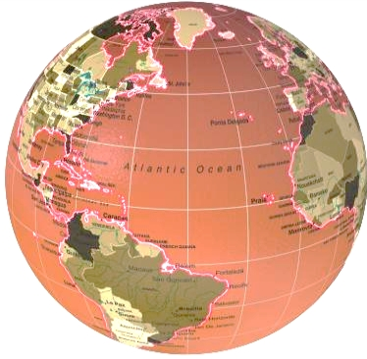
2.Where is the USA situated?
the central part of the North American Continent
the central part of the South American Continent
3.What two countries border the US?
Japan, Canada
Brazil, Canada
Canada, Mexico
Mexico, Brazil

Slide 11
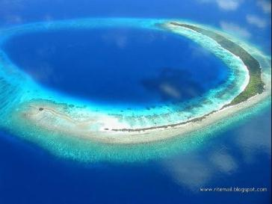
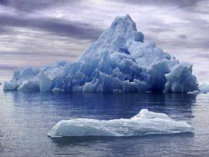
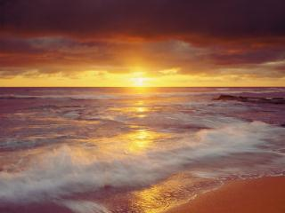
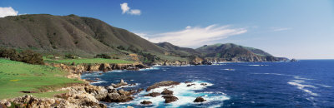
4.What oceans is the USA washed by?
the Pacific Ocean
the Atlantic Ocean
the Indian Ocean
the Arctic Ocean

Slide 12
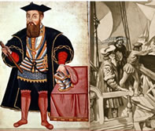
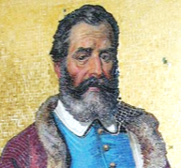
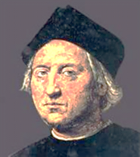
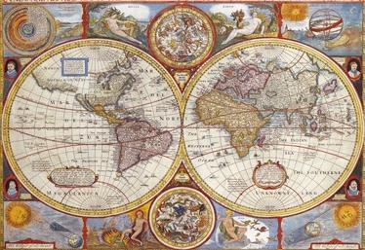
5.Who discovered America and when?
Vasco do Gama
Christopher Columbus
Marko Polo
http://video.nationalgeographic.com/video/player/kids/history-kids/christopher-columbus-kids.html

Slide 13
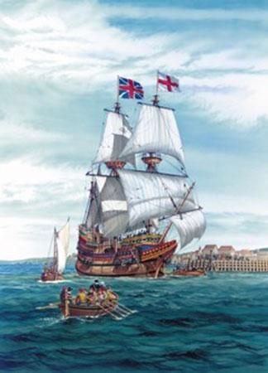
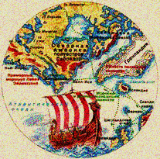
6.What was the name of the ship that brought the Pilgrims to New England in1620?
GoldenHind
Sunflower
Mayflower
Titanic

Slide 14
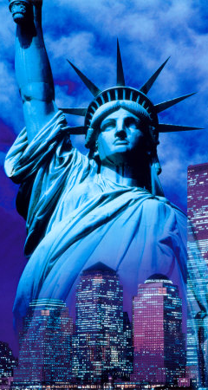

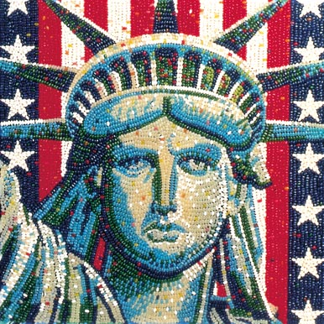
7.What is the name of the American flag?
Union Jack
Stripe
Red and white stars
Stars and Stripes
8.Who gave the Statue of Liberty to the people of America?
Britain
Spain
Germany
France
http://www.google.ru/imgres?q=Who+presented+the+Statue+of+
http://uk.ask.com/question/who-gave-the-statue-of-liberty-to-america

Slide 15
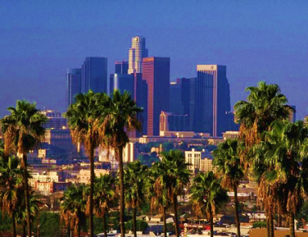
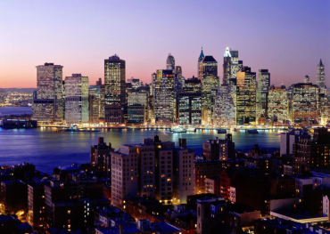
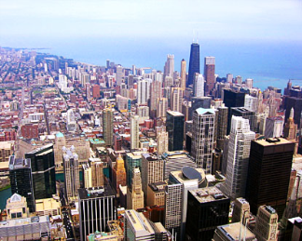
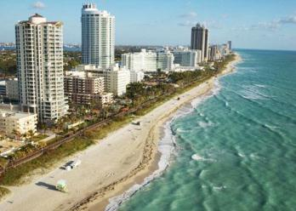
9.What is the largest city in the USA?
New York
Los Angeles
Chicago
Houston

Slide 16

Let’s sing a song: “If you are happy”
If you're happy and you know it Clap your hands. Clap, Clap. If you're happy and you know it Clap your hands. Clap, Clap. If you're happy and you know it and you really want to show it If you're happy and you know it Clap your hands. Clap, Clap.
http://www.youtube.com/watch?v=FrsM9WggCdo

Slide 17
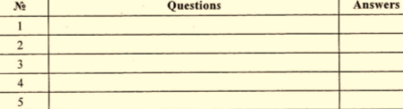
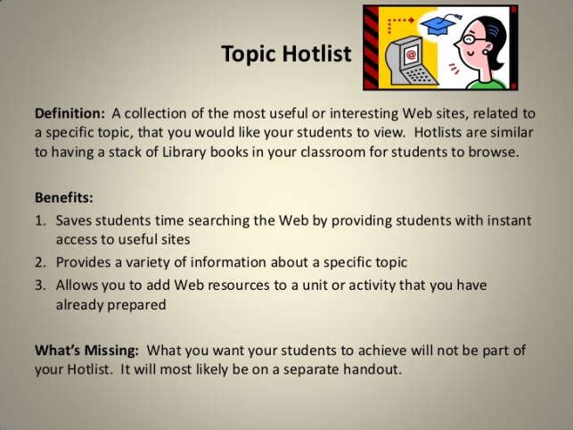
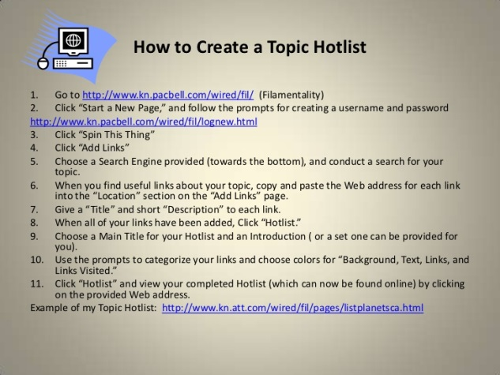
Task A. Choose two topics for your quiz:
American history
American symbols
American states
The Presidents
Famous People
Places to visit
American sport
Task B. Use your “Hotlist” and Google to find resources on your topics.
Task C. Write down the questions and design your own Quiz.

Slide 18

Hotlist
http://www.netstate.com/state_flags.htm
http://www.house.gov/content/visitors/
http://videoclips.mrdonn.org/americanhistory.html
http://www.infoplease.com/ipa/A0108477.html
http://travel.sulekha.com/united-states-attractions.htm
http://www.kidinfo.com/american_history/famous_historical_people.htm
http://www.statesymbolsusa.org/National_Symbols/American_Hollidays.html
http://video.nationalgeographic.com/video/player/kids/history-kids/christopher-columbus-kids.html

Slide 19
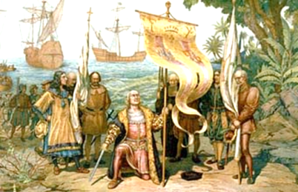
1.Where was Christopher Columbus born?
England
America
Spain
Italy
2.What did Christopher Columbus discovered ?
Central America
South America
North America
The United States of America
3.What tradition did the first colonists start ?
Memorial Day
Independence Day
Thanksgiving Day
Halloween

Slide 20
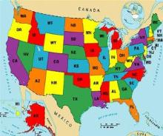

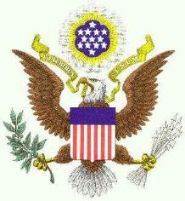


4.How many states are there in the US?
49
50
51
52
5.What is the national emblem (symbol) of the USA?
The rose
The thistle
The shamrock
The eagle

Slide 21
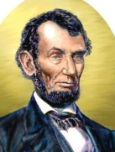
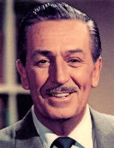
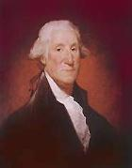
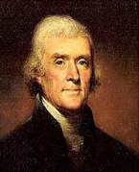
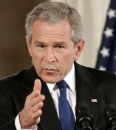
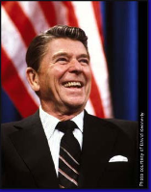
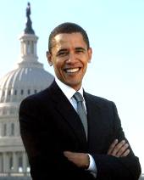
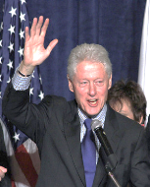
6.Who was the fist President of the USA?
Abraham Lincoln
Thomas Jefferson
George Washington
Walt Disney
7.Who is the President of the USA nowadays?
Bill Clinton
George Bush
Ronald Reagan
Barack Obama
http://home.earthlink.net/~theherreras/index.html
http://www.google.ru/imgres?q=Bill+Clinton&hl=ru&newwindow=1&biw=954&bih=471&tbm=isch&tbnid=mo4w

Slide 22
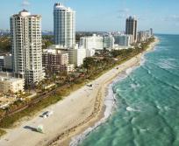
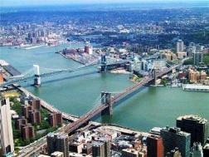
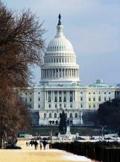
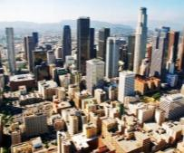
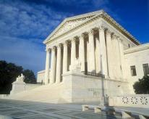
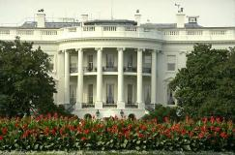
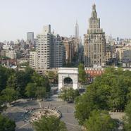
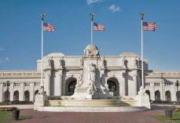
8.What is the capital of the USA?
Los Angeles
Chicago
New York
Washington DC
9.Where does the President of the USA lives in?
White House
Capitol
Union Station
The Supreme Court

Slide 23
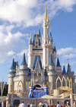
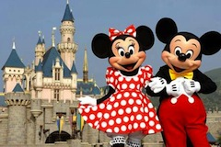
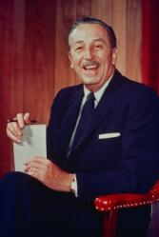
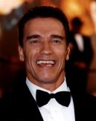
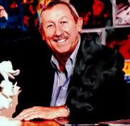
10.In what state is Disney World located?
in Texas
in California
in Nevada
in Florida
11.Who is the founder of Disney World?
Roy E. Disney
Bill Clinton
Walter E. Disney
Arnold Schwarzenegger

Slide 24
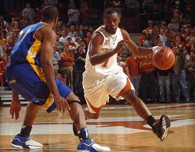




12.What are the most popular sports in the USA?
soccer, tennis, rugby
hockey, skating, skiing
golf, wrestling, badminton
football, basketball, baseball
http://www.backgroundhq.com/layouts/college_basketball.html

Slide 25
Hometask:
Make your own quiz about Festivals and Traditions of the USA.

Slide 26
В оформлении презентации использованы изображения со следующих сайтов:
http://www.google.ru/imgres?q=Who+presented+the+Statue+of
http://uk.ask.com/question/who-gave-the-statue-of-liberty-to-america
http://www.softschools.com/quizzes/grammar/pronoun/quiz227.html
http://www.youtube.com/watch?v=FrsM9WggCdo
http://www.science.co.il/People/Ronald-Reagan
http://iteslj.org/v/ei/animals.html
http://www.allthetests.com/quiz29/quizbedingung.php
http://www.google.ru/search?q=map+of+the+usa&hl
http://video.nationalgeographic.com/video/player/kids/history-kids/christopher-kids.html
http://www.dtcc.com/about/annuals/2010/expl_vasco_da_gama.php
http://www.backgroundhq.com/layouts/college_basketball.html
http://www.google.ru/imgres?q=New+York&h
http://barackobama.ru/bio/ http://iteslj.org/v/ei/sports.html

Slide 27
Answers:
№ | Task №3
1 | D
2 | A
3 | C
4 | A, B, C
5 | B
6 | C
7 | D
8 | D
9 | A
№ | Task №C
1 | Italy
2 | Central America
3 | Thanksgiving Day
4 | 50
5 | the eagle
6 | George Washington
7 | Barack Obama
8 | Washington DC
9 | White House
10 | in Florida
11 | Walter E. Disney
12 | football, basketball, baseball

