Slide 1
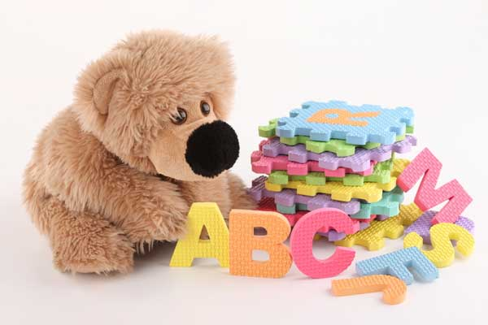

ВСЕЗНАЙКА

Slide 2
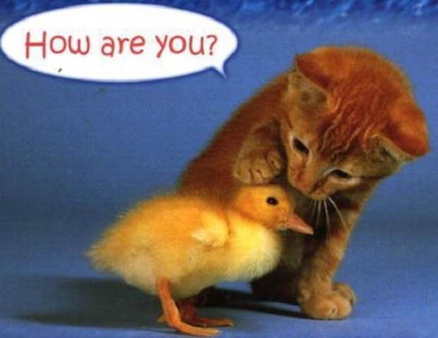

Slide 3
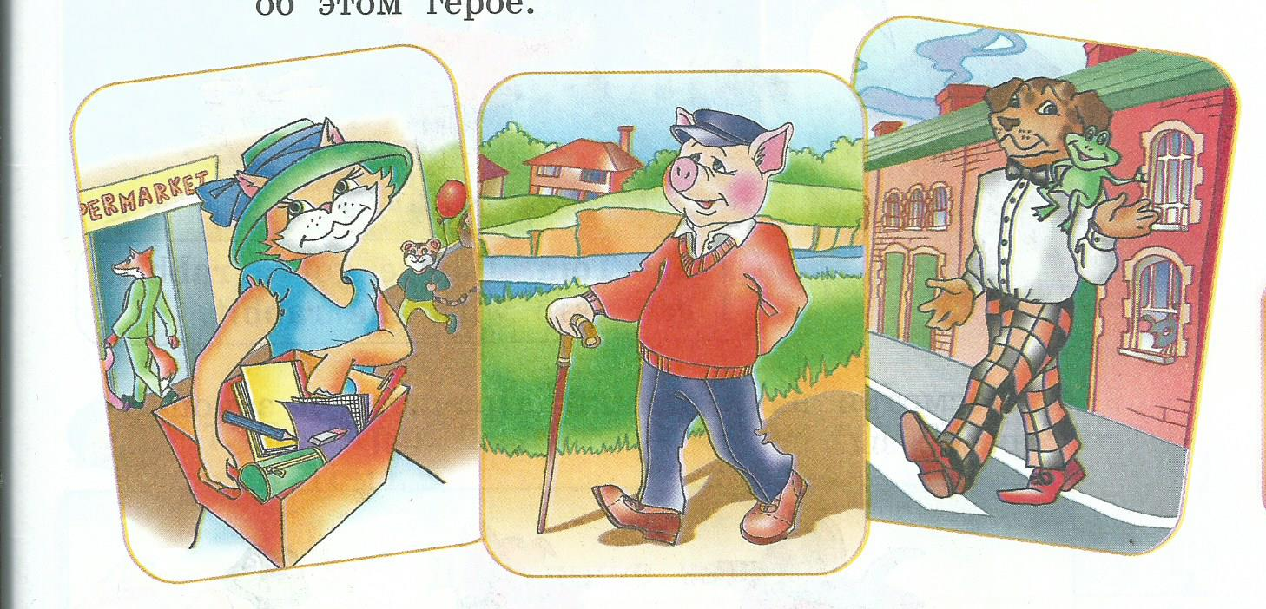
POEMS -СТИХИ

Slide 4
Phonetic exercise
[ʌ] jump, run, mother
[k] black, Nick, cockerel
[æ] cat, Ann, family
[w] we, one, what
[ai] five, my, nine
[e] seven, tennis, red

Slide 5
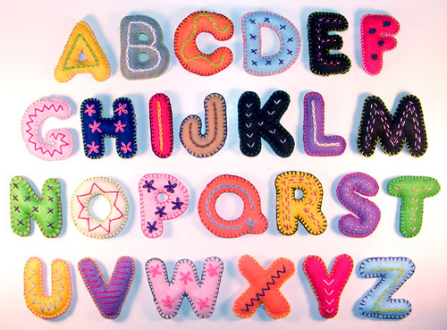

Slide 6

Let`s sing the ABC

Slide 7
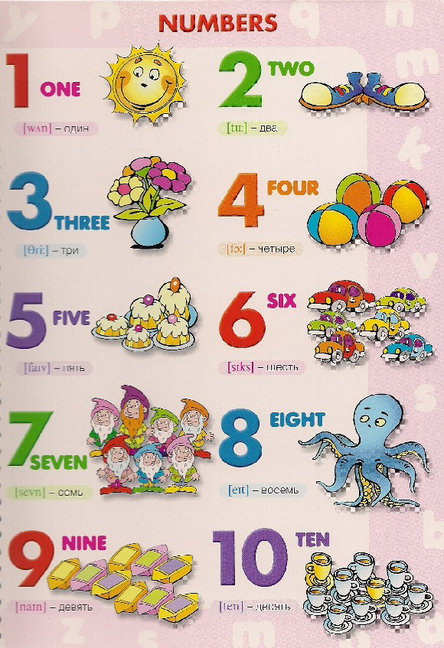
How many girls and boys?

Slide 8
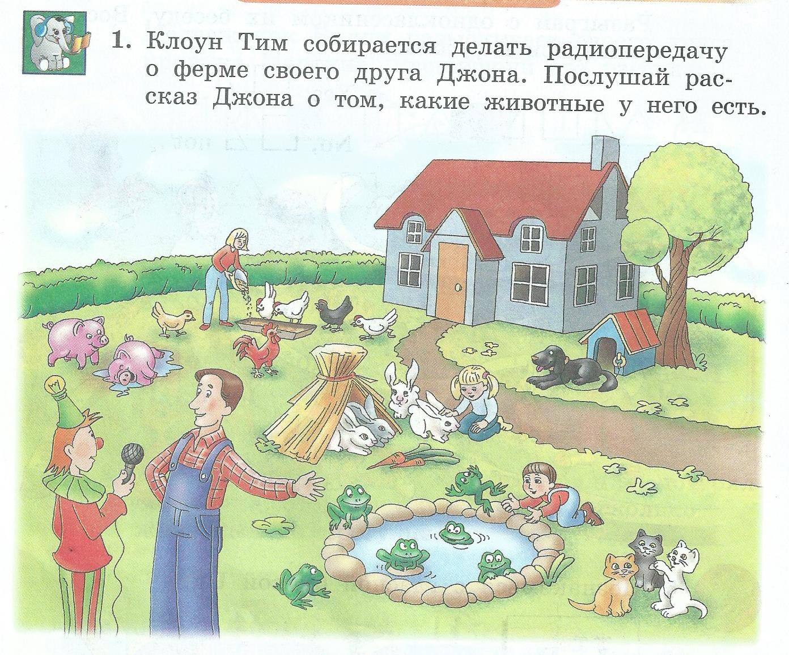
At a farm - На ферме

Slide 9
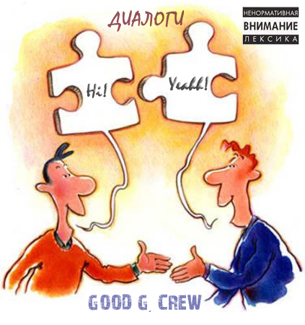
Dialogue-knowing-диалог
Hello!
Hi!
What is your name?-My name is …
And what is your name? – my name is …
How old are you? – I am …
And you ?- I am …
Where do you live? – I live …

Slide 10
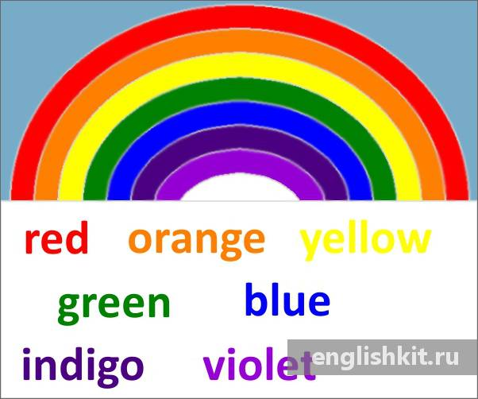
Физкультминутка
run

Slide 11
Grammar
1. Tom, sing, can’t
2. long, His, isn’t, pen
3. cockerel, got, big, a , Jess, hasn’t
1. duck, swim, can, a
2. fox, A, black, isn’t
3. Tim, a, funny, got, has, rabbit

Slide 12
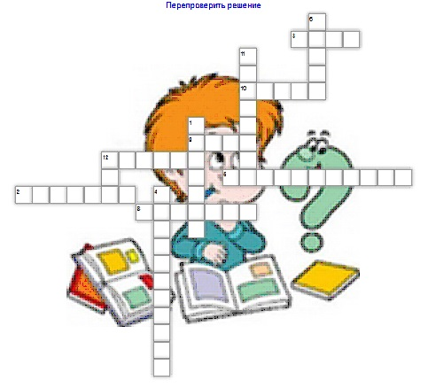
Crosswords

Slide 13
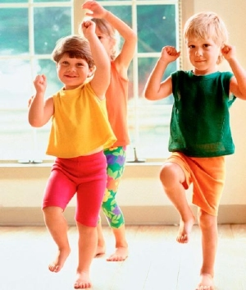
It`s time to have a rest

Slide 14


