Slide 1

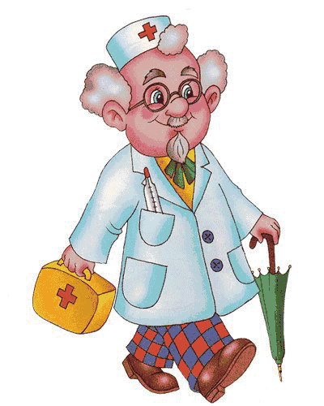
DO YOU CARE ABOUT YOUR HEALTH?

Slide 2

PLAN OF OUR WORK
1. Revising vocabulary
2. Speaking ( giving some advice)
3. Brushing up grammar (Past Simple,
Present Perfect).
4. Acting out the dialogues

Slide 3
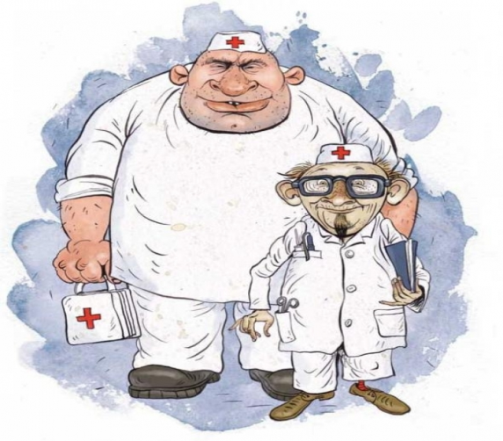
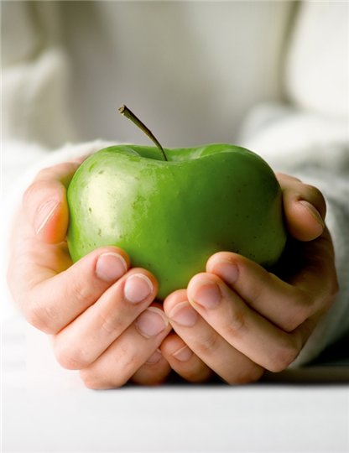

1. An apple a day keeps a doctor away.
2. Good health is above wealth.
3. Early to bed
Early to rise
Makes a man healthy, wealthy and
wise.

Slide 4
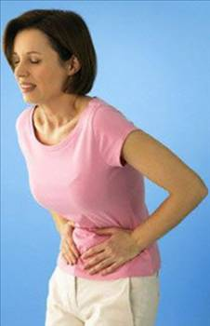
To have a stomachache.

Slide 5
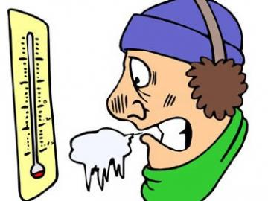
TO CATCH A COLD

Slide 6
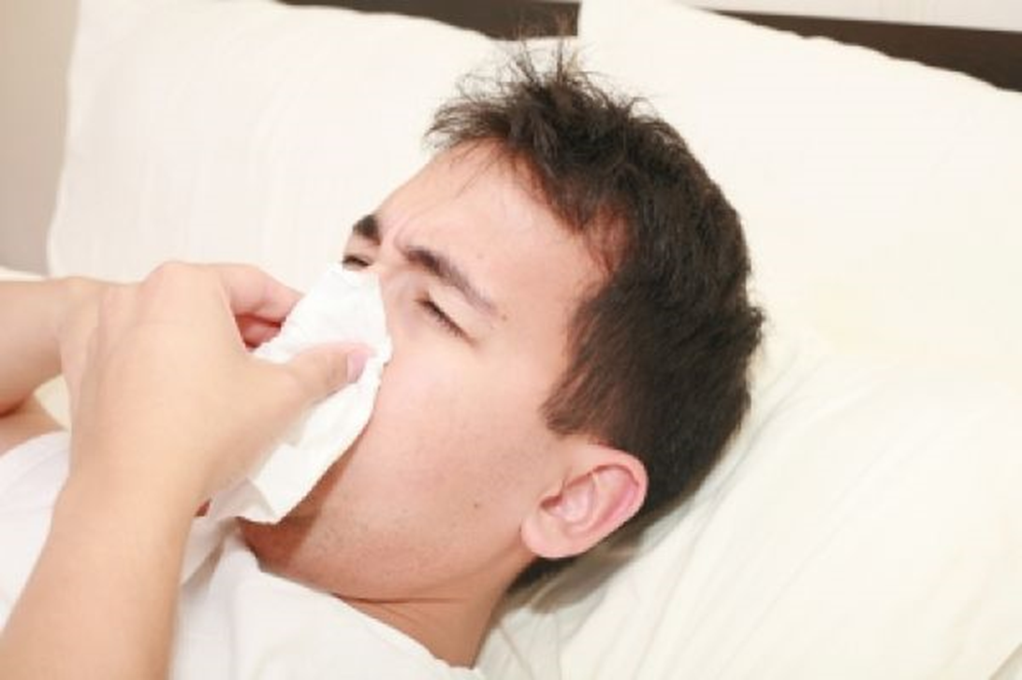
To have a running nose

Slide 7
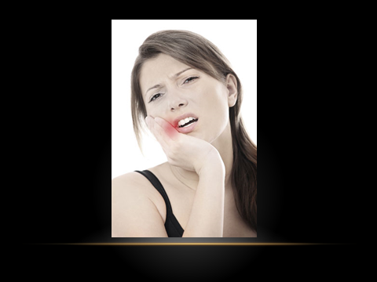
To have toothache

Slide 8
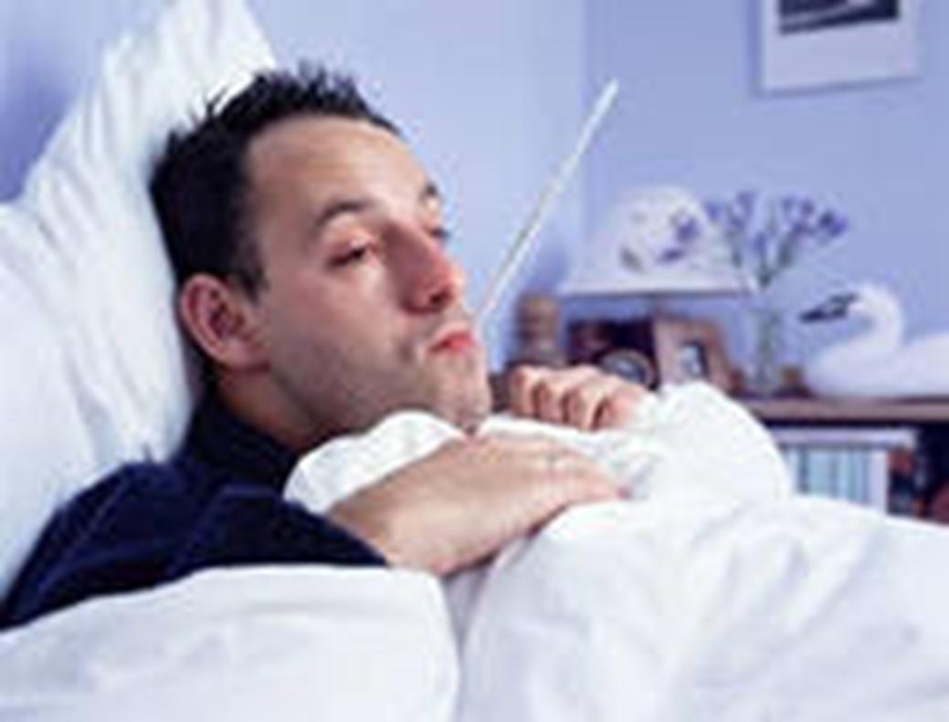
To have the fly

Slide 9
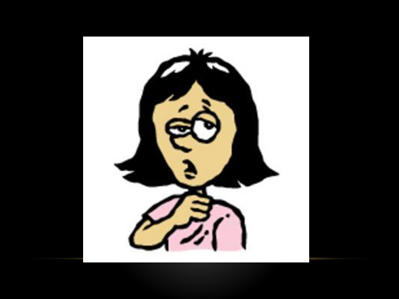
To have a sore throat

Slide 10
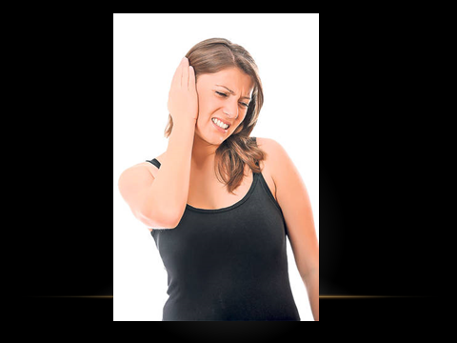
To have earache

Slide 11
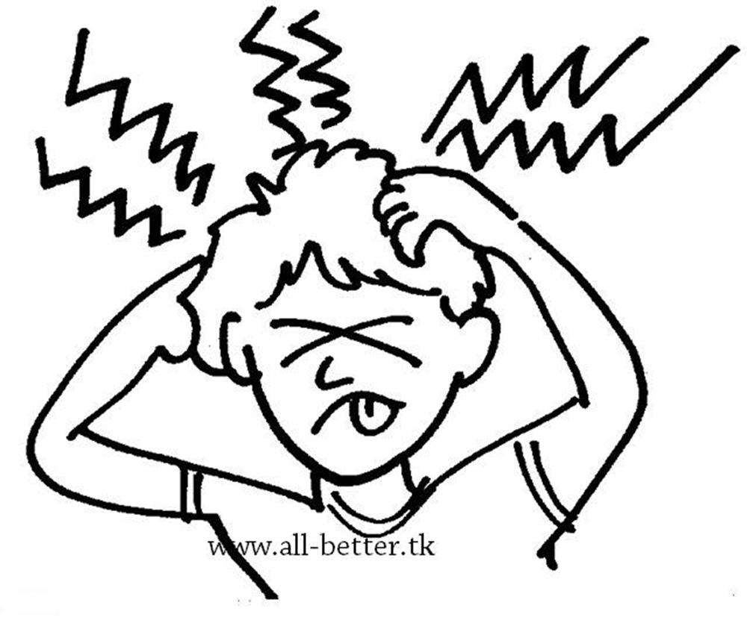
To have a headache

Slide 12
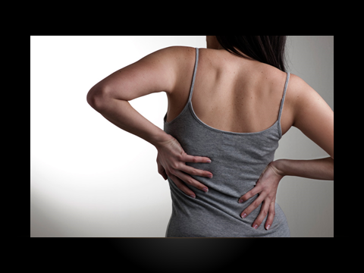
To have backache

Slide 13

What should (shouldn't) you do to be healthy?

Slide 14
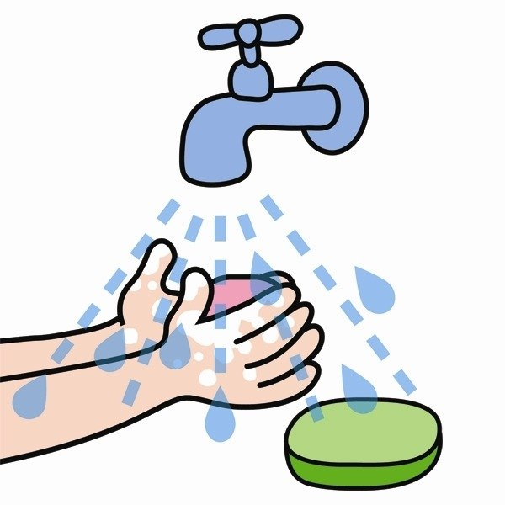
You should wash your hands before meals.

Slide 15
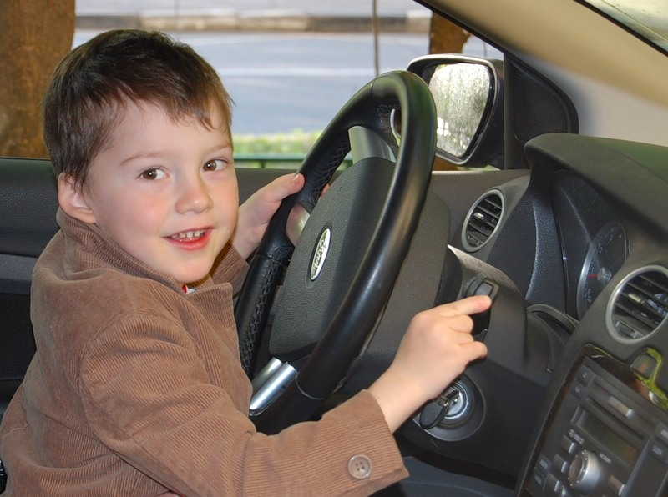
You should not stay alone in the car.

Slide 16

You should not take other people’s medicine.

Slide 17

You should not sit close to the TV.

Slide 18
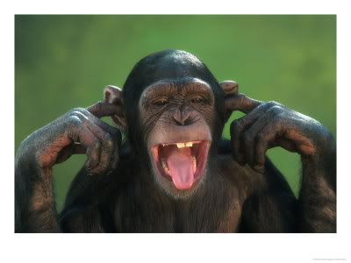
You should not put anything in your ears.

Slide 19
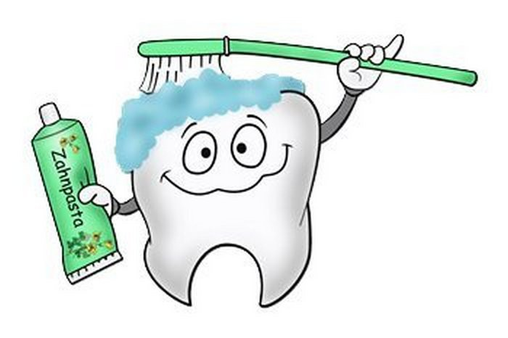
You should clean your teeth twice a day.

Slide 20
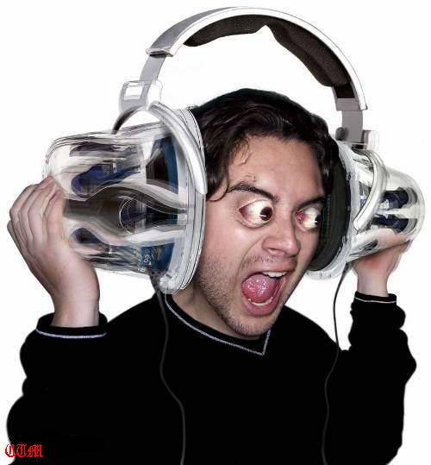
You should not listen to loud music into headphones.

Slide 21
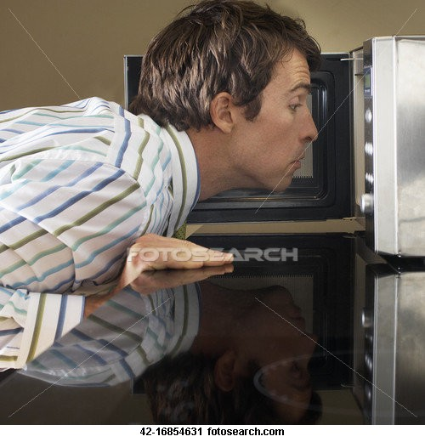
You should not play with a microwave oven.

Slide 22

You should eat healthy food.

Slide 23

You should not sit at the computer for a long time.

Slide 24
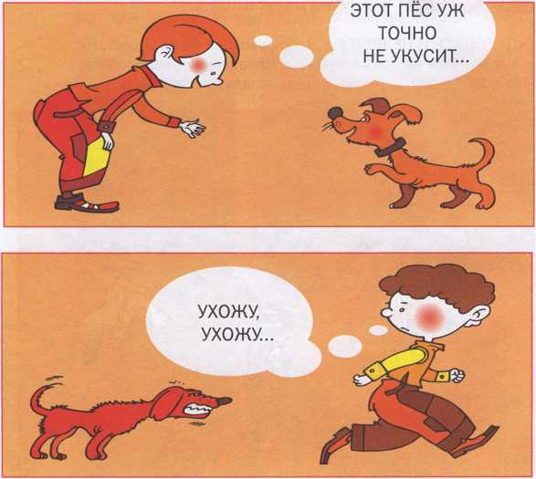
You should not play with angry dogs

Slide 25

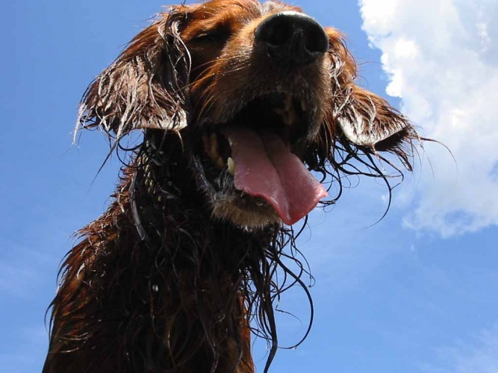
After the bath
After my bath
I try, try, try
to wipe myself
'till I'm dry, dry, dry.
Hands to wipe
and fingers and toes
and two wet legs
and a shiny nose.
Just think how much
less time I'd take
if I were a dog
and could shake, shake, shake.

Slide 26
PAST SIMPLE PRESENT PERFECT
PAST SIMPLE
Yesterday, last, ago, the day before yesterday, in 1960
PRESENT PERFECT
Ever, never, just, recently, already, yet, for, since, today
He played football yesterday.
He didn`t play football yesterday.
Did he play football yesterday?
He bought a car yesterday.
He didn`t buy a car yesterday.
Did he buy a car yesterday?
He has just played football.
He hasn`t played football .
Has he played football?
He has bought a car.
He hasn`t bought a car.
Has he bought a car?

Slide 27
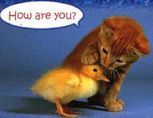
Dialogues
I haven`t seen you for ages
You don`t look well
Some health problems
What`s wrong with you
Consult a doctor
Have a medical check
Take medicine
Stay in bed and have a rest
Visit a dentist
Have vitamins and do sports
It may be a serious problem

Slide 28
PLAN OF OUR WORK
1. Revising vocabulary
2. Speaking ( giving some advice)
3. Brushing up grammar (Past Simple,
Present Perfect).
4. Acting out the dialogues

Slide 29
1. An apple a day keeps a doctor away.
2. Good health is above wealth.
3. Early to bed
Early to rise
Makes a man healthy, wealthy and
wise.

