Slide 1
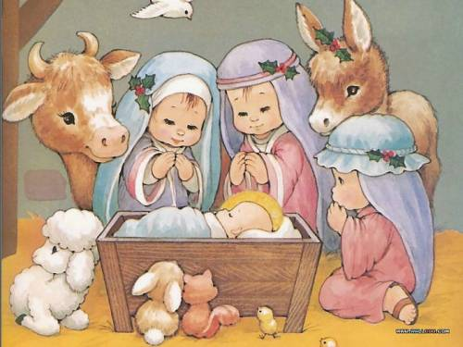
What word hides? It is the topic of our lesson.
Eyerybody knows that _************__
Is a very happy time !
Snowflakes are playing with us
Giving us a chanсe of smile.

Slide 2

You are right!
It is Christmas !!!
How do you think?
What will we do today?

Slide 3
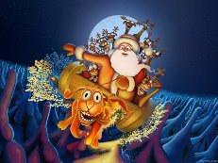
C
H
R
I
S
T
M
A
S
Cirсles on the water:

Slide 4
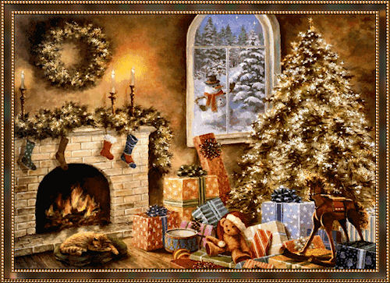
Answers:
Celebrate
Horse
Raindeer
Ice
Snowflakes
Tree
Merry
Angels
Snow

Slide 5
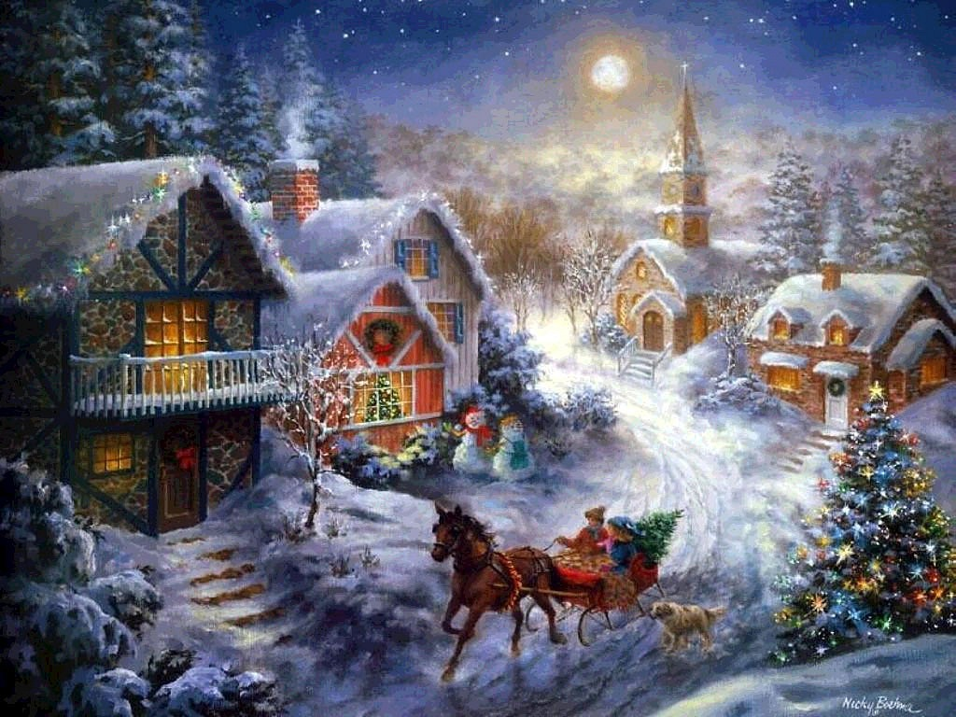
Work in groups:
Survive the picture !
Use the forms of Present Progressive.

Slide 6
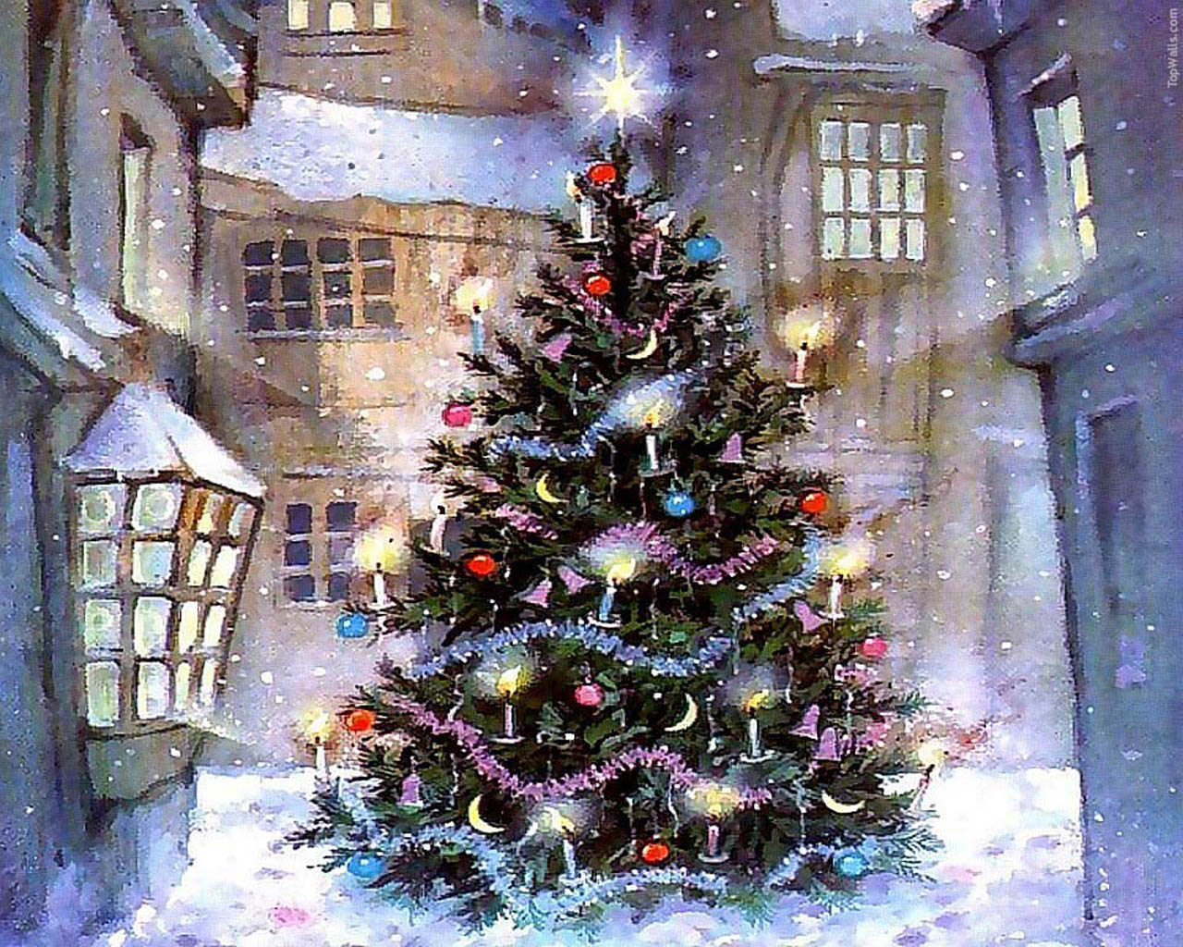
Celebrate Christmas

Slide 7
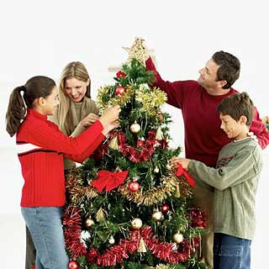
On the 25th of December British people celebrate Christmas.

Slide 8
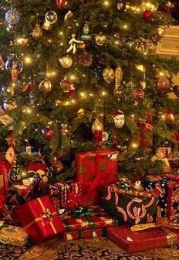
Every year Londoners get a present from Norway-a big Christmas tree.

Slide 9
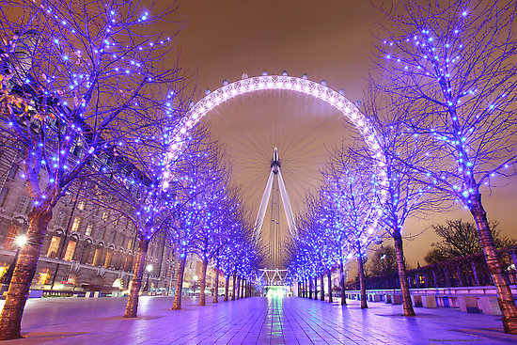
Central London’s streets have got beautiful decorations at Christmas.

Slide 10
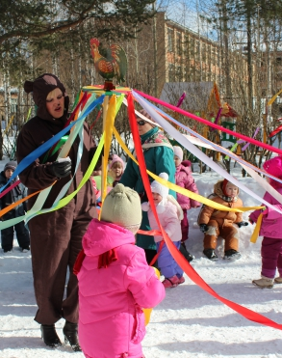
Before Christmas groups of singers perform traditional Christmas songs or carols in the streets and squares. They collect money for charity.

Slide 11
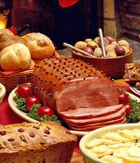
British Christmas dinner consist of a roast turkey with carrots and potatoes and Christmas pudding.

Slide 12
Method“Yes” or “No?”:
1.On the 25th of January British people celebrate Christmas.
2. Every year Londoners get a present from Russia-a big Christmas tree.
3. London’s cars have got beautiful decorations at Christmas.
4. Before Christmas singers collect money for shopping.
5.British Christmas dinner consist of a roast pork.

Slide 13
Find mistakes:
Deer Santa !!!
London
Britain
December,25
Thank you very much for your presents last year. I played with your computer games with my friends. Best of all I liked “Simpsons”. It was really interesting.
I study very well. My favorite subject is English. I like to read and learn by heart. I would like to have new mobile phone with Internet.
Write me soon.
Best wishes.
Ann

Slide 14
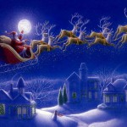
At home:
Write a Letter to Santa.
Don’t forget to ask a present for yourself.

