Slide 1
Урок для 3 класса
по теме «Present Continuous»
Учителя МБОУ СОШ №102 г. Новосибирска
Кяупа Елены Анатольевны
Цель урока:
Введение времени Present Continuous в утвердительных предложениях

Slide 2
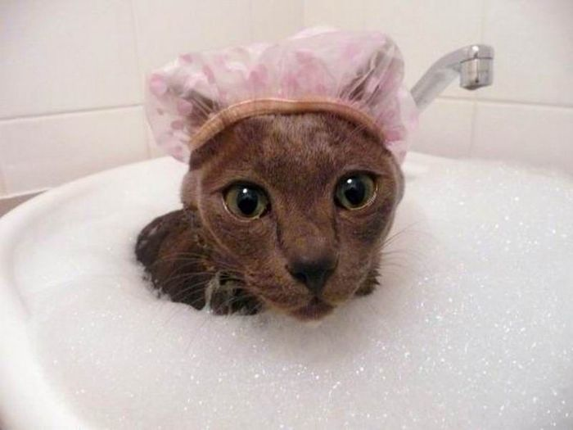
Present Continuous Настоящее длительное
Кто-то или что-то делает
сейчас
The cat is having a bath.

Slide 3
How to make sentences?
Remember the fairy-tale about a dragon!

Slide 4







He
She
It
You
We
They
I
is
am
are
что делает
сейчас
read
ing

Slide 5
is
am
are
I
It
He
We
They
She
You
ing
что делает
сейчас

Slide 6
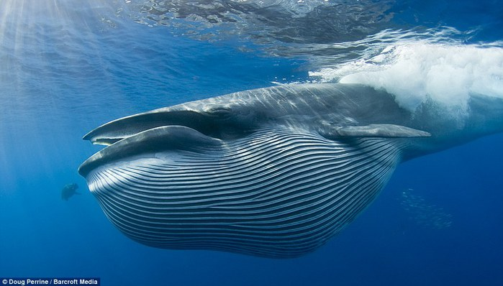
The whale __ swim __.
is
m
ing

Slide 7
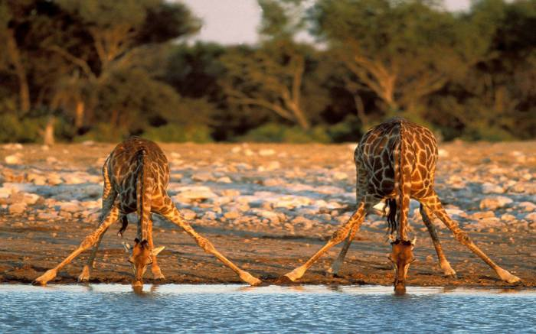
The giraffes __ drink__.
are
ing.

Slide 8
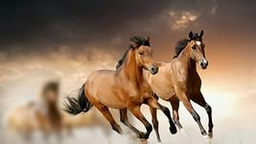
The horses __ run __.
are
n
ing

Slide 9

am
I __ study__ English.
ing

Slide 10
Writing Rules
run
run ing
1)
ing
n
2)
have
ing
hav
ing
e
3)
drink
ing
drink
ing

Slide 11
sleep
sleep
ing
fight
fight
ing
sit
sit
t
ing
danc
e
dance
ing
drink
drink
ing
swim
swim
m
ing

Slide 12
The whale is swimming
The hippos are fighting
The camels are running

Slide 13
Tom
watching TV
.
is
.
is
Sally
a bath
having

Slide 14
The birds
singing
.
are
.
are
The tigers
roaring

Slide 15

Can you make sentences in Present Continuous?
- Yes, I can !
- Yes, but not
very well.
- So-so.

Slide 16
HOMEWORK:
p.32 (w.b.),
learn a dragon.
ex.1 (site)

