Slide 1
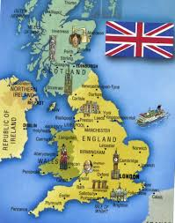
The Icons of the United Kingdom

Slide 2
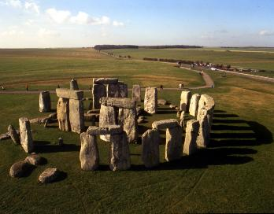
Stonehenge
Stonehenge is a prehistoric
monument on Salisbury Plain in Wiltshire, England. It was built about 4000 years ago. Scientists think the early inhabitants of Britain were sun-worshippers and built Stonehenge in honour of the god sun. Some believe that Stonehenge was a temple used by the Druids for their religious ceremonies.

Slide 3
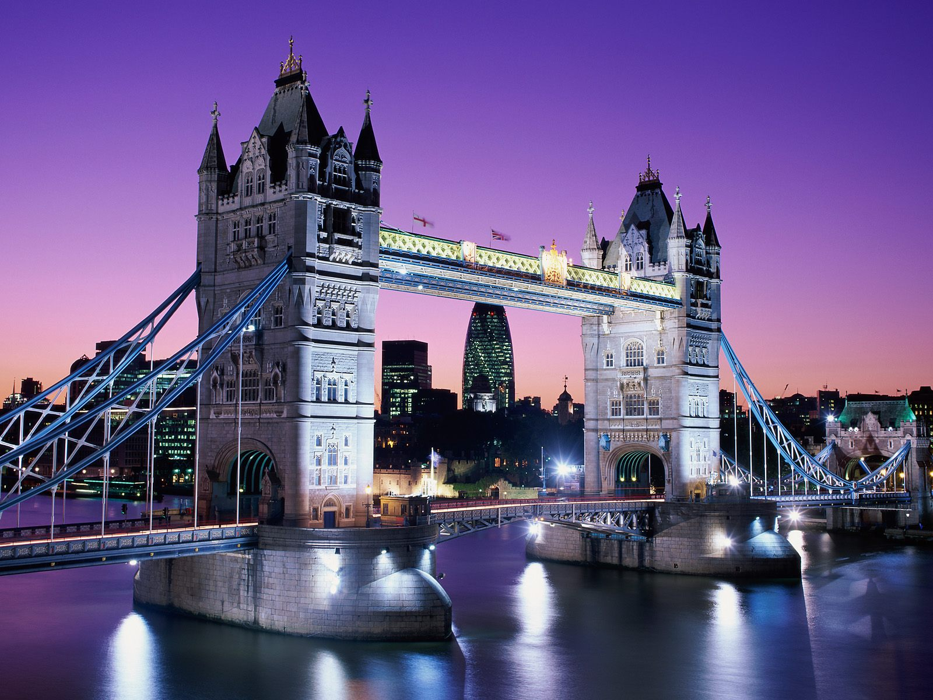
Tower Bridge
Tower Bridge (built 1886–1894)considered a wonder of the world when it was opened. It crosses the River Thames. It is close to the Tower of London, from which it takes its name, and has become an iconic symbol of London. Tower Bridge is the only Thames bridge which can be raised to let large ship to pass.

Slide 4
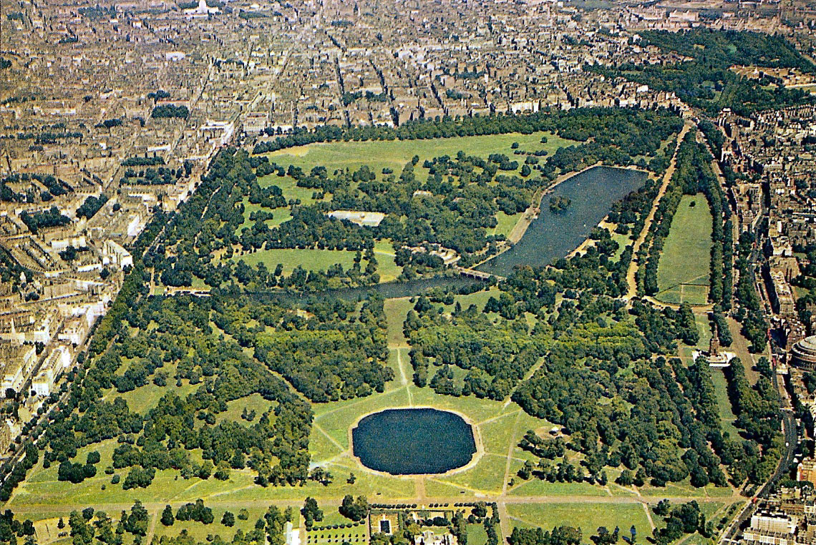
Hyde Park
Hyde Park is one of the largest parks in London including the adjoining Kensington Gardens. Hyde Park has a large and attractive lake called the Serpentine. This park is famous for its Speakers' Corner where numerous speakers propound the most extraordinary ideas in front of the public.

Slide 5
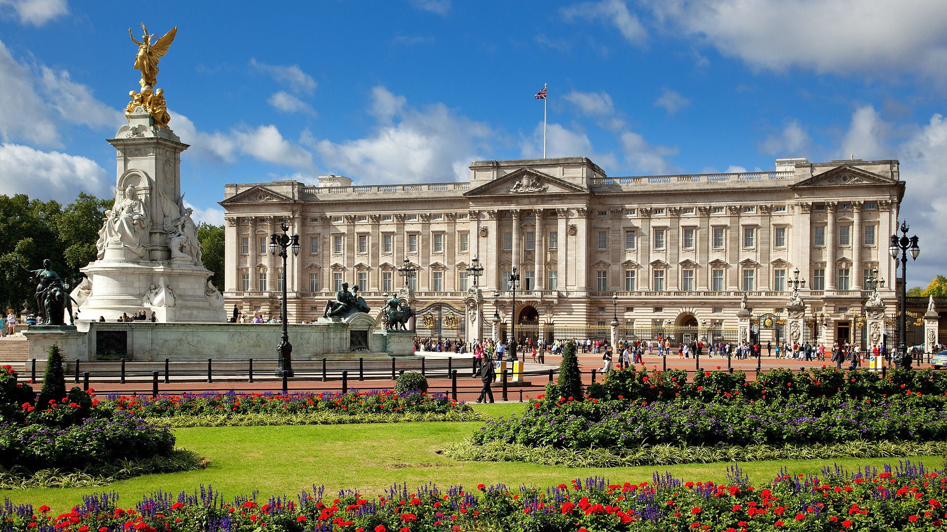
Buckingham palace
Buckingham palace is the official London residence and principal workplace of the British monarch.
Located in the City of Westminster, the palace is a setting for state occasions and royal hospitality. When the Queen is in London the royal standard flutters over the palace.

Slide 6
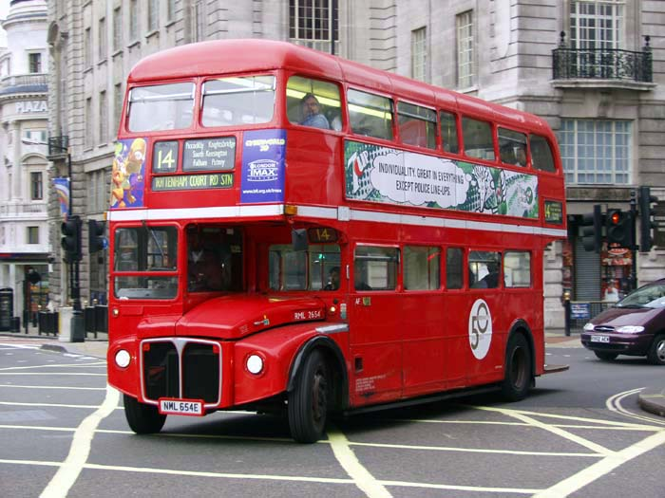
Big Red London Bus
The London Bus is one of London's principal icons. The powerful Routemasters which date from 1950s and 60s were designed specially for London. Although the Routemaster has now been largely phased out of service, with only two heritage routes still using the vehicles the majority of buses in London are still red and therefore the red double-decker bus remains a widely recognised symbol of the city.

Slide 7
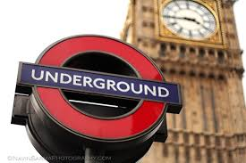
London Underground
London Underground or the Tube as most people call it is the oldest in the world. The first underground railway, the Metropolitan Railway, was opened in 1863. The system serves 270 stations and has 402 kilometres (250 m) of track, 55 per cent of which is above ground. The trains are rather slow – their average speed is 30 km per hour.
Notes:
ао

Slide 8
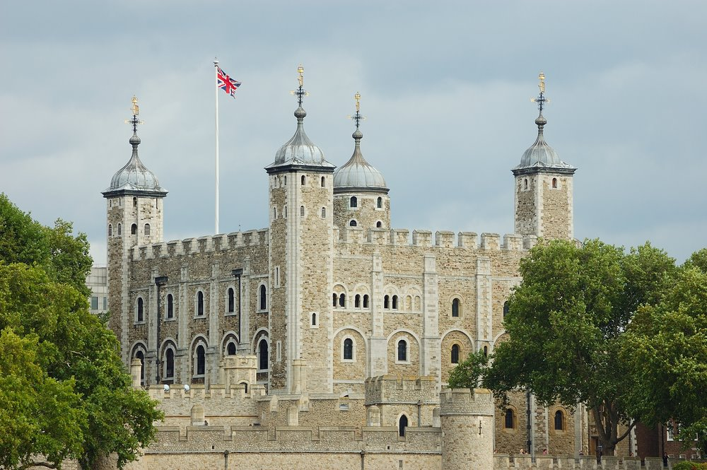
The Tower of London
The Tower of London, is a historic castle on the north bank of the River Thames in central London. It was started in 1066 by William the Conqueror. Throughout its 900year history the Tower has been many things: a palace, a fortress, a prison, a place of execution and even a zoo. Today the Tower is a historical museum. About 150 people and eight ravens live in the Tower.

Slide 9
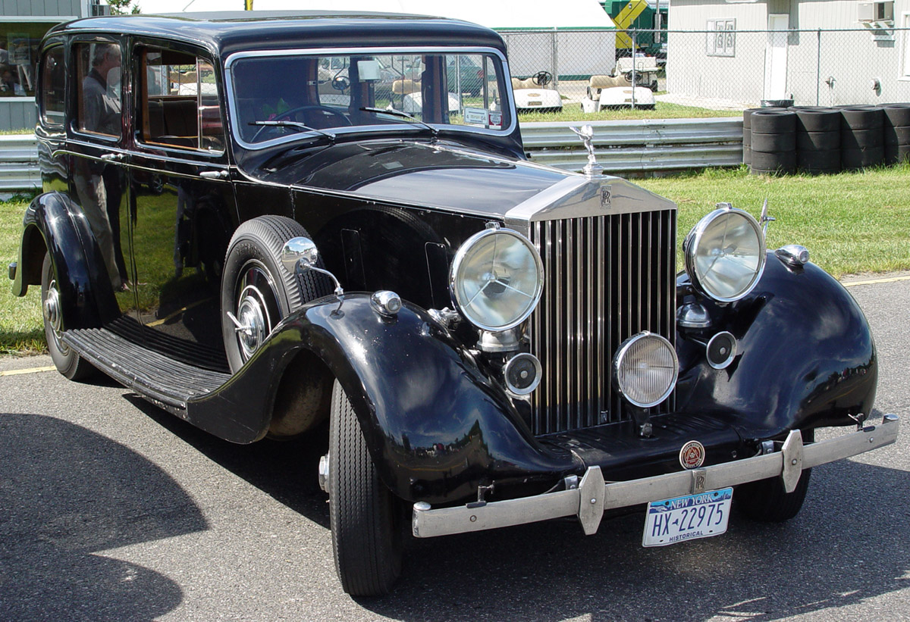
Rolls Royce
The most luxurious classic car in the world was born more than 100 years ago. It was the brainchild of engineer Henry Royce and car trader Charles Rolls. When they founded the Rolls Royce company in 1904-1905, their aim was nothing less than to make ‘the best car in the world. Two years later, the best car was produced. Its nickname was the ‘Silver Ghost’ because of its quietness and smoothness. The small metal statue on the front of every Rolls Royce is a work of art in its own right. It’s called the ‘Spirit of Ecstasy’.

Slide 10
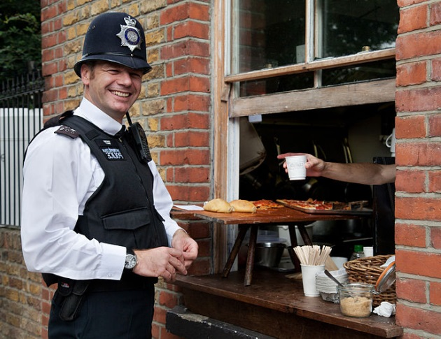
British bobby (policeman)
To be a police officer in the UK you need to have a strong constitution, a very good sense of humor, a sense of duty and most of all believe in the importance of law and order. The London police force was created in 1829 by Sir Robert Peel (hence the nicknames “bobbies” and “peelers” for policemen). Sir Robert Peel was a very famous politician. He became a Member of Parliament when he was only 21.

Slide 11
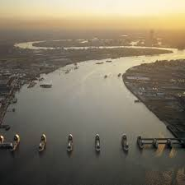
The Thames
The river Thames originates on a hill Cotswold and flows into the North Sea, forming the estuary. Width of the river within the boundaries of London 200-250 m. The Thames is the second longest river in the UK. It is 352 km long. Historians call it liquid history . The Thames was once a dangerous river. There were many floods on it and people had to build a barrier to protect London. The Thames is called very often Old Father Thames

Slide 12
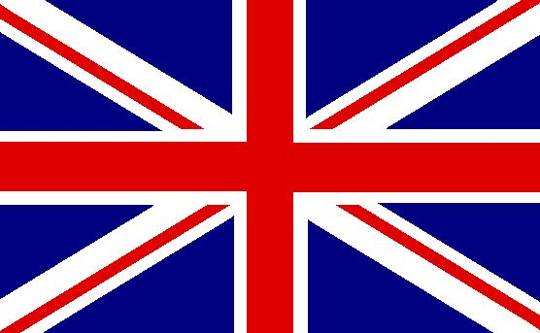
The Union Jack
Flag of Great Britain is one of the state symbols of the United Kingdom of Great Britain and Northern Ireland. It is a blue rectangular cloth with the image of a red cross in a white straight edging imposed on white and red oblique crosses. The nickname of the flag is the Union Jack.

Slide 13
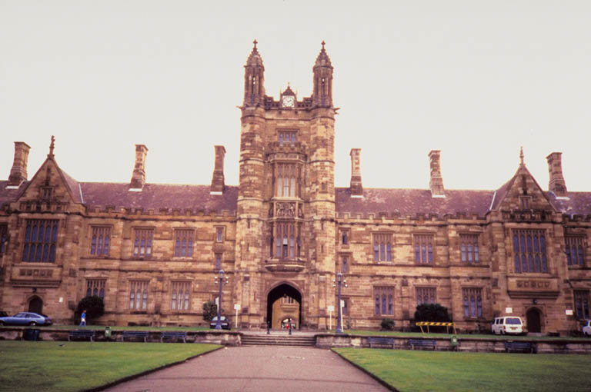
Private School
Private schools are educational institutions of primary or secondary education. Eton is probably the most famous school in the world. It has educated boys for nearly six centuries.
Harrow, the second best public school after Eton was founded in 1572. Well, if you want to study in public school you need to have money as some public school charge is EU 20 000 a year.

Slide 14
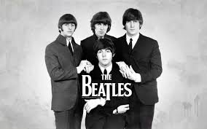
The Beatles
The Beatles band members separately called "The Beatles", also referred to as "the Fab Four" - British rock band from Liverpool, founded in 1960, which included playing John Lennon, Paul McCartney, George Harrison, Ringo Starr. Also, at different times in the group were Pete Best, Stuart Sutcliffe and Jimmy Nicol. Most of the songs the Beatles created co-written and signed by John Lennon and Paul McCartney.

Slide 15
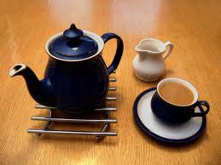
A Cup of Tea
Tea in England - more than tea. It’s a suitable occasion for a chat over a cup of tea. This tradition is observed not only by the queen but the simple British too. Tea making is an art.
This is a special culture - from brewing to use; it has many followers and far beyond the island. The famous five o'clock tea no longer need to be translated. There’s a tradition of celebrating the International Day of tea (December 15)!

Slide 16
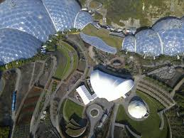
Eden Project
The Eden Project began as a dream. Tim Smit, an archaeologist, decided to build a new Eden – a beautiful park with huge greenhouses filled with exotic plants from all over the world. In spring 2001 a large environmental park in Cornwall was opened to the public. Greenhouses area is 22 000m ².

Slide 17
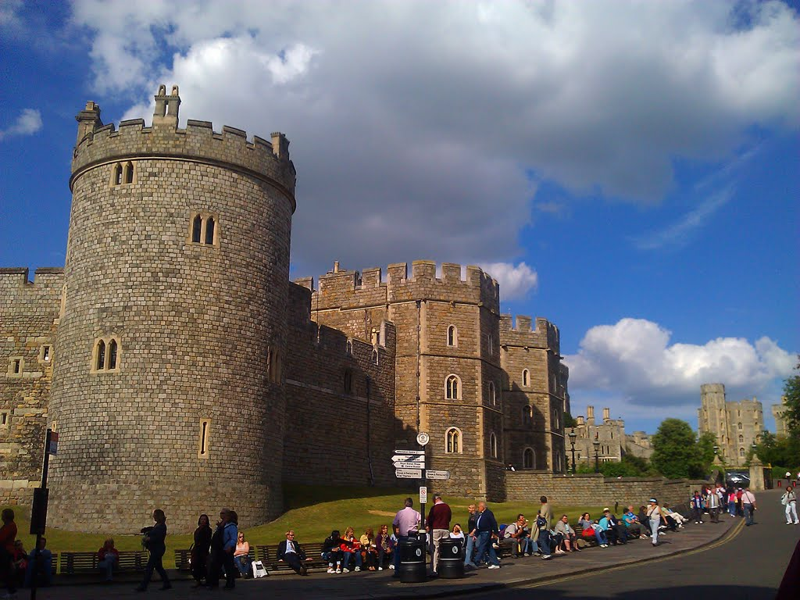
Windsor Castle
Windsor Castle is an official residence of the British Royal family. William the Conqueror began building it on a hill above the River Thames 900 years ago. The dominant structure of the castle is the high Round Tower. It is built on the site where, according to tradition, King Arthur sat with the Knights of the Round Table. Today, nine centuries after its foundation, the Castle continues to perform its prime role as an official residence of the Queen.

Slide 18
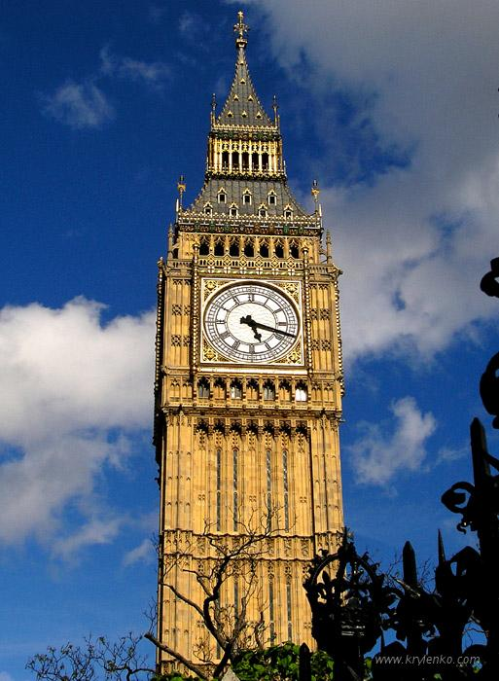
Big Ben
Big Ben is the name of the largest of the six bells of Westminster Palace in London. Nobody knows why it is called so. May be it was something to do with Sir Benjamin Hall, a fat man who was in charge of the building works at Westminster and whose nickname was Big Ben. Clock Tower as a whole which in September 2012 was officially called "Elizabeth Tower"

Slide 19
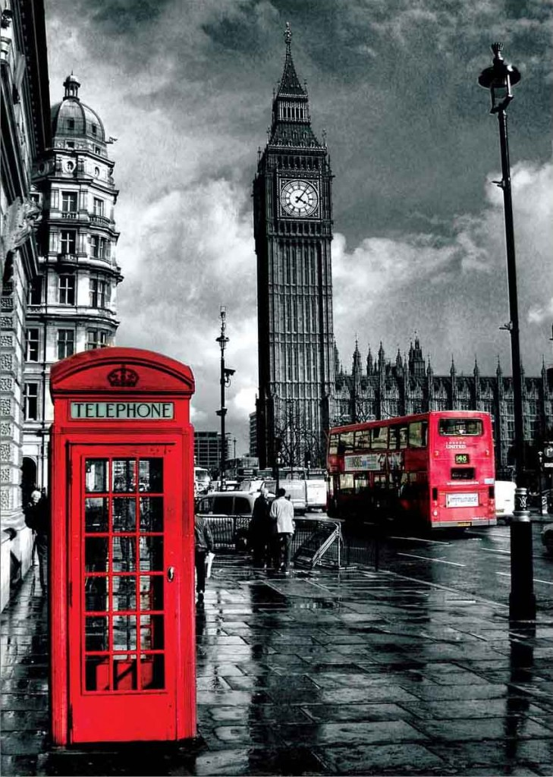
Red Telephone Box
The famous red telephone boxes were designed by architect Giles Gilbert Scott in the 1920s. The colour red was chosen to make them easy to spot.
Sadly, these images of England are now disappearing. After the privatization of the Post Office Telephone, British Telecom began to replace them with a new model.

Slide 20
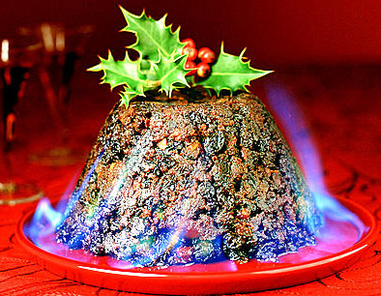
Christmas Pudding
Christmas pudding is traditionally served on Christmas Day (December 25) as part of the Christmas dinner. It has its origins in medieval England, and is sometimes known as plum pudding . Xmas pudding with its breathtaking aromas is round and dark-coloured The pudding is composed of many dried fruits and also, flavoured with cinnamon, nutmeg,
ginger, and other spices. The pudding is decorated with a small branch of holly on the top and sometimes a small silver coins is hidden inside.

Slide 21
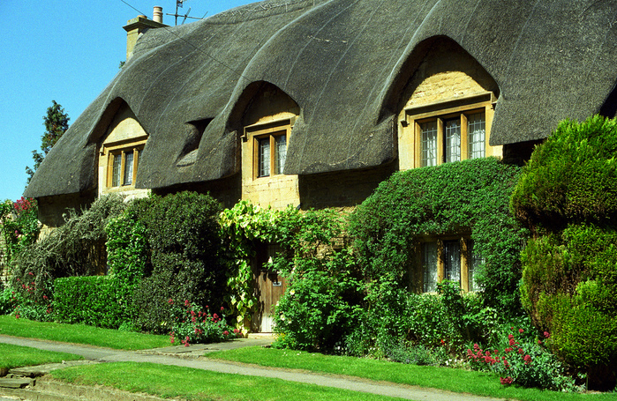
The End

