Slide 1
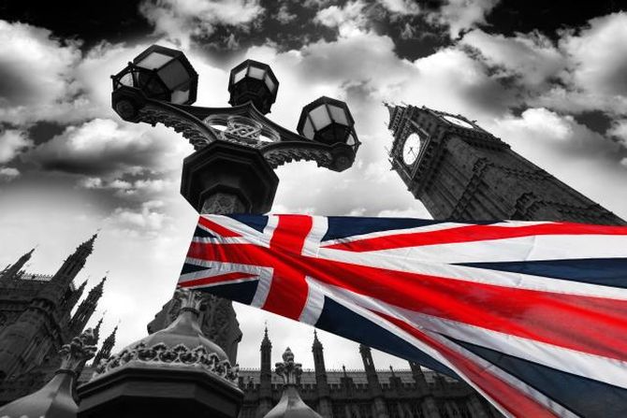
Методическая разработка Викторина по английскому языку Тема: «Тайны туманного Альбиона»
Автор: Коновалова Анна Александровна, преподаватель иностранного языка ГБОУ СПО Зарайского педагогического колледжа им. В. В. Виноградова
Московской области

Slide 2
Цель занятия: обобщить пройденный материал по разделу «Страноведение. Британия»
Задачи:
- оценить уровень знаний учащихся;
- закрепить навыки работы в группе;
- расширить кругозор учащихся.
Необходимое техническое обеспечение: компьютер, проектор, аудиосистема.

Slide 3
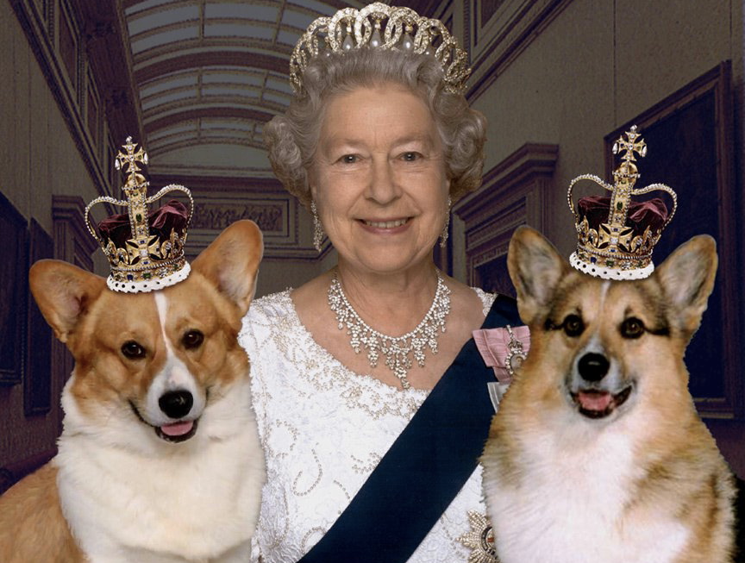
I этап
Ассоциации к слову QUEEN.
Каждая команда называет по очереди по английскому слову-ассоциации.
Побеждает команда, последняя назвавшая слово. (1 бал)

Slide 4
II этап
Wrong word – Найти лишнее слово в каждой строчке
1. Dickens, Byron, Shakespeare, McCartney
2. Buckingham, Windsor, Louver, Alnwick
3. Belfast, Dublin, Edinburgh, Cardiff
4. The Celts, the Druids, the Picts, the Angels
5. The British Isles, Albion, Great Britain,
the English Chanel
Правильный ответ в каждой строчке - 1 бал

Slide 5
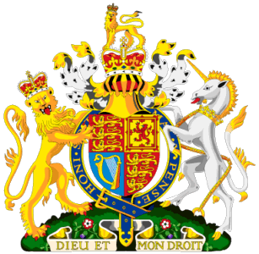
1. McCartney
2. Louver
3. Dublin
4. the Druids
5. the English Chanel

Slide 6
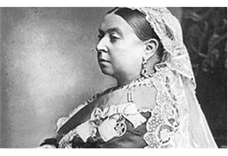
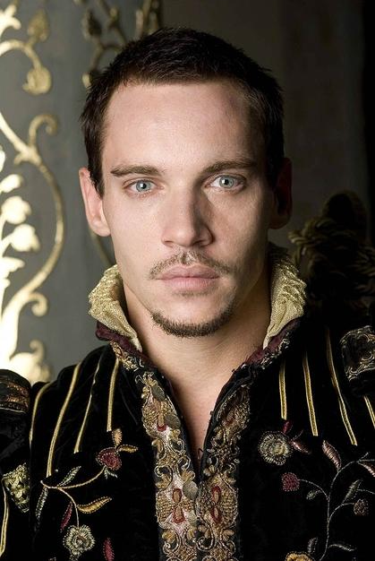
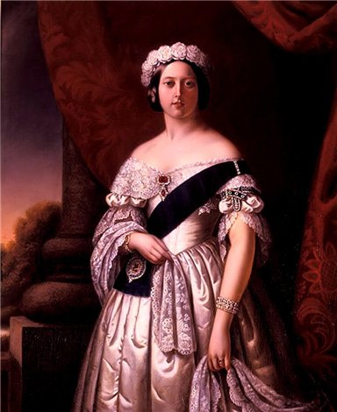
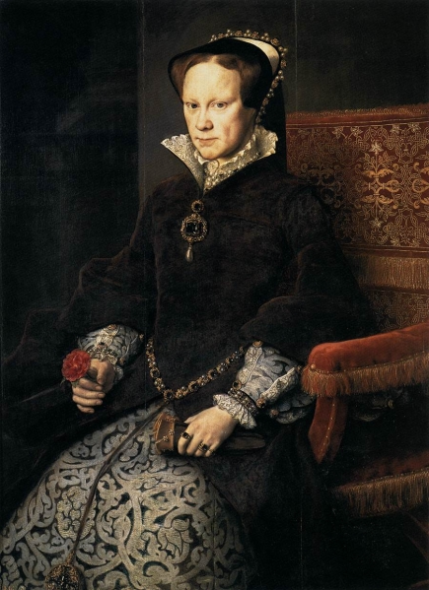
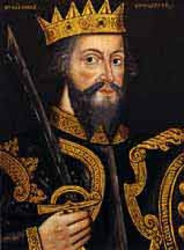
Who AM I? III этап

Slide 7
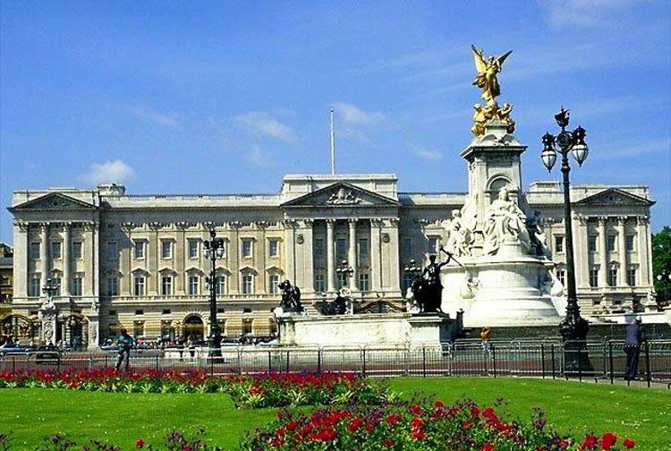
IV этап
BUCKINGHAM

Slide 8
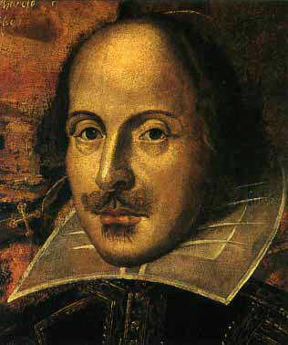
V этап - Faces
A famous English playwright, the author of ”Hamlet”

Slide 9
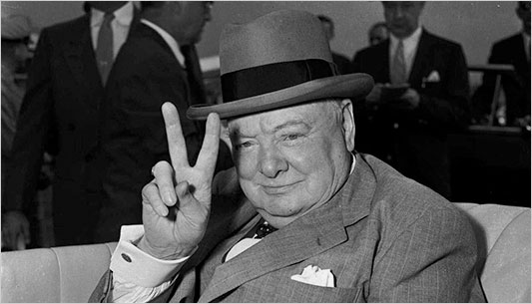
The Prime Minister of
the UK during W W II

Slide 10
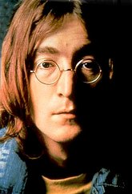
The front leader of a Liverpool group

Slide 11
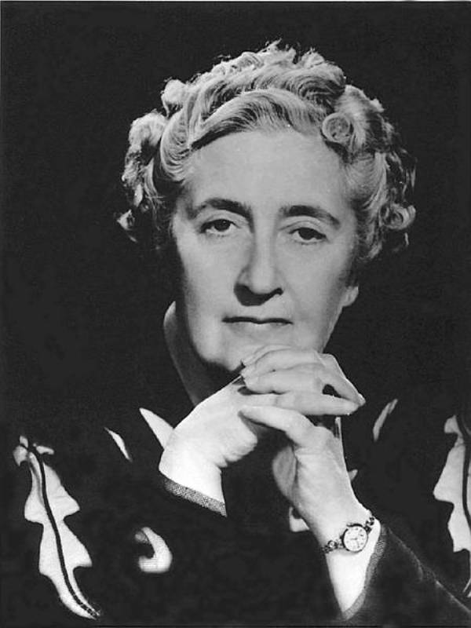
This woman is the author of detective stories about Hercule Poirot

Slide 12
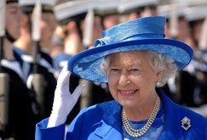
This woman has a son whose title is the Prince of Wales

Slide 13
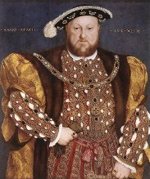
This English monarch had executed
two of his wives

Slide 14
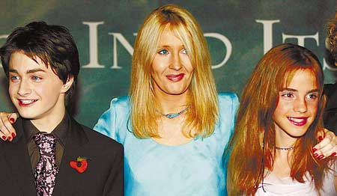
This woman is the author of seven books about a young magician

Slide 15
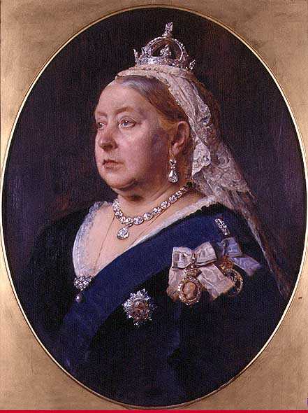
This woman built a cultural centre in the name of her husband

Slide 16
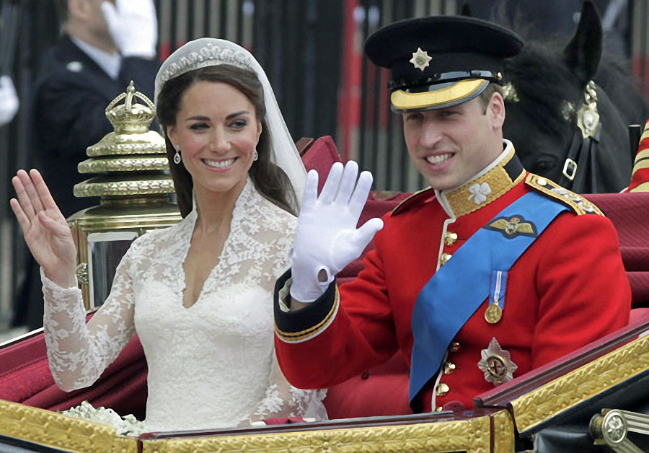
This young man will be the king of the UK after his father’s death

Slide 17
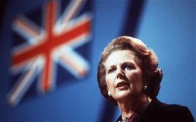
The only female Prime Minister of the UK

Slide 18
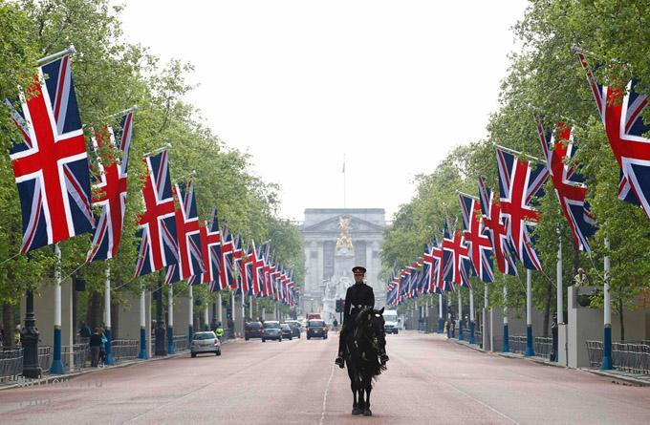
VI этап
1. The future king of England is called the Prince of Wales
2. Welsh is an official language in Wales
3. The BBC stands for “Best British Culture”
4. In Britain black cats are believed to bring bad luck
5. The president of Britain is elected every seven years
6. Haggis is a traditional Scottish musical instrument
7. A bobby is a guard at the Tower of London
8. Shakespeare was born in Stratford-upon-Avon

Slide 19
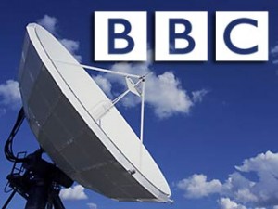
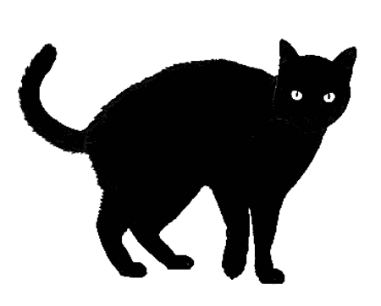
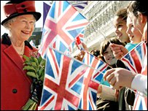
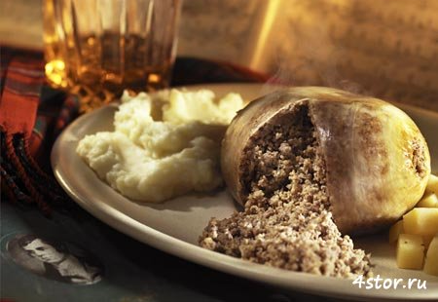
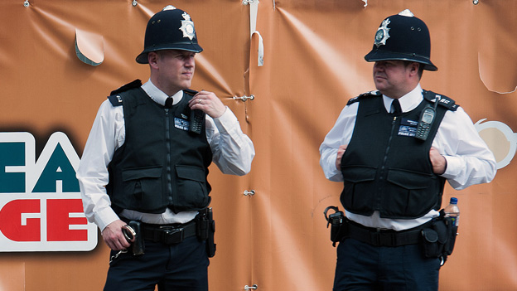
1.T
2.T
3.F - British Broadcasting Company
4.F - they bring good luck
5.F - it’s a constitutional monarchy
6.F - it’s a dish
7.F - it’s a nickname of a police officer
8.T

Slide 20
VII Блиц-тест
1)The capital of Northern Ireland a. Dublin b. Cardiff c. Belfast
2)The British flag is often called a. the Union Jack
b. the Stars and Stripes c. the Maple Leaf
3) Ben Nevis is a. a famous footballer
b. a sort of whiskey c. a mountain
4) The mysterious Loch ness Monster is from a. Wales
b. Ireland c. Scotland
5) The kilt is a. a skirt b. a shirt c. a pair of trousers
6) The Great Fire in London was in a. 1966 b. 966 BC c. 1666
7) Who built the wall to separate Scotland from England?
a. Elizabeth I b. Emperor Hadrian c. William the Conqueror
8) The famous tennis contest takes place at a. Wembly
b. Covent Garden c. Wimbledon

Slide 21
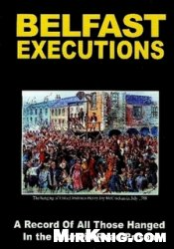

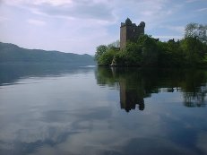
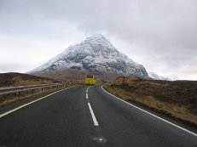
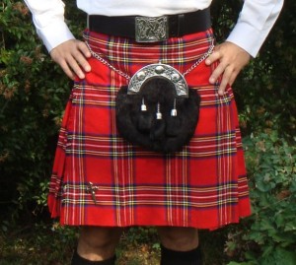
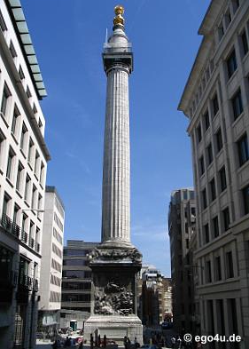
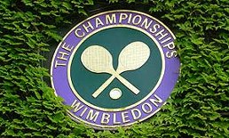
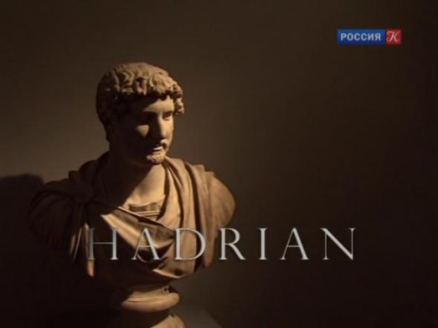
1.Belfast
2.The Union Jack
3.A mountain
4.Scotland
5.A skirt
6.1666
7.Emperor Hadrian
8.Wimbledon

Slide 22
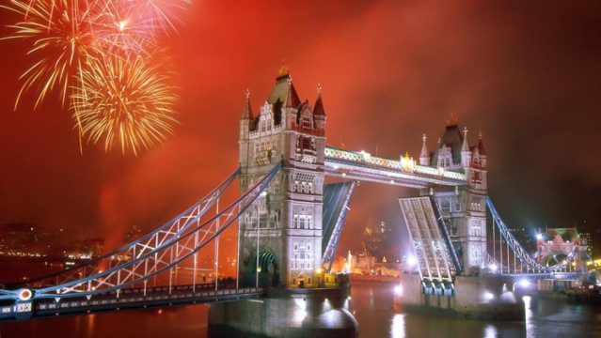
Let’s count your score
Congratulations,
the winners!!!
Thank you!!!

