Slide 1
London

Slide 2
Today we’ll go on an excursion around London

Slide 3
Be active and hard-working!

Slide 4
Complete the sentence.
I know that … .

Slide 5
What is in Russian the word “ a fortress”?

Slide 6
What is in Russian the word “ a palace”?

Slide 7
What is in Russian the word “ a prison”?

Slide 8
What is in Russian the word “ a cathedral”?

Slide 9
Какое грамматическое время мы используем, когда говорим о том, что мы уже сделали?

Slide 10
Present Perfect

Slide 11
Say that you have already done the following.
Water the flowers!

Slide 12
I have already watered the flowers.

Slide 13
Cook breakfast!

Slide 14
I have already cooked breakfast.

Slide 15
Wash up!

Slide 16
I have already washed up.

Slide 17
Let’s begin our tour around London.

Slide 18
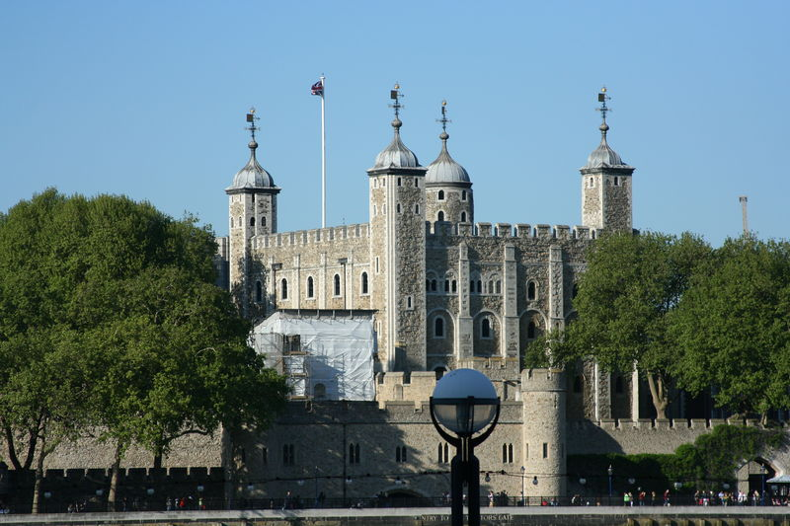

Slide 19
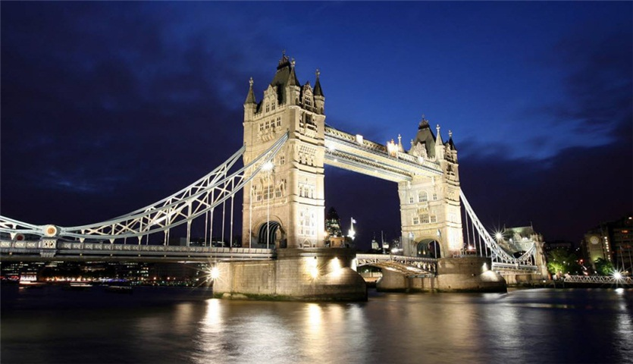

Slide 20
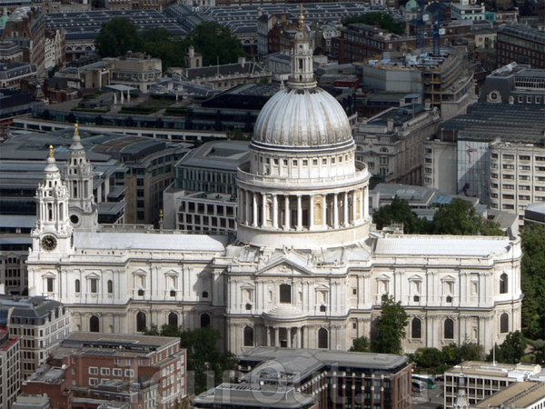

Slide 21
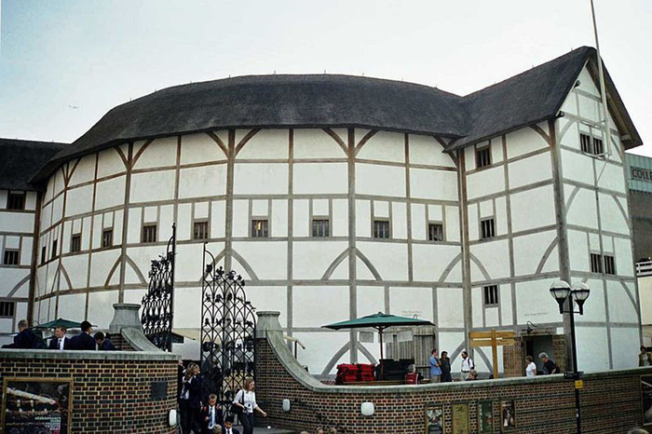

Slide 22
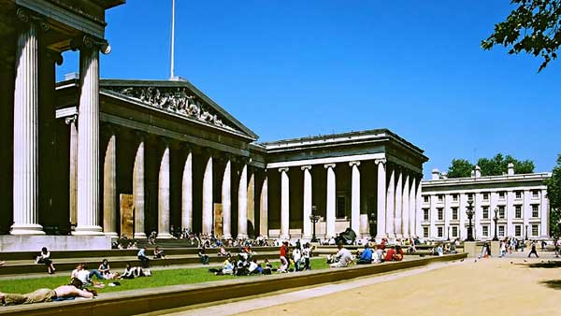

Slide 23
Is the Tower of London a museum or a palace now?

Slide 24
It is a museum now.

Slide 25
Who designed St. Paul’s Cathedral?

Slide 26
Sir Christopher Wren.

Slide 27
How many works are there in the British Museum?

Slide 28
8 million works.

Slide 29
Is the Globe Theatre a copy or original Shakespeare’s Theatre?

Slide 30
It is a copy.

Slide 31
It’s time to count your stars.
If you have 15-20 stars, your mark is “5”.
If you have 10-12 stars, your mark is “4”.

Slide 32
Your hometask: find information and make a poster about one place of interest in London you like most.

Slide 33
I hope some day you will visit the places we remind in this lesson.

Slide 34
Good luck!

