Slide 1
Стоунхендж
Презентация к уроку английского языка в 6 классе. (Учебник – Happy English.ru. Авторы – К. Кауфман, М. Кауфман.)
Подготовила: учитель английского языка
МБОУ «ООШ №13» с. Новосевастпольское.
Сепертеладзе Ольга Николаевна

Slide 2
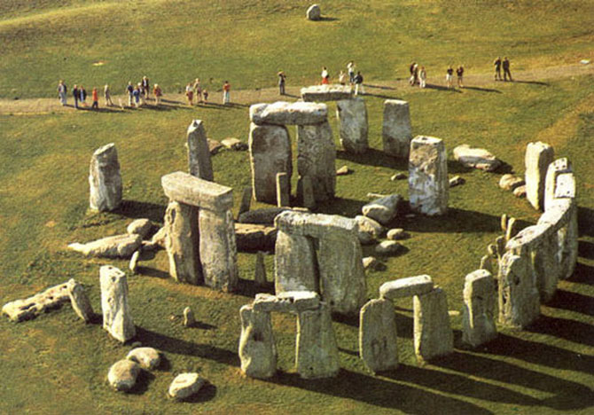
STONEHENGE

Slide 3
Stonehenge is in the heart of England, about 130 kilometers from London. They say, it was built between 3500 and 1100 B.C. We can translate the name Stonehenge as “Stones which hang in the air.”
It’s one of the most famous prehistoric monuments in Britain.
There are more than 200 theories about Stonehenge. What do we know about this “Giant’s Ring?” Who built it? What for?
Many scientists and architects investigated the 85 huge bluestones and sarsens 4- 7 metres tall and 45 tons weigh, but nowadays the questions are not answered.
Mysteries of Stonehenge attract lots of tourists, but they are not allowed inside the complex. The price of an 8 – hour excursion is €115.
Here are some of the theories.

Slide 4
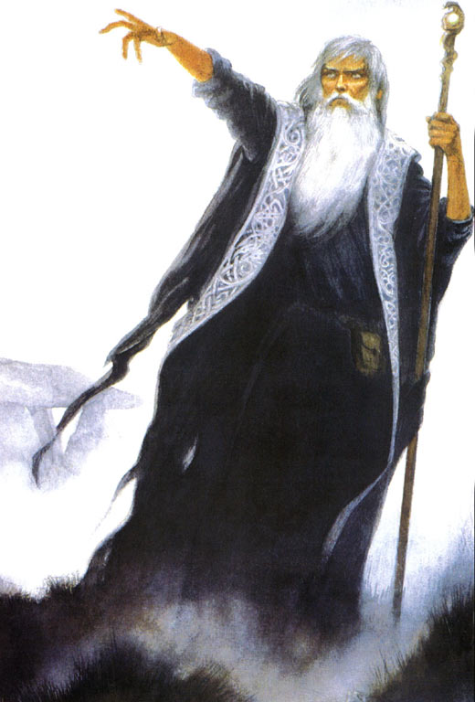
Version 1
.
There was a magic place Camelot in England. The kings and knights of Camelot were strong and wise. After a big war with Saxons many soldiers died. A great wizard Merlin used his magic to build Stonehenge to honour the dead.

Slide 5
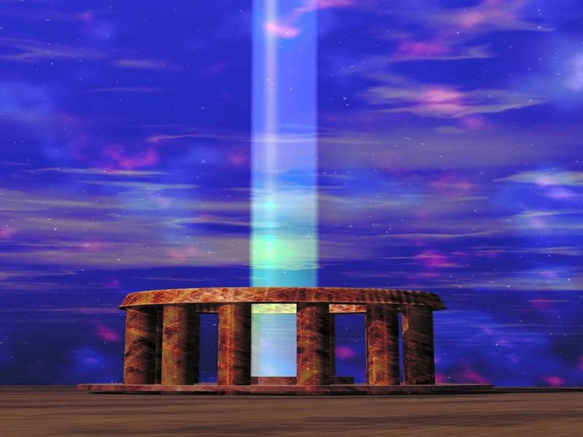
Version 2
Some people believe, that aliens built Stonehenge and used it as a compass for their spaceships.

Slide 6
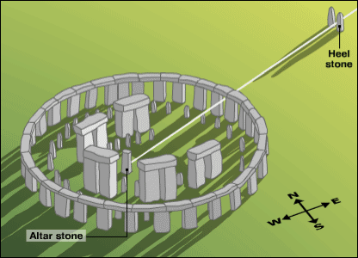
Version 3
It was the most outstanding ancient observatory. Those, who built it, knew a lot about planets, stars, the summer and winter solstices. “It was a very exact computer to define solar and lunar eclipses” - Professor Gerald Hawkings said.

Slide 7
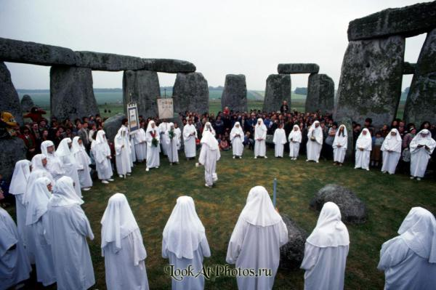
Version 4
Maybe Stonehenge was a temple of the ancient Gods and Druids. There are ancient graves of the nobles around Stonehenge, they say.

Slide 8
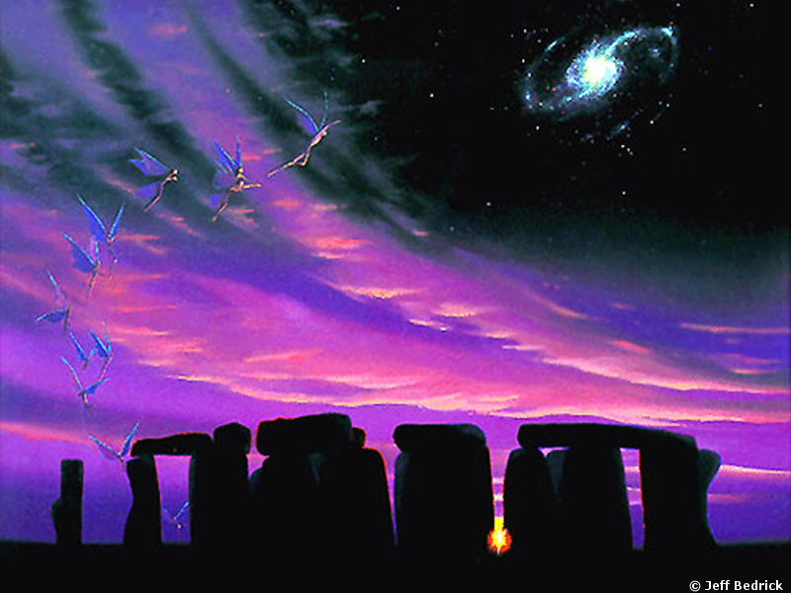
A Ballad of Stonehenge
“Three thousand years before Christ was a child,
England was beautiful, young and wild.
There were people, forests and rivers there,
And the magic stones hung in the air.

Slide 9
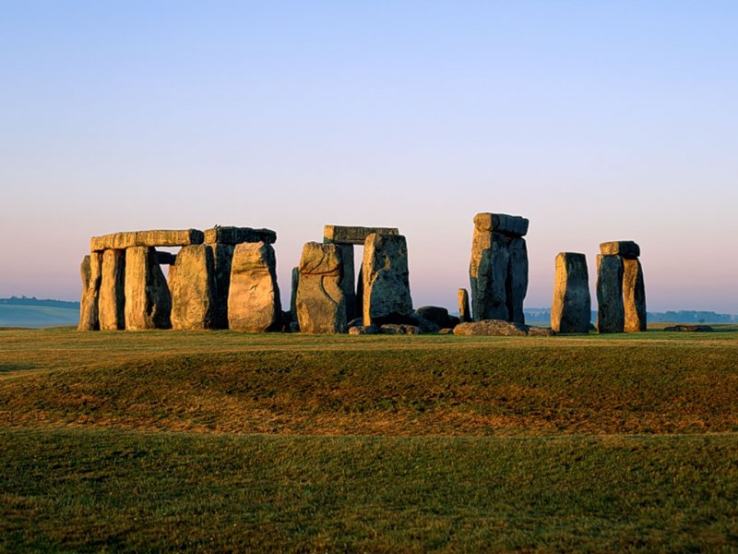
The people who brought them were strong and brave,
And under these stones they found their graves.
Where did they come from? Where did they go?
Who were these people? We’ll never know.

Slide 10
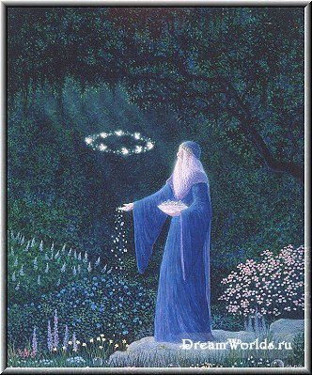
Was it a temple? An ancient god’s house?
Was it a compass for friends from the stars?
They built it five thousand years ago,
But why did they do it? We’ll never know.

Slide 11
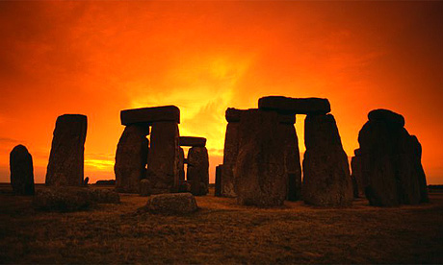
Now these days are gone and the people are gone,
But midsummer sunrise still shines on the stone.
And the midwinter sunset still comes with the rain,
And Stonehenge greets them on Salisbury Plane.” (K.,M. Kaufman)

Slide 12
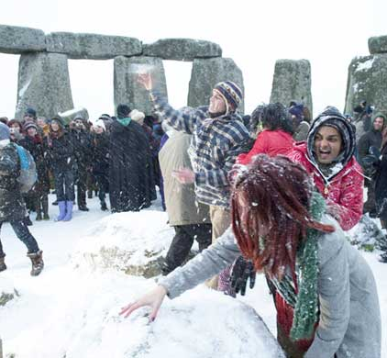
Many generations of scientists will do their best to understand what is Stonehenge. Don’t you think it is a good place to play snowballs nowadays?

Slide 13
PROJECT:
Dear friend, what is your idea of Stonehenge?

Slide 14
Использованная литература
1. Фарлонг Д. «Стоунхендж и пирамиды Египта». Серия: «Тайны древних цивилизаций». 2001.
2. Гарри Гаррисон, Леон Стоувер. «Стоунхендж». 2002.
3. Уайт Дж., Хокинс Дж. «Разгадка тайны Стоунхенджа».
4. Журнал «Эхо планеты» №25 1998 г. « Интересные факты и события».
5.Майк Паркер. «Стоунхендж: исследование величайшей загадки каменного века.»

