Slide 1
ГБОУ школа №246 Приморского района
Санкт-Петербурга
Презентация к уроку
Английского языка
в 5 классе на тему:
«East or West, home is best.»
.
Выполнена: учителем английского языка
Кондрашкиной Светланой Владимировной
2014 год

Slide 2
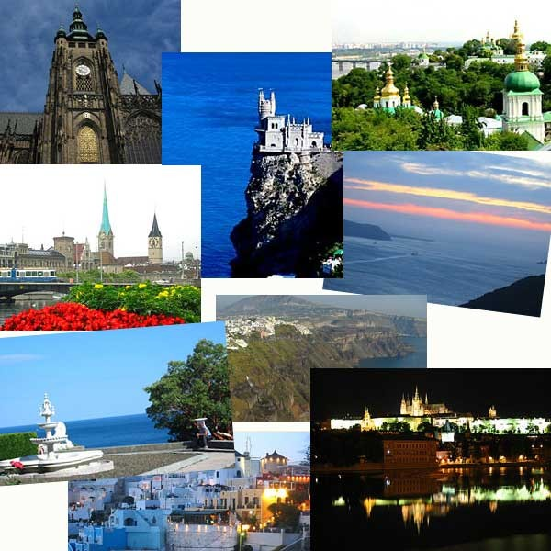
East or West, home is best.

Slide 3

1.There is welcome home . 2.The wider we roam the home is best. 3.East or West, no place like home.
.

Slide 4
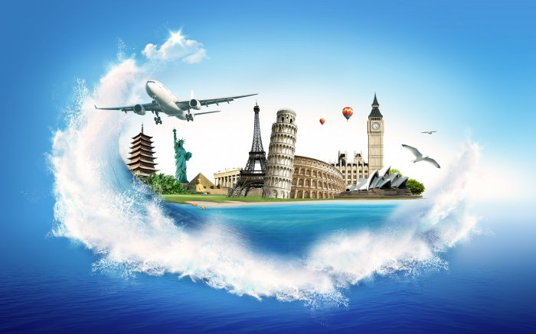
«The world is a book and those who do not travel read only a page», said St. Augustine.
.

Slide 5
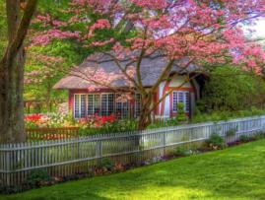
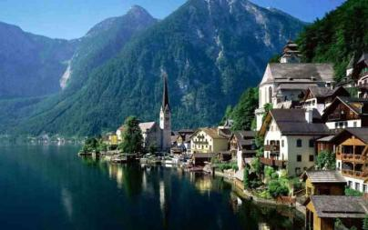
«A question»
Some people live in the country
Where the houses are very small,
Some people live in the city,
Where the houses are very tall.
But in the country where the houses are small,
The gardens are very big,
And the city where the houses are tall,
There are no gardens at all.
Where would you rather live?
Edith Segal.

Slide 6
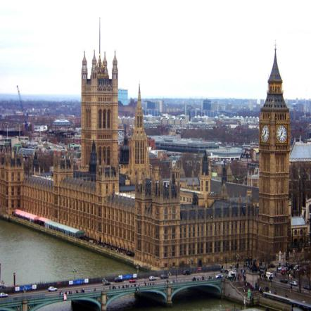
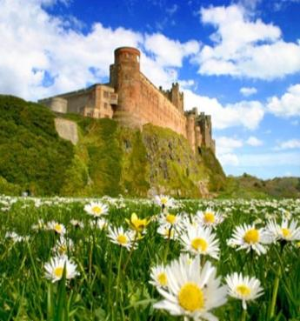
England is an attractive land.
It’s a land of attractive landscapes with lakes and dales.

Slide 7
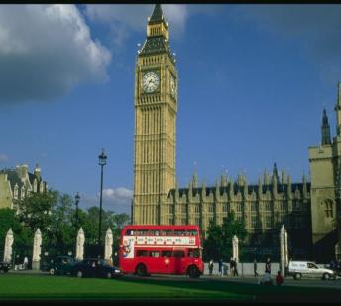
Great Britain invites you. Let’s see how well do you know this country? Complete the sentences using the right answer.
1.There are-------countries in the UK.
2.The buses and telephone
boxes are------------in Britain.
3.The symbol of England is------.
4.The London Zoo is in-----------.
5.The London home of the
Queen is------.

Slide 8
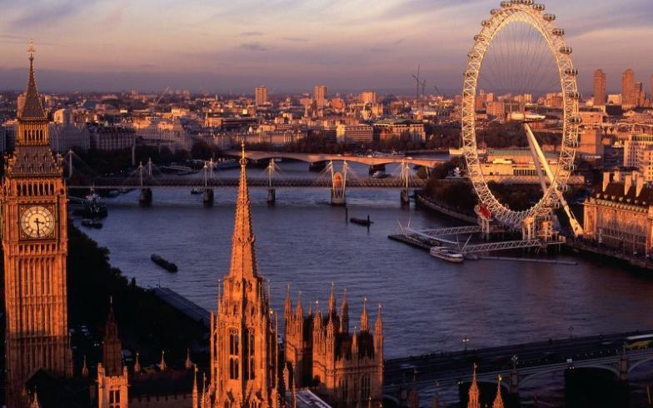
.
I would recommend you to visit the London Eye-the biggest wheel in Britain. There’s a wonderful view from it.

Slide 9
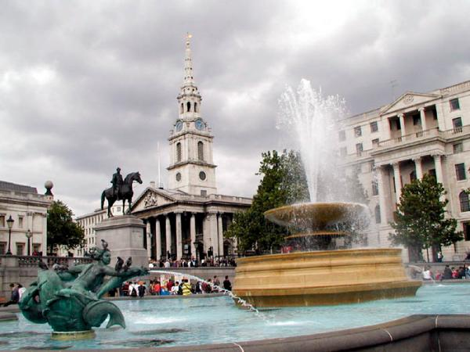
I think it would be better to start sightseeing with Trafalgar Square-the most popular place for people to meet.

Slide 10
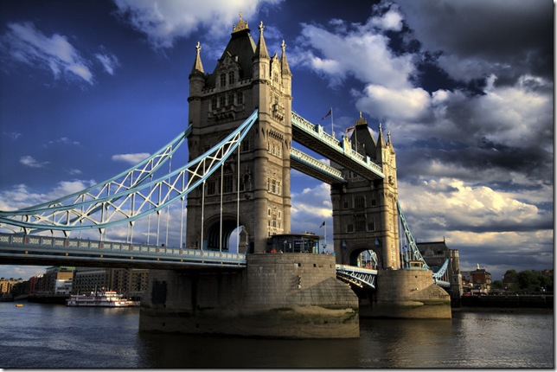
I suppose, Tower Bridge is one of the oldest bridges in London. It is over a hundred years old.

Slide 11
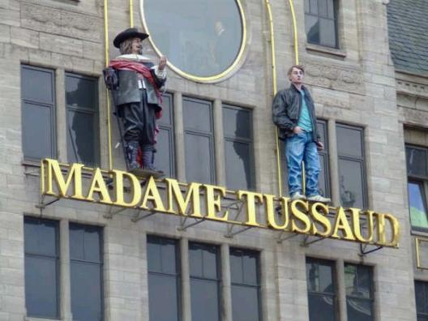
Madame Tussaud’s is the world’s most famous waxwork museum. Over two million people go there every year to see figures of presidents, film stars and pop stars.

Slide 12
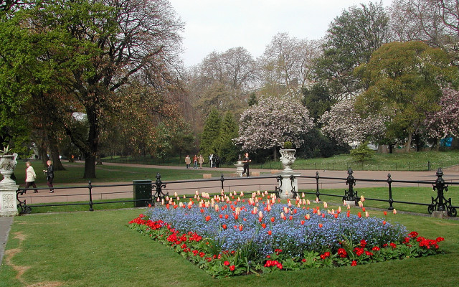
Hyde Park-the most famous park in London.

Slide 13
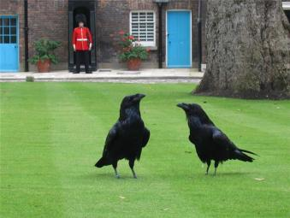
The Tower of London is a very big castle. It is the oldest place in London. I’m sure you know a lot about this place. Can you answer my questions:
1. When was the Tower founded?
2. Who founded it?
3. What is the symbol of the Tower?
4. What legend about Tower ravens do you know?
5. Who guards the Tower?
6. For many centuries it
served as…

Slide 14
Try to find the hidden words which denote London sights.
s | t | r | L | O | N | D | O | N | E | Y | E | k | p | g | O | m | V | o | v
p | o | T | R | A | F | A | L | G | A | R | S | Q | U | A | R | E | B | e | z
n | f | e | g | j | a | o | p | e | B | I | G | B | E | N | L | o | H | y | t
p | T | H | A | M | E | S | c | a | d | n | j | y | p | m | E | w | V | a | g
s | a | d | n | u | t | f | u | l | T | O | W | E | R | B | R | I | D | G | E
M | A | D | A | M | T | U | S | S | A | U | D | S | h | o | P | e | T | s | y
a | c | i | c | r | o | b | j | H | Y | D | E | P | A | R | K | h | A | t | o
g | o | a | l | k | b | c | e | w | m | T | H | E | T | O | W | E | R | n | l
m | y | B | U | C | K | I | N | G | H | A | M | P | A | L | A | C | E | w | e

Slide 15
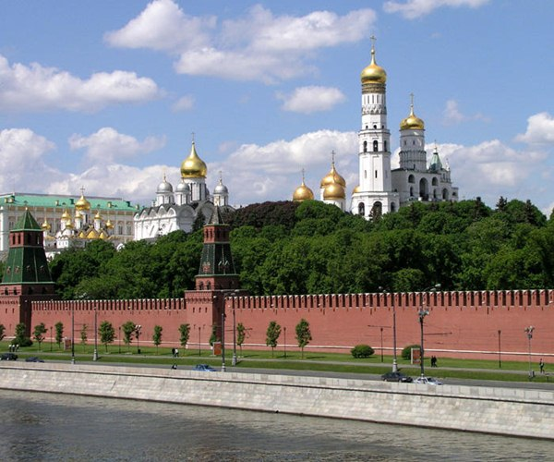
There is a lot to see in Russia, but first of all foreign tourists visit the capital of our country-Moscow.

Slide 16
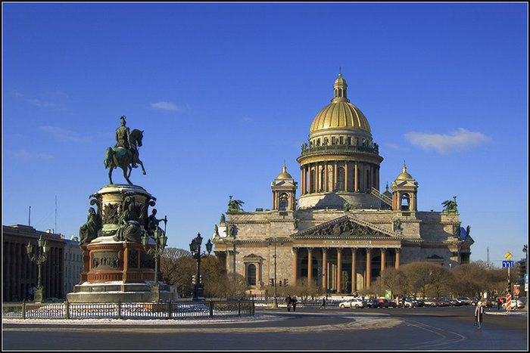
St.Petersburg attracts tourists from all over the world.

Slide 17
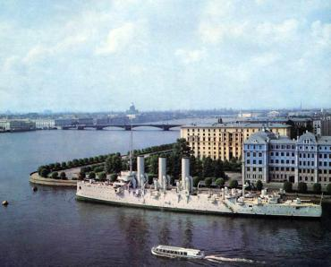
The Williams decided to visit Russia. They are discussing their visit to Russia.
Let’s listen to the dialogue and answer the questions.
1. What cities did they decide to visit?
2. What attractions did they
mention? (Red Square,
the Kremlin, Avrora,
the Luzhniki, the Hermitage,
St. Isaac’s Cathedral).

Slide 18
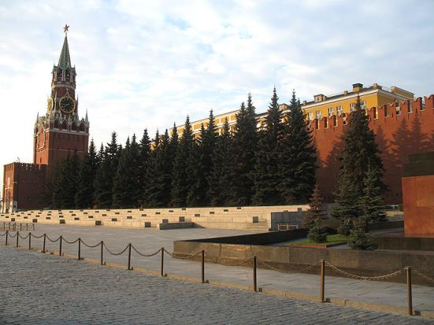
Read and fill in the sentences with appropriate words and the right form of the adjectives.
1). (Beautiful) place in -----is Kremlin.
2). Red Square is (popular) place for people to meet in-----.

Slide 19
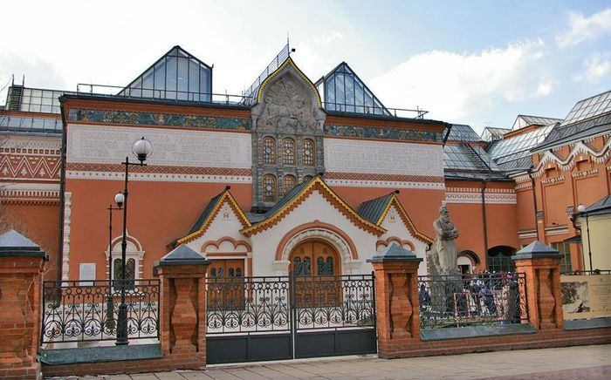
3).The Tretyakov Gallery is one of (old) gallery in -----where you can see pictures of famous Russian and foreign artists.

Slide 20
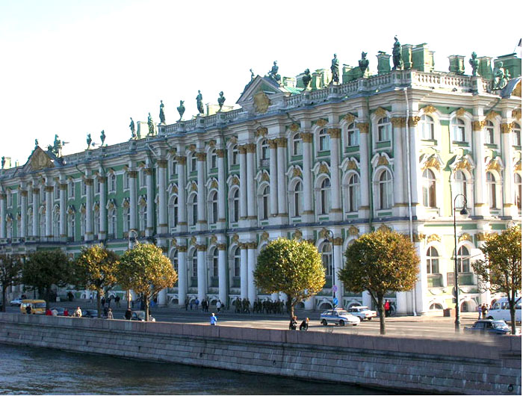
4). The Hermitage is one of (large) art museum in -----.

Slide 21
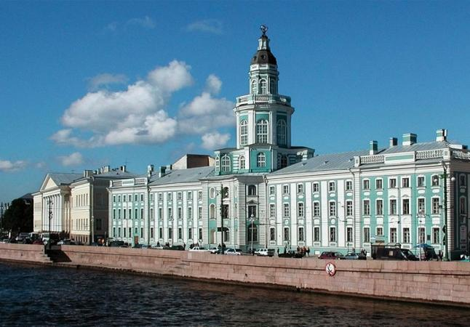
5). Kunst- kamera is (famous) museum in-------- where people can see interesting works.

Slide 22
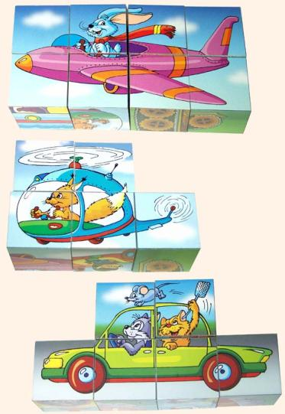
Sing the song. Looking for adventures.
On my holiday
I found a place to see
It’s somewhere
Between London and Torquay.
I travelled there by plane,
By car, by train.
And my friends were there
Travelling with me.
Hey-ho, we’ll go
Anywhere the winds blow.
Set sail! We’ll see
Treasure Island in the sea!

Slide 23
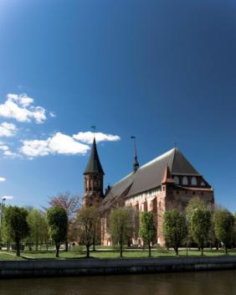
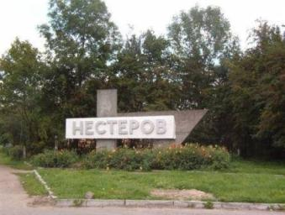
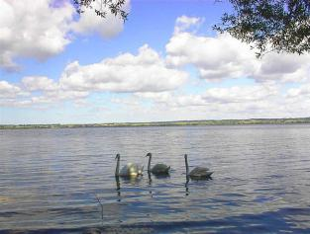
Let’s discover the magic of our native town.
Our native town is a small clean town in the east of Kaliningrad region. It is very beautiful, peaceful town.

Slide 24
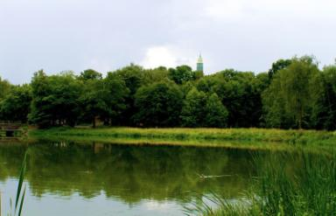
Work in small groups and discuss the answers to these questions.
1. What is the most beautiful part of your home town?
2. What is the noisiest part of the home town?
3. Which is the tallest building?
4. Which is the smallest
shop?
5. Which is the longest
street?

Slide 25
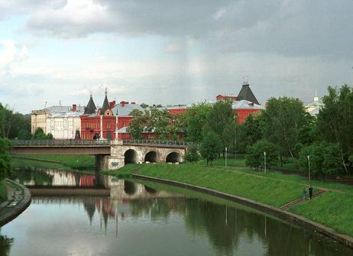
Interview your friend about his/her dream place, take notes and then report to the group.
1. I’d like to live in a big----place near the sea.
2. I love modern cities with------- and wide streets.
3. I’d like to live in a town
with-----.
4. I’d like to live on-----.
5. I’d like to have many
interesting places
in my dream town…..

Slide 26
Where would you like to live ?
I’d like to live in.. a big modern city
a town with lots of parks
a village near the sea a small clean town
the oldest and the biggest city
a village with beautiful gardens

Slide 27
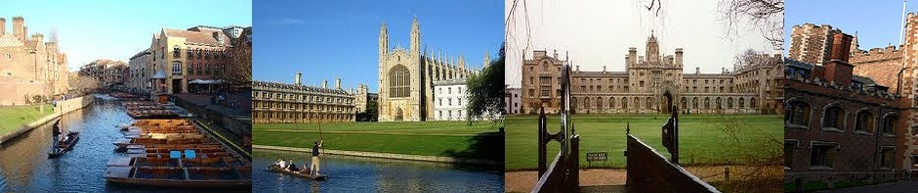
“Activity is the only road to knowledge “ said George Bernard Show.
I think that today we had a very interesting and useful lesson.

