Slide 1
My outside interest

Slide 2
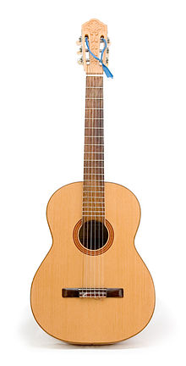
Guitar
Guitar is a string musical instrument.
guitars used nylon and metal strings.
start to play the guitar using nylon strings because they are easier to play.

Slide 3
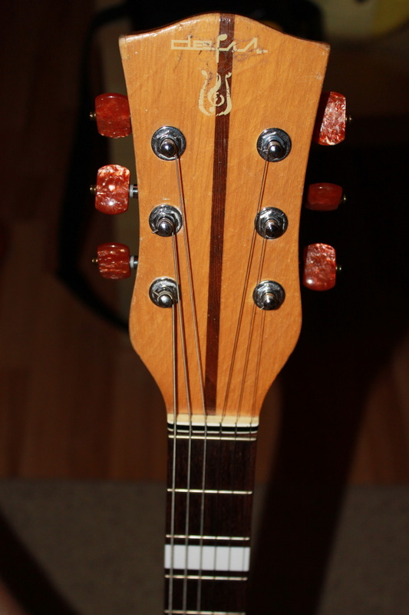
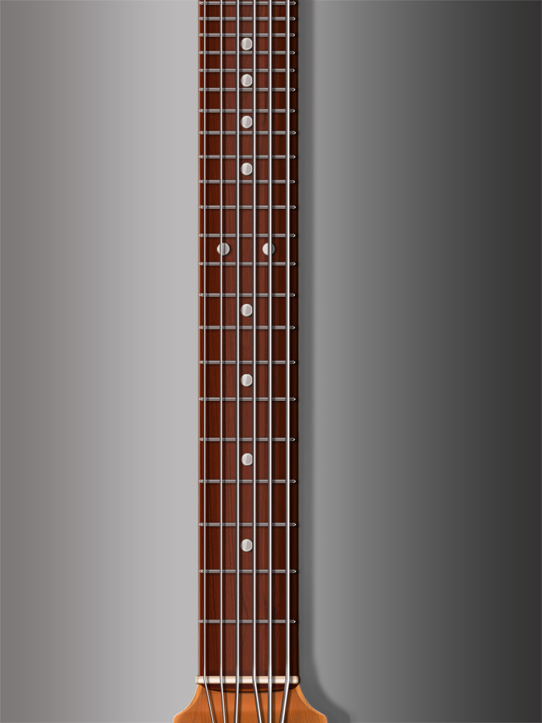
guitar parts
Head.
fret board

Slide 4
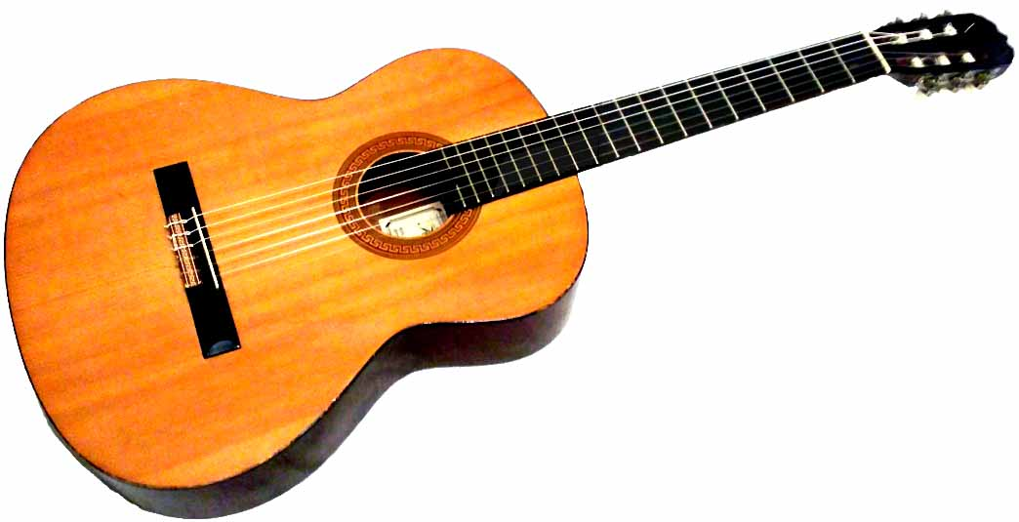
body

Slide 5
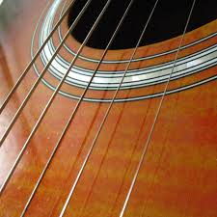
Device.
guitar weighs 0,5 – 15 kg.
the guitar is 4 – 14 strings.

Slide 6

Playing the guitar is the most
interesting activity for me.
In our time many people
can play the guitar.
I advise you to start playing
the guitar

