Slide 1
Poetry
in our
life

Slide 2
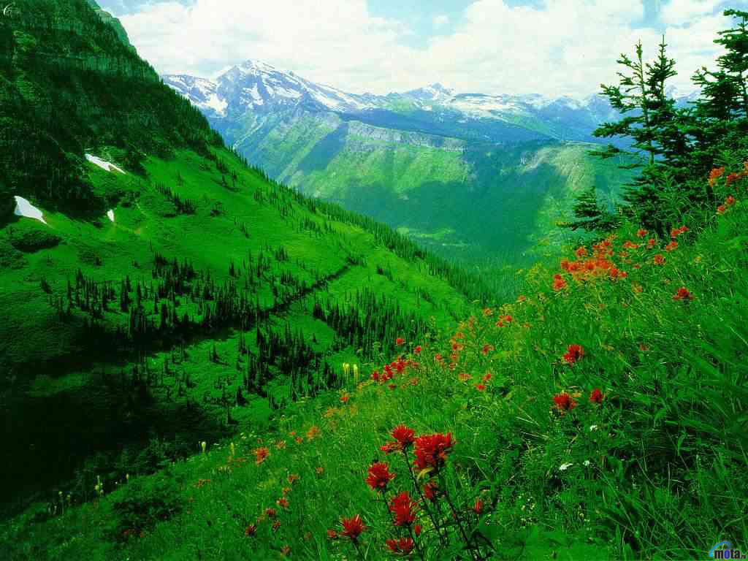
What a wonderful world!

Slide 3
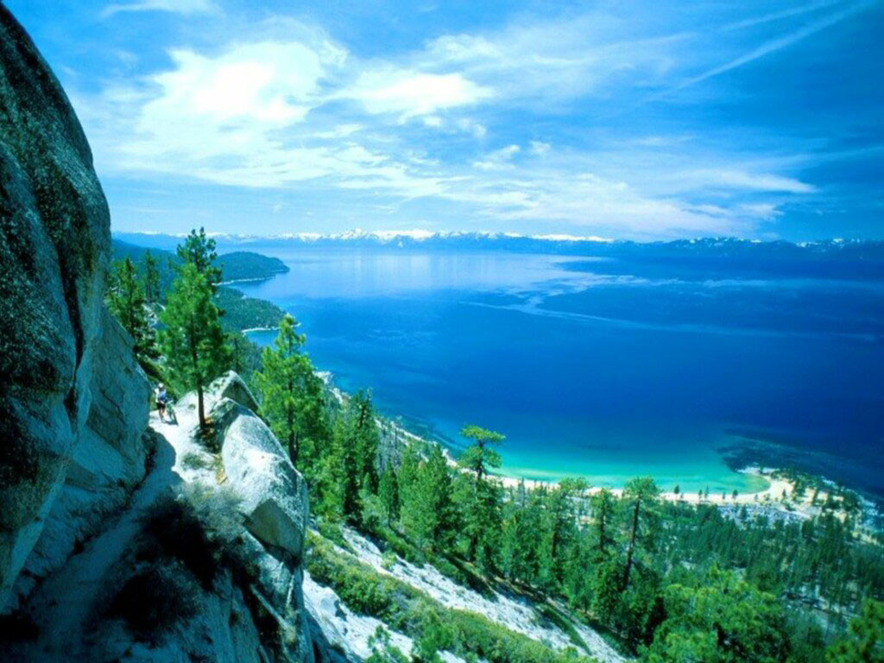
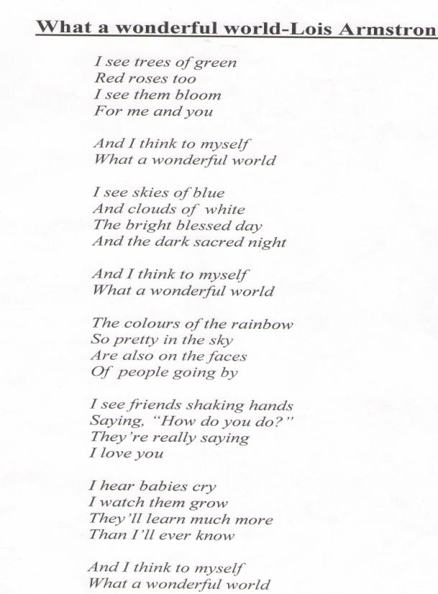

Slide 4
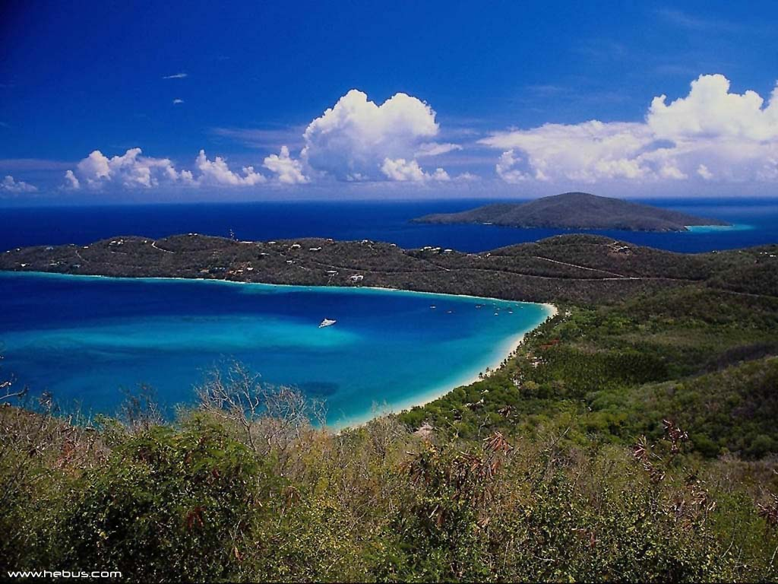

Slide 5
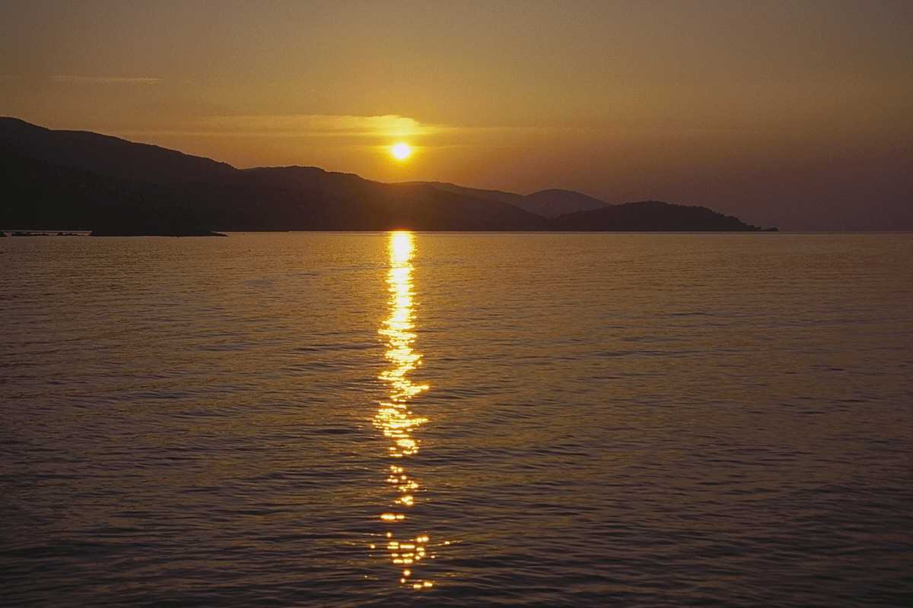

Slide 6
Our lesson is devoted to poetry. We love poetry, it plays an important role in our life, because with poetry we express our feelings of love to our Motherland, to nature, to every person who is dearest to us.
Poetry in our country is connected with Abai Kunanbayev, in Russia – with
Alexander Pushkin, in Scotland – with Robert Burns.
They are the profound founders of poetry.
We love their poems, we keep them in our hearts as national treasures which should be passed from generation to generation.
Their poems are read and valued all over the world.
Abai and Pushkin- they are like “ twin brothers”.
They made great contribution to literature.

Slide 7
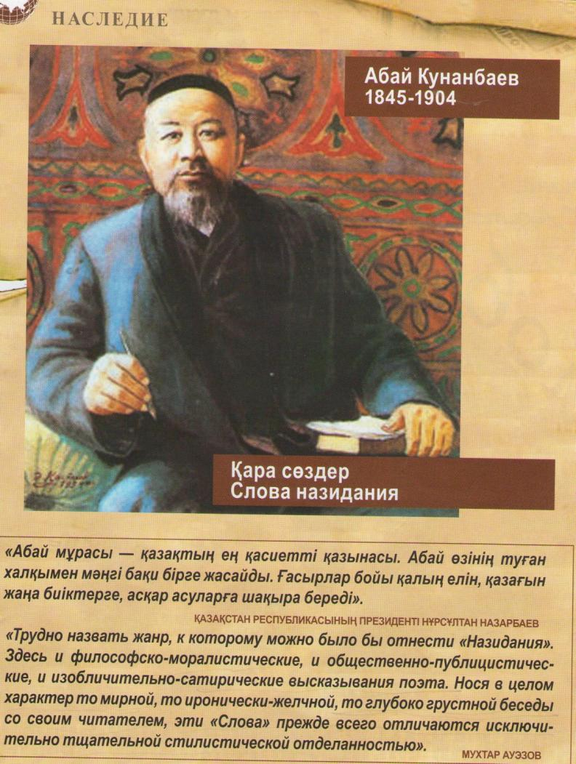

Abai
Kunanbayev

Slide 8
Abai Kunanbayev is a great –enlightener, a bard, a founder of Kazakh literature.
In the history of each nation there are some highly reverend national places.
So Shyngistau is the birthplace of a genius of the Kazakh literature- Abai Kunanbayev.
He was born on August 10, 1845, in Semipalatinsk region in the family of a rich feudal lord.
Abai finished medresse. He studied at Russian school.
He translated works of Pushkin, Lermontov, Gothe and other poets and writers into
Kazakh.
He started writing poetry at school. His poems were composed of that he heard and seen in his childhood.
From his childhood he heard fairy-tales and the legend about Enlik and Kebek’s tragic love
from his grandmother Zere and his mother Ulzhan.
Abai’s works urge people to labour andto struggle for reorganization of life.
A lot of his poems are dedicated to new attitude to the family, to the parents ‘ duty, to the education of young generation.
Abai described nature, life and traditions of simple people poetically.
Abai fluently spoke Russian, Arabic, Chagatai languages, which helped him to study world literature in the original.
The most famous work of Abai is “Words of Edification”, his famous song “Kozimnng karasy” is sung by Kazakh people.

Slide 9
Слова назидания
Четырнадцатое слово
Самое дорогое у человека – это его сердце. У казахов понятия “мужество” и “трусость” родились от слова “сердце”. В народе батыра называют “жүректі”, что означает – жигит с настоящим сердцем, труса кличут “жүрексіз”, то есть человеком, у которого сердце отсутствует.
Все лучшие человеческие качества, такие, как отзывчивость, сострадание человеческому горю и человеколюбие, - рождаются сердцем...

Slide 10
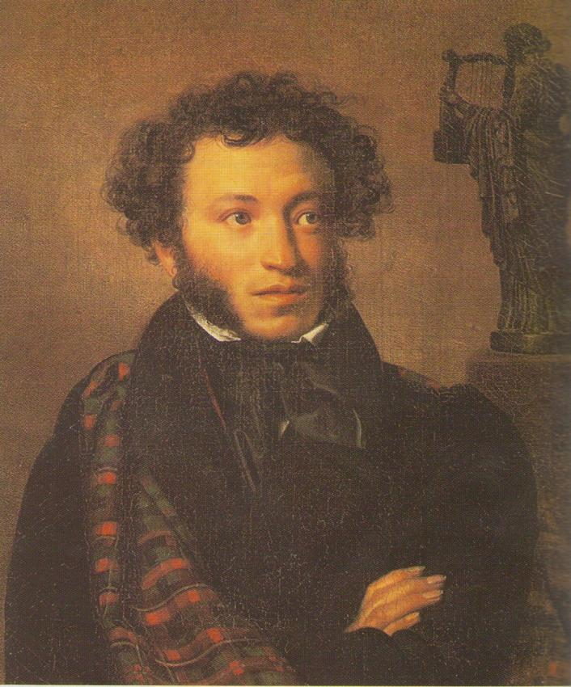
Alexander Pushkin

Slide 11
Pushkin is the most important Russian writer of all times.
He was born in 1799 into an upper-class family.
In 1811 he entered a lyceum at Tsarskoe Selo.
His earliest long poem was “ Ruslan and Lyudmila”, a romantic poem.
A series of verse- tales followed- “The Prisoner of Caucasus”, “ The Fountain of
Bakhchisarai”.
In 1823 Pushkin began writing his masterpiece “Eugene Onegin.”
Every summer in June thousands of people come to the village of Mikhailovskoe to the festival of poetry, to see the places where he lived and worked.
Pushkin is always alive for us, he is the man we all know and love, the greatest of poets.
Generations come and leave, but Pushkin still remains with us.
Pushkin is called by many “ the Sun of Russian literature.”

Slide 12
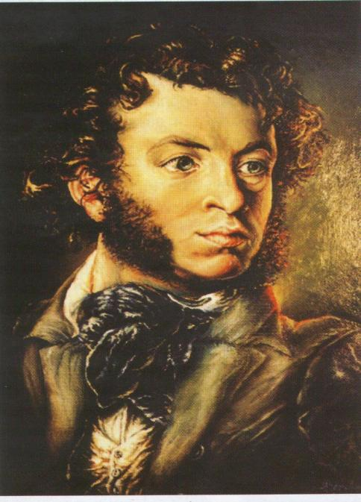
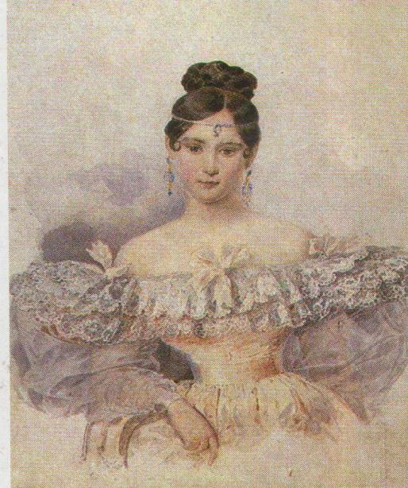
I recollect the charming feeling:
You were in front of me like sign-
The passing vision, human-being,
The beauty genius of mine.
The poem “ I Recollect the Charming Feeling” Pushkin devoted to Natalia Goncharova.
He fell in love with Natalia Goncharova and they got married.
This poem is the expression of great and pure love.
We feel in each line the passionate love of the poet to his beloved.

Slide 13
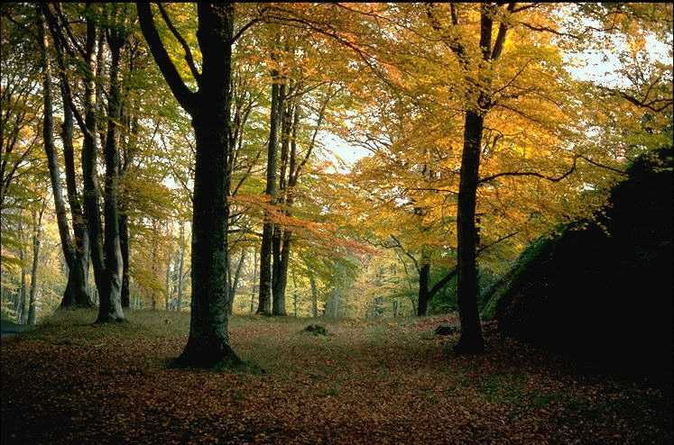
I recollect the charming feeling:
You were in front of me like sign-
The passing vision, human-being,
The beauty genius of mine.
I often was in gloomy spirits?
I felt a desperate alert.
So long I heard your voice and features.
I saw in all night dreams, My God.
The years passed. And I felt pity
When thoughts of you went all away,
And I forgot your voice, so pretty,
And couldn’t see your face again.

Slide 14
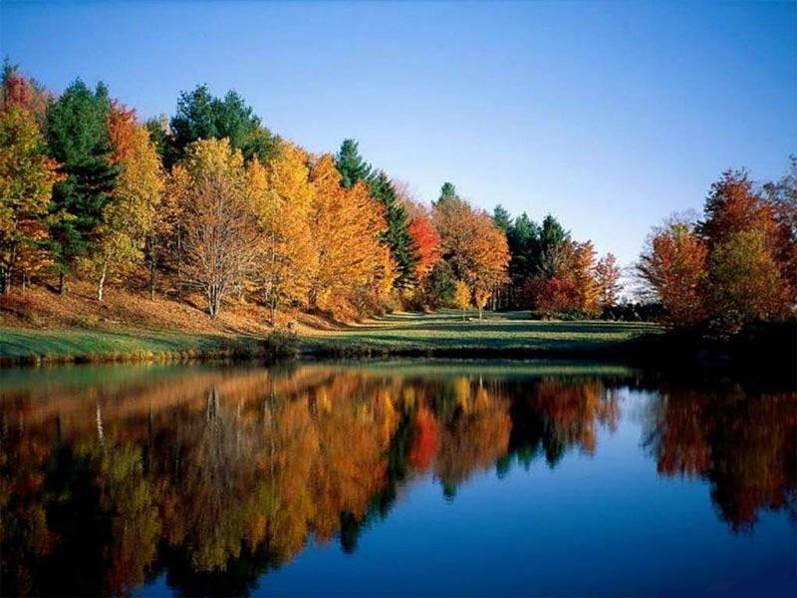
So far away in full of darkness.
My days were passing so calm,
With no deity and brightness,
No running eyes, no love, no charm.
But once my soul awaken,
Your image was for me a sign-
The passing vision, human-being,
The beauty genius of mine.
My heart against beats with such lightness
And they were born for it in sum –
And feelings: deity and brightness,
And running eyes, and love, and charm.

Slide 15
Robert Burns
"My Hearts in the Highlands"

Slide 16
My hearts in the Highlands,
My heart’s not here
My heart’s in the Highlands
A chasing the deer
A chasing the wild deer
And following the roe

Slide 17
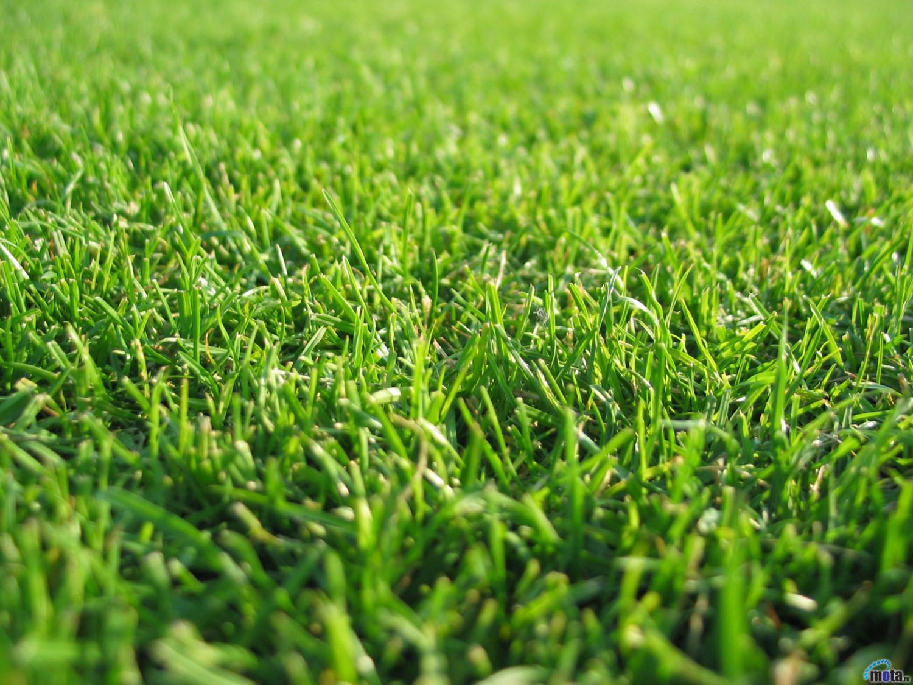
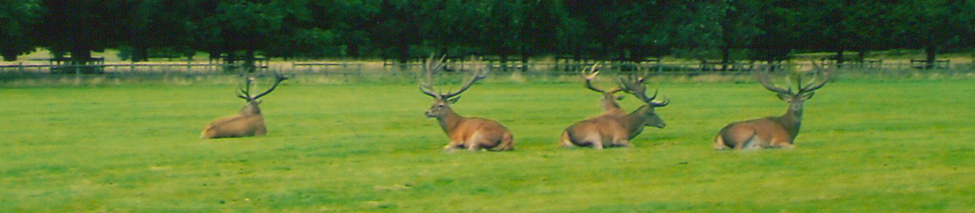

Slide 18
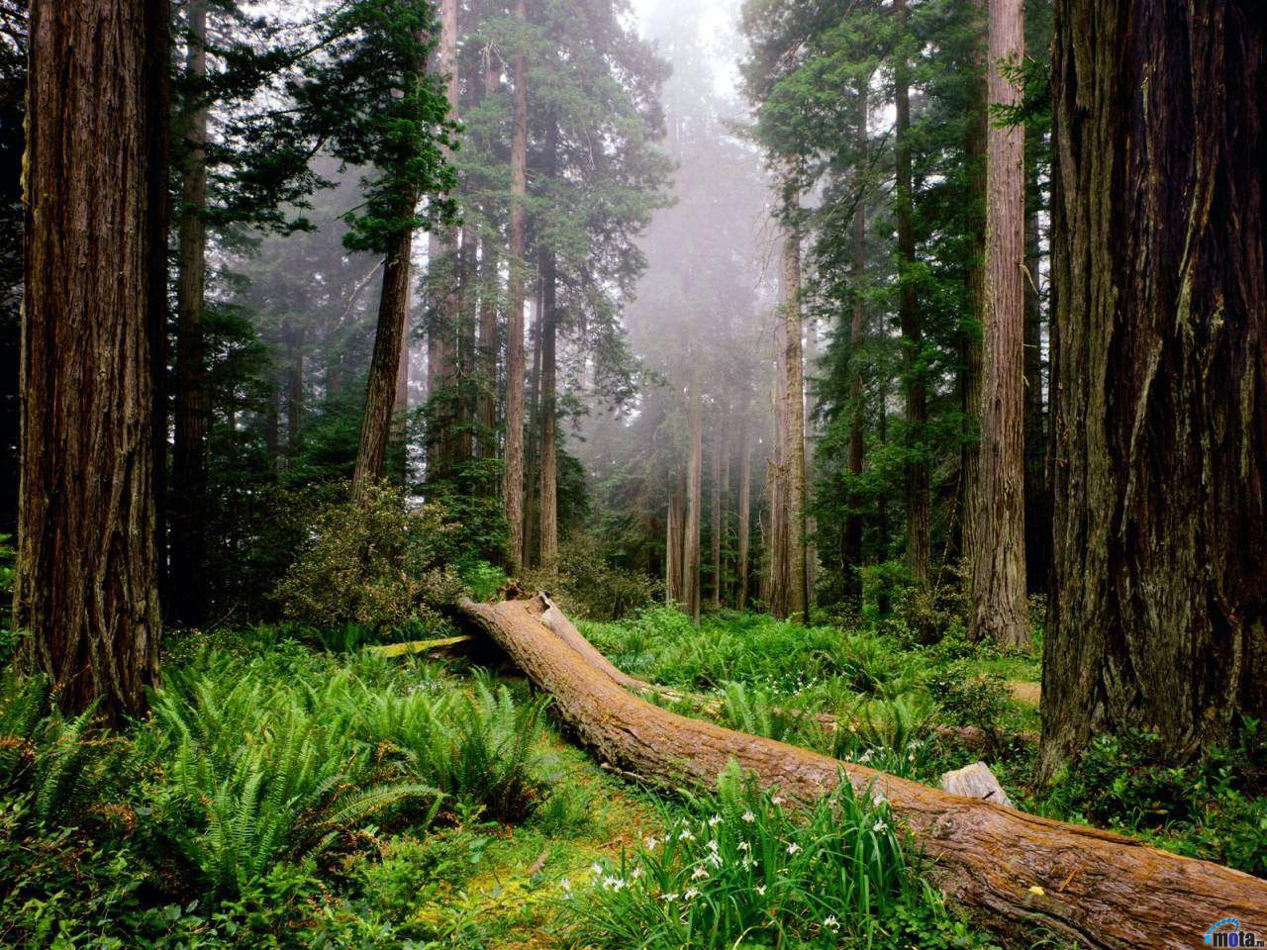

Slide 19
My heart’s in the Highlands
Wherever I go.
Farewell to the Highlands
Farewell to the North
The birthplace of valor, the country of worth
Wherever I wonder, wherever I rove
The hills of the Highlands forever I love.

Slide 20
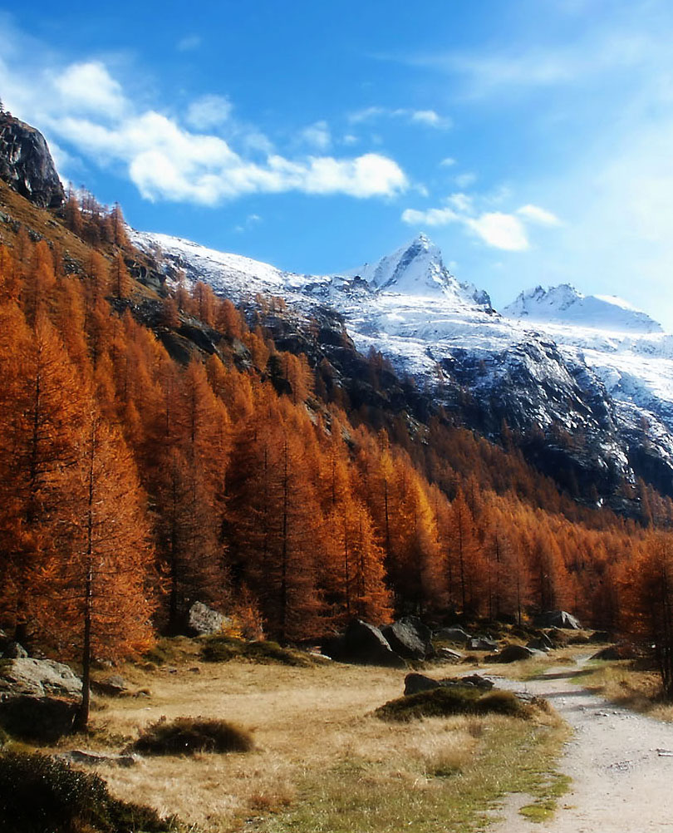

Slide 21
Farewell to the mountains,
Light covered with snow
Farewell to the stars
And green valleys bellow.
Farewell to the forest
And wild handing woods
Farewell to the torrent
And loud- pouring floods.

Slide 22
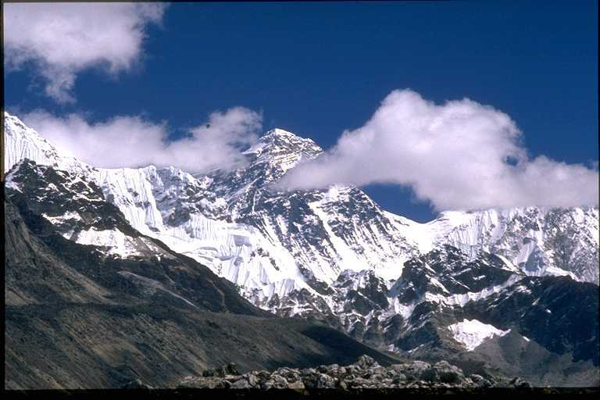

Slide 23
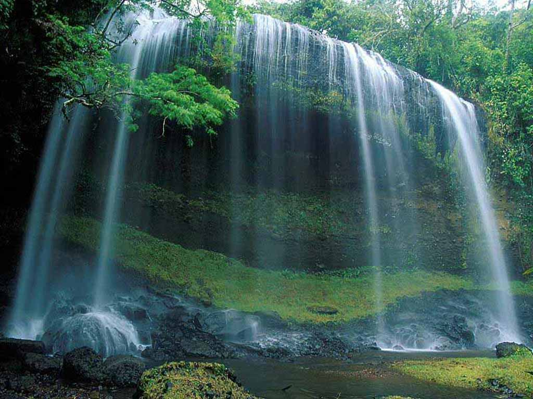

Slide 24

R. Burns
"Red, Red, Red
Rose"

Slide 25


Slide 26
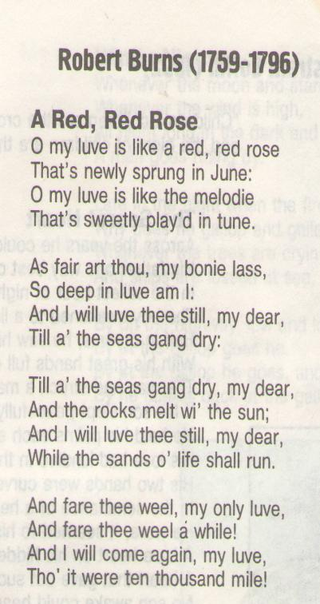
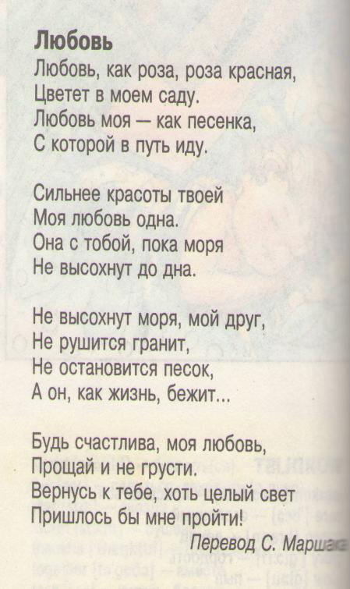

Slide 27
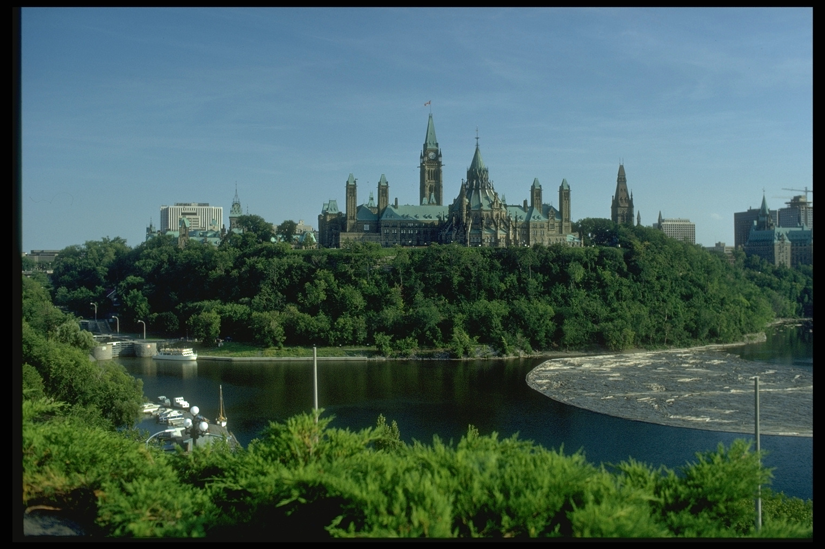
Students' favourite poems:

Slide 28
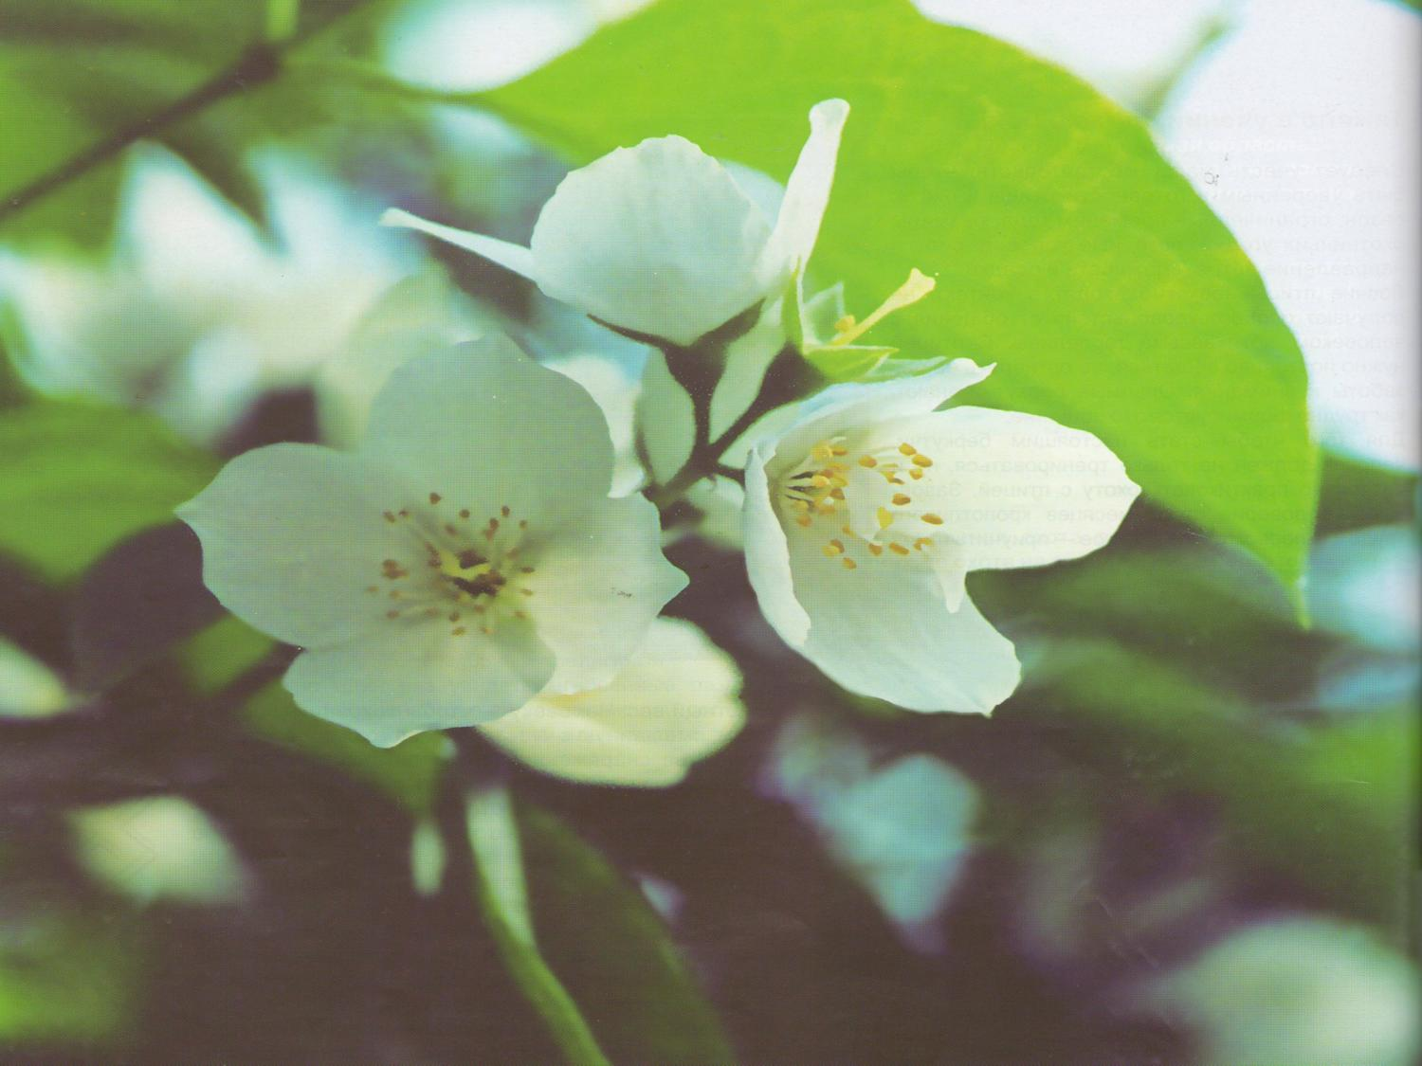
Poem “The Daffodils”
W. Wordsworth

Slide 29
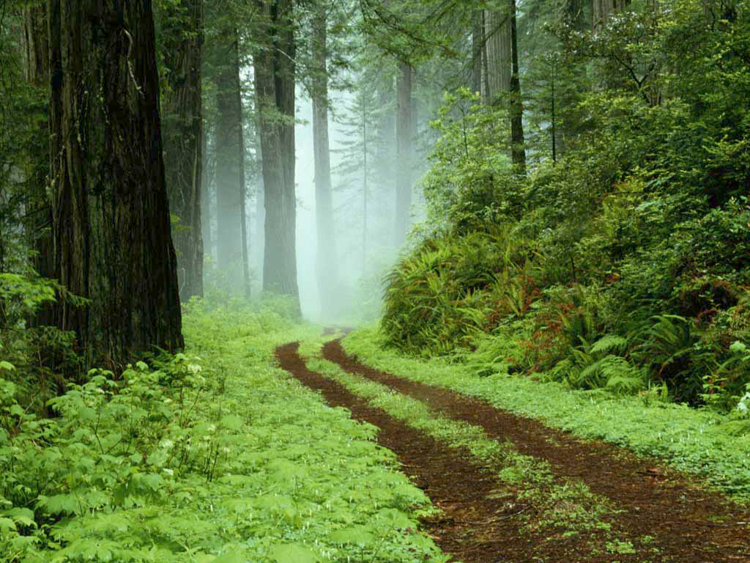
I wondered lonely as a cloud
That floats on high o’er valleys and hills,
When all at once I saw a crowd,
A host of golden daffodils,
Beside the lake, beneath the trees,
Fluttering and dancing in the breeze.

Slide 30
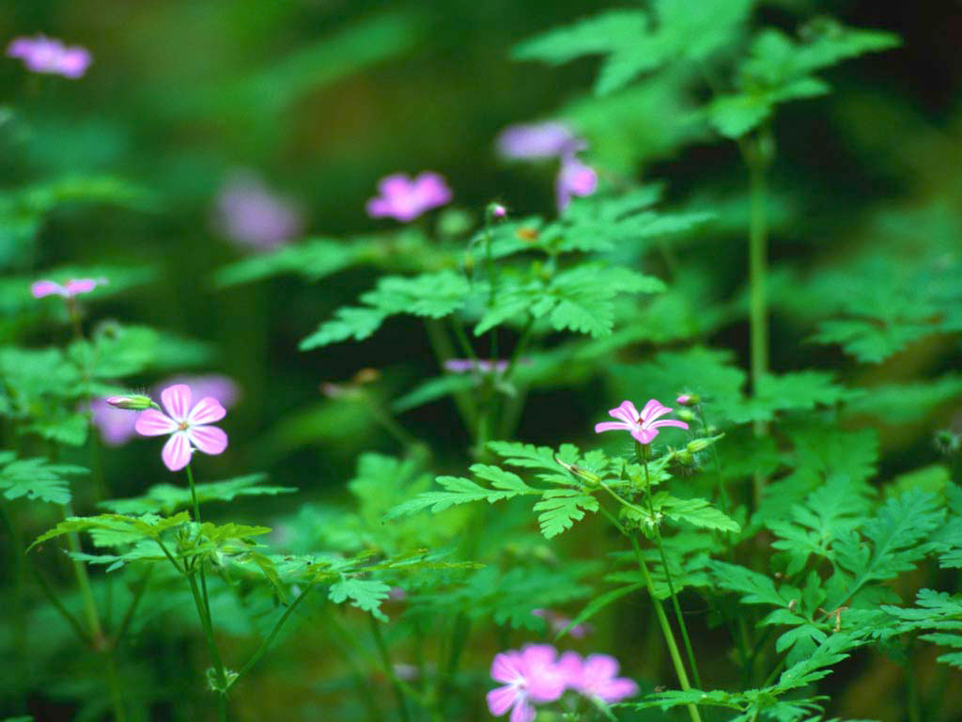
Continuous as the stars that shine
And twinkle on the Milky Way,
They stretched in never- ending line
Along the margin of a bay:
Ten thousand saw I at a glance
Tossing their heads in sprightly dance.

Slide 31
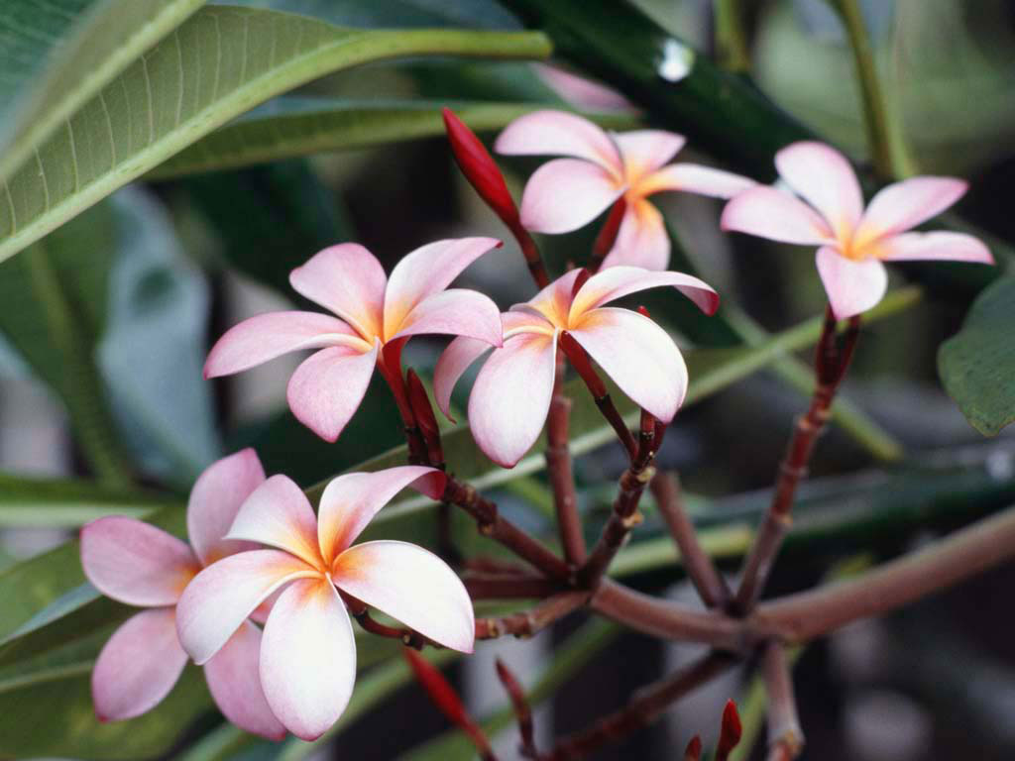
The waves beside them danced, but they
Out-did the sparkling waves in glee:
A poet couldn’t but be gay
In such a jocund company.
I gazed and gazed – but little thought
What wealth the snow to me had brought:

Slide 32
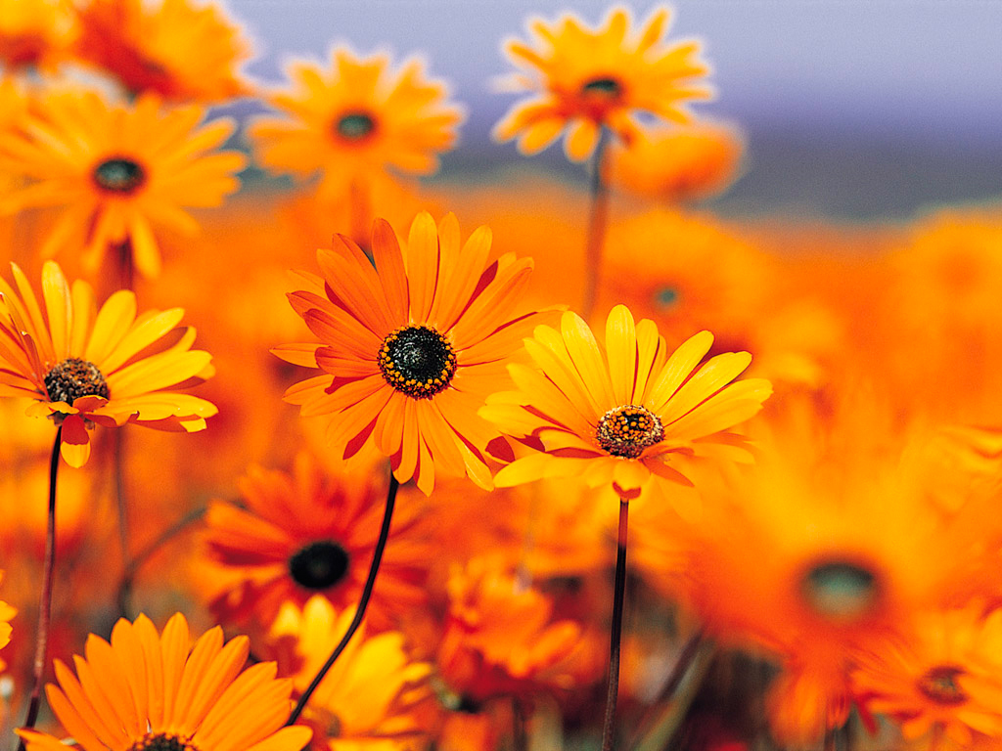
For oft, when on my couch I LIE
In vacant or in pensive mood,
They flash upon that inward eye
Which is the bliss of solitude:
And then my heart with pleasure fills,
And dances with the daffodils.

Slide 33
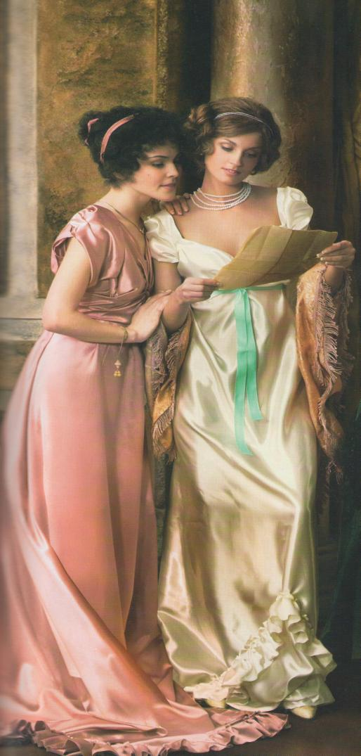
Poem
"She Walks in Beauty"

Slide 34
She walks in beauty, like the night
Of cloudless climes and starry skies
And all that’s best of dark and bright
Mute in her aspect and her eyes
These mellowed to that tender light
Which heaven to gaudy day denies
One shade the more, one ray the less
Had half impaired the nameless grass
Or softly lighters o’er her face
Where thoughts serenely sweet express
How pure, have dear their dwelling-place
And on that cheek and o’er that brow
So soft, so calm, yet eloquent
The smiles that win the goodness spent
I mind at peace with all bellow
A heart whose love is innocent!

Slide 35
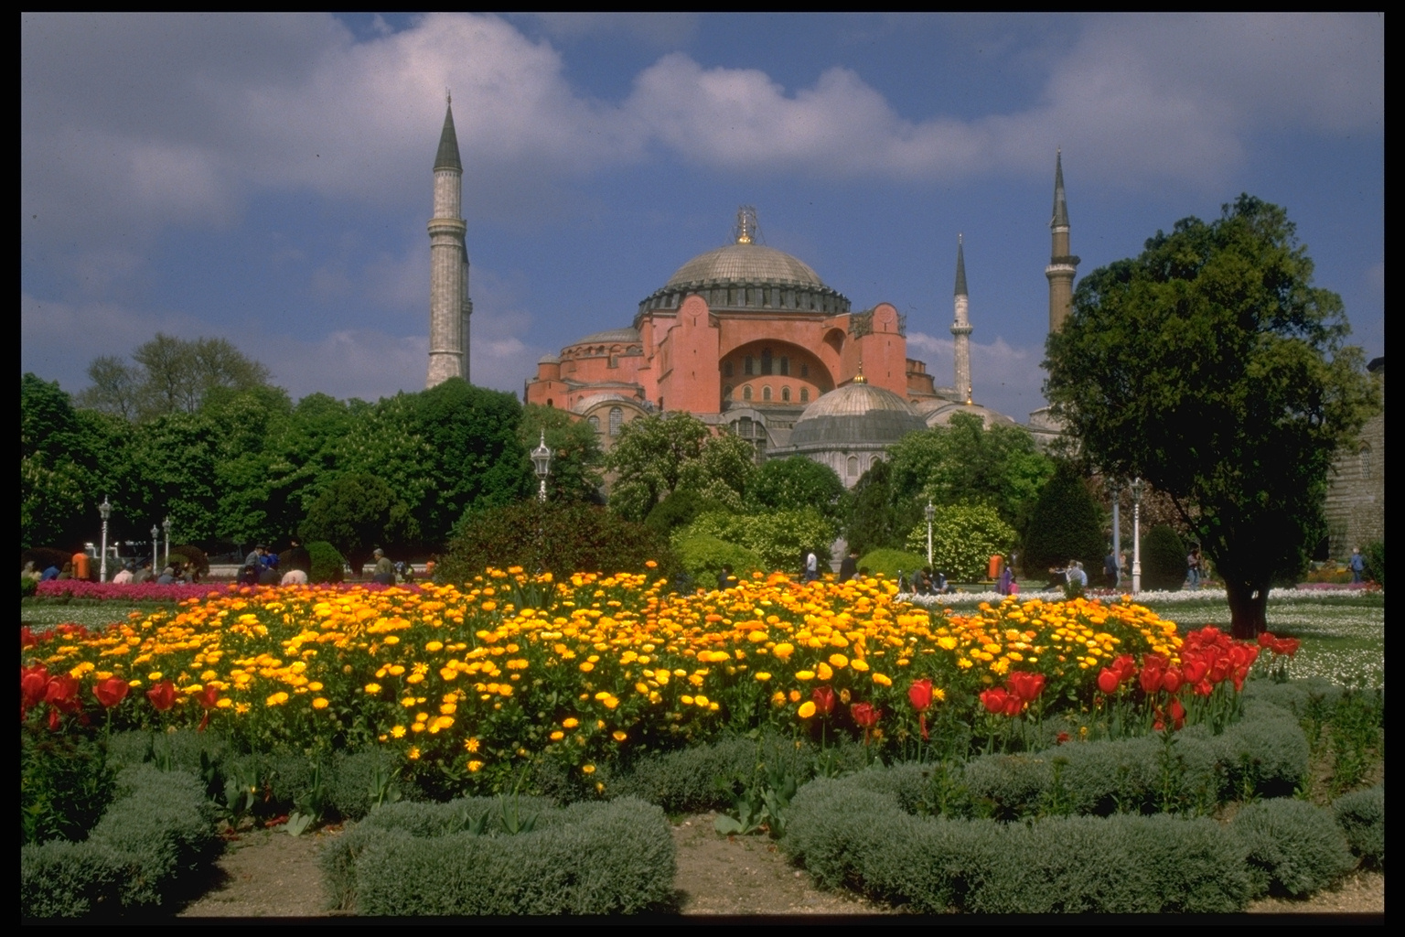
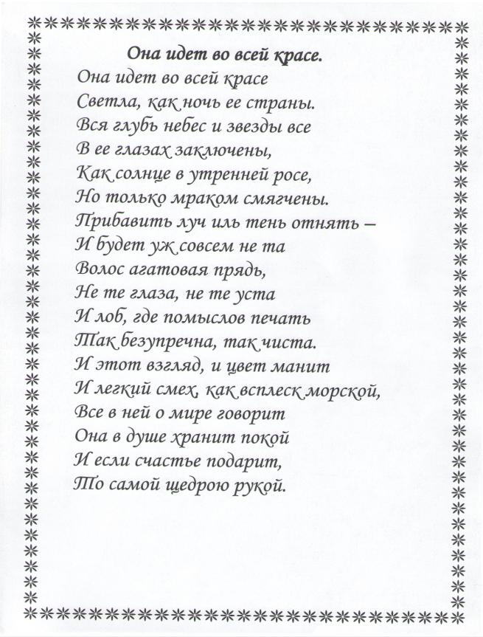

Slide 36
Conclusion.
Discussion

