Slide 1
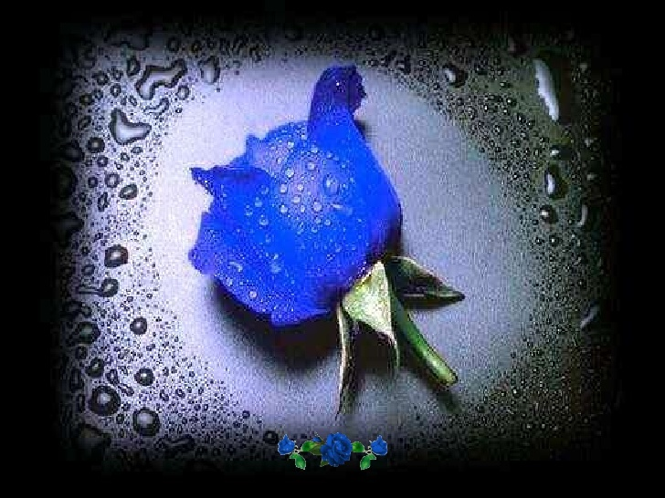
Куркина Лидия Николаевна [284-328-578]
Презентация к уроку английского языка для 9 класса «BLUE ROSE in Literature, Art and Music».
Подготовила:
учитель английского языка
МБОУ СОШ № 95 г. Краснодара
Куркина Л.Н.

Slide 2
Write as many words as you can think of related to roses.
ROSES
Parts of roses
Your feelings
Other images

Slide 3
Read the passage containing the words under analysis.
-The title of the text is…
-It is an extract from…
-The text is presented in the form of a dialogue (a narration).
-The text is about…, it tells us about… (the main idea of the text).
Lexico-grammatical analysis
-The word is a noun/verb/adjective/adverb/numeral/pronoun.
Verb: regular/irregular; tense;give three forms;active/passive;
Noun: countable/uncountable; singular/plural; a word combination, a set expression;
Adjective:comparative/superlative;
-Synonyms, antonyms.
-The derivatives of the word are….
-The …… is derived from the …. by means of the affix…/conversion;
-The Russian for ….. is ….
How to analyse? Lexico-grammatical analysis.

Slide 4
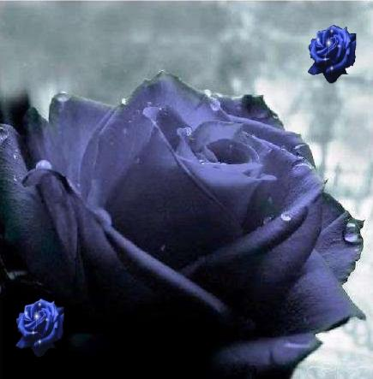
BLUE ROSE Read and analyse.
A blue rose is a flower of the genus Rosa that presents blue-to-violet pigmentation instead of the more common red, white, or yellow. Blue roses have fascinated people for many years. True blue roses are not found in nature, and generations at least since the Victorian times have taken white roses and put them in blue water, thus making them blue. The fascination and attempts at creating a blue rose have finally paid off.White roses have been dyed blue. In 2004, researchers used genetic modification to create roses that
contain the blue pigment .

Slide 5
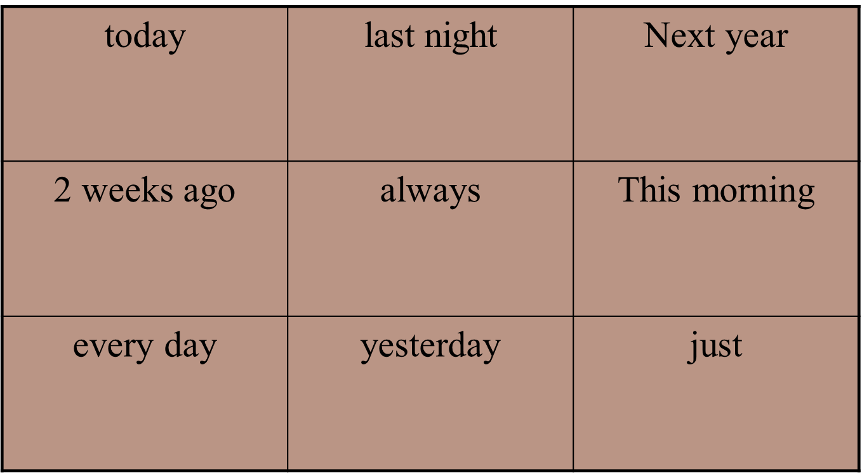
Find the place for this sentence: Rose hips are pressed and filtered to make rose hip syrup. Explain why.

Slide 6
What word is odd? Why?
Signify-Culture-Associate-Denote
Blue -Chinese-Blood-Royal
With-In-Under-Are

Slide 7
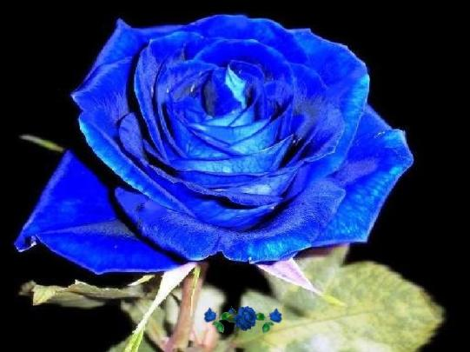
BLUE ROSE in Literature Read and analyse.
"The Glass Menagerie" is a heartbreaking and well-loved stage play written by Tennessee Williams in 1944. One character is Laura, a teenage girl who suffers with pleurosis, a respiratory condition that was more common before the wide use of antibiotics. The main symptom of pleurosis is painful breathing. A man on whom Laura has had a crush for many years misheard her in high school when she told him she had pleurosis, he heard «blue roses». Blue Roses was his nickname for Laura
for that reason.

Slide 8
A star counter
Exercises for eyes

Slide 9
This is a letter for you!

Slide 10

Follow the arrow:

Slide 15
Save your eyes

Slide 16
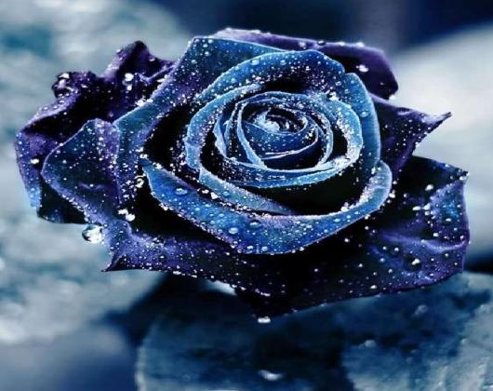
BLUE ROSE in Literature
Read and analyse. Do you like the poem?
Rudyard Kipling
Blue Roses
Roses red and roses white
Plucked I for my love's delight.
She would none of all my posies--
Bade me gather her blue roses.
Half the world I wandered through,
Seeking where such flowers grew;
Half the world unto my quest
Answered me with laugh and jest.
Home I came at wintertide,
But my silly love had died,
Seeking with her latest breath
Roses from the arms of Death.
It may be beyond the grave
She shall find what she would have.
Mine was but an idle quest--
Roses white and red are best.

Slide 17
What word is missing?
Roses … and roses white
Plucked I for my love's delight.
She would none of all my posies--
Bade me gather … blue roses.
Half the world I wandered through,
Seeking where such flowers grew;
Half the world unto my quest
Answered me with laugh and jest.
….. I came at wintertide,
But my silly love had died,
Seeking with her latest breath
Roses from the arms of Death.
It may be beyond the grave
She shall find what she would have.
Mine was but an idle quest-
Roses white and red are ….

Slide 18
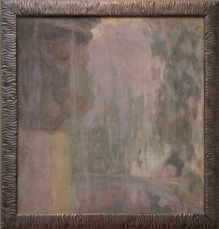
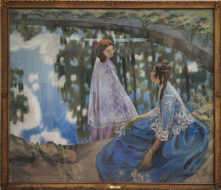
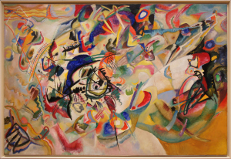
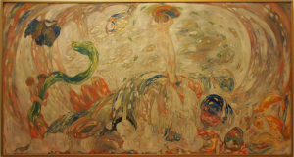
BLUE ROSE in Art

Slide 19
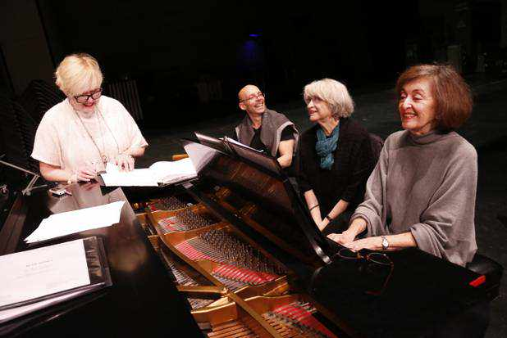
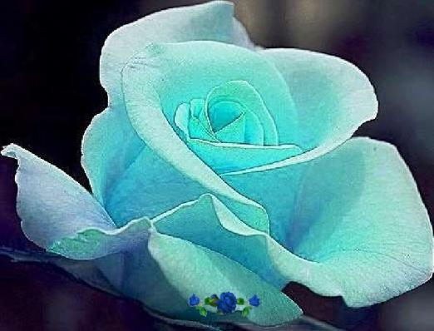
BLUE ROSE in Music
Blue Rose were an all-star all-women band that played bluegrass music. All of the musicians in the group are solo artists in their own right who joined together to record an album as a group in 1988 for Sugar Hill Records.

Slide 20
Rose Set Expressions
rose petal / leaf - лепесток / лист розы
rose-bud - бутон розы
rose stalk / stem - стебель розы
thorns of the rose - шипы розы
rosebush / rose tree - розовый куст, куст роз
rose garland - гирлянда из роз
rose wreath - венок из роз
rose knot - узел розочкой
rose water - розовая вода
rose oil - розовое масло

Slide 21
Yes or No? Let’s check your memory.
Blue Rose was a Symbolist artist association in Moscow from 1806 to 1808.
"The Glass Menagerie" is a heartbreaking and well-loved stage play.
Blue Rose were an all-star all-men band.
A blue rose is a flower of the genus Rosa that presents red-to-violet pigmentation.

Slide 22
Check your results
Blue Rose was a Symbolist artist association in Moscow from 1906 to 1908.
"The Glass Menagerie" is a heartbreaking and well-loved stage play.
Blue Rose were an all-star all-women band.
A blue rose is a flower of the genus Rosa that presents blue-to-violet pigmentation.

Slide 23
Homework
to write a composition about a blue rose: «Why I like a blue rose» or «Why I do not like a blue rose»;
analyse the word a rose.

Slide 24
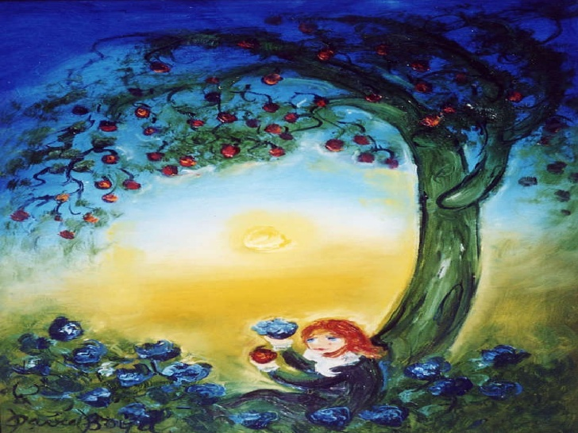
Thank you for your attention!

