Slide 1
Current. Ammeter.
1) revise theme current sources, construction and principle of work of the current source
2) know the meaning of current
3) make electric circuit experimentally and using symbols

Slide 2
Electric sources revision
Translate into English:
1
Электрический ток
1
Electric current
Направление электрического тока
Direction of electric current
2
2
Постоянный и переменный ток
Direct and alternating current
3
3
4
Источники тока
4
Sources of current
Действие электрического тока
Effect of electric current
5
5
6
Электрическая цепь
6
Electric circuit
7
Напряжение
7
Voltage
Положительный и отрицательный заряды
Positive and negative charges
8
8

Slide 3
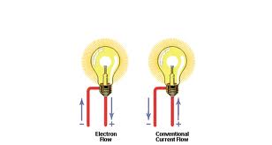

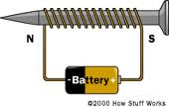
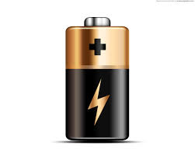
Team competition
You have a list of questions and 2 minutes for preparation. Your teams will answer one by one, but every next answer should be given another student in the team.

Slide 4
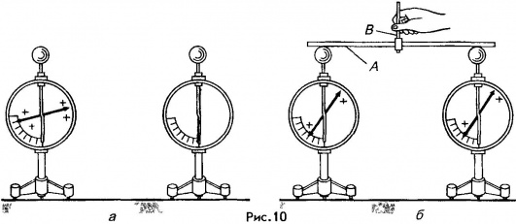
Questions:
Describe figure on the slide:

Slide 5
Questions:
Electric current is the motion of _______
Electric circuit is _________of electricity, _________ and ___________
Current may be of two types:____________and______________.

Slide 6
Questions:
What effects of electric current do you know?
What are conditions for current existence?

Slide 7
Questions:
You have prepared electric source. Tell about it.

Slide 8
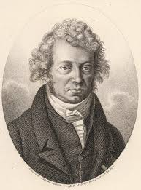
Questions:
Who said the term “electric current” for the first time?
André-Marie Ampère
(20 January 1775 – 10 June 1836)

Slide 9
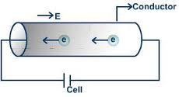
Current - Сила тока (I, A)
Current is the amount of charge passing through a point in the circuit in one second.

Slide 10
Current
I - Current (A)
q – Charge (C)
t – time (s)

Slide 11
Units of current
Caution!
1A is dangerous for life!

Slide 12
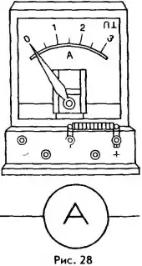
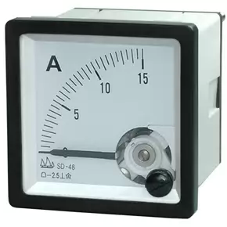
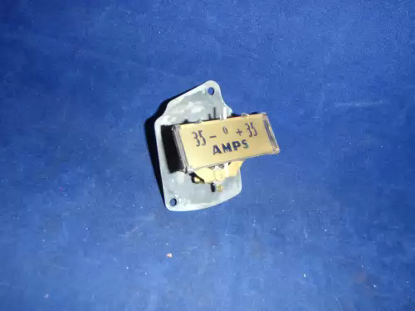
Ammeter (Амперметр)
Ammeter is the device for measuring current

Slide 13
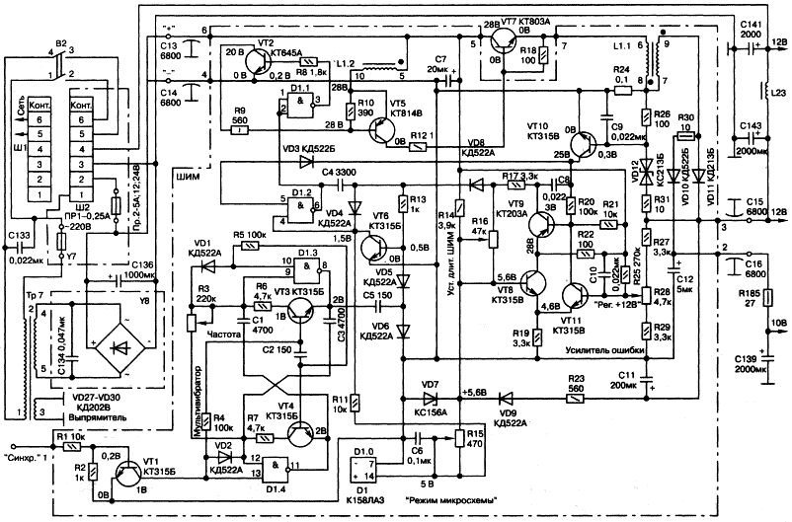
Example of a TV-set circuit:

Slide 14
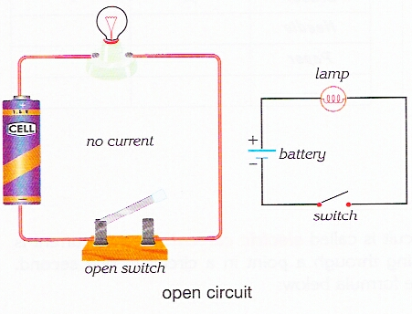
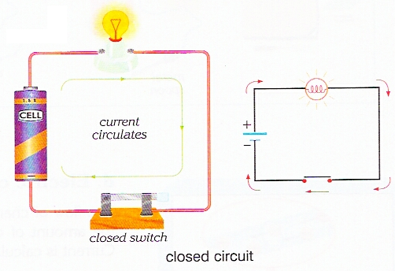
Make a circuit:
Draw a circuit into the exercise-book,
Write down
I= …

Slide 15
Practice:
1
2
Find current in electric bulb , if electric charge of 300C travels through it during 10min.
What charge will travel during 3min through ammeter if current is 0.2A?
3
4
Current is 200A. What is the time the charge of 60000C travels through it?
Current in the iron is 0.2A. What charge will travel through it during 5 min?

Slide 16
Test on the theme “Force of current”
# 2
# 3
#1
Test:
# 4
# 5

Slide 17
Question #1
Current is…
a
b
c
Is the charge travelled through the cross-section area of the conductor during a minute
Is the charge travelled through the cross-section area of the conductor during a second
Is the thermal motion of electrons

Slide 18
Question #2
Ammeter is…
a
b
c
Device for measuring charge
Device for measuring number of electrons
Device for measuring force of current

Slide 19
Question #3
What circuit is correct?
a
b
c
A
A
A

Slide 20
Question #4
A charge of 3.6*10⁴C passes through a bulb in 1 hour. What is the current passing through the bulb?
a
b
c
10A
3.6A
7.2A

Slide 21
Question #5
An amount of 10²⁰ electrons pass through the cross section of a wire in 8s. What current is passing through the wire? (take e=1.6*10⁻¹⁹C)
a
b
c
16A
4A
2A

Slide 22
Diagram
1b
5 - “5”
2c
4 - “4”
3c
3 – “3”
2 – “2”
4a
What is your mark?
5c

Slide 23
Home work:
Home work: §36 p.52 Questions 1-4(or), #5 (wr)

Slide 24
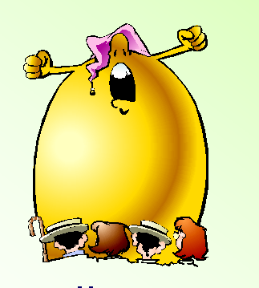


Feedback:
Text
Text
Text
I didn’t understand
anything and was waiting
the end of the lesson
I understood
everything.
I liked the lesson.
I didn’t like
the lesson

Slide 25
Thank You !
http://ppt.prtxt.ru

