Slide 1
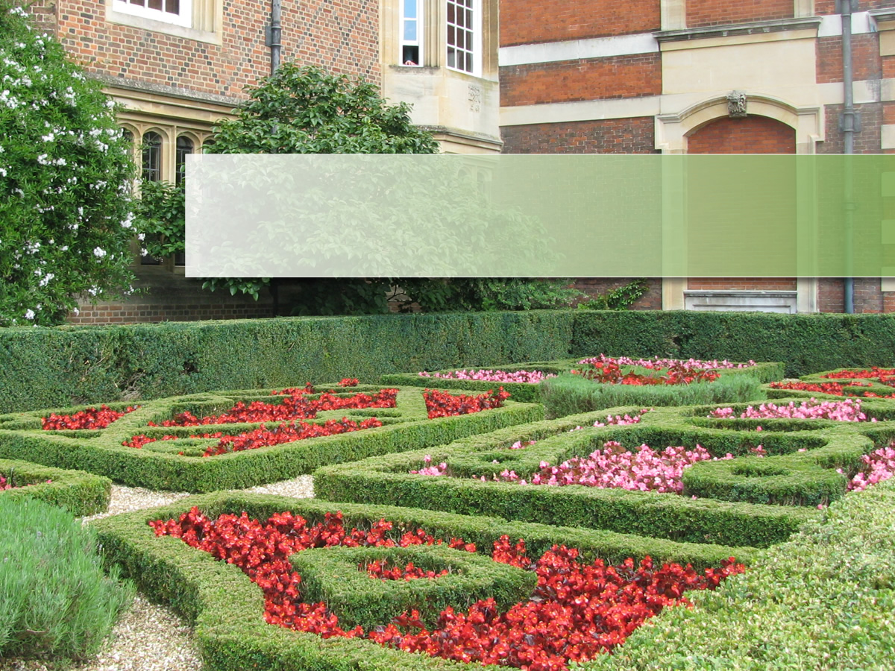
Magic Maze
Автор: Любас Людмила Николаевна, учитель английского языка МБОУ«Лицей №2»,
г. Братск, Иркутская область
г. Братск, 2013

Slide 2
Enjoying Your Home
Phonetics
Matching
Word Chain
Relaxation
The correct sentence
Making up sentences
Choose the correct word

Slide 3
Phonetics
1
2
3
4

Slide 4
Matching
Bed
Case
Business
Man
Pencil
Chair
Arm
Room

Slide 5
Matching
Book
Room
Home
Room
Class
Case
Bath
Work

Slide 6
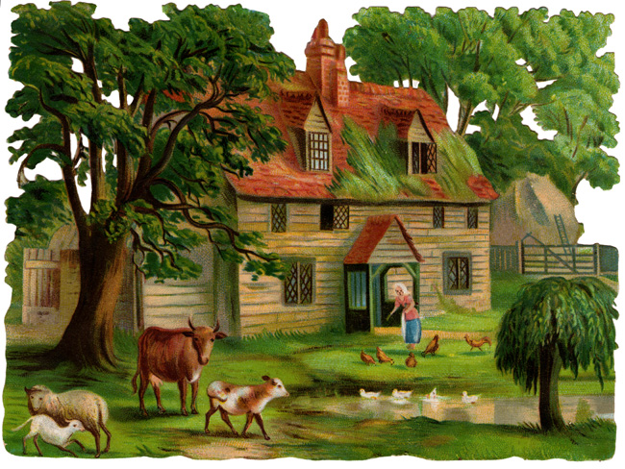
Matching
Bookcase
Homework
Classroom
Bathroom
Bedroom
Businessman
Pencil case
Armchair

Slide 7
Word Chain
Betweenthearmchairsintheleftcorneroftheroominthemidleoftheroominthechildrenroom

Slide 8
Word Chain
Between the armchairs
In the left corner of the room
In the middle of the room
In the children room

Slide 9
Relaxation
http://www.youtube.com/watch?v=lUkTW0pBg2U

Slide 10
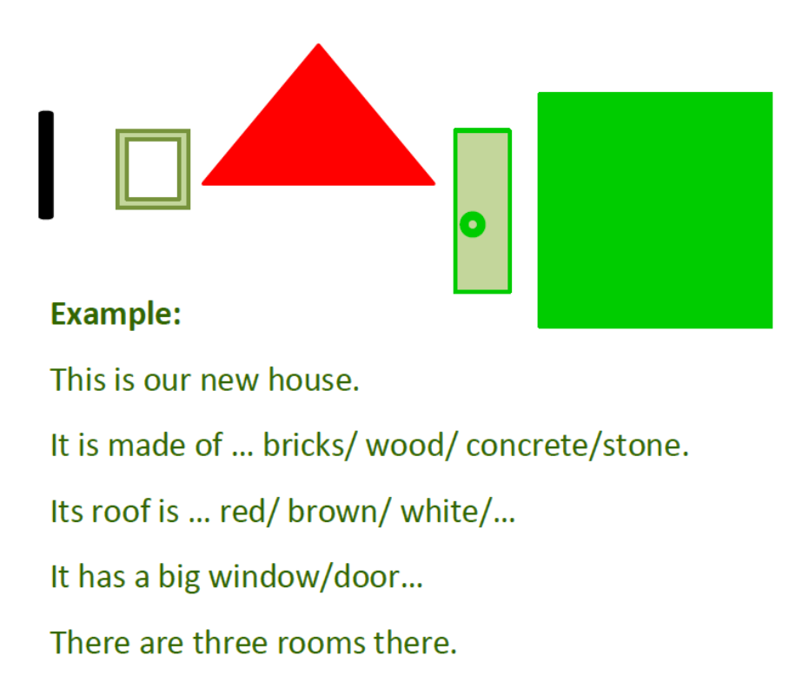

Build a new house!

Slide 11
Correct sentences
There’s/ There are a big hall downstairs.
There’s/ There are two bathrooms upstairs.
There’s/ There are beautiful trees in the garden.
There’s/ There are a kitchen downstairs.
There’s/ There are three bedrooms in the house.
There’s/ There are a living room in the house.

Slide 12
Making up sentences
the living-room/ There’s/ in/ a sofa/.
in/ isn’t/ the kitchen/ There/ a mirror/.
the bedroom/ there/ in/ Are/ beds/ two/ ?
are/ wardrobes/ the hall/ There/ in/ two/.
a lamp/ there /Is/ room/ your/ in/ ?
any/ aren’t/ cupboards/ in/ There/ the hall/.

Slide 13
Choose the right word
There is a carpet (on the floor/ on the window.)
There is an arm-chair (in the left corner of the room/ in the wardrobe.)
There is a TV (on the piano/ on the table.)
There is a lamp (under the shelf/ above the window.)
There is a computer (on the wall/ on the desk.)

Slide 14
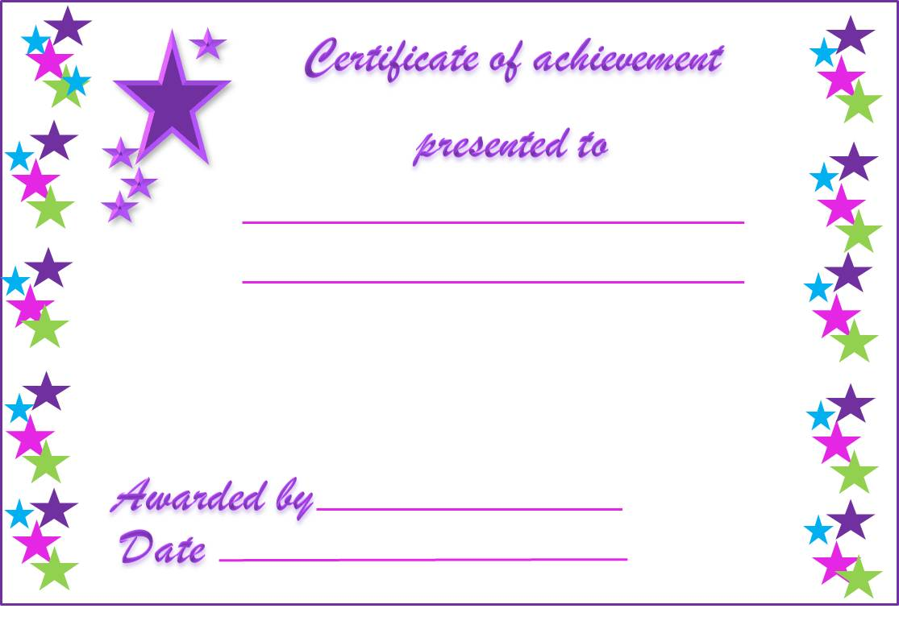
Good Job!

Slide 15
References
http://www.allkidsnetwork.com/mazes/Detail.asp?fil=maze-castle2.jpg
http://www.youtube.com/watch?v=lUkTW0pBg2U

