Slide 1
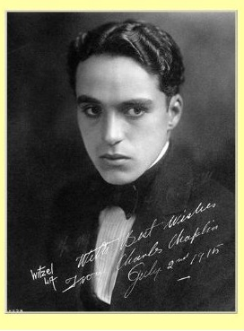
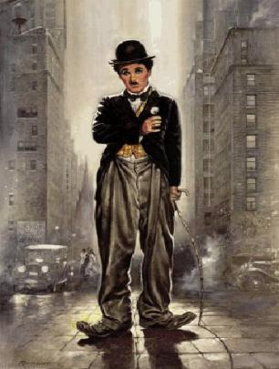
Sir Charles Spencer "Charlie" Chaplin

Slide 2
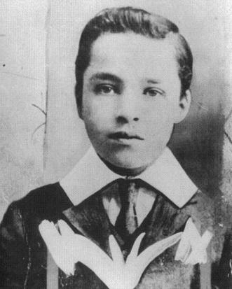
CHILDHOOD
Charles Spencer Chaplin was born on 16 April 1889 to Hannah Chaplin (née Hill) and Charles Chaplin
At the time of his birth, Chaplin's parents were both entertainers in the music hall tradition.

Slide 3
CHILDHOOD
Chaplin's childhood was fraught with poverty and hardship, making his eventual trajectory
"I was hardly aware of a crisis because we lived in a continual crisis; and, being a boy, I dismissed our troubles with gracious forgetfulness.“*
– *Chaplin on his childhood

Slide 4
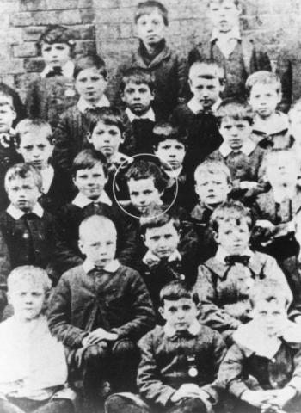
CHILDHOOD
Between his time in the poor schools young Chaplin had started performing on stage. He recalled that his first appearance came at five years old. It was an isolated incident, but at nine years old Chaplin became interested in the theatre.

Slide 5
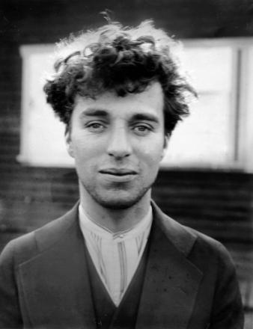
YOUTH
Chaplin quickly began work in another role, touring with his brother – who was also pursuing an acting career – in a comedy sketch called Repairs.

Slide 6
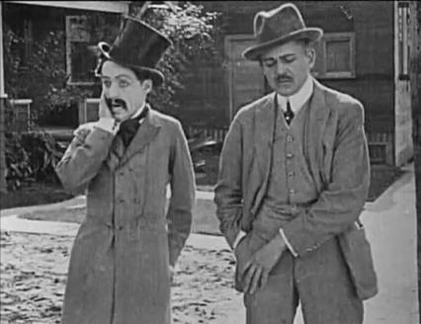
CAREER
Chaplin was six months into the second American tour when his manager received a telegram from the New York Motion Picture Company. One of their members had seen Chaplin perform and felt that he would make a good replacement for Fred Mace, star of their Keystone Studios who intended to leave.

Slide 7
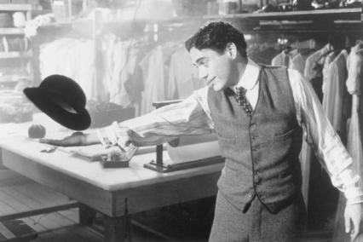
CAREER
“I don't know how I make up. On the way the lot and I instantly decided to wear baggy pants that would sit on me the bag, too big shoes and a bowler hat, but in the hands get a walking cane. I wanted to in my suit all was contradictory Dressing, I haven't thought about what the. I felt him, and when I returned to the pavilion, my character has been born.”

Slide 8
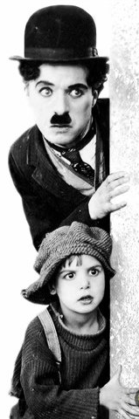
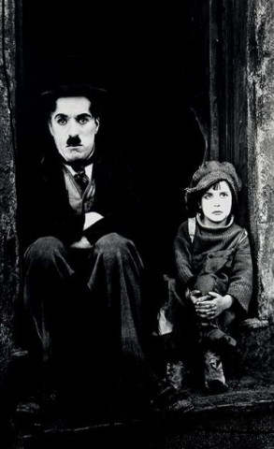
CAREER
The Kid (1921), with Jackie Coogan, combined comedy with drama and was Chaplin's first film to exceed an hour.

Slide 9
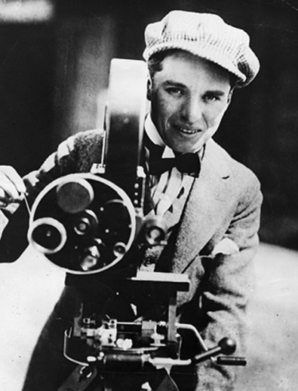
CAREER
In 1914 Chaplin self-directed his first film («Taken rain»), in which he was an actor, Director and screenwriter.

Slide 10
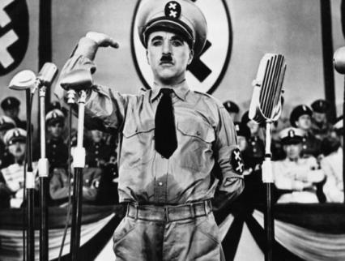
CAREER
The first fully sound picture Chaplin became «the Great dictator» .It was the last film, where they used the image of the crawler-Charlie.
The Great Dictator received five Academy Award nominations, including Best Picture, Best Original Screenplay and Best Actor

Slide 11
WHAT DO YOU KNOW ABOUT Charlie" Chaplin?
What is the full name of Charlie Chaplin?
When was he born?
What age he did his appearance?
Can you name the combined comedy and drama with the participation of Charlie Chaplin?
Do you know his first film, in which he was an actor, Director and screenwriter?

Slide 12
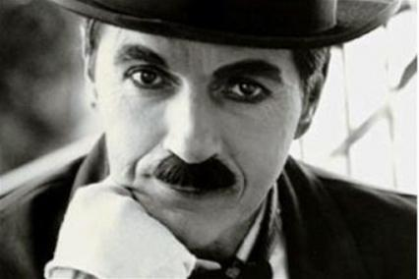

Fragments of speech of Charlie Chaplin in honor of his 70th anniversary
When I began to love myself I realized how much you can hurt a man, even if I am that man himself. Today I call this Respect.
When I began to love myself I understood, that if any circumstance, I am in the right place at the right time, and everything happens at the right time. Now I call it Confidence.
When I began to love myself I realized that my mind can bother me and even make me sick. But when I connected it to my heart, my mind became a valuable ally. Today I call this connection the Wisdom of the heart.
The biggest mistake people make when they are not trying to earn a living, what they like best.

Slide 13
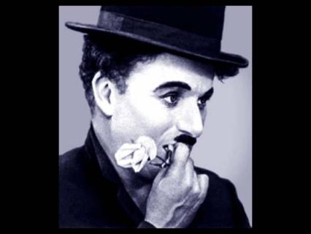
SOME INTERESTING FACTS
Chaplin was left-handed
The favorite Chaplin’s sport was Boxing
The favorite Chaplin’s dance was Tango
Once Chaplin incognito participated in the contest twins at San Francisco and couldn't even go to the finals of this contest
Chaplin bequeathed $ 1,000,000 man who will give birth to a child

Slide 14
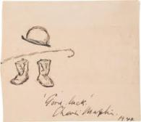
Thank you for your attention! Surkova Olesya

