Slide 1
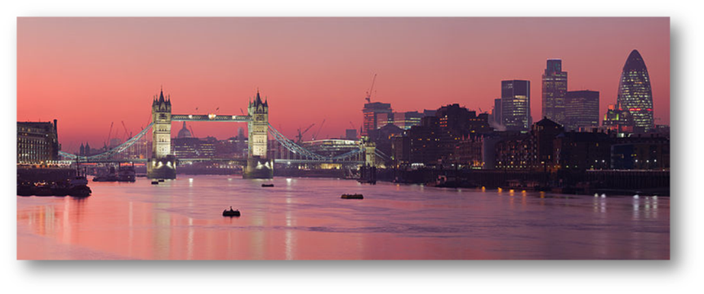
The trip along the river Thames

Slide 2

Look & Guess! What is this man speaking about?

Slide 3
What is he speaking about?

Slide 4


Slide 5
London’s top sites
River Thames
The White Tower
What is he speaking about?
Tower Bridge
Crown jewels
Williams the Conquer
Chapel of Saint John
Collection of medieval weaponry

Slide 6
The trip along the river Thames

Slide 7
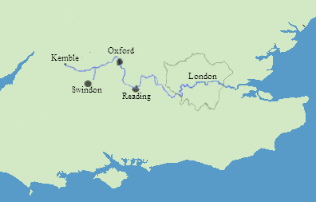
Thames map
Total length - 215 miles (346 km)
The Thames is the longest river in England and the second longest in the United Kingdom.

Slide 8
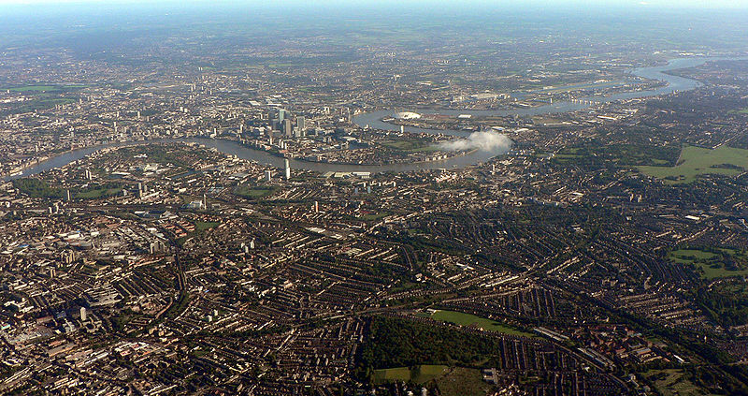
The Thames drains the whole of Greater London
(The Thames as it flows through east London,
with the Isle of Dogs in the center.)

Slide 9
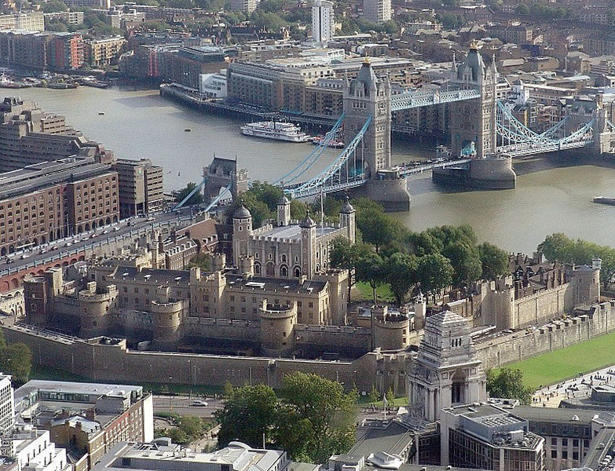
The Tower, with Tower Bridge built 800 years later.

Slide 10
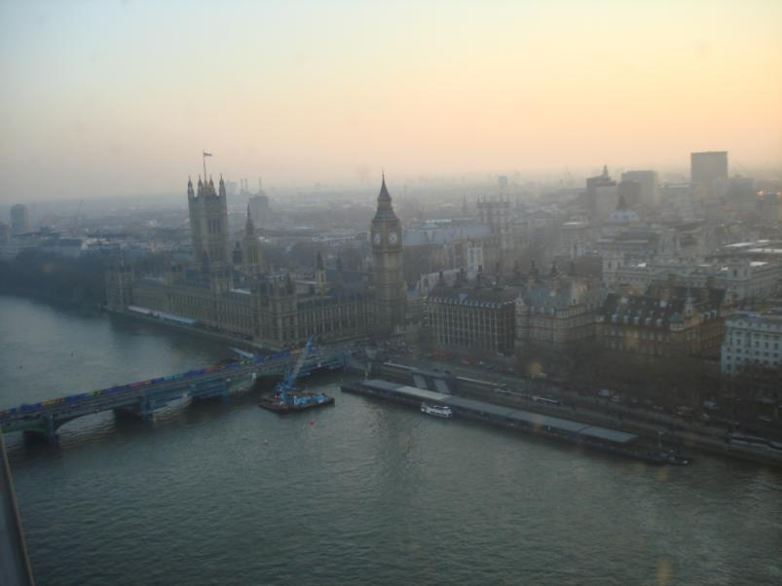
The Thames passes by some of the sights of London, including
the Houses of Parliament and the London Eye.

Slide 11
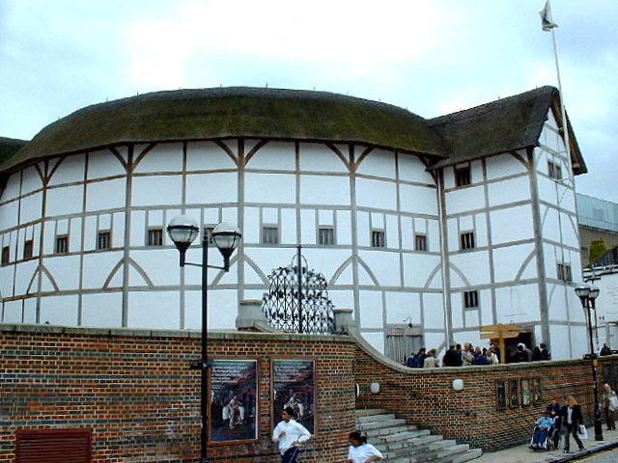
Shakespeare's Globe
Shakespeare's Globe is a reconstruction of the Globe Theatre
on the south bank of the River Thames

Slide 12
Listen & answer the questions
When was the Tower Bridge build?
When did William The Duke of Normandy became “The Conqueror”?
What is the name of the oldest Chapel in England?
Can you take the cameras to the Tower?
What part of London is the oldest one?

Slide 13
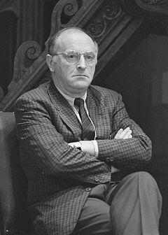
ИО́СИФ АЛЕКСА́НДРОВИЧ БРО́ДСКИЙ (24 МАЯ 1940, ЛЕНИНГРАД — 28 ЯНВАРЯ 1996, НЬЮ-ЙОРК)
"...Бесконечная улица, делая резкий крюк,
выбегает к реке, кончаясь железной стрелкой.
Тело сыплет шаги на землю из мятых брюк,
и деревья стоят, словно в очереди за мелкой
осетриной волн; это все, на что
Темза способна по части рыбы..."
русский и американский поэт, драматург, переводчик, лауреат Нобелевской премии по литературе 1987 года.
Стихи писал преимущественно на русском языке, эссеистику на английском. Один из крупнейших русских поэтов XX века.

Slide 14
Many of London’s top sites front for _____0_____ which has become a transportation furan fare for tourists. We are sailing from ___1___under Big Ben to the tower of London enjoying an informative ___2___of the interviews.
Tower Bridge looks medieval but it was actually built with ___3___in eighteen ninety four in form of Medieval style to match its famous neighbor just a few steps. The Tower of London ____4___to the Norman Conquest.
William the Duke of Normandy became Williams the Conquer when he crossed the English channel in ___5___and took the throne of England. To help established his rule he had this awesome and really awesome in the state
Fortress built. Its purpose - put ___6___between him and his new subjects.
This is the original tower – The White Tower gave ___7___its name.
The style of the age was Roman-Essex which the English call Norman for ___8___who imported it.
This charming chapel of Saint John dated to 10 A.D - one of the oldest in England provides a rare look and pure Norman architecture.
Round roman style arches and thick walls.
You’ll see ___9___ of medieval weaponry in armory
The entry includes a peak at the most dazzling crown jewels in Europe (___10__!) and entertaining tour with one of the human warders or beefeaters.
The Tower marks the oldest part of London - a district called the City. This is ___11__of Britain but this days bank, headquarters, shiny skyscrapers and many of the elegant original bank offices survived as fancy pubs.
the river Thames -0
a.the invaders
b.no cameras allowed
c.the steel skeleton
d.the financial center
e.ten sixty six
f.intimidated collection
g.the castle complex
h.Westminster
i.fifteen feet of stones
j.narration
k.goes back

Slide 15
CHECK YOURSELF
1 | h.
2 | j.
3 | c.
4 | k.
5 | e.
6 | i.
7 | g.
8 | a.
9 | f.
10 | b.
11 | d.
5- «3»
6-8 – «4»
9-11 – «5»

Slide 16
http://www.youtube.com/watch?v=PP7lLcVYHfA

Slide 17
Did you like this task?
What did you like?
What was new\the most interesting\difficult for you?

Slide 18


Slide 19
