Slide 1
«Healthy food»
Презентация к уроку учителя английского языка Киселевой Н.В.

Slide 2
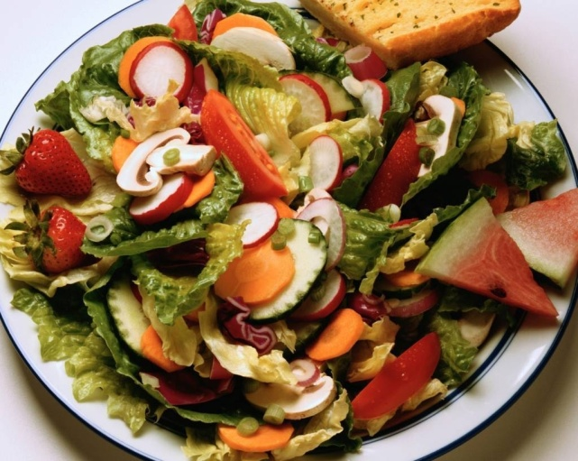
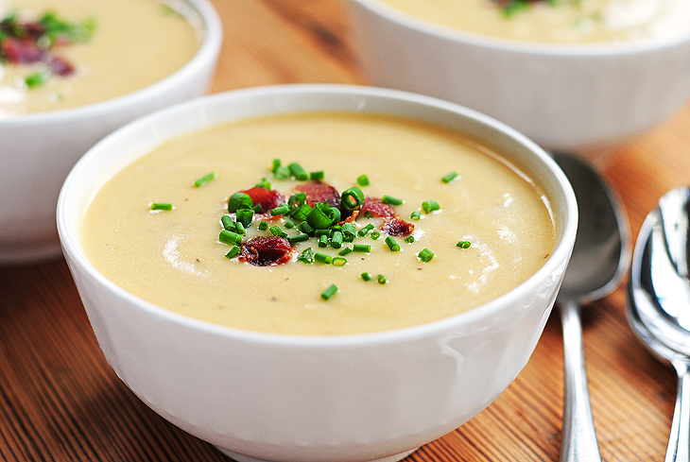
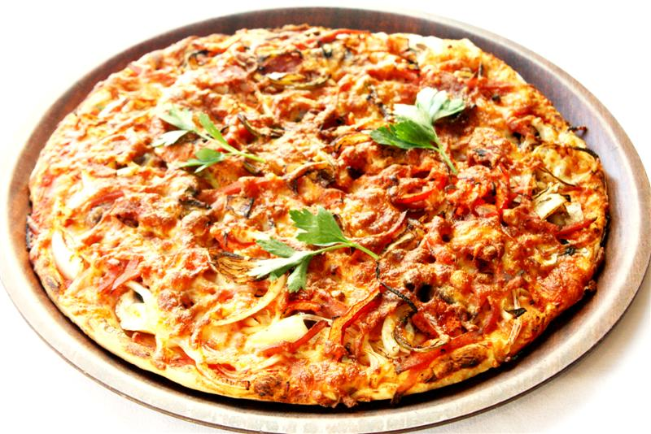
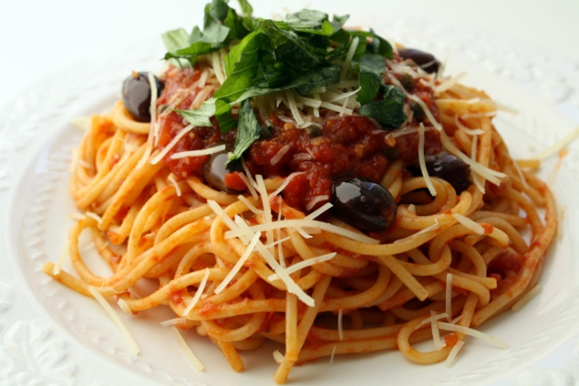
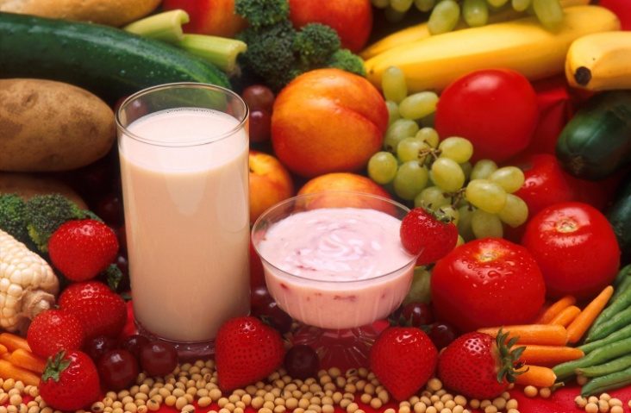
Answer the questions.
What’s your favourite food?

Slide 3





What do you usually drink?

Slide 4
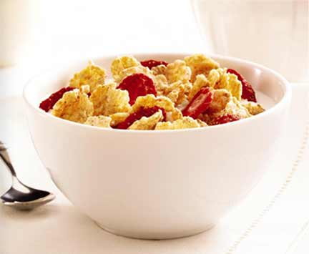
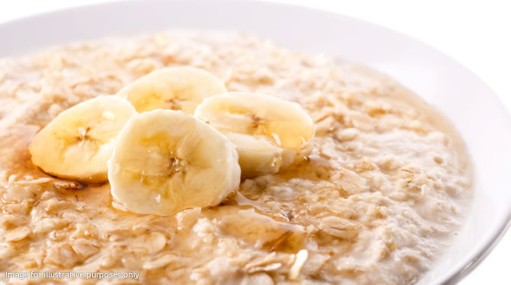
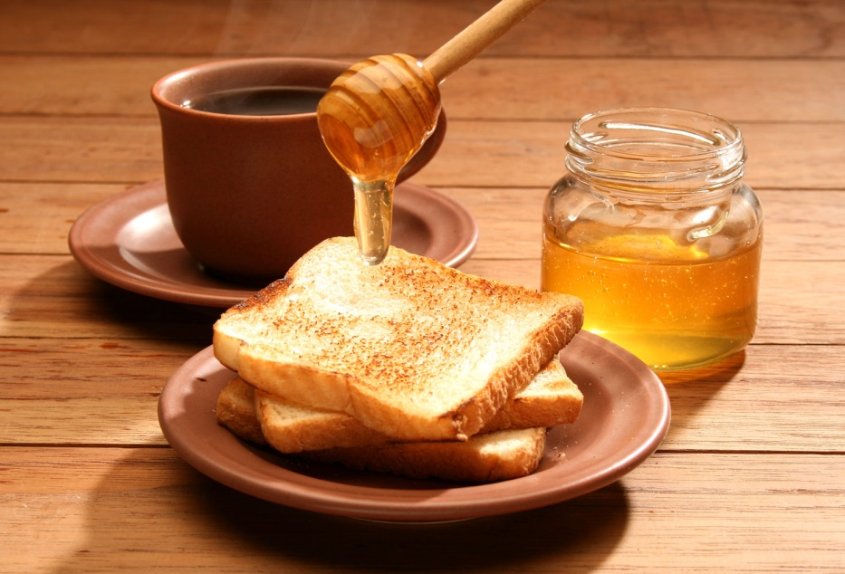

What do you have for breakfast?

Slide 5
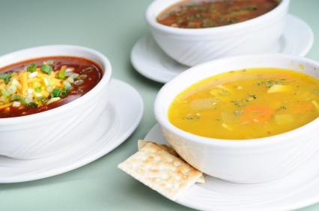
Do you have soup for lunch?

Slide 6
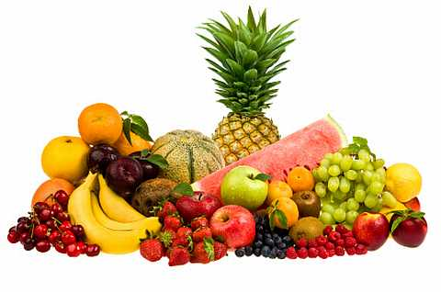
Do you like fruit?

Slide 7
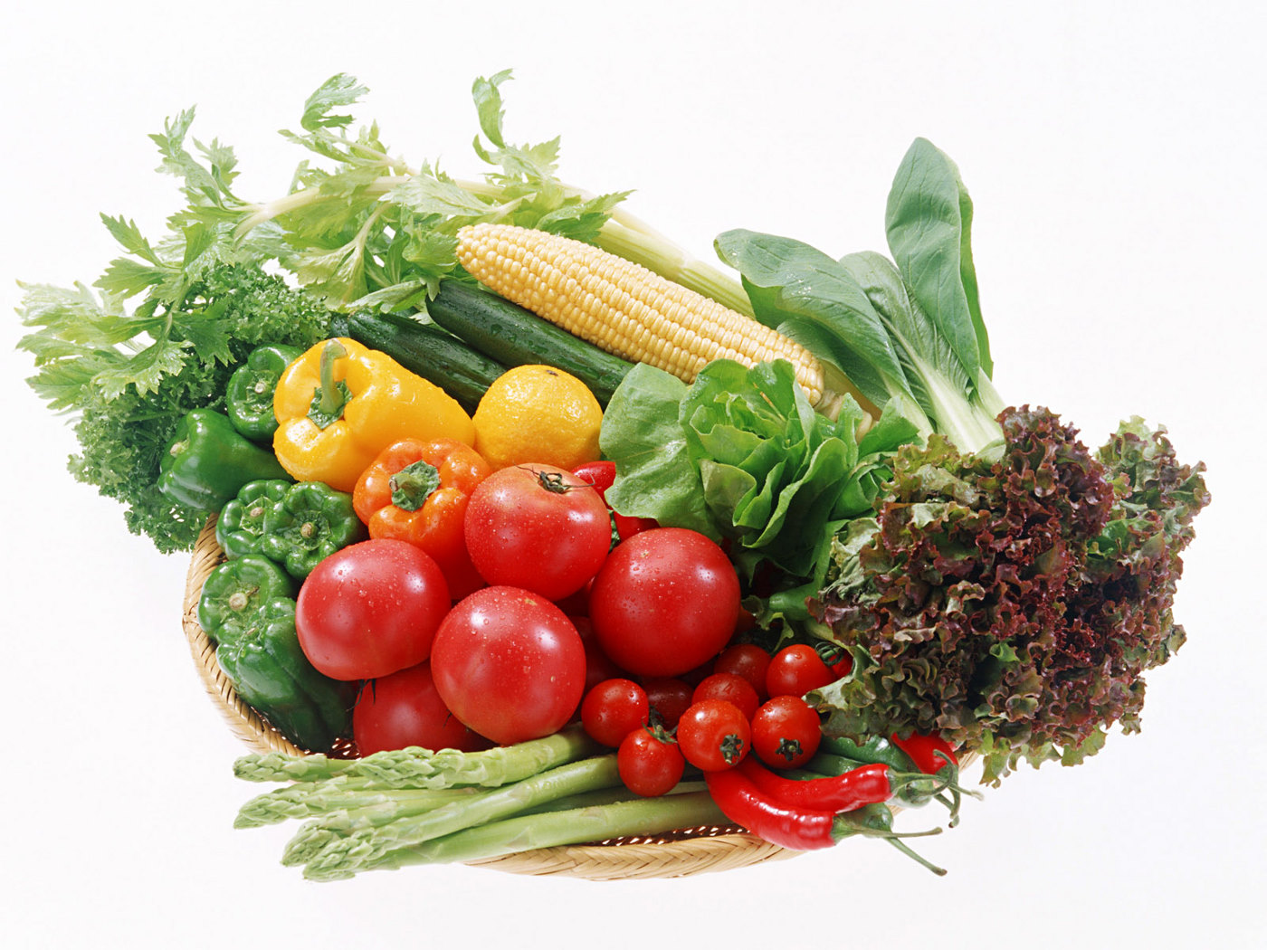
Do you eat vegetables every day?

Slide 8
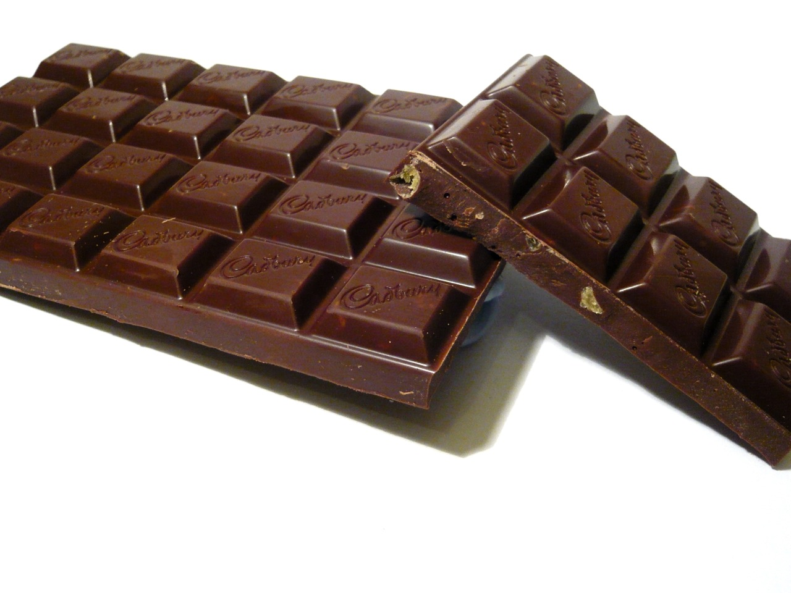
Do you like chocolate?

Slide 9

Get up, little Freddy,
Breakfast is ready:
Butter and cheese
All that you please
Milk and bread for little Fred.
Tea and jam for brother Sam.

Slide 10

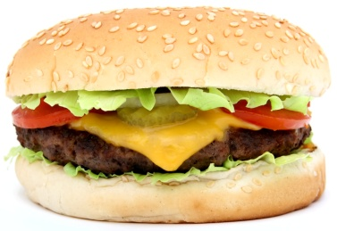


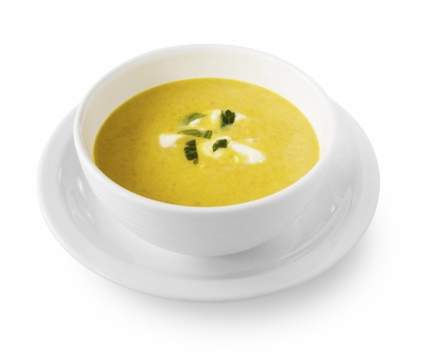
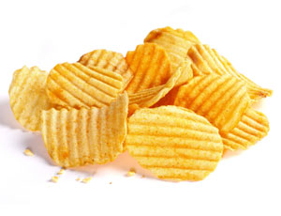

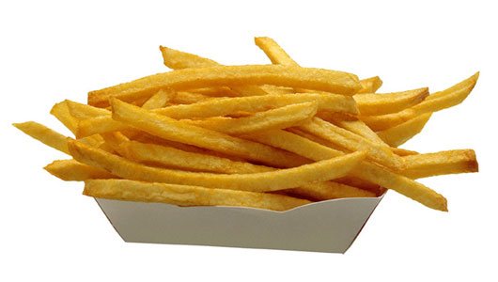
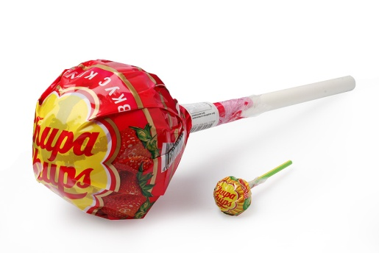
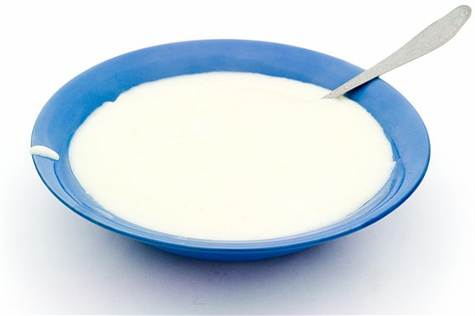
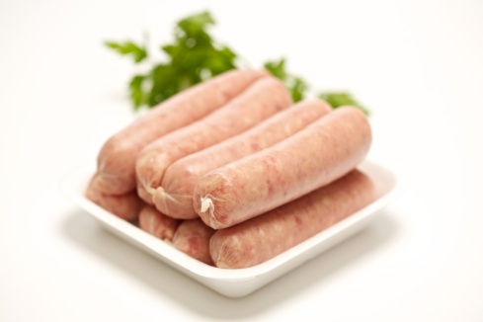
Which foods do you think are good for you?

Slide 11
HEALTHY FOOD | NOT VERY HEALTHY FOOD
Milk Cheese Soup Porridge Vegetables Fruit Juice | Sausages Hamburger Fry potatoes Chips Sweets Cola Cake

Slide 12

We need healthy food to stay healthy. Good food has a lot of vitamins, protein and minerals.

Slide 13
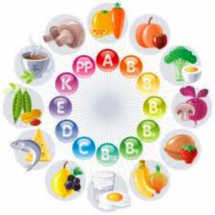


Vitamins
are important for
your body.

Slide 14

Protein helps you to grow and give you energy.

Slide 15
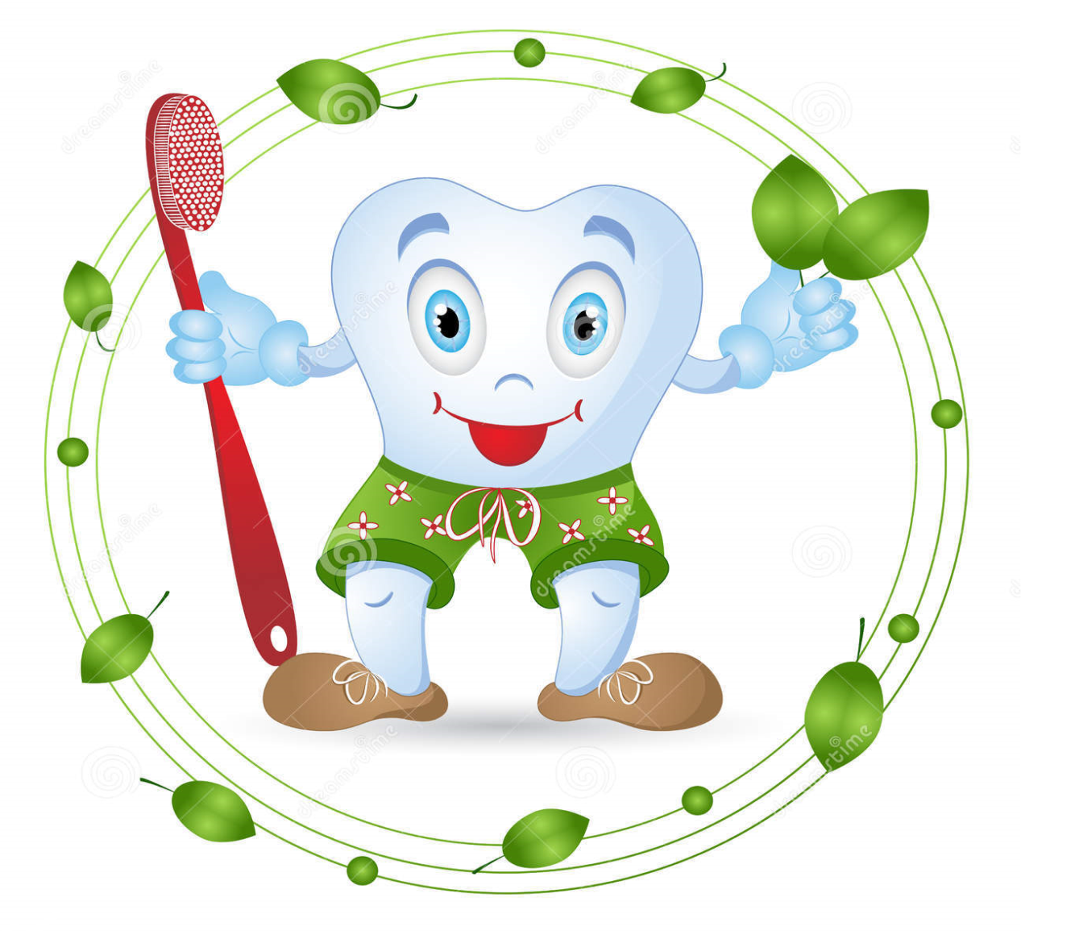
Minerals make your bones and teeth strong.

Slide 16
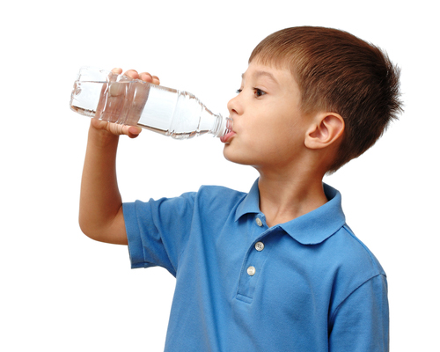
Water is important for your blood.
Drink lots of water every day!

Slide 17
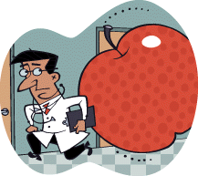
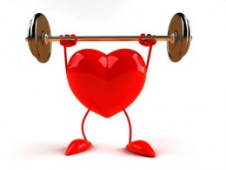
Read the proverbs and comment them.
An apple a day keeps doctor away.
Health is above wealth.

Slide 18
Listen and complete the text. Use these words.
sugar, diet, vitamins, protein, fat, vegetables, minerals
I eat healthy food. I drink milk for ___.
I don’t eat lots of cake. Cakes have lots of ___. Sometimes I eat sausages. They have lots of good ___, but they’ve got ___. I eat lots of fruit and ___. There are different types of ___ in milk, vegetables, eggs, meat, cereals and many other foods. I eat soup every day. It’s very good for you. I drink lots of water every day. I have a healthy ___.

Slide 19

Are these sentences true or false?
Vitamins are important for your eyes, your skin, your bones, for hair and for other parts of your body.

Slide 20
Are these sentences true or false?
There are some vitamins in milk.
There isn’t any sugar in cake.
Sausages haven’t got fats.

Slide 21
Are these sentences true or false?
Protein is good for you.
Water is important for your blood.
Fruit isn’t healthy.

Slide 22





If you want to live the healthy way,
Eat FIVE fruits and vegetables every day.
Have juice at breakfast, carrots with lunch,
Grapes for a snack (eat a big bunch).
Peas and potatoes with your dinner –
That adds up to five, and you’re the winner!

Slide 23
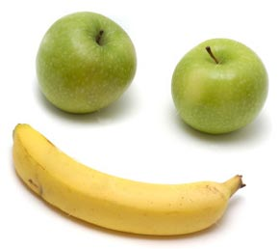
EAT WELL,
STAY HEALTHY!

