Slide 1
Муниципальное образовательное бюджетное учреждение «Средняя общеобразовательная школа №2»
ARE YOU CURIOUS?
Урок английского языка в 4 классе
Учитель английского языка
Носкова татьяна Николаевна
г. Верещагино, 2014г.

Slide 2
Look at the pictures and make up a sentence using the grammatical structure “there is/are”

Slide 3
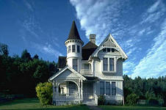

Slide 4
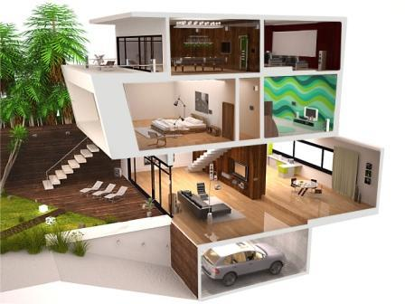

Slide 5
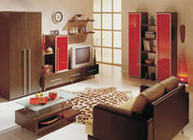
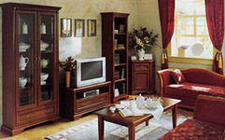

Slide 6
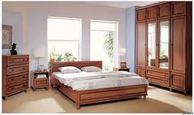
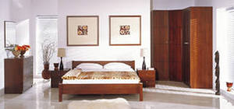

Slide 7
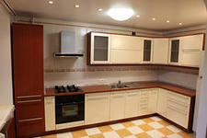

Slide 8
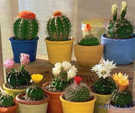
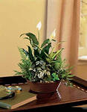
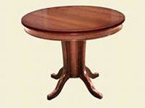

Slide 9
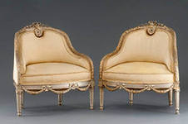
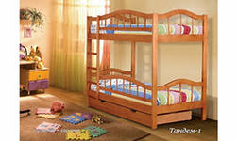
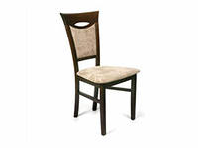
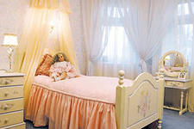

Slide 10
Are you curious? Do you ask questions?

Slide 11
How to ask questions Ex. 13,p.24
+ There is a piano in the house.
? Is there a piano in the house?
+ There is a picture on the wall.
? … … a picture on the wall?
+ There are chairs in the room.
? ………………………………. ?

Slide 12
Task 1. Match the questions and the answers
1. Is there a table in the kitchen?
2. Are there chairs in the toilet?
3. Are there books in the kitchen?
4. Are there armchairs in the living room?
5. Is there a TV in the hall?
1. – c)
a) No, there are not. There are no books in the kitchen.
b) Yes, there is. There is a table in the kitchen.
c) No, there are not. There are no chairs in the toilet.
d) Yes, there are. There are armchairs in the living room.
e) Yes, there is. There is a TV in the hall.

Slide 13
Match the questions and the answers
1. – b)
2. - c)
3. - a)
4. - d)
5. - e)

Slide 14
Task 2. Put words in the correct order to make a question
a computer, the kitchen, Is, there, in?
Are, in, the living room, there, 2 armchairs??
the living room, Is, in, a TV, there?
bedrooms, there, many, Are?

Slide 15
Task 2. Put words in the correct order to make a question
Is there a computer in the kitchen?
Are there 2 armchairs in the living room?
Is there a TV in the living room?
Are there many bedrooms?

Slide 16
Task 3. Make interrogative sentences out of positive.
There is a sofa in the room.
There are many books on the shelf.
There is a new computer in the room.
There are 3 nice pictures on the wall.

Slide 17
Task 3. Make interrogative sentences out of positive.
There is a sofa in the room.
Is there a sofa in the room?
2. There are many books on the shelf.
Are there many books on the shelf ?
3. There is a new computer in the room.
Is there a new computer in the room?
4. There are 3 nice pictures on the wall.
Are there 3 nice pictures on the wall?

Slide 18

Work in groups. Ask questions about the rooms.

Slide 20
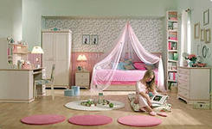
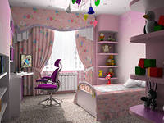
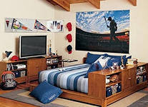

Slide 21
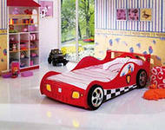
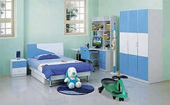
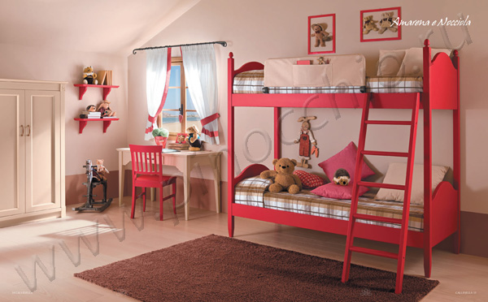

Slide 22
Homework
Ex. 16, p.24
Write questions about Tiny’s house.
Write a letter to your pen friend and ask about his\her room.
You are in a hotel. Ask questions about
the room you will live in.

Slide 23


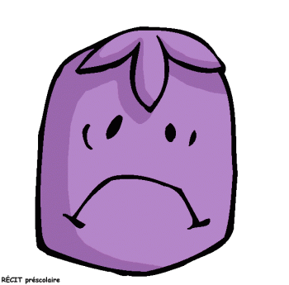
What do you feel after the lesson? Are you satisfied with your work?

Slide 24
Источники
Книга для учащихся - Английский с удовольствием - Enjoy English, для 4 класса, М.З. Биболетова, изд-во Титул, 2010
Книга для учителя - Английский с удовольствием - Enjoy English, для 4 класса, М.З. Биболетова, изд-во Титул, 2010
www.clipart.com
http://images.yandex.ru/yandsearch?text=%D0%B4%D0%BE%D0%BC&uinfo=ww-1345-wh-667-fw-1303-fh-461-pd-1

