Slide 1










Lesson 32
English-speaking countries

Slide 2
Today we shall find up the information about the English-speaking countries, to learn to use the words who, which, that.

Slide 3
there won through too week write no piece I hour hear sea meat | eye one weak peace here threw right know see two our meet their

Slide 4
advanced
powerful
to share
to be shortened
to be mixed
emblem
financial
melting pot
to occupy
a maple tree
to stretch
real

Slide 5
A Little Teapot
I’m a little teapot short and stout.
Here is my handle, here is my spout.
When I get all steamed up, and I shout:
“Tip me over and pour me out!”

Slide 6
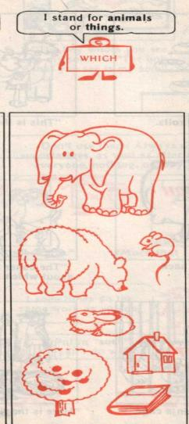
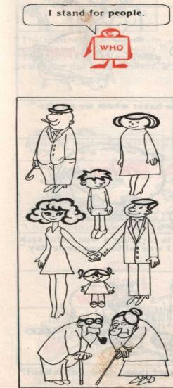
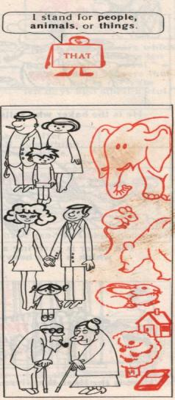
Connective pronoun

Slide 7
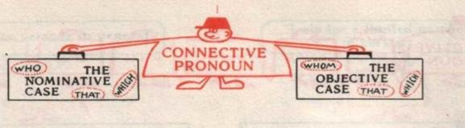
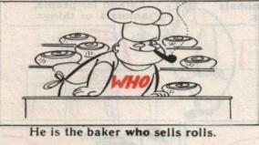
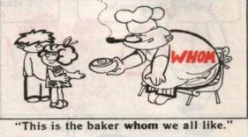
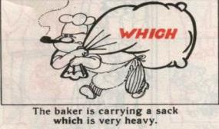
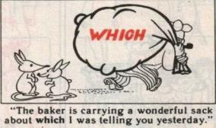
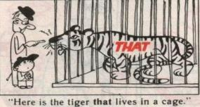
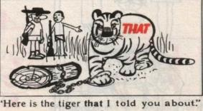

Slide 8
 | Countries | Capitals | Languages | Traditions
1
2
3
4
5
6
7
8
9
10
11

Slide 9
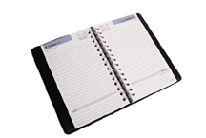
Homework
Ex 3, p. 56

Slide 10
During today’s lesson we have:
learned about…
reviewed the material about…
done…
read…
written…
got acquainted with…
found out …
remembered…

