Slide 1
Universal declaration of Human Rights(UDHR)

Slide 2
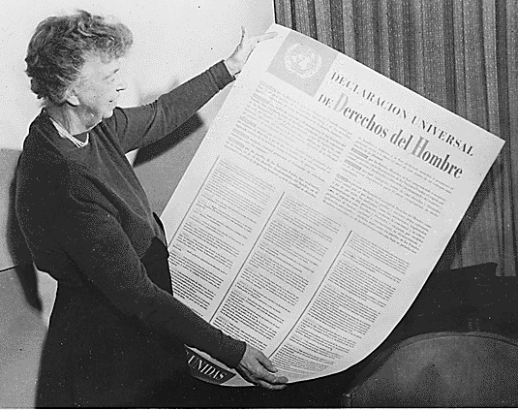

Slide 3

“All human beings are born free and equal in dignity and rights.” (article 1)

Slide 4
private life
freedom
law
RIGHTS
country
opinions
equally
education
religion

Slide 5
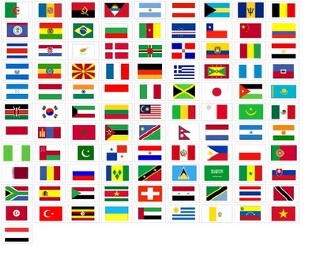
Take away your rights
Nobody has the right to:
Treat you as his or her slave
Punish you or put you in prison without a good reason
Torture you
Take away your rights

Slide 6
Proverbs
Think! Discuss the following:
Live and let live.
United we stand, divided we fall.

Slide 7
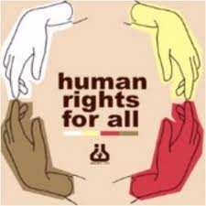
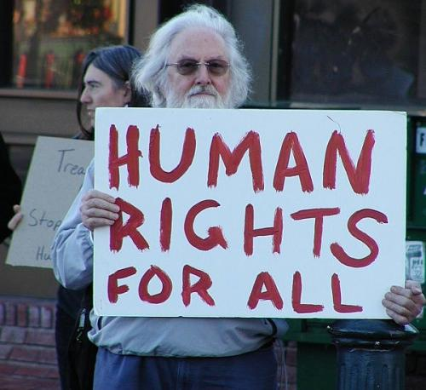
Charity or Organizations for Human Rights

Slide 8
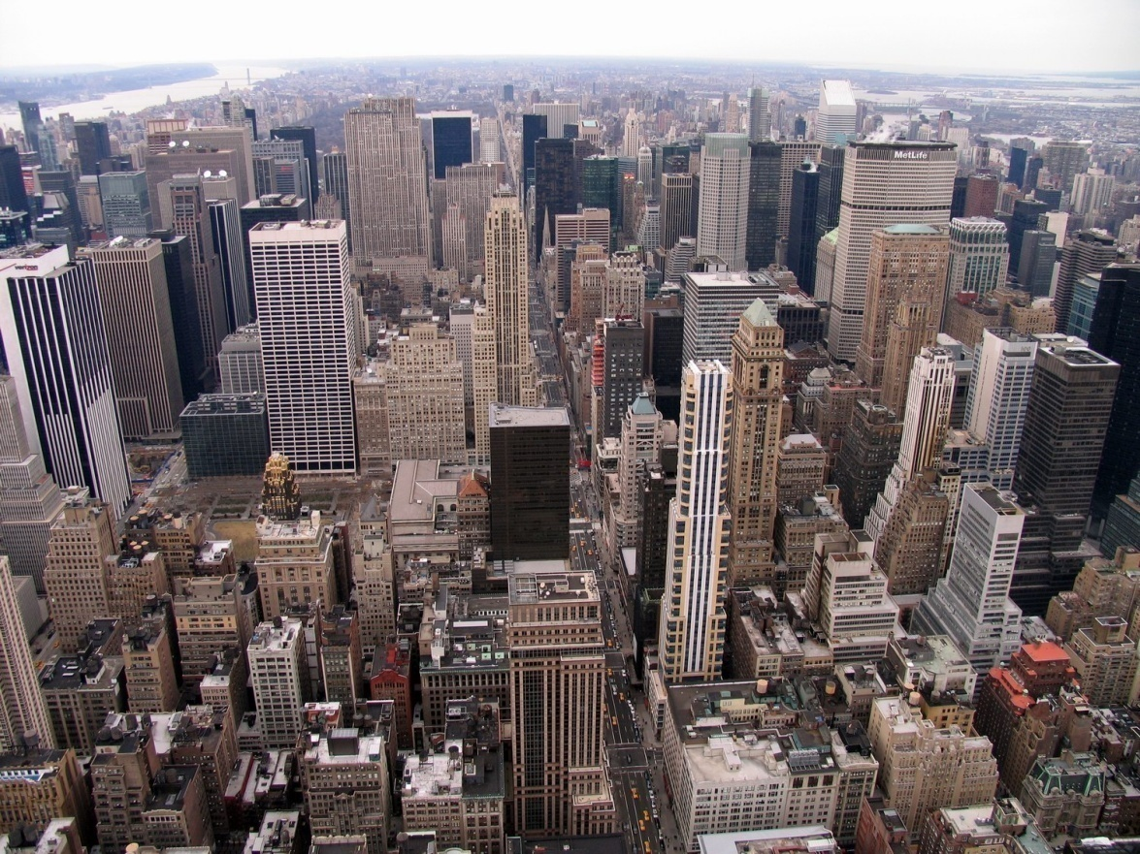
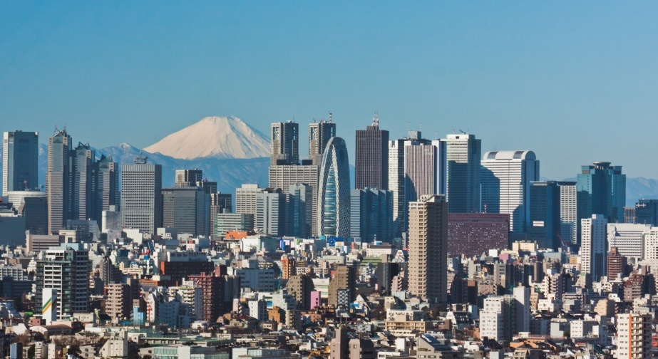
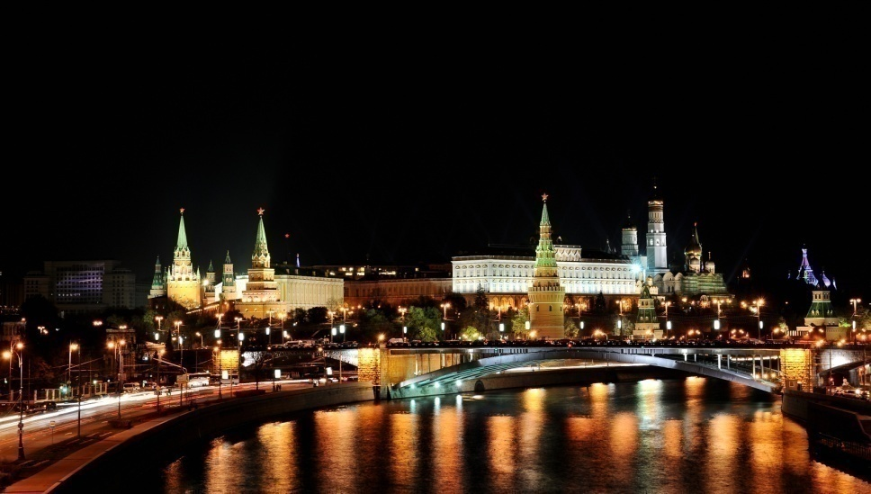
Human Rights Watch (HRW) is an international non-governmental organization that conducts research and advocacy on human rights. HRW headquarters are in New York City with offices in Amsterdam, Beirut, Berlin etc.

Slide 9
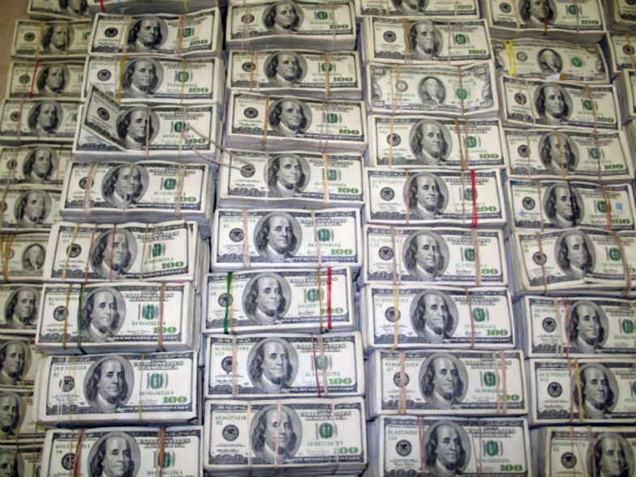

The George Soros Open Society Foundation is the primary donor of the Human Rights Watch, contributing $100 million of $128 million of contributions and grants received by the HRW in the 2011 financial year.

Slide 10
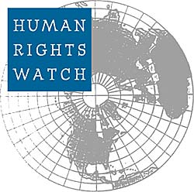
HISTORY
Human Rights Watch was founded as a private American NGO in 1978, under the name Helsinki Watch, to monitor the former Soviet Union's compliance with the Helsinki Accords.

Slide 11

FINANCING AND SERVICES
For the financial year ending June 2008, HRW reported receiving approximately US$44 million in public donations. In 2009, Human Rights Watch stated that they receive almost 75% of their financial support from North America, 25% from Western Europe and less than 1% from the rest of the world.

Slide 12

United Nations Children's Fund or UNICEF - an international organization that operates under the auspices of the United Nations.

Slide 13
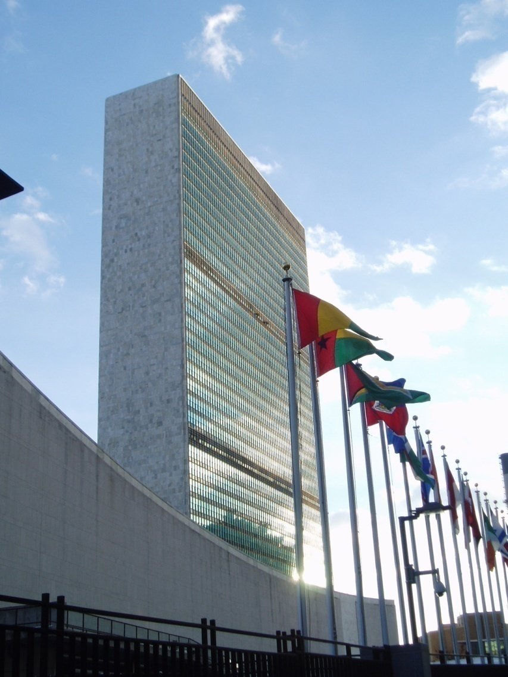
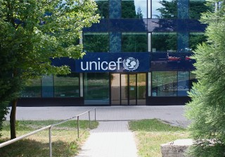
Centre of the organization is located in New York.

Slide 14
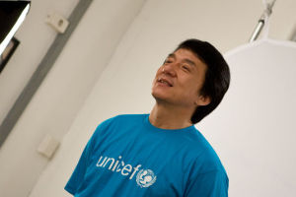
To achieve these and other goals, UNICEF helps more than 180 Goodwill Ambassadors.
Jackie Chan - one of the most active ambassadors of goodwill.

Slide 15
UN Children's Fund does not share maternal
and child. The main objectives of the UN
Children's Fund:
reduction in mortality of children under 5 years old on third;
50% reduction in maternal mortality;
provide primary education for 80% of children.

Slide 16
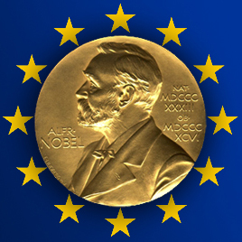
In 1965, UNICEF received the Nobel Peace Prize.

Slide 17
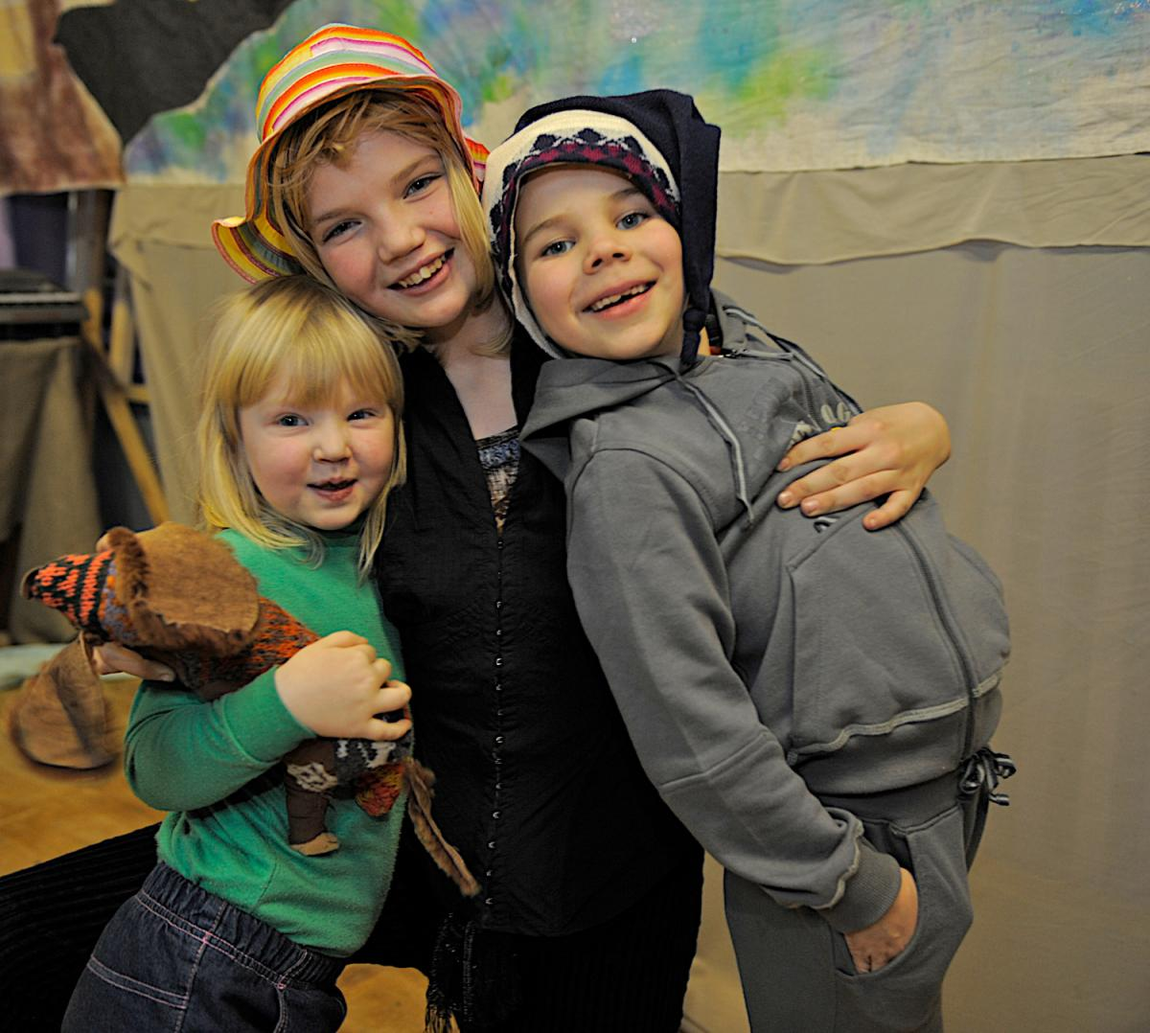
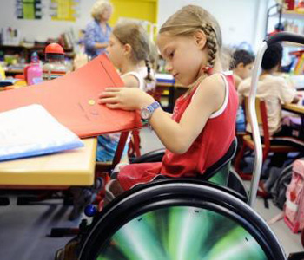
UNICEF operates in Russia

Slide 18
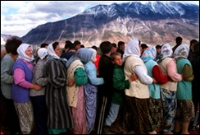
International League of Human Rights
Based in New York, with representation in Geneva and dozens of affiliates and partners around the world, the League is a non-governmental, non-profit organization now in its 65th year.

Slide 19
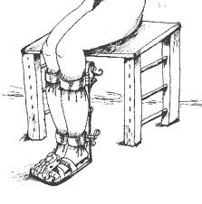
International Rehabilitation Council for Torture Victims (IRCT)
Currently, our work is focused on five areas – one strategy and four themes – that are, of course, highly interwoven. Find out more about why we focus on these areas and how we do that by clicking on the following links:
Forensic documentation
Child torture survivors
Women and girls torture survivors
Asylum-seekers, refugees, and internally displaced persons
Poverty
Front Line the International Foundation for the Protection of Human Rights Defenders Trust
81 Main Street
Blackrock, Co. Dublin, Ireland
If you are a lawyer defending human rights, please contact:
Avocats sans Frontieres France
8, Rue du Prieuré
FR - 31000 Toulouse, France

Slide 20
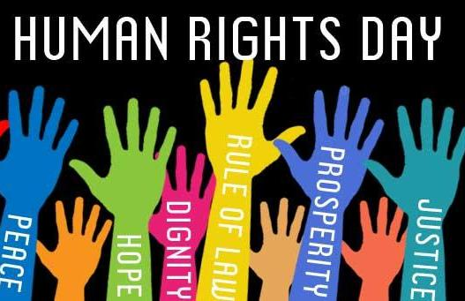
International Society for Human Rights (ISHR)
The main areas of the work of the ISHR are:
1. Support of persons, who are persecuted, imprisoned and discriminated against because of their religious and/ or political beliefs,
2. Public relations in human rights issues,
3. Education in human rights issues for persons, who live in states, which are at present in a phase of transformation towards democracy,
4. Humanitarian aid.

Slide 21
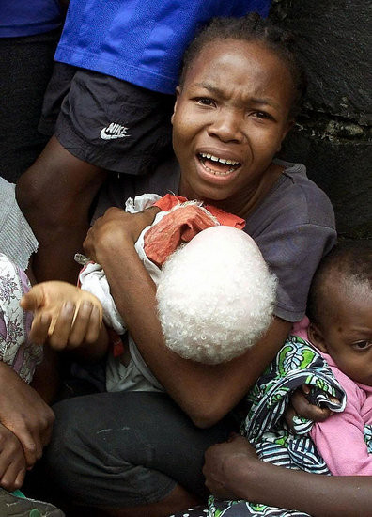
International Federation for Human Rights - FIDH
To embody global movement of human rights
Human rights are a basis of society to provide equality, freedom and dignity of each person. FIDH, its legitimacy, experience, methods and reliability, has a unique role in assistance to achievement them. Since 2009 of FIDH it realizes priority projects are broken into priorities for actions:
1 . freedom and ability to work defenders
2. universality of human rights, especially for women, the unequal address is one of the main obstacles in a way of progress of mankind
3. To encourage and protect the rights of migrants

Slide 22
Charity organizations in Russia
Stand up for your human rights
Defend them with your heart
Stand up for your human rights
We all must do our part

Slide 23

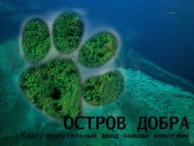


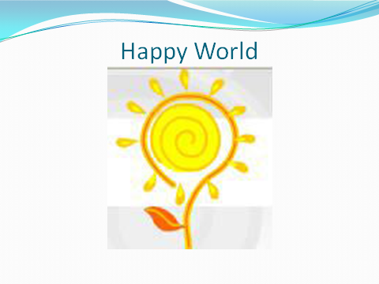
Help acting
Children's
Hearts
Island of Kindness
ROSSPAS

Slide 24

A Right for all!

Slide 25
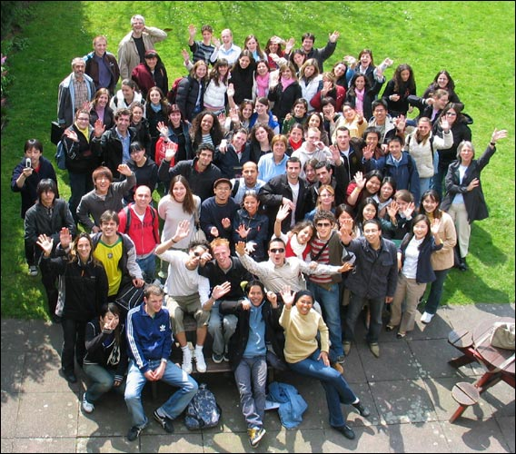
Live in freedom and safety !!!

