Slide 1
Презентация к уроку по теме “OUTSTANDING PEOPLE”
229-839-950
Фролова Н.В.
Гимназия 7
Волгоград

Slide 2
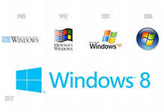

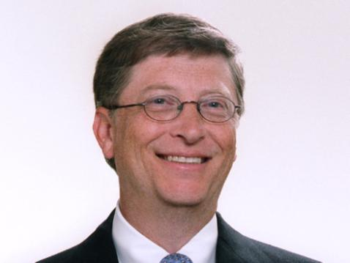

Notes:
Everyone has heard of Bill Gates, one of the richest and most successful people in the world. Microsoft, the business he started with a friend in 1975, has become the world's largest computer software company,' and Gates was the world's youngest billionaire at the age of 31.

Slide 3
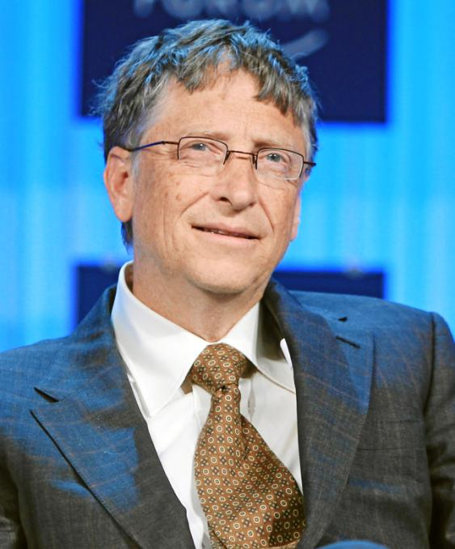

Slide 4
Facts
Full name: William Henry Gates III
Born: 28 October, 1955 in Seattle, USA
Very intelligent, good at Maths and Science
Private school in Lakeside
Finish school in 1973
Harvard 1973-1975
Started Microsoft in 1975
Married Melinda French in 1994
Wrote books in1995 , 1999
Character: ambitious, hardworking, generous
Likes: puzzles, golf, reading books

Slide 5
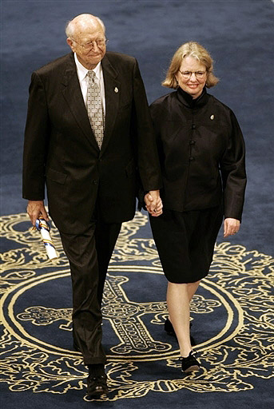
Parents
Father: William H. Gates II, is a Seattle attorney.
Mother: Mary Gates, was a schoolteacher, University of Washington regent, and chairwoman of United Way International.

Slide 6
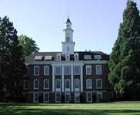
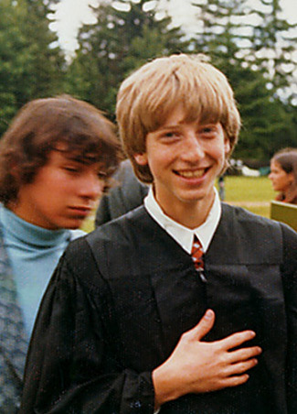
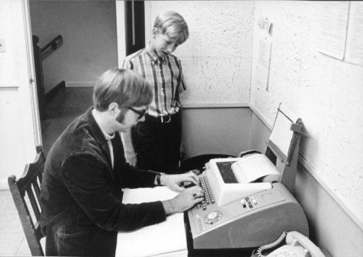
Private Lakeside
Notes:
His full name is William Henry Gates III, and he was born on 28th October, 1955, in Seattle, USA. At school, Bill soon showed that he was very intelligent, and especially good at Maths and Science. His parents decided to send him to Lakeside, the private school where he first began to use computers. 13-year-old Bill Gates and his school friend Paul Allen were soon spending all their time writing programs and learning about computers instead of doing their schoolwork!

Slide 7
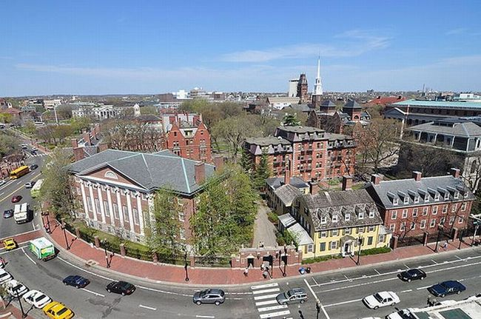
Harvard University
Notes:
After finishing school in 1973, Bill went to Harvard, America's most famous university. The next year, he and Paul Allen wrote an operating program for the Altair, one of the world's first microcomputers.

Slide 8
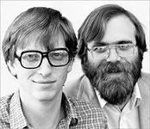
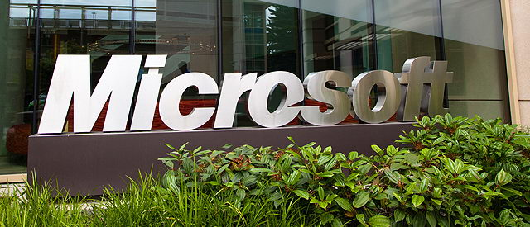
In 1975 Gates left Harvard to devote his energies to Microsoft, a company he had begun with his friend Paul Allen.
Notes:
The two friends started Microsoft in 1975, and Gates left Harvard. Before long, Microsoft was a major business success. Since then, the company has continued to grow, producing most of the world's leading PC software. One reason for his success is that Gates has always been very ambitious and hardworking.

Slide 9
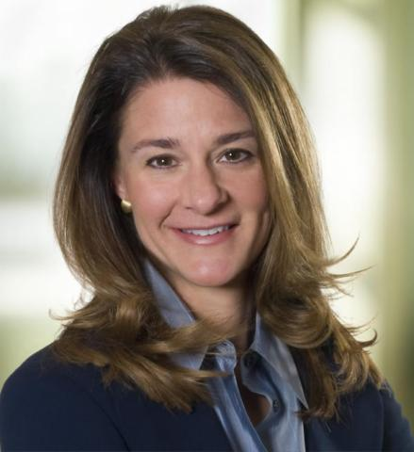
Melinda French
Married Melinda French in 1994
Notes:
This has not left him much time for a normal personal life, but in 1994 he married Melinda French; a Microsoft employee

Slide 10

"The Road Ahead", published in 1995, was at the top of the bestseller list for seven weeks.
Notes:
and in 1995 he wrote a best-selling book, The Road Ahead.

Slide 11
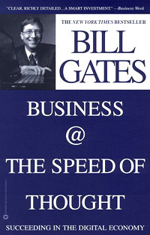
In 1999, Gates wrote "Business @ the Speed of Thought“.
Notes:
The book was published in 25 languages and is available in more than 60 countries.

Slide 12
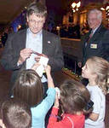
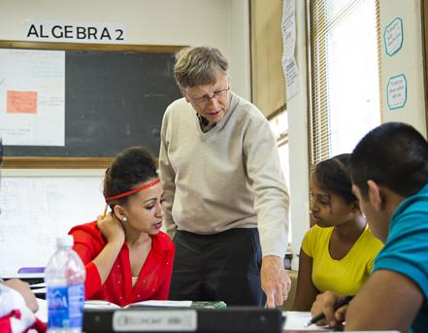
Gates has donated the proceeds of both books to non-profit organizations that support the use of technology in education
Charity

Slide 13
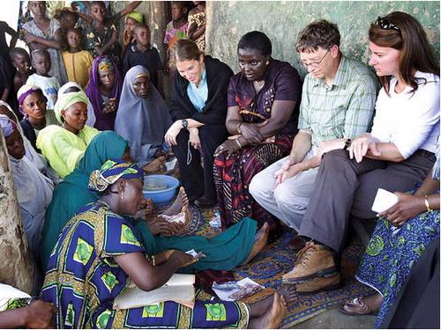
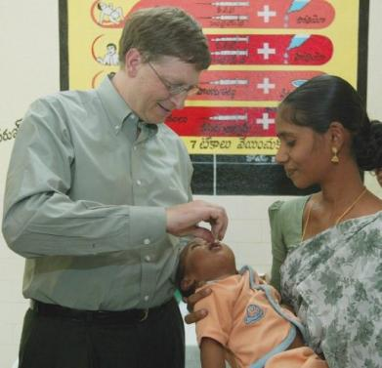
Gates and his wife, Melinda, started a foundation in 2000 to help the poor in the United States and around the world.
Notes:
When it comes to helping others, though, Gates is very generous. He has already given huge amounts of money to charity, and says that he plans to give away almost all of his wealth when he retires.

Slide 14
Источники:
http://www.microsoft.com/en-us/news/exec/billg/
http://images.yandex.ru/yandsearch?text

