Slide 1
Can’t

Slide 2
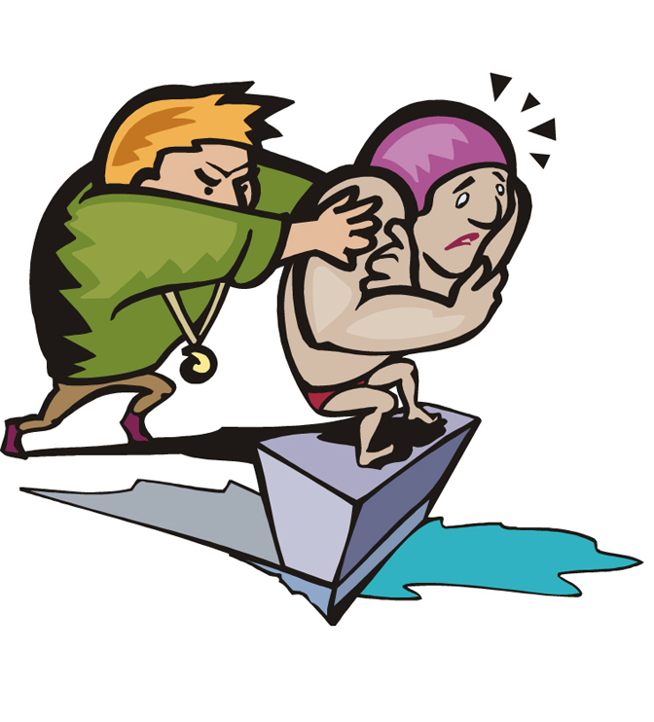
He can’t swim.

Slide 3
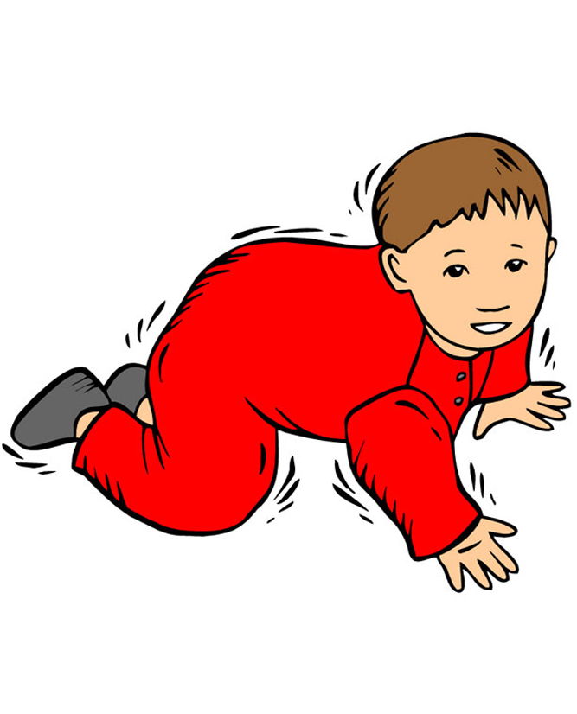
He can’t walk.

Slide 4
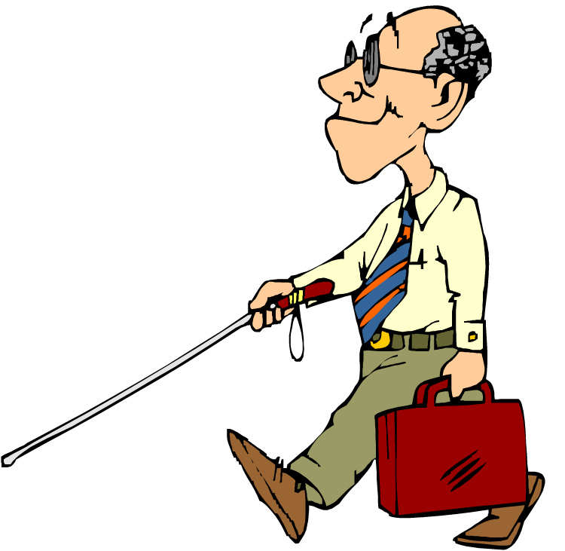
He can’t see.

Slide 5
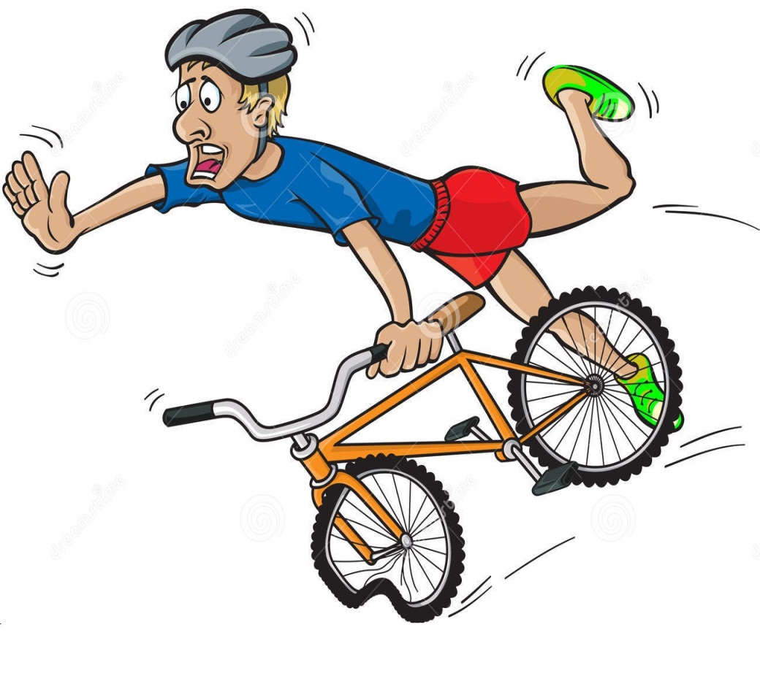
He can’t ride a bike.

Slide 6

It can’t fly.

Slide 7

It can’t run.

Slide 8
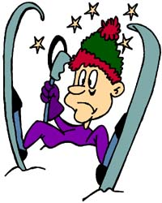
He can’t ski.

Slide 9
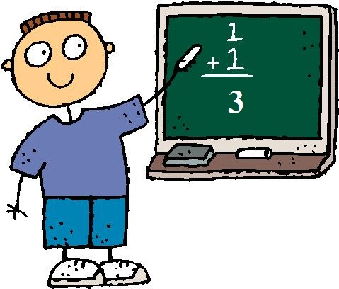
He can’t count.

Slide 10
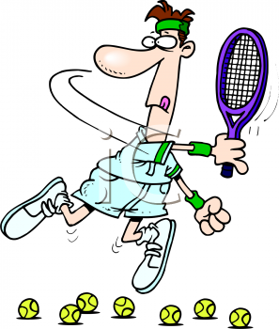
He can’t play tennis.

