Slide 1
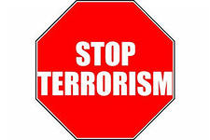

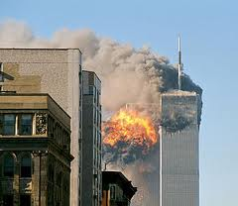
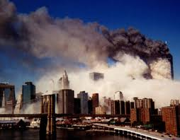
Terrorism

Slide 2
Terrorism – the terrible truth of the 21st century

Slide 3

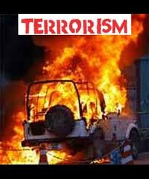
What is Terrorism?

Slide 4

Terrorism is the systematic use of terror, often violent.
Which consists of violent acts which are intended to create fear, are perpetrated for a religious, political or, ideological goal; and deliberately target civilians.

Slide 5
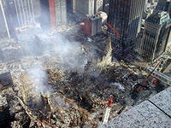
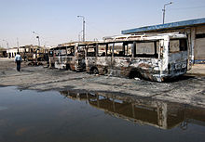
The effectiveness of the terrorist act lies not in the act itself, but in the public’s or government’s reaction to the act.

Slide 6
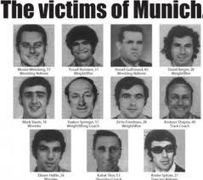

The Munich Olympics in 1972
The Munich massacre is a common reference name for an attack that occurred during the 1972 Summer Olympics in Munich, Bavaria, in southern West Germany.
The terrorists demanded the release of 234 prisoners held in Israeli jails.

Slide 7
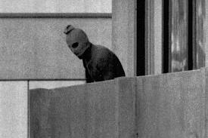
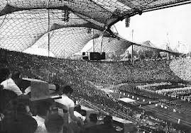
The phrase “one man’s terrorist is another man’s freedom fighter” is a view terrorists themselves would accept.

Slide 8
The History of Terrorism

Slide 9
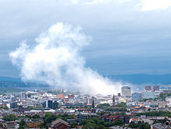
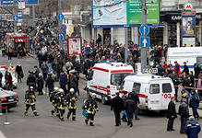
Terrorist acts or the threat of such action have been in existence for millennia.

Slide 10
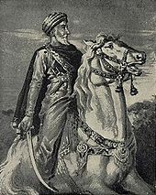
The earliest known organization that exhibited aspects of a modern terrorist organization was the Zealots of Judea.
The Assassins were the next group to show recognizable characteristics of terrorism

Slide 11
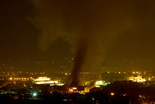

The French Revolution provided the first uses of the words "Terrorist" and "Terrorism". Use of the word "terrorism" began in 1795 in reference to the Reign of Terror initiated by the Revolutionary government.

Slide 12
The Current State of Terrorism

Slide 13
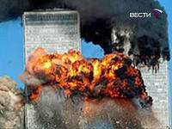
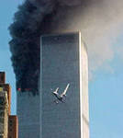
The largest act of international terrorism occurred on September 11, 2001 in a set of coordinated attacks on the United States of America where Islamic terrorists hijacked civilian airliners and used them to attack the World Trade Center towers in New York City and the Pentagon in Washington, DC.

Slide 14
Terrorist categories and cells

Slide 15
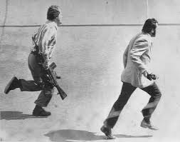
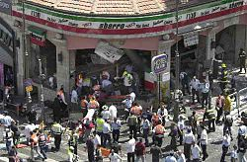
Common threats of the various definitions identify terrorism as:
• Political
• Psychological
• Coercive
• Dynamic
• Deliberate

Slide 16
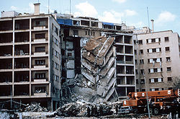
Political terrorism
A terrorist act is a political act or is committed with the intention to cause a political effect.

Slide 17
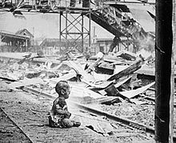
Psychological terrorism
The intended results of terrorist acts cause a psychological effect ("terror").

Slide 18
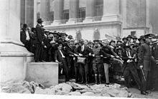
Coercive terrorism
Violence and destruction are used in the commission of the act to produce the desired effect.

Slide 19

Dynamic terrorism
Terrorist acts June-January in 2009
Terrorist groups demand change, revolution, or political movement.

Slide 20
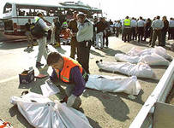
Deliberate terrorism
Terrorism is an activity planned and intended to achieve particular goals. It is a rationally employed, specifically selected tactic, and is not a random act.

Slide 21
Media Exploitation

Slide 22
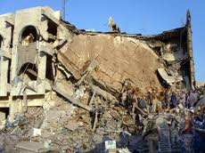
Terrorism's effects are not necessarily aimed at the victims of terrorist violence. Victims are usually objects to be exploited by the terrorists for their effect on a third party.

Slide 23
Illegality of Methods

Slide 24
Terrorism is a criminal act. Whether the terrorist chooses to identify himself with military terminology, or with civilian imagery ("brotherhood", "committee", etc.), he is a criminal in both spheres.

Slide 25
Preparation and Support

Slide 26
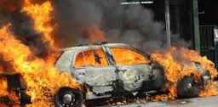
It's important to understand that actual terrorist operations are the result of extensive preparation and support operations.

Slide 27
The Intent of Terrorist Groups

Slide 28
A terrorist group commits acts of violence to-…

Slide 29
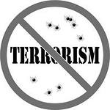
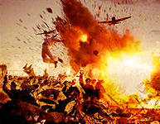
•Produce, widespread fear
•Obtain worldwide, national, or local recognition for their cause by attracting the attention of the media
•Weaken government security forces so that the government overreacts and appears repressive
•Steal or export money and equipment, especially.

Slide 30
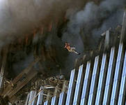
Influence government decisions, legislation, or other critical decisions
•Free prisoners
•Satisfy vengeance

Slide 31
Tactics of terrorism

Slide 32

Bombings
Bombings are the most common type of terrorist act.
Typically, improvised explosive devices are inexpensive and easy to make.

Slide 33
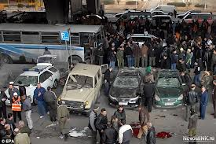
Kidnappings and Hostage-Takings
Terrorists use kidnapping and hostage-taking to establish a bargaining position and to elicit publicity.
Kidnapping is one of the most difficult acts for a terrorist group to accomplish.

Slide 34
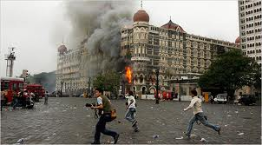
Armed Attacks and Assassinations
Armed attacks include raids and ambushes. Assassinations are the killing of a selected victim.

Slide 35
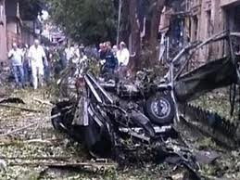
Arsons and Firebombings
Incendiary devices are cheap and easy to hide. Arson and firebombings are easily conducted by terrorist groups that may not be as well-organized, equipped, or trained as a major terrorist organization.

Slide 36
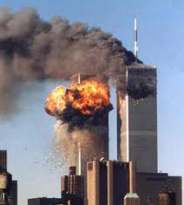
Hijackings and Skyjackings
Hijacking is the seizure by force of a surface vehicle, its passengers, and/or its cargo.
Skyjacking is the taking of an aircraft, which creates a mobile, hostage barricade situation.

Slide 37
Other Types of Terrorist Incidents
Cyberterrorism is a new form of terrorism that is only going to increase in profile as we rely on computer networks to relay information and provide connectivity to today’s modern and fast-paced world.

Slide 38
Nuclear weapons and
Terrorism

Slide 39
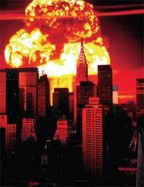
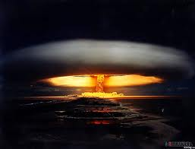
Historically, terrorist attacks using nuclear, biological, and chemical (NBC) weapons have been rare. Due to the extremely high number of casualties that NBC weapons produce, they are also referred to as weapons of mass destruction (WMD).

Slide 40
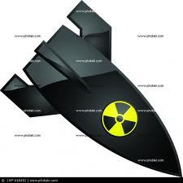
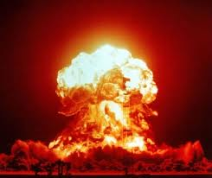
It is believed that in the future terrorists will have greater access to WMD because unstable nations or states may fail to safeguard their stockpiles of WMD from accidental losses, illicit sales.

Slide 41
Terrorist categories and cells

Slide 42
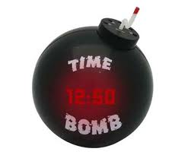
Terrorist groups can be at various stages of development in terms of capabilities and sophistication

Slide 43

The smallest elements of terrorist organizations are the cells that serve as building blocks for the terrorist organization.
Terrorists may organize cells based on family or employment relationships, on a geographic basis, or by specific functions such as direct action and intelligence.

Slide 44
Separatist.
Separatist groups are those with the goal of separation from existing entities through independence, political autonomy, or religious freedom or domination.

Slide 45
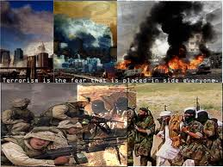
Nationalistic.
The loyalty and devotion to a nation, and the national consciousness derived from placing one nation's culture and interests above those of other nations or groups

Slide 46
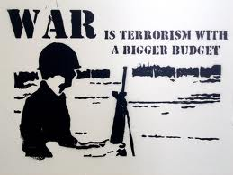
Revolutionary
Dedicated to the overthrow of an established order and replacing it with a new political or social structure.

Slide 47
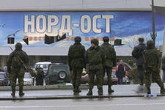
Political.
Political ideologies are concerned with the structure and organization of the forms of government and communities.

Slide 48
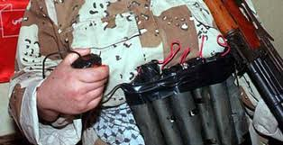
Religious
Religiously inspired terrorism is on the rise, with a 43 percent increase of total international terror groups supporting religious motivation between 1980 and 1995.

Slide 49
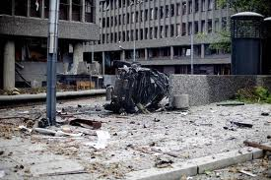
Domestic
These terrorists are "home-grown" and operate within and against their home country

Slide 50
Measures against
terrorism

Slide 51
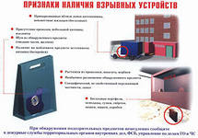
Government shouldn’t ignore terrorist attacks or hide the fact that we might have a problem with terrorism
Governments should provide information about terrorism to people

Slide 52
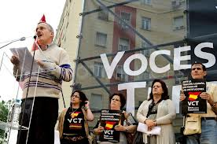
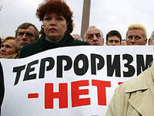
Government all over should cooperate and share information in order to prevent terrorist attacks
Schoolchildren should be taught tolerance and respect to human life
Civilians should cooperate and form voluntary organizations.

Slide 53

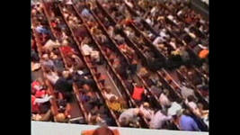
Terrorist acts

Slide 54
Terrorist acts in Russia

Slide 55
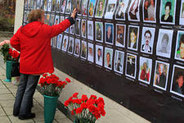
2000
On December 8 — in the city of Pyatigorsk (Stavropol Krai) around the market two cars were at the same time blown up. As a result of acts of terrorism 4 persons were killed, 45were wounded.

Slide 56
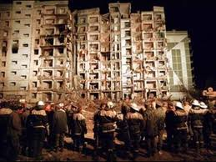
2001
On March 15 — on March 16 — three terrorists captured in Istanbul (Turkey) 174 hostages aboard Tu-154 of "Vnukovo Airlines" which was taking off for Moscow. The liner landed in Saudi Arabia where as a result of storm hostages were released. The stewardess and one terrorist were killed.

Slide 57
2002
On October 19 — the Tavry car was blown up at the "McDonald's" building on Pokryshkin Street in Moscow. At explosion 1 person was killed, 8 got wounded. The damage in 3 million 320 thousand rubles was caused to the building.
On October 23 — on October 26 — Act of terrorism on Dubrovka — over 900 were taken hostage in the building of the Theatrical center on Dubrovka (Moscow).

Slide 58
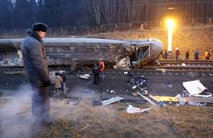
2003
On July 5 — in airfield to Tushino (Moscow) two terrorists carried out explosion during a rock festival "Wings". 16 people were killed, about 50 were wounded.

Slide 59
2004
On February 6 — a suicide bomber carried out a terract in the train between Avtozavodskaya and Paveletskaya stations of Moscow Metro. 42 persons were killed, about 250 were wounded.
On September 1 — on September 3 — the Act of terrorism in Beslan — the group of terrorists captured over 1100 hostages in the school No. 1 building in Beslan (North Ossetia). As a result of act of terrorism 334 hostages, from them 186 — children were killed. Over 800 were wounded. 31 terrorists were killed.

Slide 60
On August 24 — Explosions of the Tu-154 and Tu-134 planes in air over the Tula and Rostov areas, carried out by suicide bombers. 90 people were killed
On August 31 — the female suicide bomber put in action the explosive device at Rizhskaya metro station (Moscow). More than 10 people were killed, and 50 more got wounded.

Slide 61
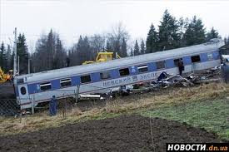
2009
On August 17 — Act of terrorism in Nazran (2009). 25 people were killed and 136 got wounded.
On November 27 — Crash of the train "Nevsky Express" is classified as act of terrorism. 95 people were hospitalized, 28 people were killed

Slide 62
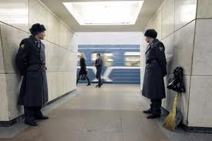
2011
On January 24 in Moscow at the Domodedovo airport a suicide bomber at 16:32 undermined a bomb. According to the Ministry of Health and Social Development of the Russian Federation, 37 people were killed, 130 were wounded.

Slide 63
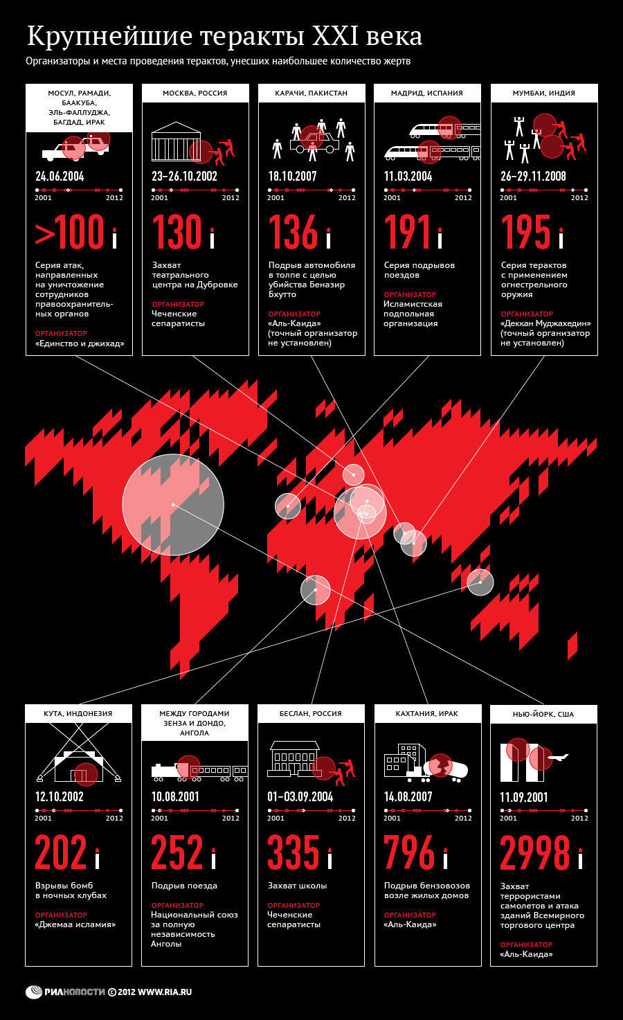

Slide 65
Terrorism – the terrible truth of the 21st century Questionnaire

Slide 66
1. How many definitions of the word terrorism are there?
A. 100
B. 10
C. 50
2. When did the Munich Olympics take place ?
A. 1975
B. 1980
C. 1972
3. Where did the word terrorism come from?
A. England
B. France
C. Egypt
D. Italy

Slide 67
4. When did the largest act of international terrorism occur?
A. October 10, 2011
B. September 11, 2001
C. January 9, 2010
5. The terrorist act in Beslan took place in:
A. September 1
B. October 2
C. November 3

