Slide 1
Тема урока
«Спорт и здоровый образ жизни»

Slide 2
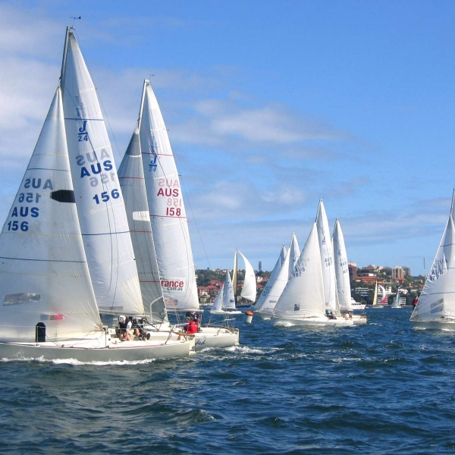
Sailing

Slide 3

Downhill skiing

Slide 4
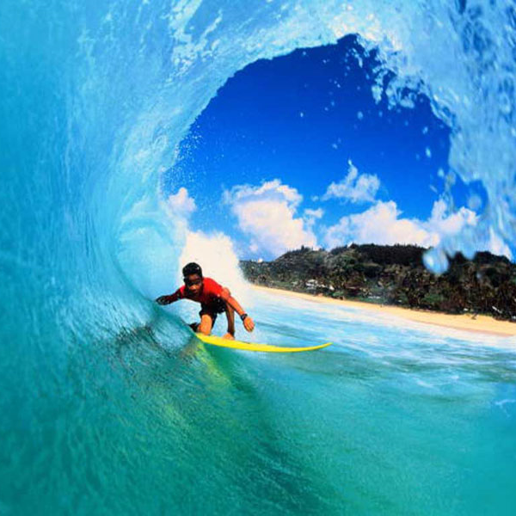
Surfing

Slide 5
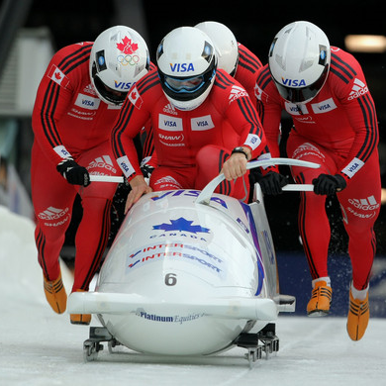
Bobsledding

Slide 6
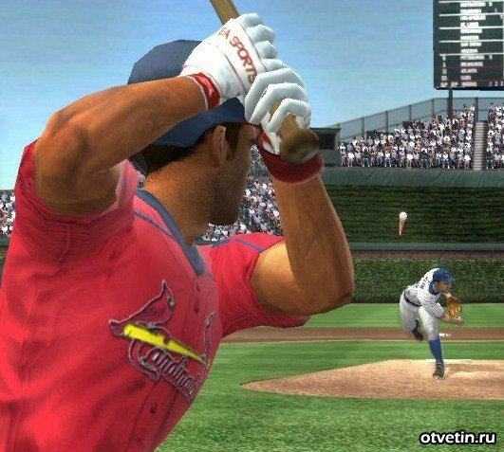
Baseball

Slide 7
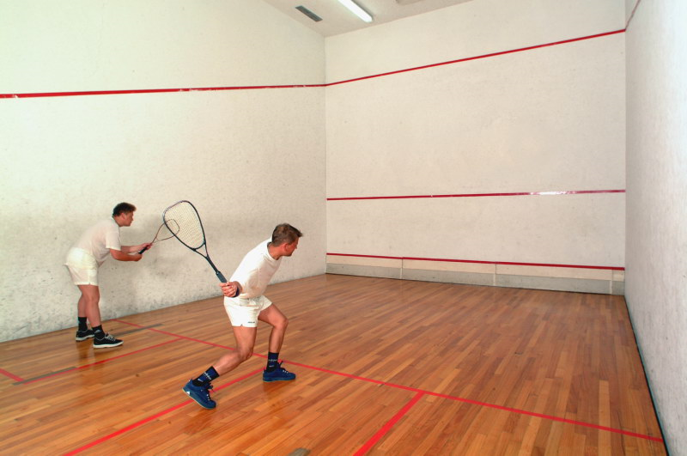
Squash

Slide 8
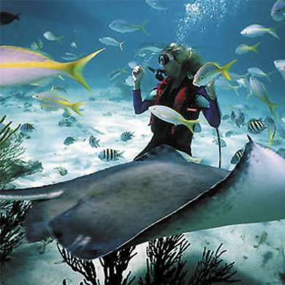
Diving

Slide 9
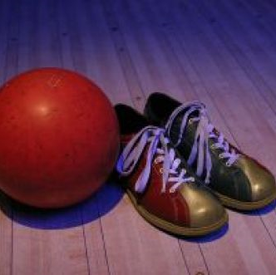
Bowling

Slide 10
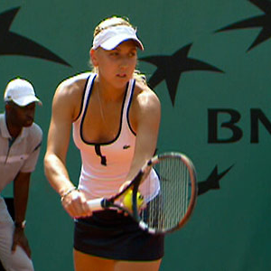
Tennis

Slide 11
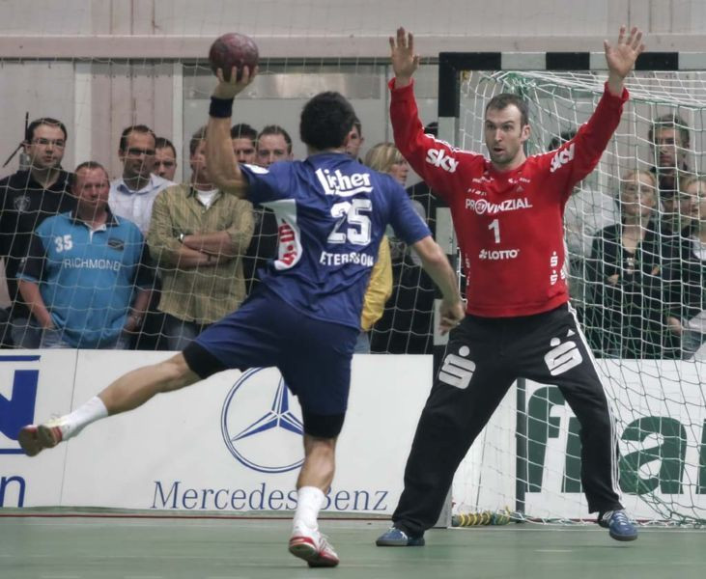
Handball

Slide 12
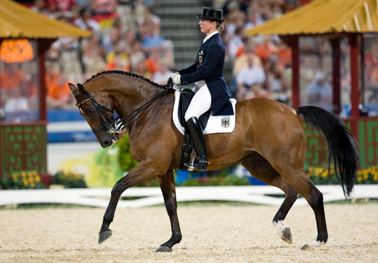
Horse-racing

Slide 13
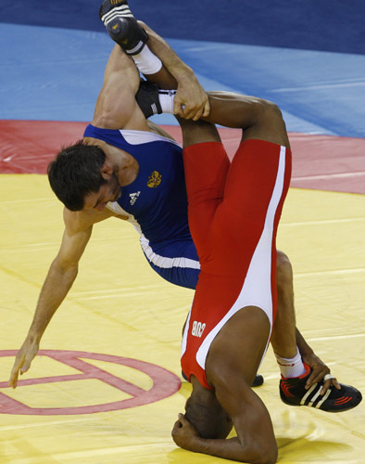
Wrestling

Slide 14
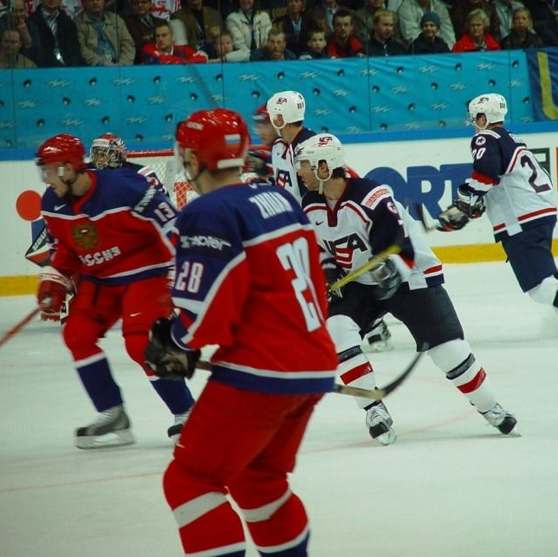
Ice hockey

Slide 15
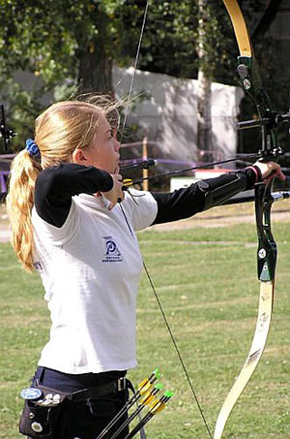
Archery

Slide 16
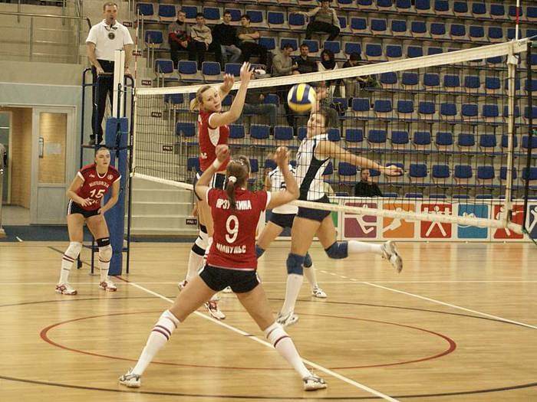
Volleyball

Slide 17
Ask your neighbor about his or her favourite sports. Fill in the table below.
 | Likes doing | Likes watching | Favourite TV sports programmes
Often
Seldom
Never

Slide 18
Letter
My name is N. I am a seventh-former. Not long ago I began to smoke. Certainly on the one hand I know that smoking is dangerous. And I don’t like the taste of cigarettes. But on the other hand my classmates called me names, and I want to look more grown-up than I really am. I think that smoking adds something to my image – I am classy. Well, can you help me to realize what should I do?

Slide 19
Discussion
1) Почему курить вредно? – Why is smoking dangerous?
2) Как решить проблему курения? – How to solve this problem?

Slide 20
Advices
Parents and teachers must fight against this problem together.
They must explain to the children that they ruin health by smoking.
Smoking should be banned in public places.
You must have a strong will because it’s very difficult to get rid of this habit.
You may find a hobby.
You may go in for sports.

Slide 21
Вопросы Ответы
Do you think you are a healthy person?
Do you watch your fat and cholesterol levels all the time?
Is it very important to eat healthy food?
Do you go in for sport?
What will you do if you want to keep fit?
Is sport an essential part in your life?
What role does sport play in your life?
Is the healthy life-style popular in Russia?
To feel sick
To fall ill
To take care of our health
A pretty healthy person
To get a cold
To take regular exercises
To have a healthy outlook on life
As for me
As far as I know

Slide 22
What you know about food
1. Are vitamins and mineral supplements...
useful for preventing colds and boosting energy?
a waste of money?
an insurance policy against modern food that may be short on essential nutrients?

Slide 23
2. How many portions of fruit and vegetables should you eat every day?
a) two;
b) three;
c) four.

Slide 24
3. A calorie is...
a) a type of vitamin;
b) a unit of energy;
c) a blood cell.

Slide 25
4. Protein is...
a) a body-building material;
b) a hormone;
c) sugar.

Slide 26
5. Vitamin A helps us...
a) build strong bones;
b) produce healthy skin;
с) in the digestion of fats.

Slide 27
6. Vitamin B12 primarily helps...
a) night vision;
b) growth of teeth;
c) growth of nerve cells and blood cells.

Slide 28
7. Vitamin К is essential for...
a) manufacture of fats;
b) hormone production;
c) blood clotting.

Slide 29
8. Lack of iron leads to...
a) a form of anemia;
b) discoloured teeth;
c) soft bones.

Slide 30
9. Why is fast food a bad idea?
a) It hardly contains any nutrients;
b) it gives little protein in relation to fat;
c) it contains too much salt and fat.

Slide 31
10. Which has the highest sugar content?
a) A plain chocolate bar;
b) a milk chocolate bar;
c) a coffee.

Slide 32
11. How many people in Western Europe are overweight?
a) 11%;
b) 26%;
c) 37%.

Slide 33
12. Which is the best way to lose weight and stay healthy?
a) To use slimming and vitamin pills;
b) to eat only fruit and vegetables;
c) to eat a variety of foods but in smaller quantities.

Slide 34
13. Which activity burns up the most energy per minute?
a) Swimming;
b) walking quickly;
c) football.

Slide 35
14. How often should we exercise?
a) At least 20 minutes once a week;
b) at least 20 minutes twice a week;
c) at least 20 minutes three times a week.

Slide 36
Key: 1c, 2a, 3b, 4a, 5b, 6c, 8a, 9c, 10a, 11c, 12c, 13a, 14b.

