Slide 1

LISTEN, SPEAK AND PLAY
«What
colours
do
you
know?»

Slide 2
GUESS — WHAT COLOUR IS IT?
der - gerona -
eyllow - leub -
geren - perupl -
adrkleub -
red
orange
yellow
blue
green
purple
darkblue

Slide 3
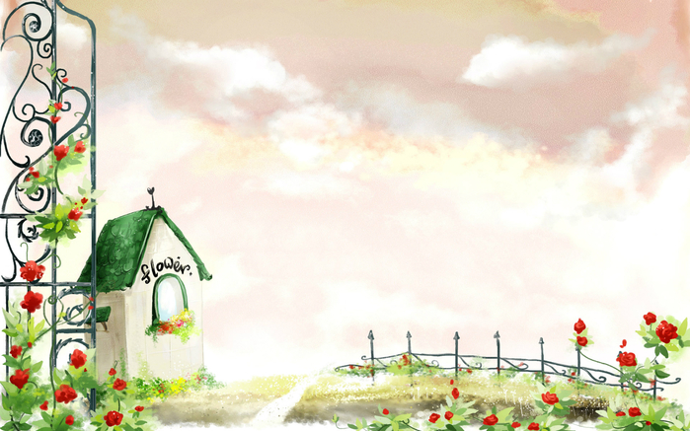
LET ,S REPEAT COLOURS OF THE RAINBOW.

Slide 4

WHAT COLOURS DID YOU FIND?
KJHGOLDBNVIYEABLUEBJITEUGREENGYUOU
YRYELLOWRIYEBLIUVFVFSILVERUYBHVUIYT
BREDNBUTYBROWNHDJVHJIBLACKBVTGYWP
YNKYTGORANGEBHSLZABMLOYGREYYIJYBG
HGDREPURPLEBVYTRVHKDFDARKBLUEBHG

Slide 5
WHAT COLOURS DID YOU FIND?
KJHGOLDBNVIYEABLUEBJITEUGREENGYUOU
YRYELLOWRIYEBLIUVFVFSILVERUYBHVUIYT
BREDNBUTYBROWNHDJVHJIBLACKBVTGYWP
YNKYTGORANGEBHSLZABMLOYGREYYIJYBG
HGDREPURPLEBVYTRVHKDFDARKBLUEBHG

Slide 6
THE CROSSWORD
S | C | L | O | C | K | A | A | I | M
Y | E | L | L | O | W | P | C | B | I
M | X | C | U | P | I | O | W | I | L
A | M | A | T | C | H | N | O | A | K
F | A | T | L | A | M | D | S | M | E
W | W | B | O | X | I | A | E | L | E
O | V | A | F | I | S | R | E | D | M
O | P | C | A | L | F | L | A | G | U
D | I | S | H | H | R | A | E | E | G
O | N | O | D | S | H | E | E | P | Y

Slide 7
ANSWERS ON THE CROSSWORD
S | C | L | O | C | K | A | A | I | M
Y | E | L | L | O | W | P | C | B | I
M | X | C | U | P | I | O | W | I | L
A | M | A | T | C | H | N | O | A | K
F | A | T | L | A | M | D | S | M | E
W | W | B | O | X | I | A | E | L | E
O | V | A | F | I | S | R | E | D | M
O | P | C | A | L | F | L | A | G | U
D | I | S | H | H | R | A | E | E | G
O | N | O | D | S | H | E | E | P | Y

Slide 8

LET ,S COMPLETE THE SENTENCES
I see a black cat.

Slide 9
LET ,S COMPLETE THE SENTENCES
We wear green socks.

Slide 10
LET ,S COMPLETE THE SENTENCES
They love a brown horse.

Slide 11
LET ,S COMPLETE THE SENTENCES
He sees red gloves.

Slide 12
LET ,S COMPLETE THE SENTENCES
She has a yellow duck.

Slide 13

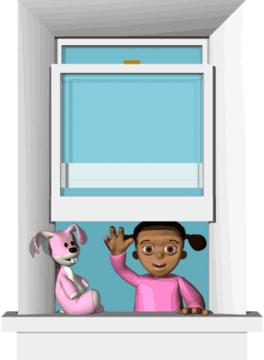
Thank you for your work!!!
Raise your head!
Jump up high!
Wave your hand!
And say…
“Good – bye”.

