Slide 1

"Определенный артикль"
Автор:
Русакова Татьяна Александровна,
учитель английского языка высшей категории
МОБУ Вышневолоцкого района
«Борисовская СОШ» Тверской области

Slide 2


Slide 3

LET`S DO SOME
WORK ON THESE SOUNDS

Slide 4
[ð]- the,
the Netherlands
[θ]- the North,
the South,
Agatha Christie,
Margaret Thatcher

Slide 5
[i:]- the East,
the sea
[ai]- a scientist,
Albert Einstein

Slide 6
[∫]- a politician,
a musician,
the ocean

Slide 7

Let`s complete
the crossword

Slide 8
M
5
W
7
S
2
U
R
P
P
S
6
4
S
I
R
O
C
I
O
T
A
L
1
R
T
3
I
C
E
R
T
E
E
I
I
R
T
S
A
N
A
T
I
M
C
T
N
I
S
A
H
I
C
T
N
E
S
I
R
T
A
N

Slide 9
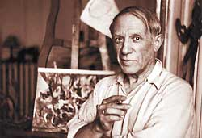
Pablo Picasso was a famous … .

Slide 10
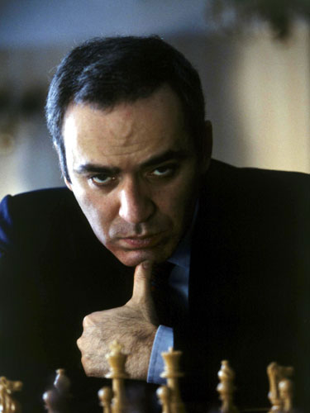
Garry Kasparov is a famous … .

Slide 11
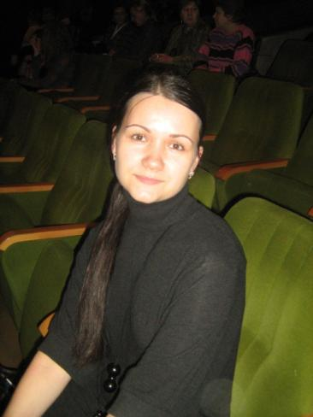
Tatyana Alexandrovna is a … .

Slide 12
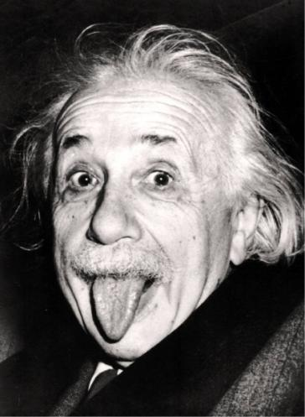
Albert Einstein was an outstanding … .

Slide 13
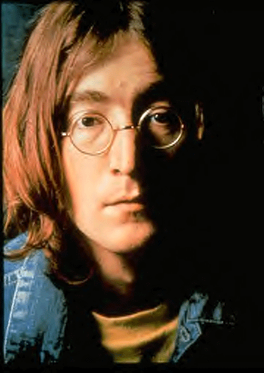
John Lennon was a well-known … .

Slide 14
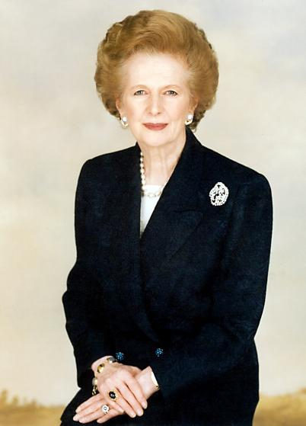
Margaret Thatcher was a famous… .

Slide 15
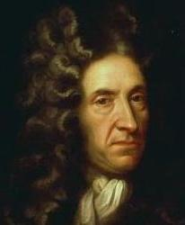
Daniel Defoe was a well-known … .

Slide 16

The indefinite article
A or an

Slide 17

THE CORRECT
ANSWERS:
There are_ foxes in the forest.
I have an orange elephant.
What is this? It is a book.
F. Chopin was a composer.
My brother is a doctor.
I have one _brother and two sisters.

Slide 18

The definite article
THE

Slide 19
Ex . 44, p.93
THE CORRECT
ANSWERS:
1. the
2. -, the
3. the
4. -,-,-

Slide 20
Ex . 46, p.94
THE CORRECT
ANSWERS:
1.Worship Street
2. The British Museum
3. Westminster Abbey
4. St Paul's Cathedral
5. MOMI
6. The Houses of Parliament,
the Tower

Slide 21
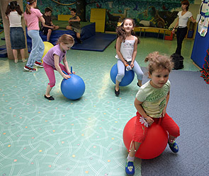

LET`S HAVE A REST!

Slide 22

With «the» | Without «the»

Slide 23
THE CORRECT
ANSWERS:
With «the» | Without «the»
Kremlin | Great Britain
Earth | Washington
House of Parliament | Downing Street
North | Regent Street
Russian Federation | Africa
UK | Europe
British Museum | Red Square
Sun
Thames
USA

Slide 24


Slide 25

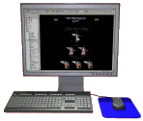
LET`S DO THE TEST
« The definite article»
THE

Slide 26

LET`S WRITE DOWN YOUR HOMEWORK

Slide 27
1. Workbook ex. 24, p. 44.
2.* Student`s book ex. 45, p. 94

Slide 28
фото, картинки и анимация:
http://lingvocat.com/blog/studying_the_english_language_and_get_acquainted_with_the_definite_article/
http://blogs0l4x4.ru/page/perevod-dokumentov-anglijskij-jazyk-spb
http://www.mypeski.ru/forum/viewtopic.php?f=54&t=1187&sid=d1a57b5a861a466f5bb82b29ae049b9b&start=80
http://hairstylesarea.com/2010/10/hairstyles-pictures-classic-medium-hairstyles-from-albert-einstein-in-memory
http://clubfate.forum2x2.com/t804-topic
http://www.diary.ru/~liboru/?from=4380
http://coollib.net/a/20215

