Slide 1
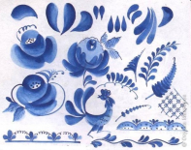


Gzhel ceramics,
a national
art craft.

Slide 2
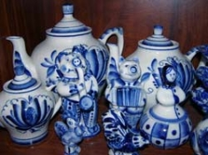
The name of Gzhel is known
all over the world. It is the name
of a Traditional Russian craft.
The name of Gzhel is considered
to be a symbol of Russia as well as
matryoshkas and samovars.

Slide 3
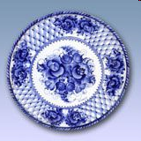
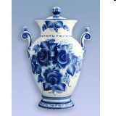
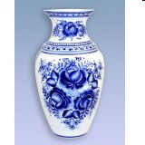
Gzhel pottery is unique.
It has a blue floral design.

Slide 4

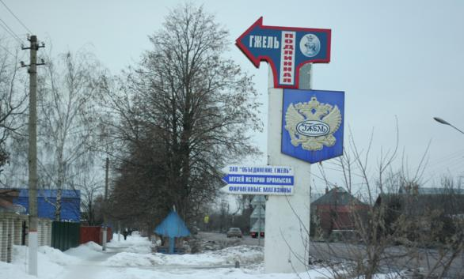
Gzhel ceramics centre is situated not far from Zhukovsky. In fact it is a large area comprising about thirty villages.

Slide 5
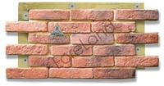
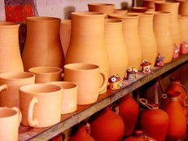
For centuries Gzhel used to supply
the Russian towns
and countryside with clay,
tiles, bricks, and pottery.

Slide 6
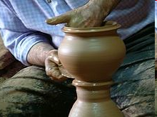
The name of Gzhel became associated with pottery in the 14th century.
Gzhel pottery was originally created by potters in their homes.

Slide 7
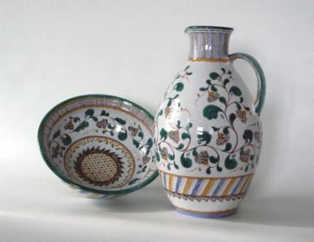
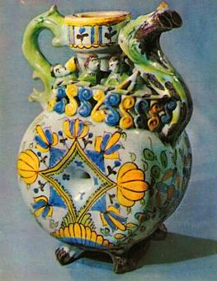
The second half of
the eighteenth century
witnessed an
important
breakthrough
in the pottery industry
of Gzhel
- majolica wares began to be
produced.

Slide 8
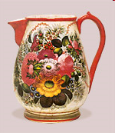
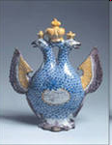

Slide 9
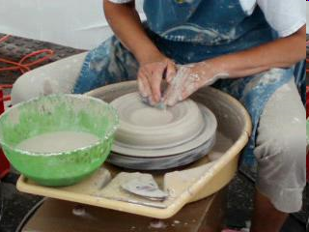
First they produced so called "black“ pottery.
The "blue" painted Gzhel tableware, which is
known in the whole world now, appeared
later when light grey clay was discovered in
1802.
Then they found white Chinaware, and
in 1804 the first porcelain factory of Gzhel
was founded.

Slide 10

The Gzhel patterns are
cobalt-blue designs on
a white background.
The traditional subjects
of Gzhel porcelain
were birds and flowers.

Slide 11
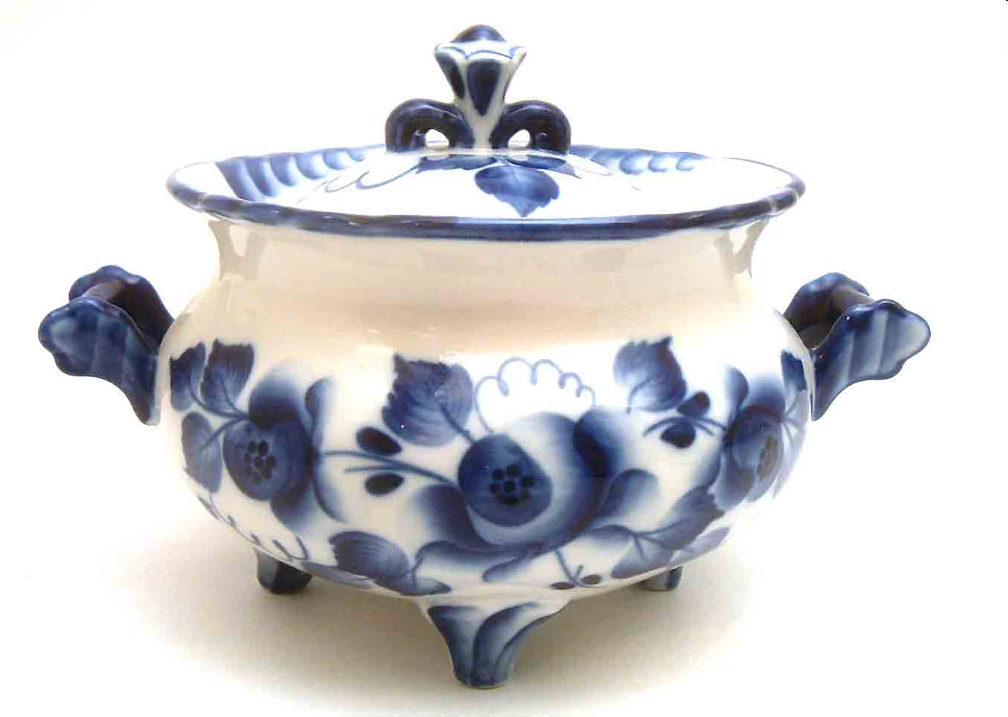

Slide 12
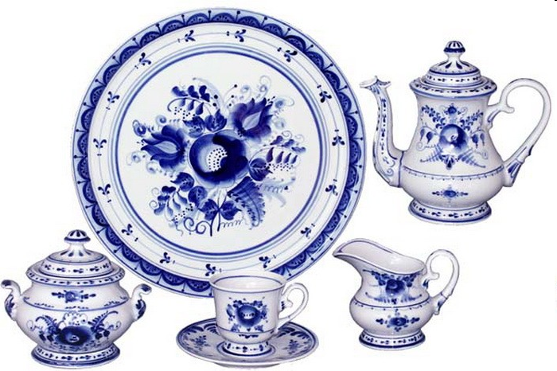

Slide 13
In 1810 the Kuznetsovs, a local
Family founded a porcelain factory here.
In the second half of the XIX century they
became the main suppliers of Russian
porcelain.
At this time, they had 18 enterprises in
different regions of the Russian Empire.

Slide 14
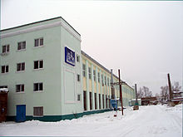
After the revolution Kuznetsovs’ factories were nationalized.

Slide 15
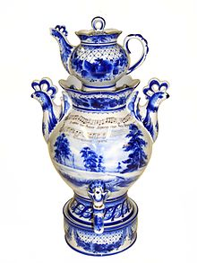

Slide 16
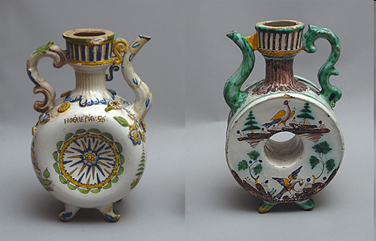

Slide 17
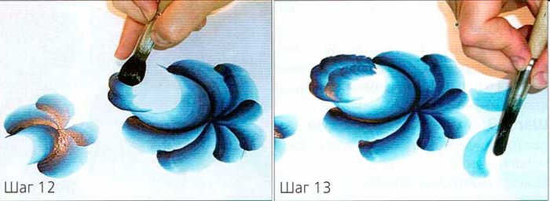
Nowadays there is a special school
in Gzhel where children
are taught the traditional craft.

Slide 18
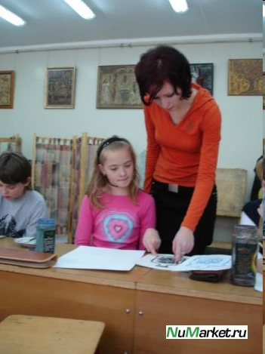
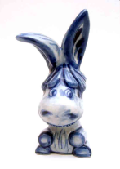
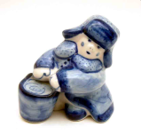
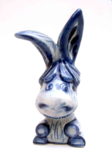



Slide 19
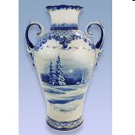
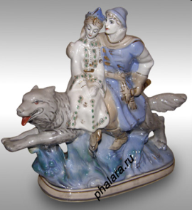
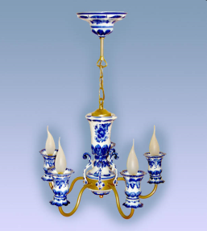
Gzhel items include vases,
toys, articles of interior:
fireplaces, chandeliers
and other porcelain.
The products of the "Gzhel" are in
demand both in Russia and abroad.

Slide 20
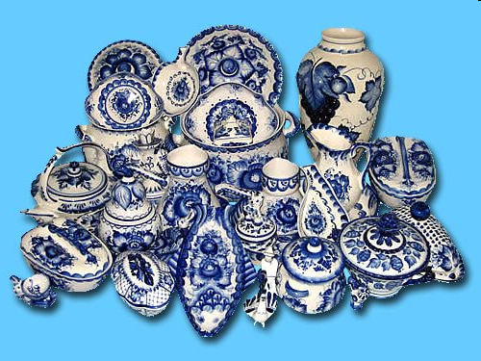

Slide 21
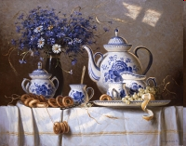

Slide 22
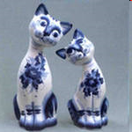
Thank you for your attention!

