Slide 1
Seasons
Учитель английского языка
Искендерова С.Н.

Slide 2
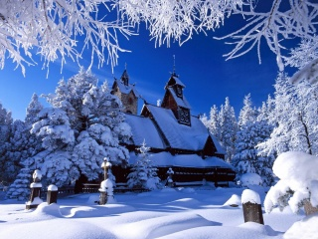
Речевая разминка

Slide 3

The 1st team What months are the winter, spring, summer and autumn in Russia?
The 2nd team
What months are winter, spring, summer and autumn moths in Great Britain?

Slide 4
Action time-Физкультминутка
http://yandex.ru/video/search?text=head%20and%20shoulders%20knees%20and%20toes&where=all&filmId=9AHX1JhxgHw

Slide 5
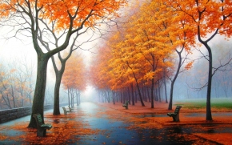

The 1st team What seasons in every picture? Describe the weather in every picture. The 2nd team Name the colours in every picture?What colours can you see in every season?

Slide 6
The 1st team
Read and translate the words correctly.
The 2nd team
Look at your papers and fill in the missing letters in the wods and read them
Great Holiday
Traditional
Roast turkey
Presents
Sent
Speech
Trafalgar Square
B… nny
B… tterfly
… aster
D… ckling
B… sket
C… ndle

Slide 7
The 1st team
Find the rhyming words, match them and read .
The 2nd team
Look at your papers and complete the sentences.
Clean | Pink
Hot | Spring
Silk | Pet
Vet | Walk
Talk | Pot
Week | Seek
There is some …
There is no …
There are some …
There are no …

Slide 8


Slide 9


